Slide 1

Predicting Kickstarter Project Success
Springboard Capstone: Nicole Fimmen

Slide 2
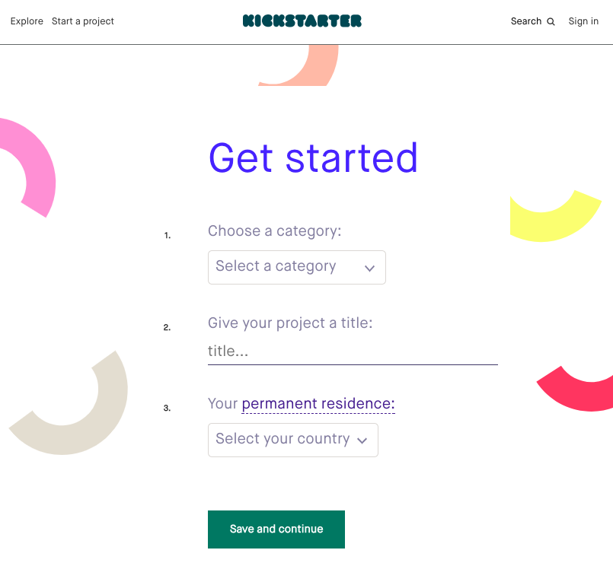
What is Kickstarter?
Kickstarer's mission is to help bring creative projects to life. Projects have many forms including food and publishing to music, fashion and technology.
Notes:
Since launching in 2009, 14 million people have backed a project, $3.4 billion has been pledged, and 134,135 projects have been successfully funded.

Slide 3
Will my project get funded?
Kickstarter is all or nothing. If a project doesn't get every dollar, the project will not be successful.

Slide 4
How to Predict Project Success
Explore the data set
Analyze the variables
Apply predictive modeling

Slide 5
Data Set
108,129 projects
33% successfully funded projects
May 2009 – 2015
US only projects
Variables: product description, keywords, goal amount and various project timelines
Notes:
Kaggle Competition data set
85% of the projects is US currency

Slide 6
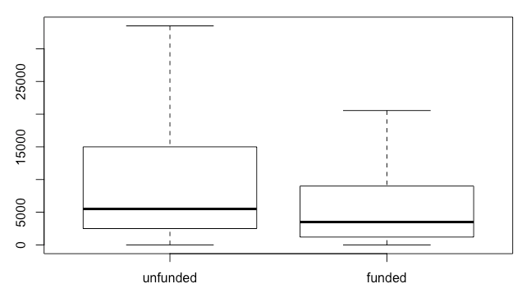
Data: Goal Amount
Successful projects ask for less money.
Unfunded average amount $3,500
Funded average amount $5,500

Slide 7
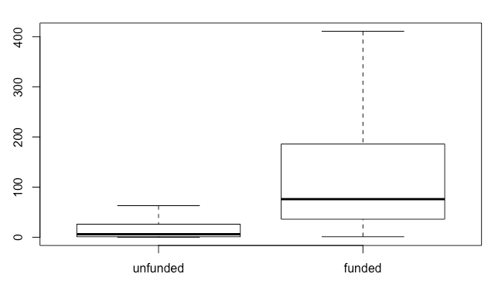
Data: Backers
Successful projects have more backers.
Unfunded an average of 6
Funded an average of 76
It is helpful to know more backers is important, however this is not a factor in the prediction as you will not know this until the project is over.
Notes:
No surprise. A wide base of support is needed for success.

Slide 8
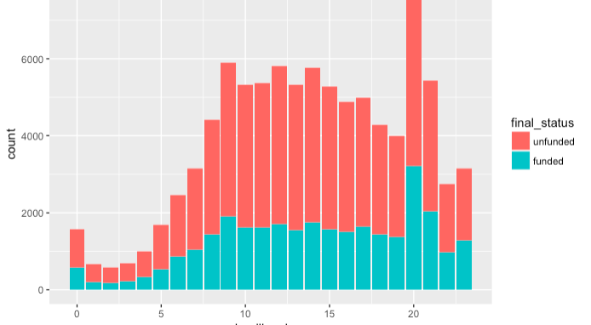
Analyze: Time
Successful projects have a deadline before 10pm.
8pm is the most common deadline hour.
Notes:
Deadline hour – 8pm the most common

Slide 9
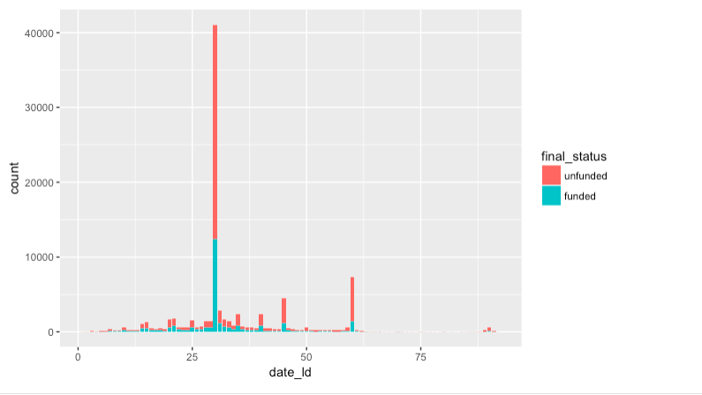
Analyze: Project Length
Successful projects are typically less than 30 days.
30 days is the most successful project length.

Slide 10
Comparing Models
Accuracy for each:
CART: %67.7
Random Forest: %68.2
Logistic regression: %67.6

Slide 11
Comparing Models
Sensitivity vs Specificity
How likely is the model going to predict funded when it actually is funded and how likely is the model going to predict unfunded when truly unfunded.
All three models were highly specific. The models are more likely to predict funded projects as unfunded.

Slide 12
Model: Insights
Most influential variables for project success.
Goal
Project length
Deadline hour
Launch hour
“I” in description

Slide 13
Recommendations
Time related aspects are influential but do not strongly predict the funding status. In order to predict a Kickstarter success rate the next steps are:
Incorporate project category
Look into project website exposure
Project description sentiment analysis
Notes:
Important variables –
Backers count
Funding requested
30 days

Slide 14
Appendix
Project files – Github
Report
R Code
Data source - Kaggle

