Slide 1
CAR-AI PREDICTION
Machine Learning Insights into the Egyptian Car Market
TEAM MEMBERS
Youssef Mohamed
Marwan Walid
Abdelrahman Ibrahim
Nader Fawzy
Nour Hani

Slide 2
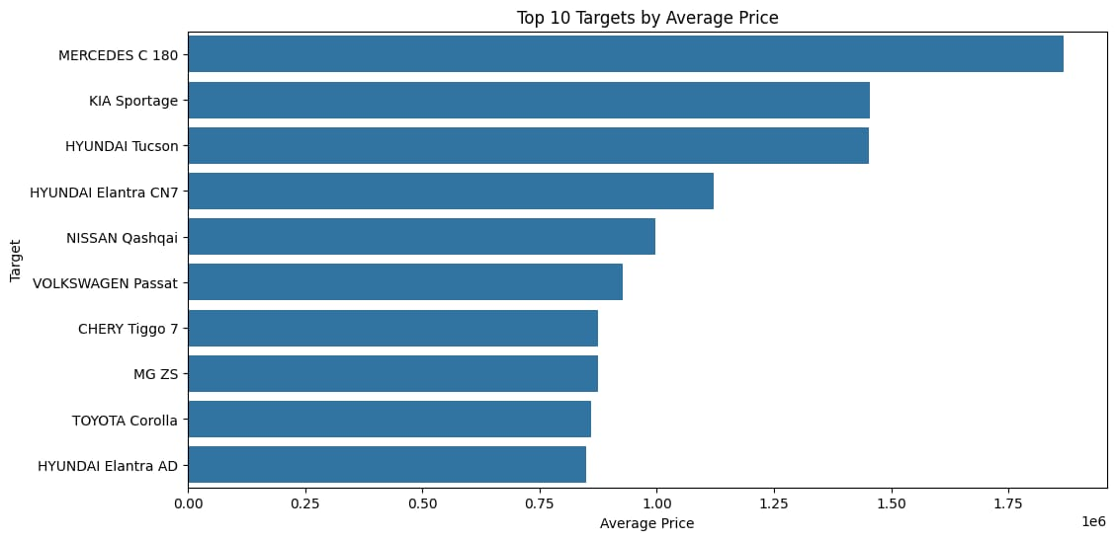
1
Which Target has the highest average price?
AI INSIGHT
Here, we find the Mercedes C180 topping the rankings in terms of average car prices; this reflects the features and services the vehicle offers, marking it as one of the best cars available.
Car-AI Prediction
1

Slide 3
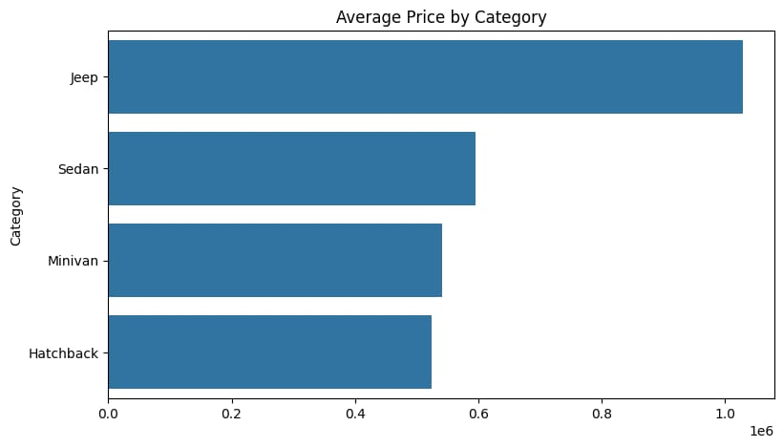
2
Which category has the highest average price?
AI INSIGHT
Here, we find that the Jeep category is the highest-priced segment, followed by sedans, and then the remaining categories.
Car-AI Prediction
2

Slide 4
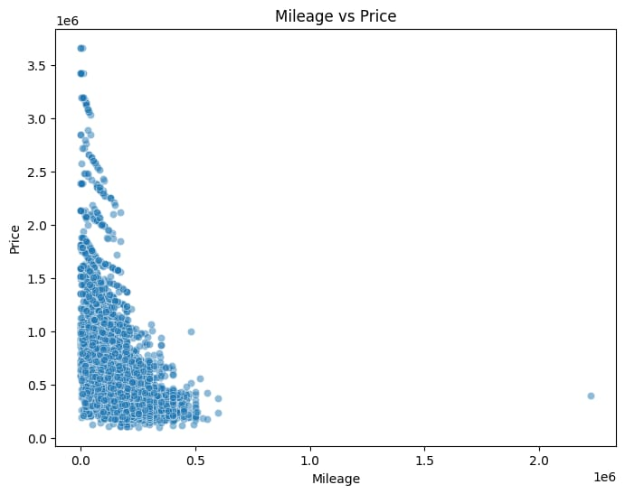
3
Does mileage affect price?
AI INSIGHT
Here, we find that the car's price generally decreases as the distance traveled increases.
Car-AI Prediction
3

Slide 5
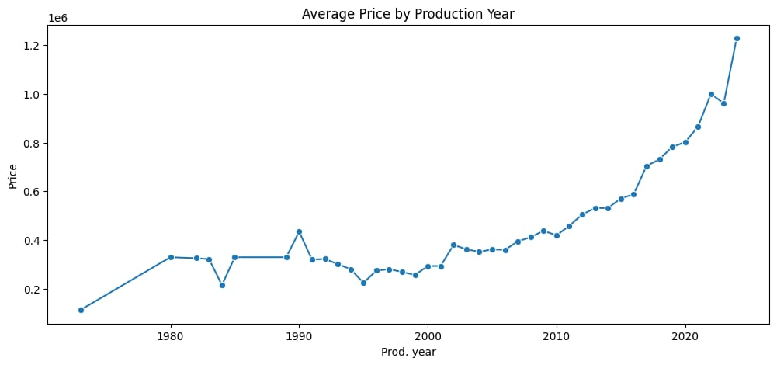
4
Do newer cars cost more?
AI INSIGHT
We observe here that prices increase as the cars become newer.
Car-AI Prediction
4

Slide 6
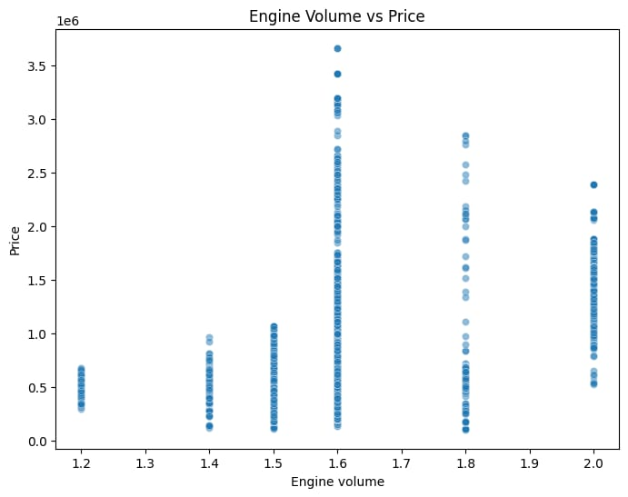
5
Does engine volume affect price?
AI INSIGHT
We find here that the price level increases as the engine capacity increases.
Car-AI Prediction
5

Slide 7
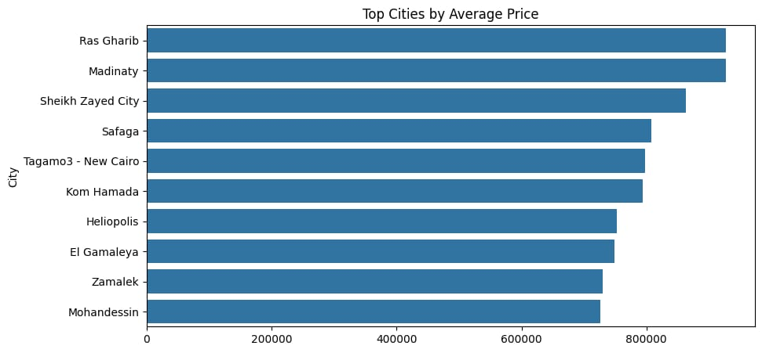
6
Which city has the highest average car price?
AI INSIGHT
Here, we find that the cities of Ras Ghareb and Madinaty have the highest concentration of expensive cars.
Car-AI Prediction
6

Slide 8
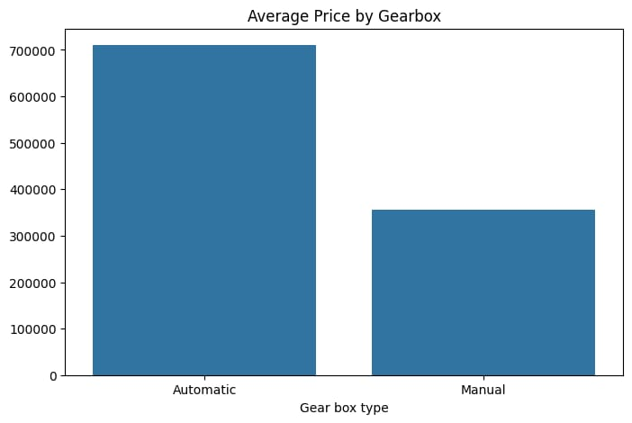
7
Which gearbox type has the highest average price?
AI INSIGHT
Here we find that automatic cars are the most expensive.
Car-AI Prediction
7

Slide 9
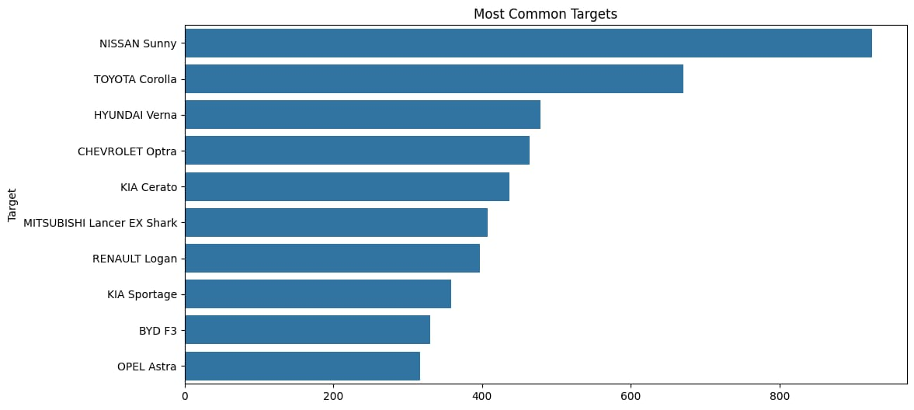
8
Which Target appears most frequently?
AI INSIGHT
We find that the Nissan Sunny is the most widespread car, indicating strong demand for it in the Egyptian market.
Car-AI Prediction
8

Slide 10
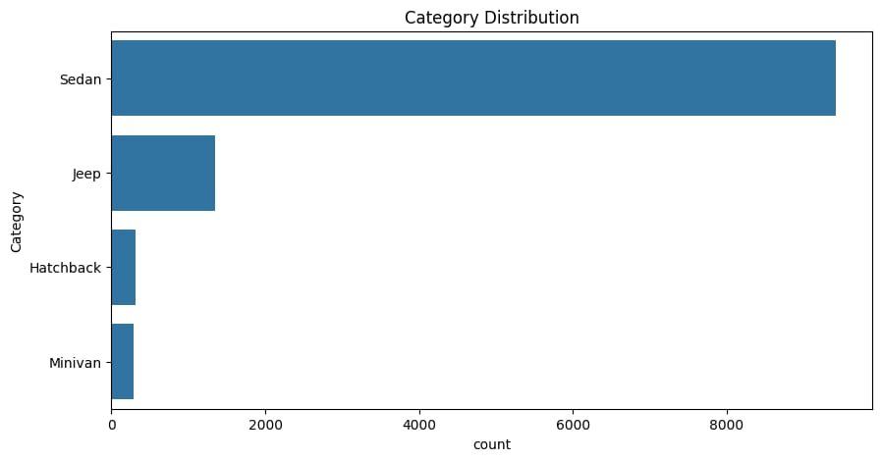
9
Which category contains the largest number of cars?
AI INSIGHT
We find that the sedan segment is the most widespread in the Egyptian market.
Car-AI Prediction
9

Slide 11
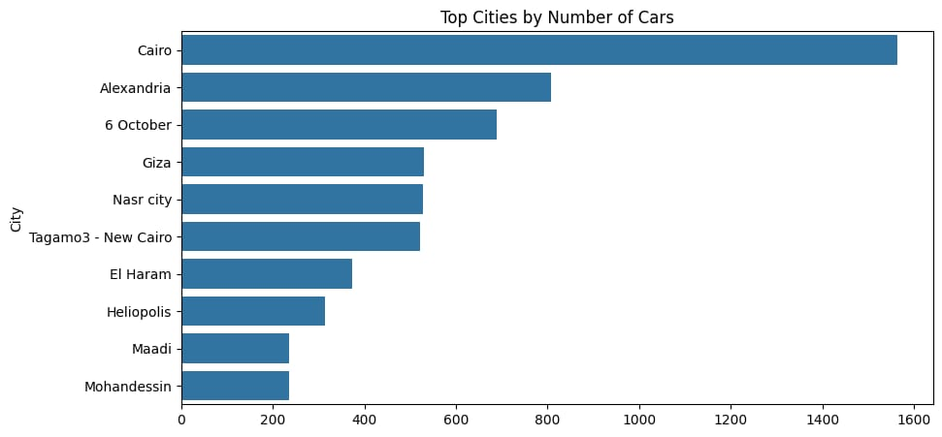
10
Which cities contain the largest number of cars?
AI INSIGHT
We find that Cairo is the city with the highest number of cars on offer; this is because it is the capital and the most populous city.
Car-AI Prediction
10

Slide 12
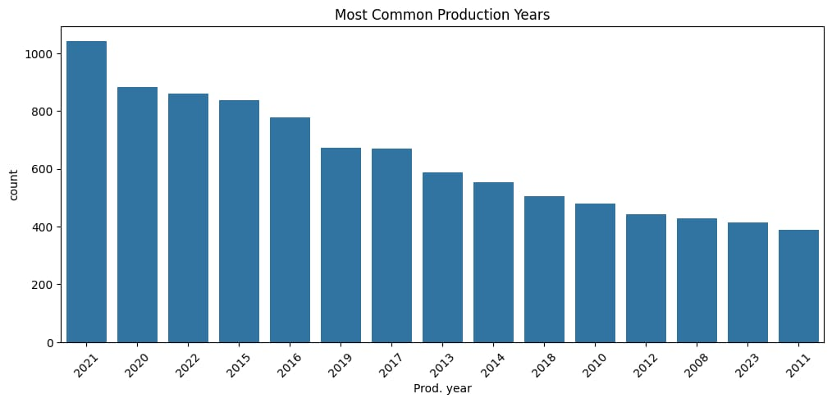
11
Which production year has the highest number of listed cars?
AI INSIGHT
We find that 2021 was a peak year for car production and market penetration, a trend driven by population growth and an increase in the number of people looking to purchase vehicles.
Car-AI Prediction
11

Slide 13
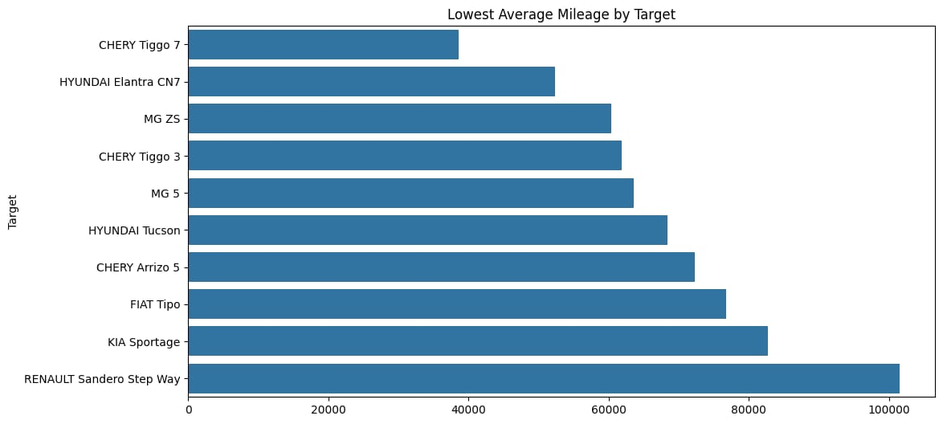
12
Which Target has the lowest average mileage?
AI INSIGHT
Here, we find that cars that have not covered long distances command a higher market value.
Car-AI Prediction
12

Slide 14
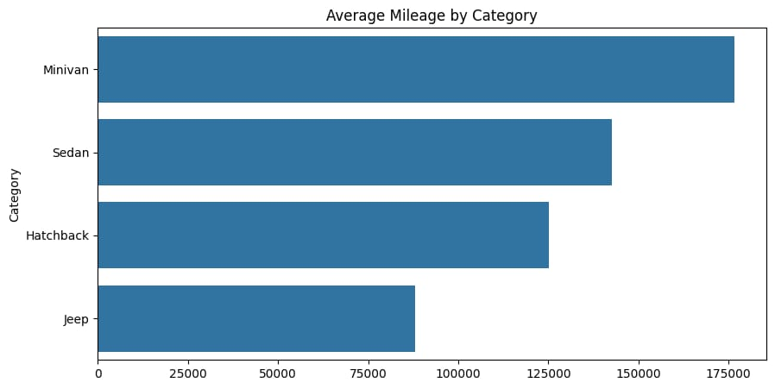
13
Which category has the highest average mileage?
AI INSIGHT
Here, we find that certain categories of vehicles cover greater distances than others, depending on the nature of their use.
Car-AI Prediction
13

Slide 15
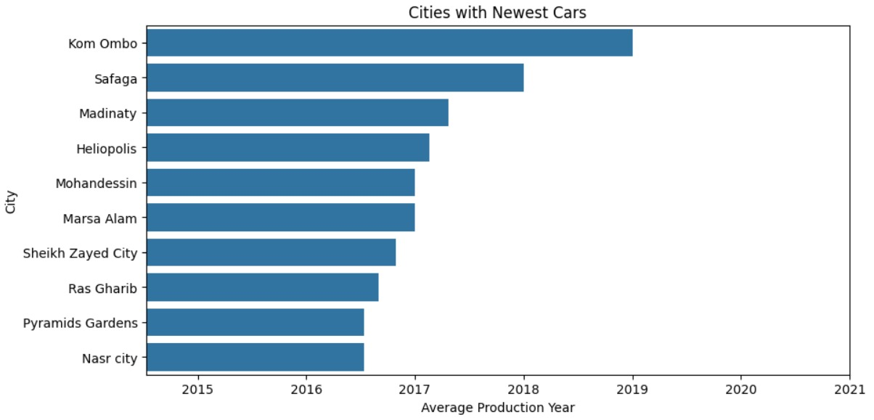
14
Which city has the newest cars?
AI INSIGHT
It is evident that the city of Kom Ombo has the highest prevalence of cars.
Car-AI Prediction
14

Slide 16
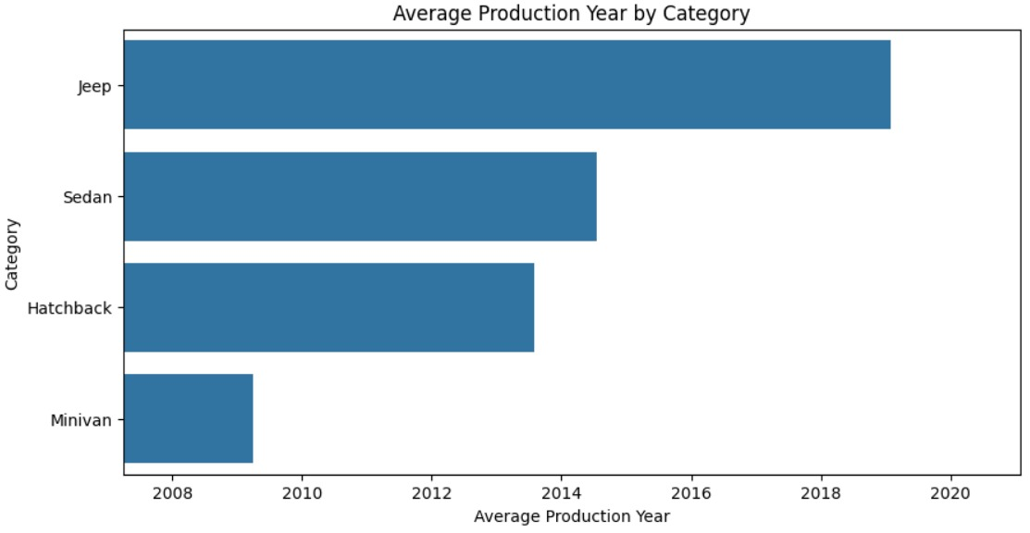
15
Which category has the newest cars?
AI INSIGHT
As shown in the image, we find here that modern categories—such as Jeeps—are always the most expensive.
Car-AI Prediction
15

Slide 17
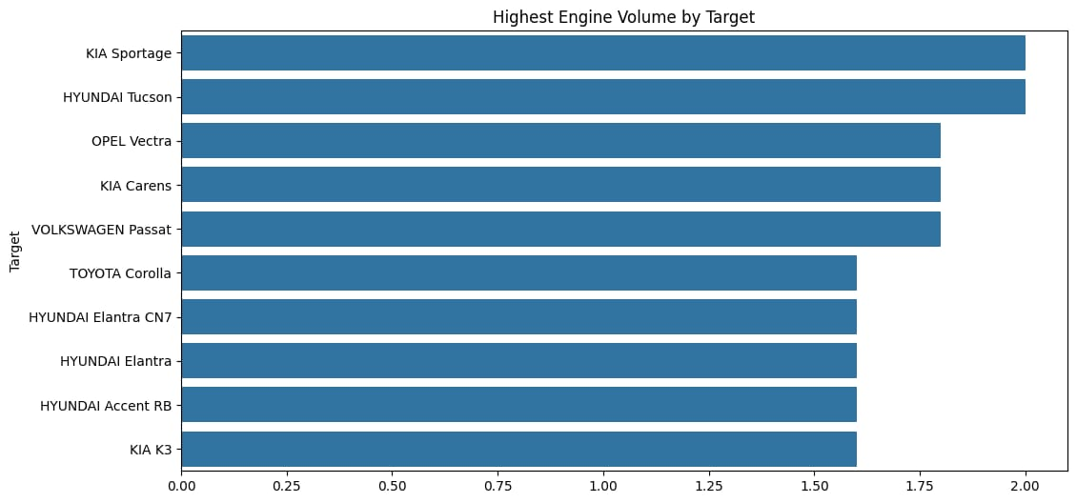
16
Which Target has the highest average engine volume?
AI INSIGHT
Models with larger engines are often sports cars or luxury vehicles.
Car-AI Prediction
16

Slide 18
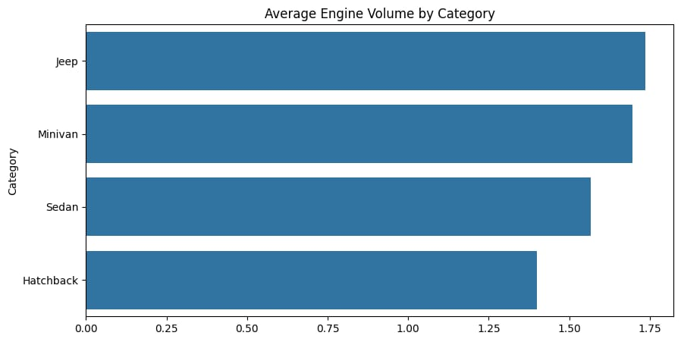
17
Which category has the highest average engine volume?
AI INSIGHT
Here, we highlight the categories with the largest engine capacities.
Car-AI Prediction
17

Slide 19
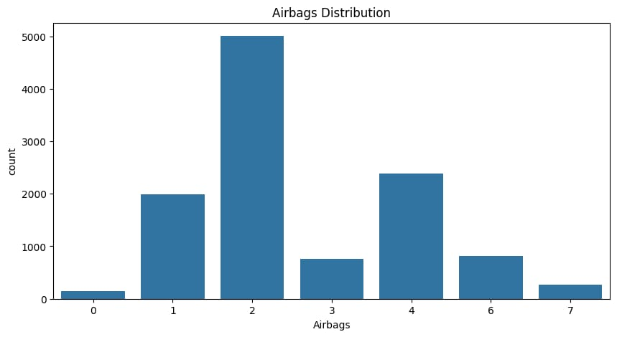
18
How are airbags distributed?
AI INSIGHT
We will explain the most common types of airbags.
Car-AI Prediction
18

Slide 20
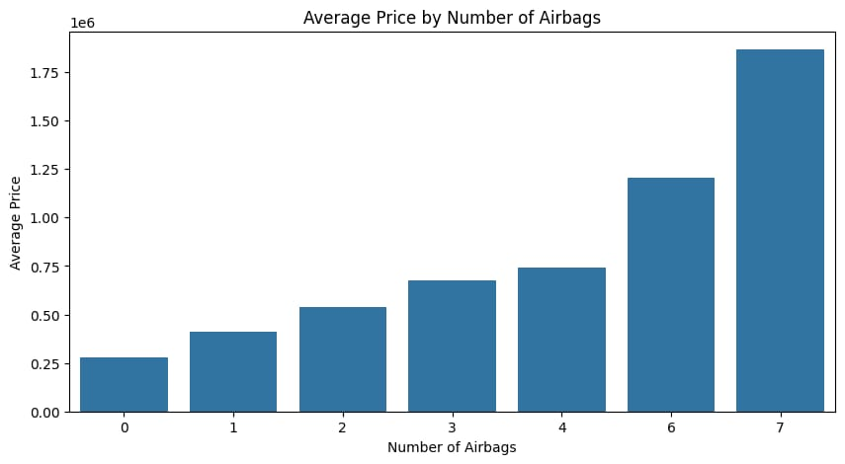
19
Does the number of airbags affect price?
AI INSIGHT
The diagram shows that as the number of airbags increases, the price increases.
Car-AI Prediction
19

Slide 21
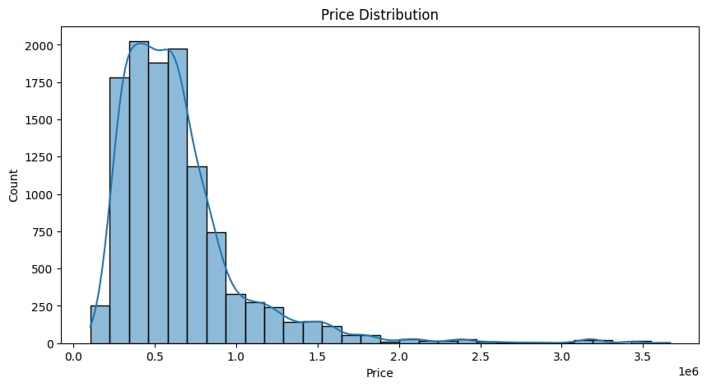
20
What is the distribution of car prices?
AI INSIGHT
The graph shows that most cars are moderately priced.
Car-AI Prediction
20

Slide 22
Thank You

