Slide 1

Accounting Basics
Sophia Rivera, MAcc, MBA

Slide 2
Definitions
Expense: Any money spent (E)
  Variable v. Fixed
Revenue: Any money that comes in (R)
Profit: Revenues minus Expenses (R – E)
Profit Margin: Profit divided by Revenue (P/R)
Break Even Point: Where expenses equal revenue (E=R)
Notes:
PM helps make better more informed decisions, compare to industries, predict income.

Slide 3
Break even analysis
Can help set sales goals/targets
Analyzing effects of changes
  NOTE
  Fixed costs: expenses essential to your business that will NOT change with scale.
  Variable costs: expenses that change based on volume.

Slide 4
Example
You run a subscription-based news site. Your expenses are as follows:
  $10 monthly to host your website on WordPress
  $50 monthly for your internet
  $2 per customer for customer acquisition
  $120 yearly for marketing
  And
  $50 per article written

Slide 5
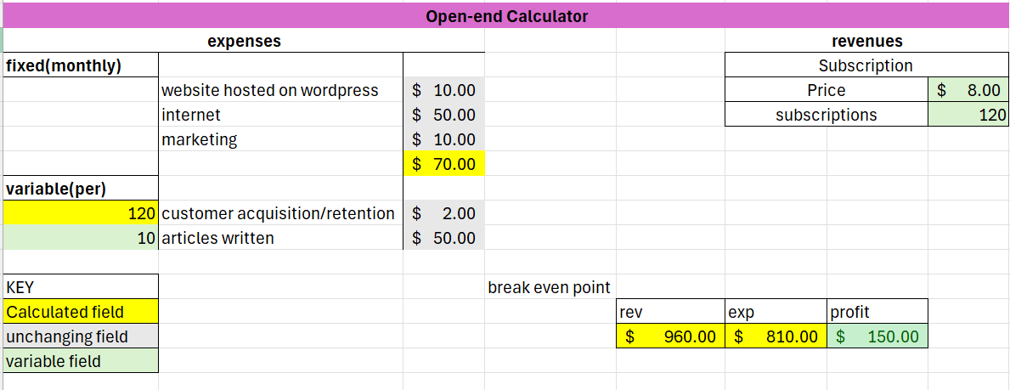
Example

Slide 6
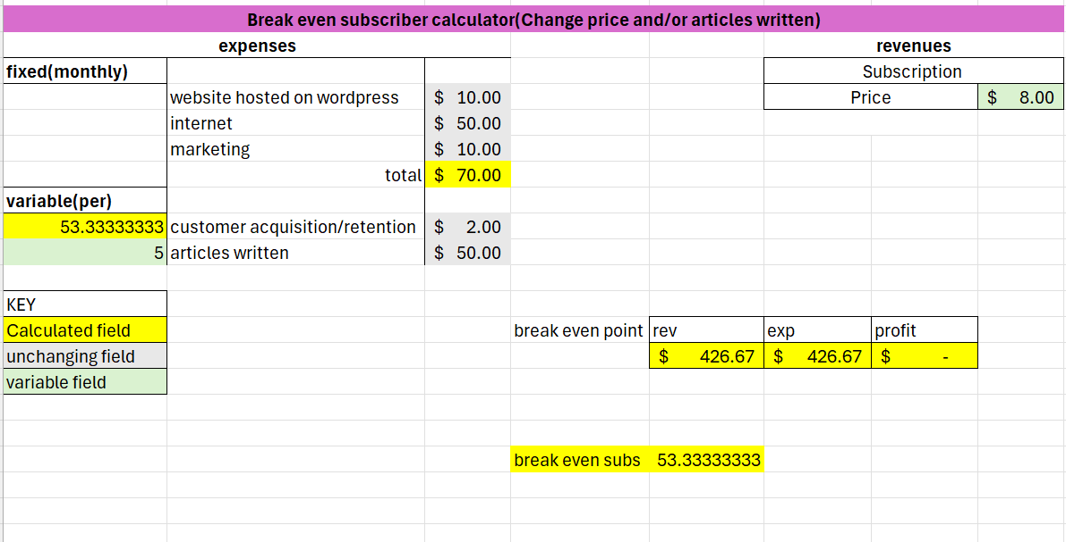
Example

Slide 7
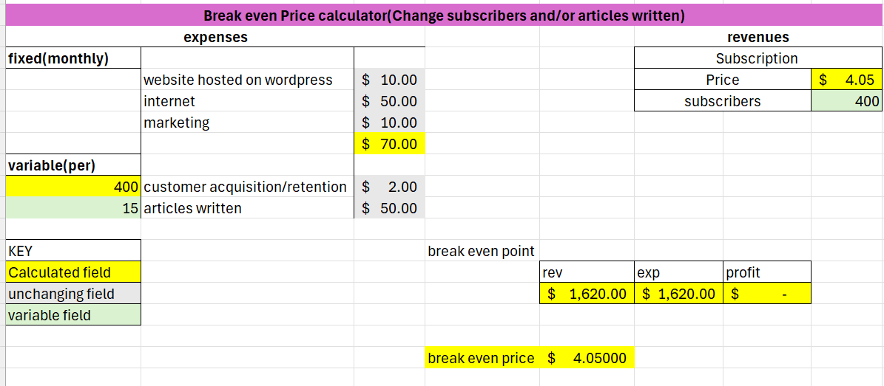
Example

Slide 8
Cash flow analysis
CFO: Cash Flow from Operating activities
  - Cash, AR/AP, Taxes etc.
CFI: Cash Flow from Investing activities
  - PPE, Land, Securities
CFF: Cash Flow from Financing activities
  - Loans, Long Term Debt

Slide 9
Example
You participate in EA. You build and sell trinkets using a 3D printer.
Expenses are:
  $50 monthly for your internet
  $800 one-time to buy a 3D printer
  $120 monthly co-working space rental
  $1 per unit
  Revenue:
  $10 per unit

