Slide 1
AI: Advantages and Disadvantage
By Nfansu Janneh
PowerPoint Presentation on Technology
CIS10154A0 Intro to Computer Info Sys 10/25/2024

Slide 2
AI contributes to many business development, Health care , social mobility and sports.

Slide 3
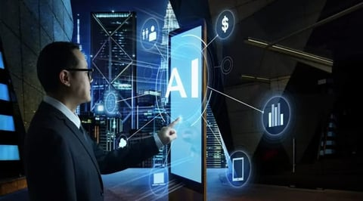
AI has helped in cost saving in today’s business. AI has improved many business services and availability. Companies can boast of around-the-clock services without having a human present

Slide 4
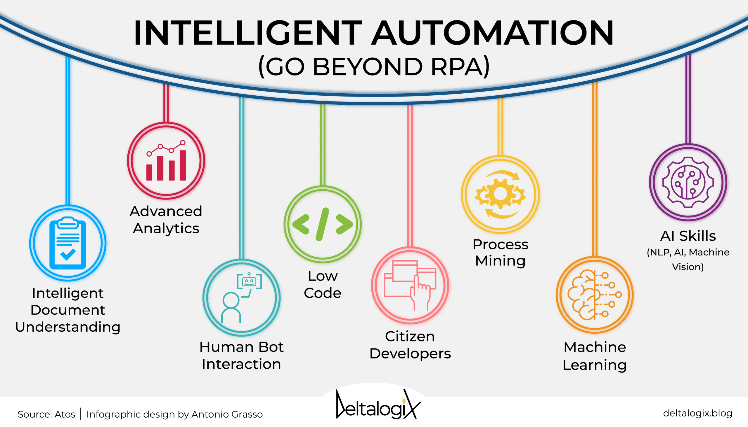
Automation is also an advance of AI, this reduces the company’s headcount, therefore helping in cost saving and reducing human error.

Slide 5
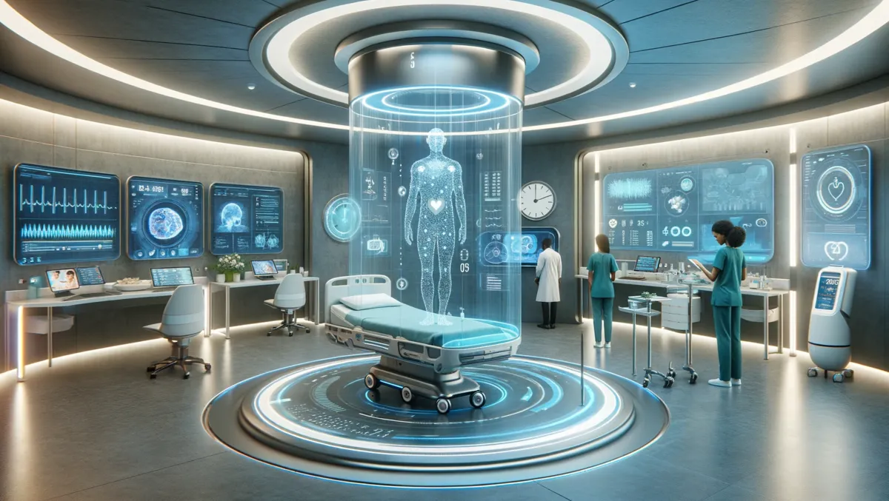
Advance in health care. The advancement in AI has contributed immensely in vaccine discovery, advances in surgery technology and new innovate patient care.

Slide 6
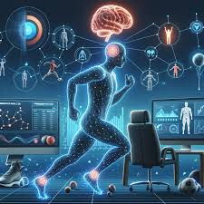
AI has help in the world of sport medicine, and on the field technology, such as goal line technology.

Slide 7
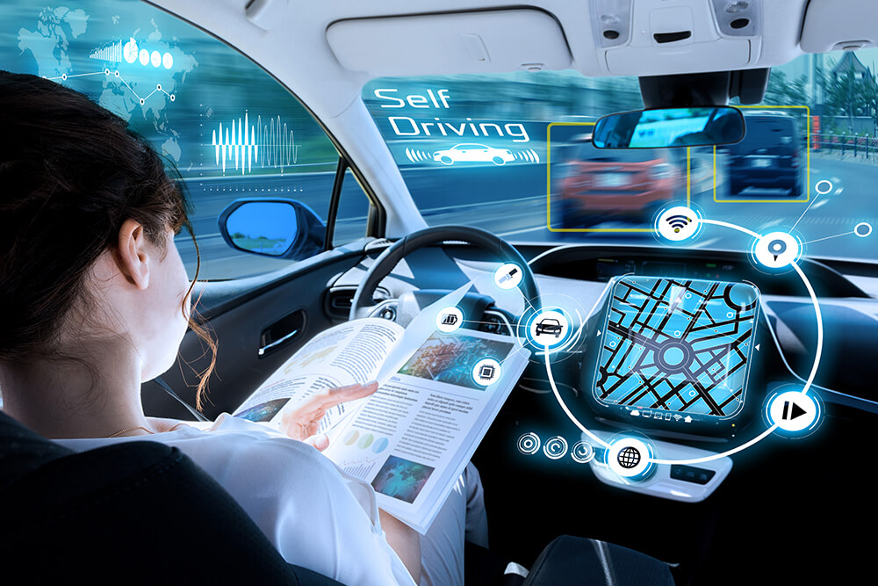
Driverless cars are an improvement of AI. There are tests that are being conducted in many major cities all across the US and some European targeted at machine learning to make driverless cars a thing of the future.

Slide 8
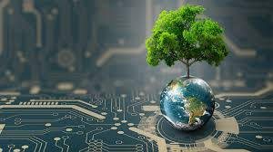
Climate change technology. AI has been helping in combating the effects of climate change.

Slide 9
Disadvantages of AI include Ethical Concerns, Unemployment and Social Control and lack of freedom.

Slide 10
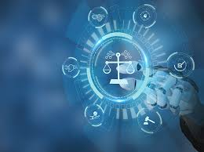
Ethical concerns can lead to discrimination against race and age.

Slide 11
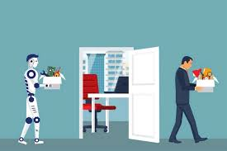
With many businesses utilizing AI, this led to many laying off employees in cut saving measures. Many professions such as customer service may become obsolete especially when robots start talking.

Slide 12
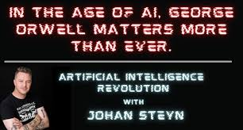
AI and the power it holds can be use by security agencies to control the masses , physically mentally and psychological control as advice in the novel 1984 by George owell.

Slide 13
Sources
How is Artificial Intelligence Influencing Business Development?
https://www.analyticsinsight.net/artificial-intelligence/how-is-artificial-intelligence-influencing-business-development
Intelligent Automation: benefits and challenges for companies
https://deltalogix.blog/en/2023/02/22/intelligent-automation-benefits-and-challenges-for-companies/
Microsoft new advanced healthcare AI capabilities & data solutions
https://itbrief.com.au/story/microsoft-new-advanced-healthcare-ai-capabilities-data-solutions
5 Ways Self-Driving Cars Could Make Our World (And Our Lives) Better
https://bernardmarr.com/5-ways-self-driving-cars-could-make-our-world-and-our-lives-better/
Injury Prevention, Optimized Training and Rehabilitation: How Is AI Reshaping the Field of Sports Medicine
https://nasianjmed.com/index.php/najm/article/view/7

Slide 14
AI and Climate Change: Leveraging Technology for Environmental Sustainability in 2024
https://www.linkedin.com/pulse/ai-climate-change-leveraging-technology-environmental-dave-balroop-amqrc
Top Ethical Issues with AI and Machine Learning
https://www.dataversity.net/top-ethical-issues-with-ai-and-machine-learning/
Artificial Intelligence : Will cause the unemployment ?
https://www.linkedin.com/pulse/artificial-intelligence-cause-unemployment-vivek-kumar-shukla
In the age of AI, George Orwell matters more than ever
https://www.linkedin.com/pulse/age-ai-george-orwell-matters-more-than-ever-prof-johan-

