Slide 1

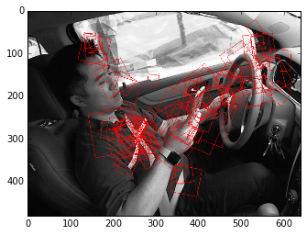

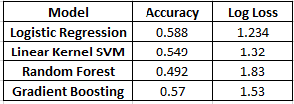
State Farm Distracted Driver Detection Nishaat Farheen, Mohit Ravi, Lanyin Zhang
Statistical Learning & Analytics
Spring, 2016
Introduction
StateFarm wants to test if dashboard cams can automatically detect distracted drivers.
Dashboard cams can help in fighting insurance fraud, having a record of your accident and getting out of a traffic violations you didn’t commit.
Data Understanding
The dataset consists of 22,000 Training images and 79,000 Test images.
The response variable is divided into 10 classes. They are:
C0 – Safe driving, C1 – texting ,
C2 – talking on the phone…….. etc
Results & Evaluation
Ran Classification algorithms on extracted features to predict the final class on Test Images.
Accuracy = (Correct Class/Total No of Samples)
Data Preparation
Due to computational limitations, we used 8,000 training images to build the model and tested on 1,000 images.
Convert Images from RGB format to Grayscale format.
Modeling
Feature extraction was performed using visual bag of words model.
This method searches for interesting areas of the image which is known as key-point detection.
We obtain around 100 descriptors per Image.
From the extracted descriptors, we cluster similar looking regions from all images, which are known as Visual words.
K-means clustering (k=256) is used for clustering.
Conclusion
We conclude that Logistic Regression is giving the best Accuracy and Least Logloss.
This model Is deployed on a local web interface for demo.

