Slide 1
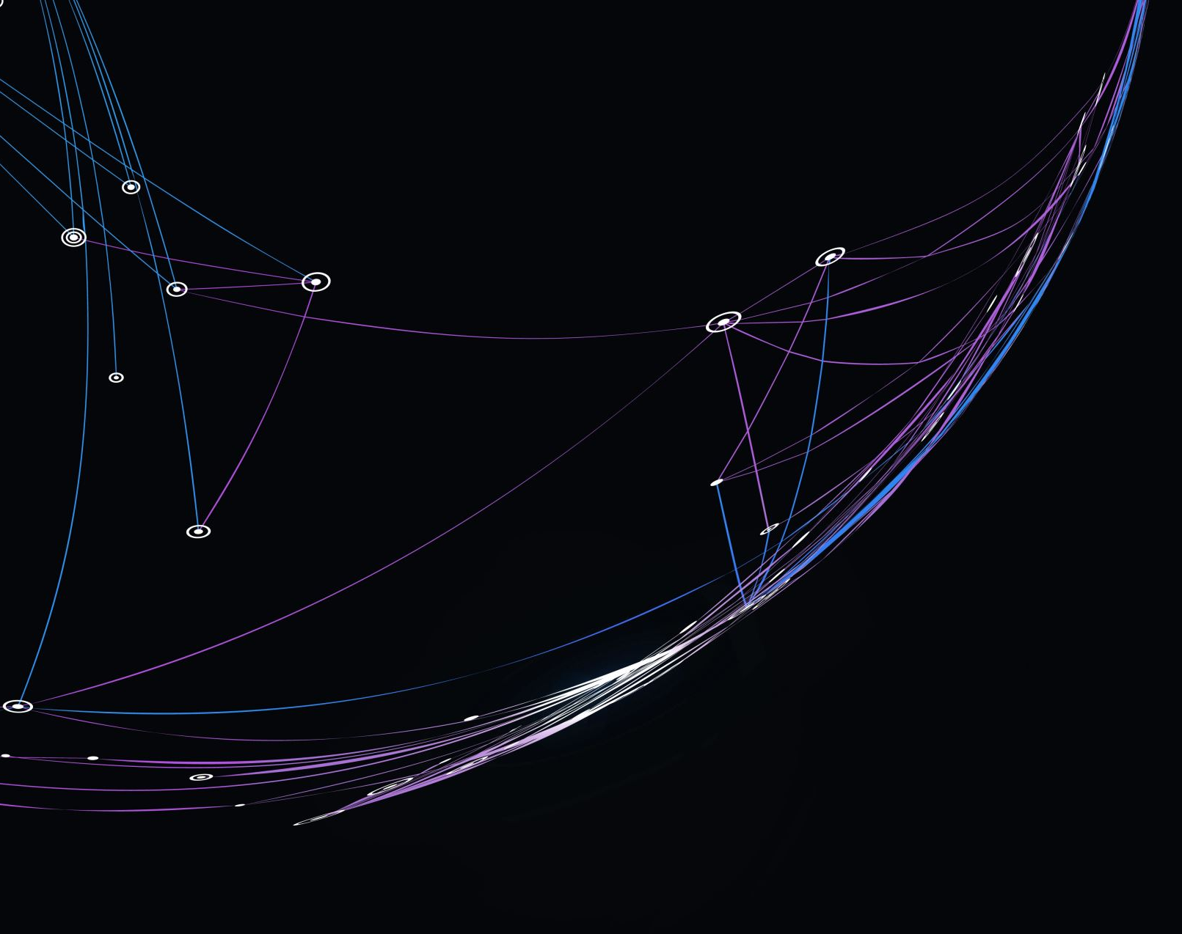
External Indices in Clustering
Joseph Nelson Farrell
DS 5230 Unsupervised Machine Learning
Northeastern University
Professor Steven Morin, PhD
03-30-24

Slide 2
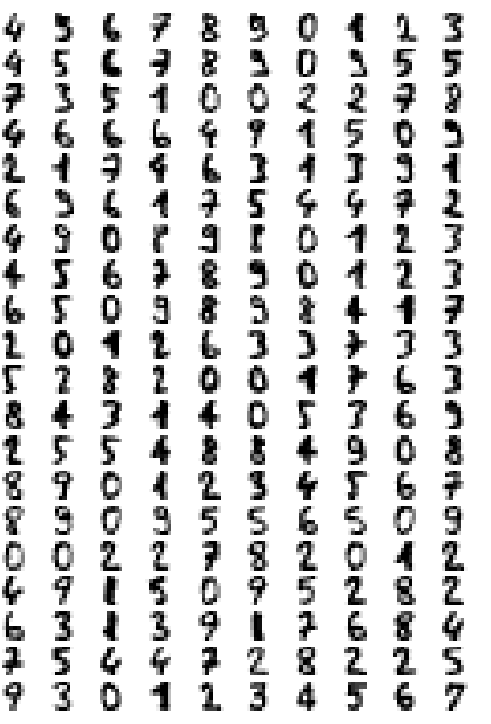
Objective: Perform dimensionality reduction on the digits dataset. Identify the best clustering algorithm using internal indices. Evaluate clustering algorithm performance using external indices.
MNIST Digits Data:
Image Size: 8 x 8
Data Shape:
Rows: 1797 - digit observations
Columns: 64 (float) – image pixel values

Slide 3
Preparation:
To avoid repetition this presentation will assume the midterm slide deck has been reviewed.
However, for a full explanation of the preparation and preprocessing please see the midterm slide deck.
This slide deck begin with dimensionality reduction using UMAP.
Nevertheless, some of the slides that follow will be repetitions from the midterm slide deck, please feel free to skip over these slides.

Slide 4
Grid Search Over UMAP Hypers:
The grid search procedure was set up to iterate over the ranges of 4 UMAP hyperparameters
min_dist: [0.0, 0.01, 0.1, 0.25, 0.5, 0.75]
n_neighbors: [5, 10, 15]
metric: ['euclidean', 'manhattan']
n_components: [2, 3]
The values of n_components were taken from:
midterm (2)
assignment (3)
Note: In assignment 3 it was determined that the latent manifold of the digits dataset was 2. However, this value was replaced by 3 because trustworthiness does in fact increase beyond 2.

Slide 5
Model Selection
At each iteration cl.clustering was called. This function implements Kmeans with the current embedding. Four intrinsic metrics were tracked.
Silhouette score
Davies Bouldin score
Calinski Harabasz score
N_clusters found by the elbow method (intertia vs num_clusteres)
If all 4 of the metrics converged on the same number of clusters Kmeans was selected as a variable model for the current embedding.
Alternatively, if Silhouette score, Davies Bouldin score, and Calinski Harabasz converged on the same number of clusters, Kmeans was also selected.
If Kmeans was selected, the hyperparameters of both Kmeans and UMAP for the current embedding were stored as a row to be added to a results frame.

Slide 6
Model Selection conti…
If the intrinsic metrics failed converge with Kmeans, Dbscan was executed.
The hyperparameters eps, and min_samples were derived mathematically.
A factor range around this derived eps was iterated over with Dbscan executed at each iteration.
The model associated with the max validity score obtained during this iterative process was selected as the best model.
The hyperparameters of both DBscan and UMAP for the current embedding were stored as row to be added to a results dataframe.

Slide 7
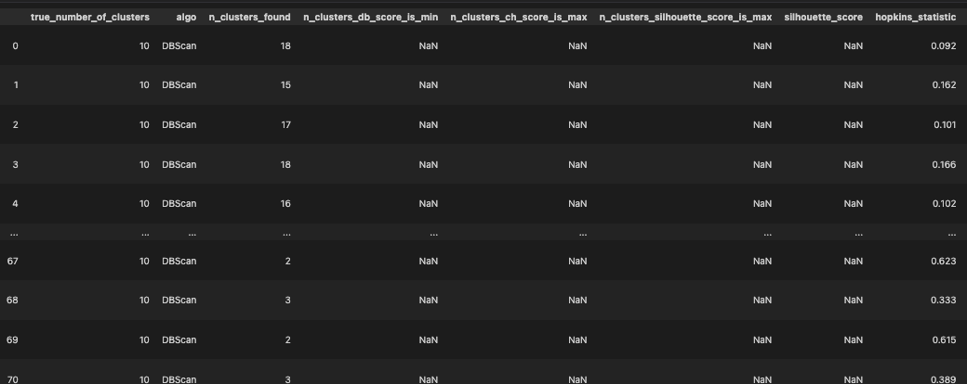
Results
The process described in previous slides produces a 72 x 16 dataframe where each row contains a UMAP embedding, and the best clustering algorithm discovered for that embedding.
Figure 1: Results Dataframe Abbreviated

Slide 8
Model Selection for Each Manifold Dimensionality
The results frame displayed on the previous slide was filtered into 2 dataframes.
n_components = 2
n_components = 3
The final selection of the latent manifold of the for each dataframe was determined by taking the maximum silhouette score or the maximum validity index.
Next the external index adjusted rand score and the best contingency matrix were used to evaluate the clustering algorithms performance.
These are external and thus require the true labels

Slide 9
Adjusted Rand Score & Contingency Matrix
The adjusted rand score is a measure of a clustering algorithm’s performance.
It is bounded and produces a score of 1 for perfect clustering, and a score of of close to 0 for random labeling.
It makes no assumptions about the structure of clusters.
A contingency matrix is helpful in understanding where the the clustering algorithm is making mistakes.
The rows of a contingency matrix are the true labels.
The columns are the predicted labels.
The diagonal elements are true labels that were predicted correctly.
By maximizing the trace, we can determine the best mapping of predicted labels to true labels.

Slide 10
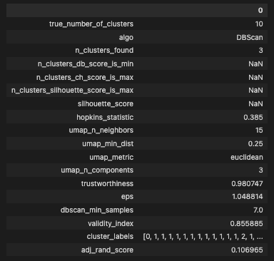
Results: Manifold Dimensionality = 3
On the right is a tabulation of latent manifold details for the 3-dimensional manifold.
This is the assignment 3 solution.
This tabulation contains the UMAP and DBscan hyperparameter values for the best clustering algorithm.
The external index adjusted rand score is also present.
As can be observed, the 3-dimensional latent manifold did not produce great clustering results.
Adjusted Rand Score = 0.106965, where is 1 is the best possible score and 0 is random random uniform.
It can also be observed that 3 clusters were identified when 10 true labels exist.
Figure 2: Transpose Manifold & Clustering Details Row

Slide 11
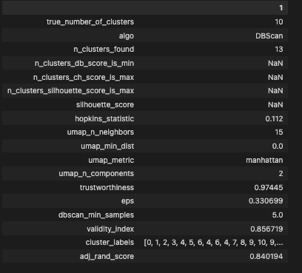
Results: Manifold Dimensionality = 2
On the right is a tabulation of latent manifold details for the 2-dimensional manifold.
This is the midterm value.
It contains the same information as the tabulation on the previous slide
Adjusted Rand Score = 0.840194.
This model performed considerably better than the best model on the 3-dimensional manifold.
As we can observe, this model found 13 clusters.
This is still more than the true number of clusters.
Next, we will evaluate where the clustering algorithm is making mistakes using the contingency matrixes.
Figure 3: Transpose Manifold & Clustering Details Row

Slide 12
Finalized Tabulation of Results
Figure 4: Finalized Tabulation of Manifold and Clustering Results
Above is finalized tabulation of the manifold and clustering results for the latent manifold dimensionality from assignment 3 (3) and the midterm (2)
As can be observed, the best clustering on the 3-dimensional manifold did not perform particularly well, achieving an adjusted rand score of only 0.106955.
The best clustering on the 2-dimensional manifold performed considerably better, achieving an adjusted rand score of 0.840194.
Next, we’ll examine the best contingency matrices to gain insights into where the clustering algorithm is making mistakes.

Slide 13
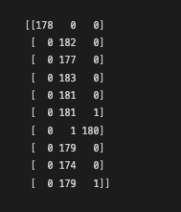
Best Contingency Matrix 3D Manifold: Assignment 3
To the right is best contingency matrix from the clustering performed on the 3D manifold.
The rows represent the true labels.
The columns represent the predicted labels.
As previously noted, the performance is rather poor, identifying only 3 clusters when 10 true classes exist.
Interestingly, while overall, the clustering algorithm did not perform well, it was able to identify 2 of the true classes and achieve one pure cluster (0) and one nearly pure cluster (6).
Despite the poor performance, next, we’ll examine some of the mislabeled images.
Figure 5: Contingency Matrix 3D Manifold

Slide 14
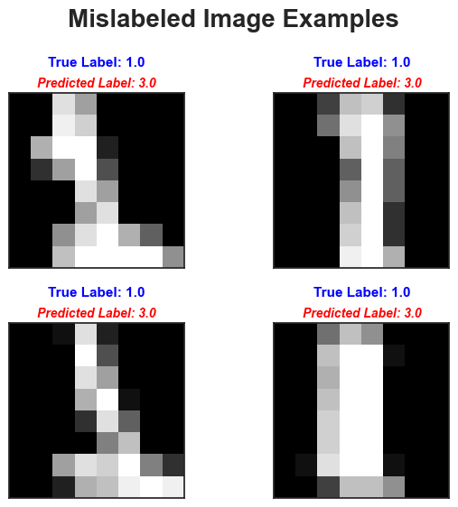
Mislabeled Image Examples 3D Embedding
Here can see a sample of true label 1 elements and their predicted label.
Because a mode method was used to determine the true labels, the majority of mislabeled elements in this embedding received predicted label 3.
This is a result of the limited number of clusters found (3) and mode of the cluster containing the majority of the elements, namely mode = true label 3.
A similar pattern is observed for other true labels with this embedding.
We’ll display this next, with more true label examples.
Figure 6: Examples of Mislabeled Element

Slide 15
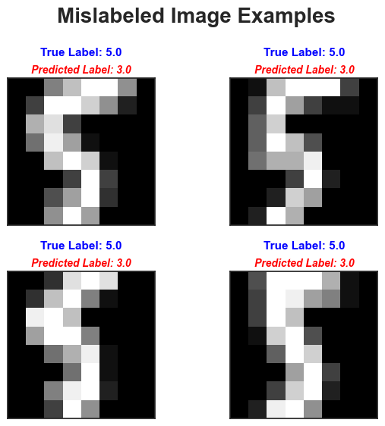
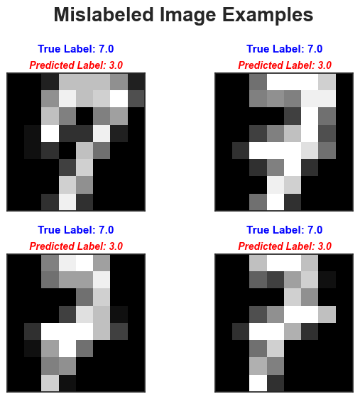
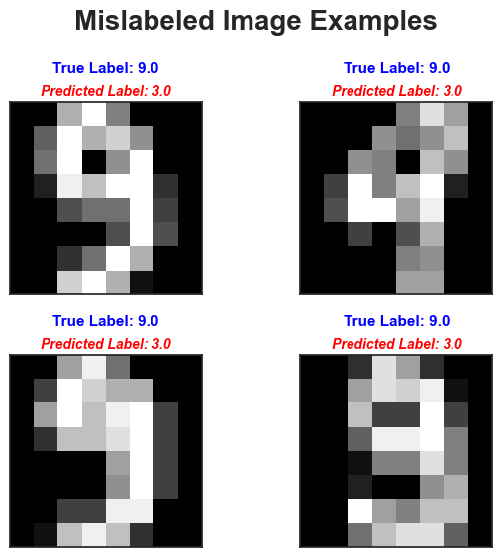
Mislabeled Image Examples 3D Embedding
Figure 6: Examples of Mislabeled Elements
Figure 7: Examples of Mislabeled Elements
Figure 8: Examples of Mislabeled Elements
Because of the poor performance of this clustering solution, we’ll move to an examination of the 2D embedding.

Slide 16
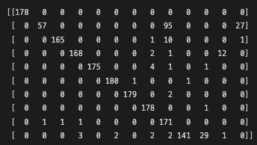
Best Contingency Matrix 2D Manifold: Midterm
To the right is best contingency matrix from the clustering performed on the 2D manifold.
Clustering on the 2D manifold performed considerably better.
Many of the true labels have a high degree of purity.
True labels where the algorithm made most mistakes are:
True Label: 1
True Label: 2
True Label: 9
The algorithm also identified 3 clusters that are not present in the true labels.
Next, we’ll examine some example images that the algorithm mislabeled.
Because this is a 2D embedding we can also examine the clusters with respect to the embedding space.
Figure 5: Contingency Matrix 2D Manifold

Slide 17
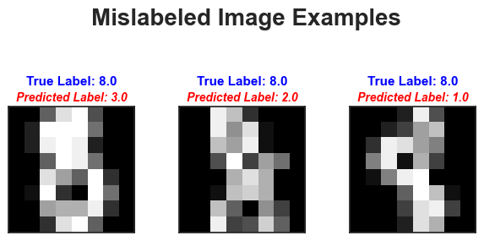
Mislabeled Image Examples 2D Manifold
Figure 8: True Label 8 – Mislabeled Images
Above are the 3 images with true label 8 that were mislabeled.
There does not appear to be pattern to the mislabeling.
Next, we’ll look at true label 4.

Slide 18
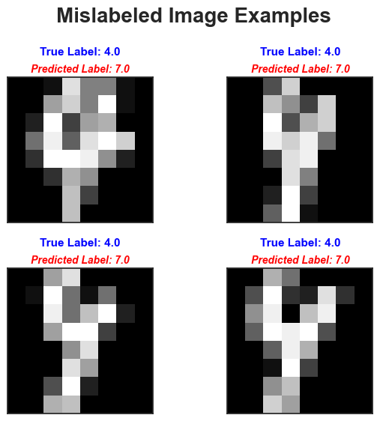
Mislabeled Image Examples 2D Manifold
On the right is a sample of true label 4 images that were mislabeled.
These mislabeled images do display a pattern, they are all in the same mislabeled cluster, namely 7.
This is not true for all the mislabeled 4’s, but interesting, nevertheless.
Now we’ll shift, and rather than further examining mislabeled elements by true label, we’ll examine mislabeled elements by looking at predicted labels that are not present in the true label set.
Figure 9: True Label 4 – Mislabeled Images

Slide 19
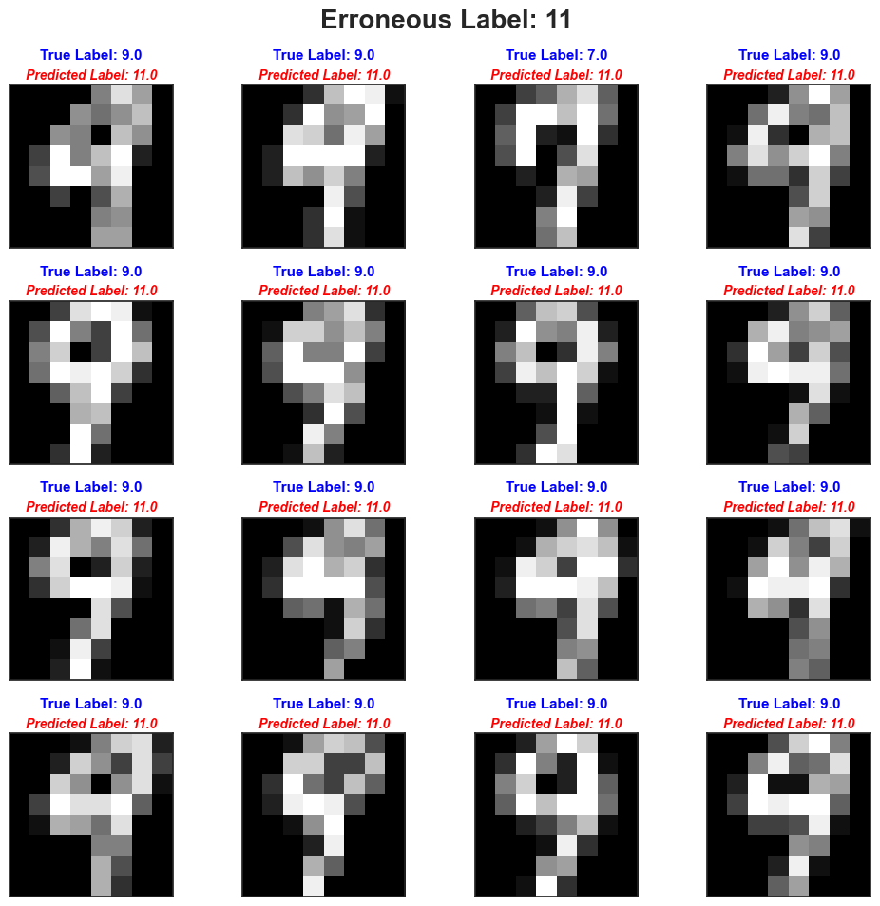
Mislabeled Image Examples 2D Manifold
This is perhaps a more informative exploration.
In this sample we can observe that many of the elements that were labeled 11 are in fact a 9.
This information could potentially be used to make corrections to the algorithmic output.
Next, we’ll examine one more of the erroneous labels.
Figure 10: Erroneous Label 11 Images

Slide 20
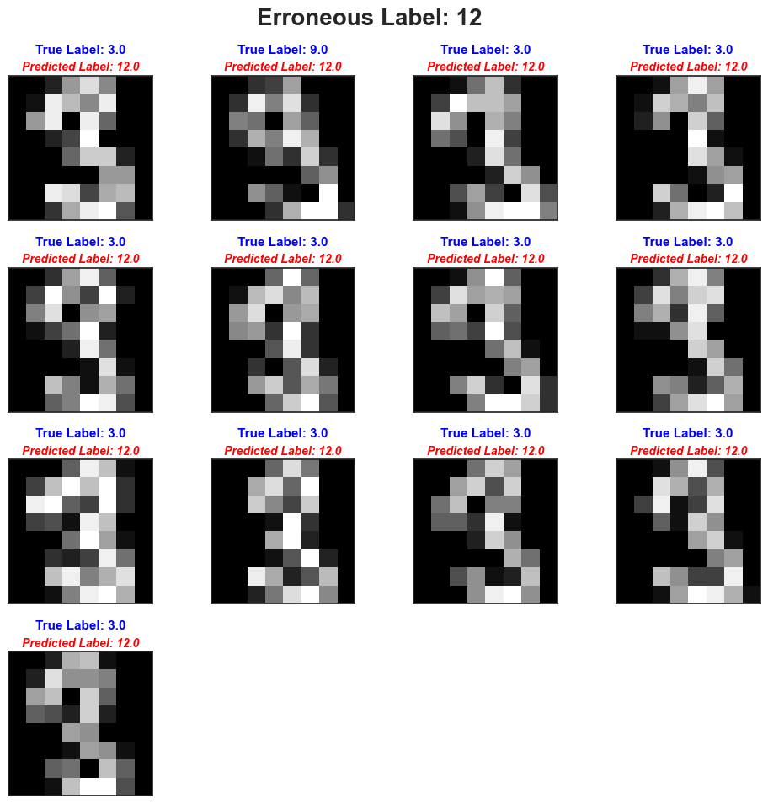
Mislabeled Image Examples 2D Manifold
This example shows the entire cluster for erroneous label 12.
Again, we can observe that many of the elements that received this label are of the same true label class, 3.
This information could potentially be used make corrections to the algorithmic output.
Because this is a 2D embedding we can further explore cluster performance with respect to the embedding space.
Figure 10: Erroneous Label 11 Images

Slide 21
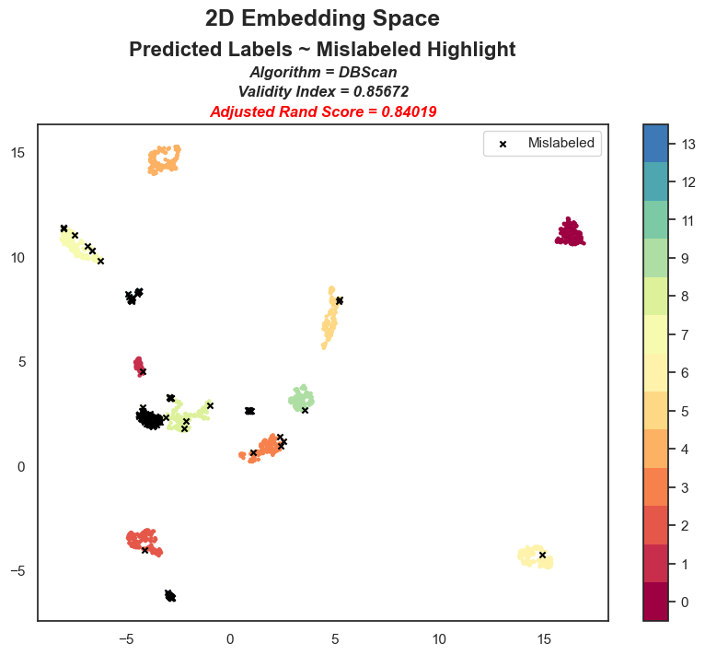
Clustering Outcome with Respect to the Embedding Space
Here we can see data points on the 2D embedding with their cluster labels.
This graphic highlights all the data points that were mislabeled.
What immediately jumps out is the large cluster of mislabeled data points around (-4, 1).
Two smaller clusters of mislabeled data points are visable around:
(-2.5, -6)
(-4, 1.5)
Many of the other mislabeled data points appear to be in proximity to true clusters.
This information could potentially be used to improve data point labeling.

Slide 22
Summary
Clustering performance on the 3D embedding was poor, only identifying 3 clusters
Clustering performance on the 2D embedding faired better, identifying 13 clusters.
Potential patterns identified with the mislabeled images could improve element labeling in the 2D embedding.

Slide 23
Acknowledgements.
Morin, S. (2024). DS 5330 Class Materials
Scikit-learn.org
Umap-learn.readthedocs.io

