Slide 1
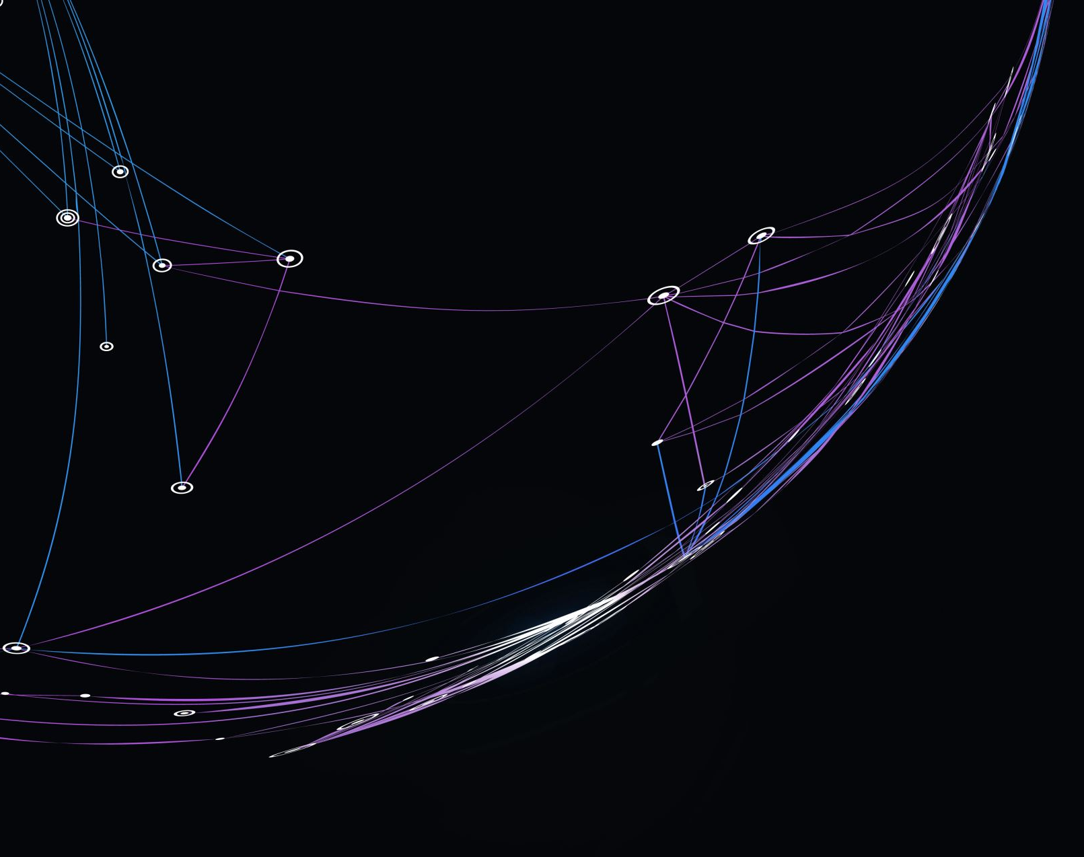
Dimensionality Reduction & Clustering Continuation
Joseph Nelson Farrell
DS 5230 Unsupervised Machine Learning
Northeastern University
Professor Steven Morin, PhD
03-15-24

Slide 2
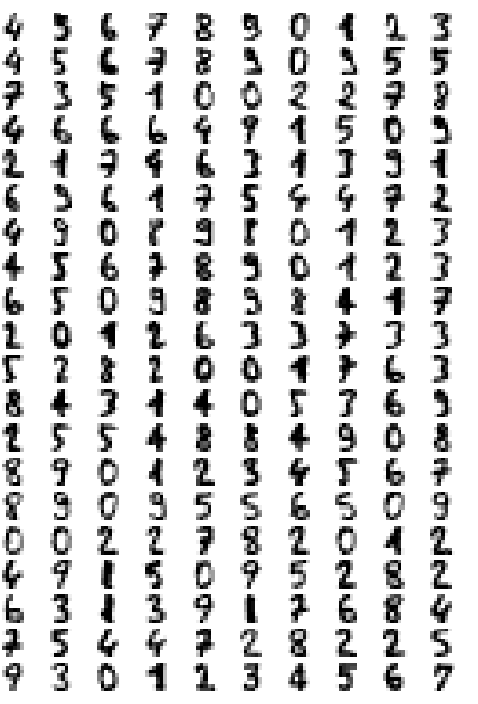
Objective: Perform dimensionality reduction on the digits dataset. Identify the best clustering algorithm using internal indices. Evaluate clustering algorithm performance using external indices.
MNIST Digits Data:
Image Size: 8 x 8
Data Shape:
Rows: 1797 - digit observations
Columns: 64 (float) – image pixel values

Slide 3
Preparation:
To avoid repetition this presentation will assume the midterm slide deck has been reviewed.
However, for a full explanation of the preparation and preprocessing please see the midterm slide deck.
This slide deck begin with dimensionality reduction using UMAP.
Nevertheless, some of the slides that follow will be repetitions from the midterm slide deck, please feel free to skip over these slides.

Slide 4
Grid Search Over UMAP Hypers:
The grid search procedure was set up to iterate over the ranges of 4 UMAP hyperparameters
min_dist: [0.0, 0.01, 0.1, 0.25, 0.5, 0.75]
n_neighbors: [5, 10, 15]
metric: ['euclidean', 'manhattan']
n_components: [2, 3]
The values of n_components were taken from the: midterm (2) and assignment (3)
Note: In assignment 3 it was determined that the latent manifold of the digits dataset was 2. However, this value was replaced by 3 because trustworthiness does in fact increase beyond 2.

Slide 5
Model Selection
At each iteration cl.clustering was called. This function implements Kmeans with the current embedding. Four intrinsic metrics were tracked.
Silhouette score
Davies Bouldin score
Calinski Harabasz score
N_clusters found by the elbow method (intertia vs num_clusteres)
If all 4 of the metrics converged on the same number of clusters Kmeans was selected as a variable model for the current embedding.
Alternatively, if Silhouette score, Davies Bouldin score, and Calinski Harabasz converged on the same number of clusters, Kmeans was also selected.
If Kmeans was selected, the hyperparameters of both Kmeans and UMAP for the current embedding were stored as a row to be added to a results frame.

Slide 6
Model Selection conti…
If the intrinsic metrics failed converge with Kmeans, Dbscan was executed.
The hyperparameters eps, and min_samples were derived mathematically.
A factor range around this derived eps was iterated over with Dbscan executed at each iteration.
The model associated with the max validity score obtained during this iterative process was selected as the best model.
The hyperparameters of both DBscan and UMAP for the current embedding were stored as row to be added to a results dataframe.

Slide 7
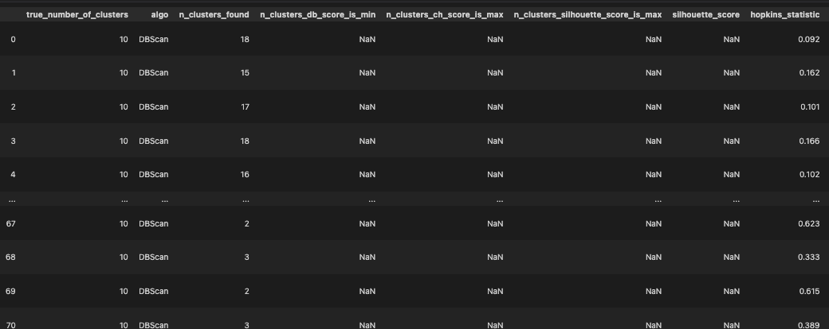
Results
The process described in previous slides produces a 72 x 16 dataframe where each row contains a UMAP embedding, and the best clustering algorithm discovered for that embedding.
Figure: Results Dataframe Abbreviated

Slide 8
Model Selection for Each Manifold Dimensionality
The results frame displayed on the previous slide was filtered into 2 dataframes.
n_components = 2
n_components = 3
The final selection of the latent manifold of the for each dataframe was determined by taking the maximum silhouette score or the maximum validity index.
Next the external index adjusted rand score and the best contingency matrix were used to evaluate the clustering algorithms performance.
These are external and thus require the true labels

Slide 9
Adjusted Rand Score & Contingency Matrix
The adjusted rand score is a supervised measure of a clustering algorithm’s performance.
It is bounded and produces a score of 1 for perfect clustering, and a score of of close to 0 for random labeling.
It makes no assumptions about the structure of clusters.
A contingency matrix is helpful in understanding where the the clustering algorithm is making mistakes.
The rows of a contingency matrix are the true labels
The columns are the predicted labels
The diagonal elements are true labels that were predicted correctly.
By maximizing the trace, we can determine the best mapping of predicted labels to true labels

Slide 10
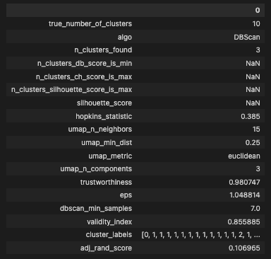
Results: Manifold Dimensionality = 3
On the right is a tabulation of latent manifold details for the 3-dimensional manifold.
This is the asignmnet 3 solution.
This tabulation contains the UMAP and DBscan hyperparameter values for the best clustering algorithm.
The external index adjusted rand score is also present.
As can be observed, the 3-dimensional latent manifold did not produce great clustering results.
Adjusted Rand Score = 0.106965, where is 1 is the best possible score and 0 is random random uniform.
It can also be observed that 3 clusters were identified when 10 true labels exist.

Slide 11
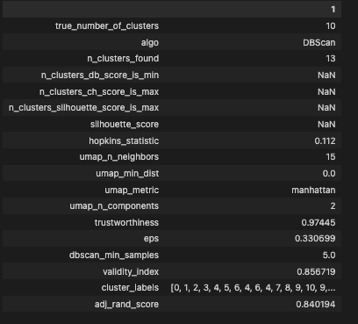
Results: Manifold Dimensionality = 2
On the right is a tabulation of latent manifold details for the 2-dimensional manifold.
This is the midterm value.
It contains the same information as the tabulation on the previous slide
Adjusted Rand Score = 0.840194.
This model performed considerably better than the best model on the 3-dimensional manifold.
As we can observe, this model found 13 clusters.
This is still more than the true number of clusters.
Next, we will evaluate where the clustering algorithm is making mistakes using the contingency matrixes.

Slide 12
Best Contingency Matrixes
On the right is a tabulation of latent manifold details for the 2-dimensional manifold.
This is the midterm value.
It contains the same information as the tabulation on the previous slide
Adjusted Rand Score = 0.840194.
This model performed considerably better than the best model on the 3-dimensional manifold.
As we can observe, this model found 13 clusters.
This is still more than the true number of clusters.
Next, we will evaluate where the clustering algorithm is making mistakes using the contingency matrixes.

Slide 13
Acknowledgements.
Morin, S. (2024). DS 5330 Class Materials
Scikit-learn.org
Umap-learn.readthedocs.io

