Slide 2
How to make optical communication products That Facebook will want to buy
Nathan Farrington
Data Center Network Engineer
2013-03-17 (OIDA Workshop, Anaheim, CA)
Notes:
This talk will describe the current data center network and optical interconnect architectures at Facebook, our roadmap going forward, and advice on how to do business with Facebook.

Slide 3
Agenda
1 | Datacenter network architecture
2 | Wishlist
3 | Doing business with Facebook

Slide 4
Datacenter network architecture

Slide 5
1. Capacity & redundancy
The Internet
DR
DR
CSW
CSW
RSW
RSW
RSW
RSW

Slide 6
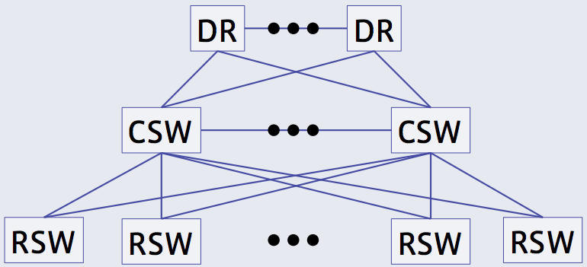
2. Backbone for predictable performance
Leased circuits through The Internet
BB
BB
BB
BB
BB
BB

Slide 7
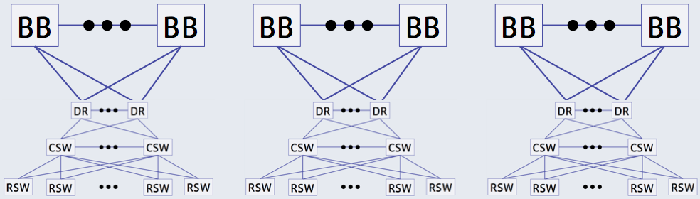
3. POPs to reduce latency
The Internet
BB
PR
PR
BB
Leased circuits through The Internet

Slide 8
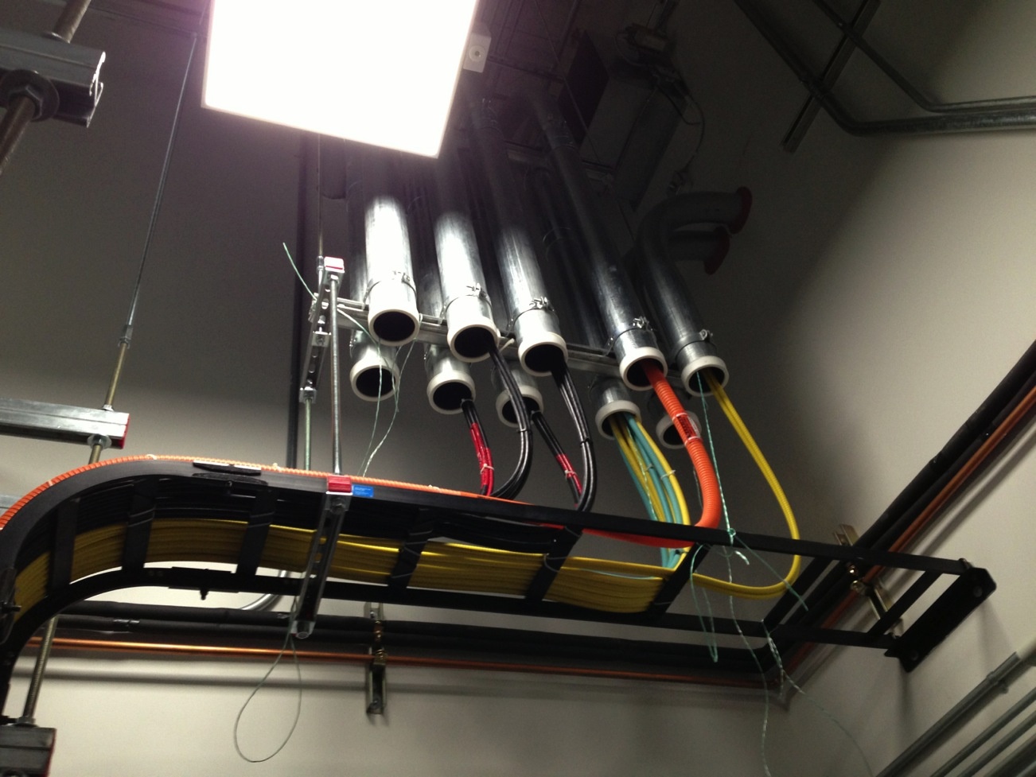
Main point of entry

Slide 9
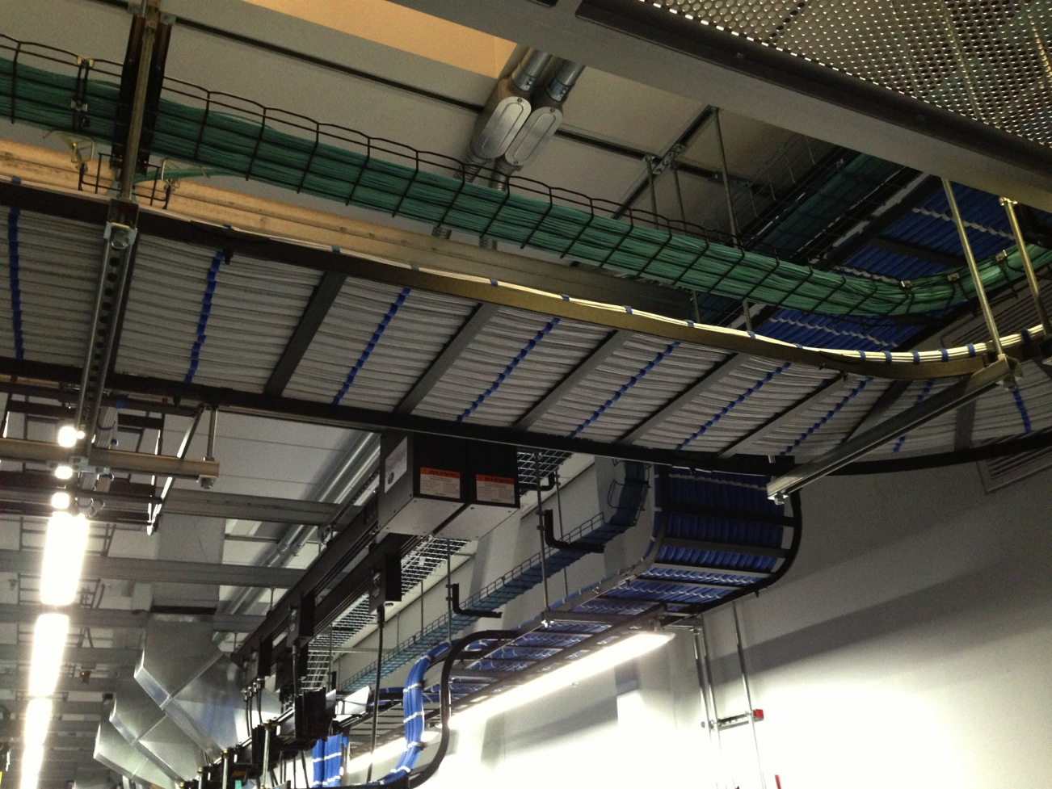
A few overhead cable trays

Slide 10
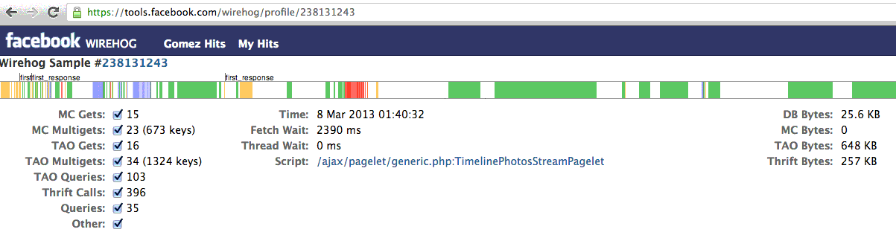
Challenge: HTTP request amplification
This 1 KB HTTP request generated 930 KB of internal network traffic
This measurement is not necessarily representative of all traffic

Slide 11
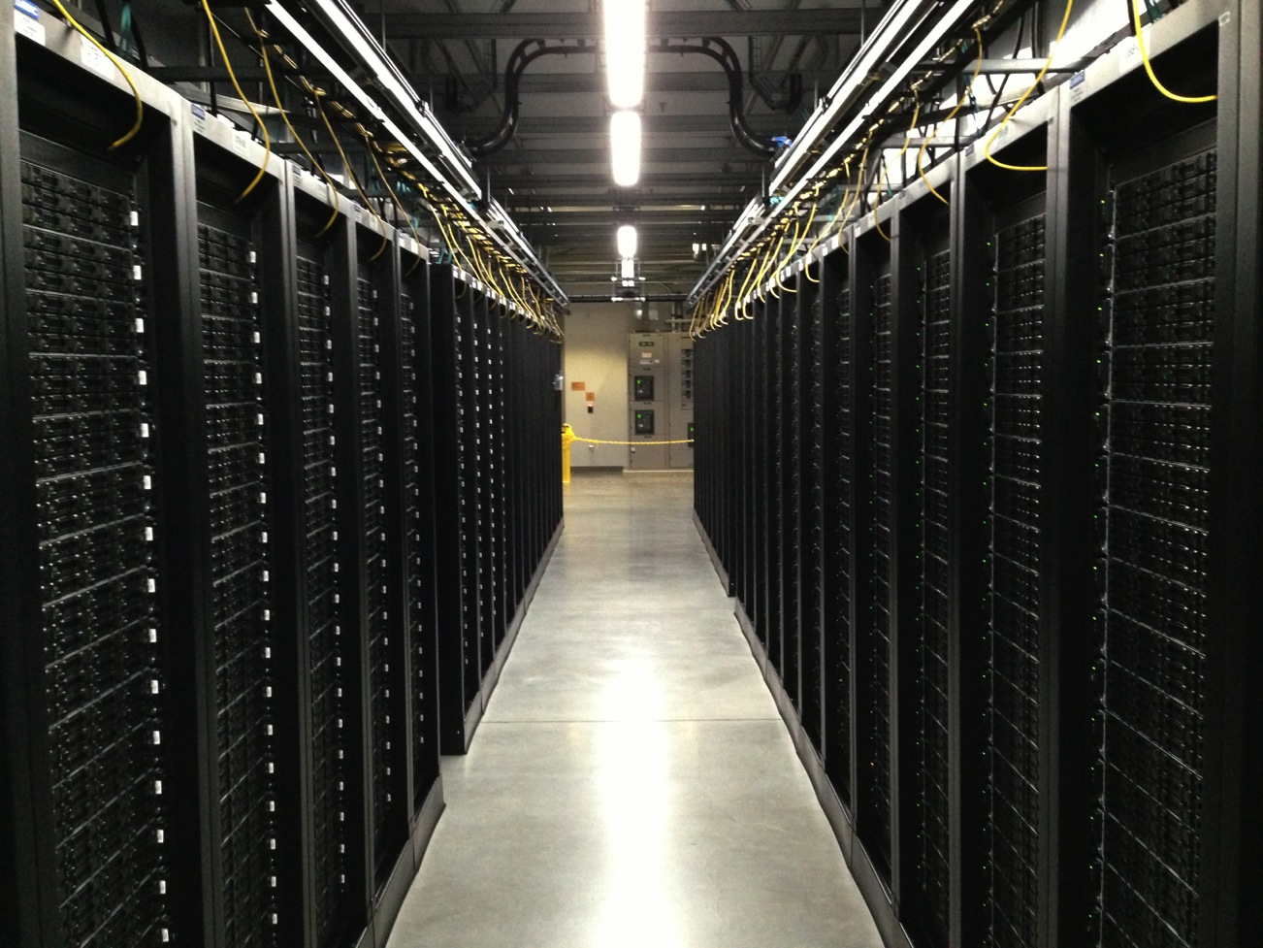
Challenge: big data

Slide 12
4. Datacenter as one computer
The Internet
FC
FC
DR
DR
CSW
CSW
RSW
RSW
RSW
RSW

Slide 13
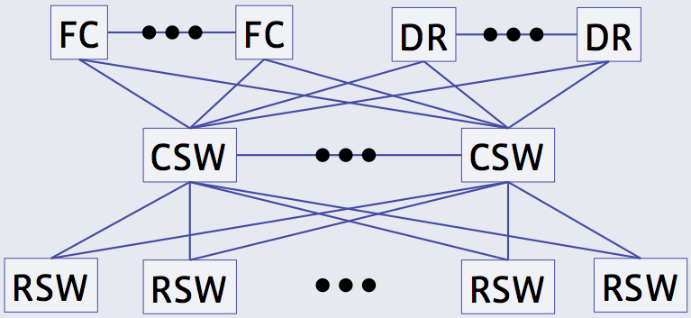
5. Multiple datacenters as one computer
FA
FA
The Internet

Slide 14
Wishlist

Slide 15

Notes:
Even with more than 1B users, Facebook is still growing. Our traffic is still growing exponentially.

Slide 16
Wishlist
More bits per second for less CAPEX and OPEX
More bits per second for less CAPEX and OPEX
More bits per second for less CAPEX and OPEX
More bits per second for less CAPEX and OPEX
More bits per second for less CAPEX and OPEX
More bits per second for less CAPEX and OPEX
More bits per second for less CAPEX and OPEX

Slide 17
Can we have just one kind of transceiver?
40G (2013), 100G (2015)
MMF or SMF with same device
Pair of fibers (or single fiber?)
Parallel fiber is lame, especially when you don’t even use all of them
150 m reach minimum, 1 km is better
Low cost, short lead time for any quantity
Multisource
Open source

Slide 18
Doing business with Facebook

Slide 19
Doing business with Facebook
We will buy non-standard/pre-standard optical products
Please work with us closely before investing your own NRE
Things change FAST!
Get access to our roadmap (NDA)
Send us samples (fully packaged)
We want to poke around on the insides of your stuff
If this scares you then go somewhere else

