Slide 1
Multipath TCP under MASSIVE Packet Reordering
DCSwitch
Nathan Farrington
June 8, 2009

Slide 2
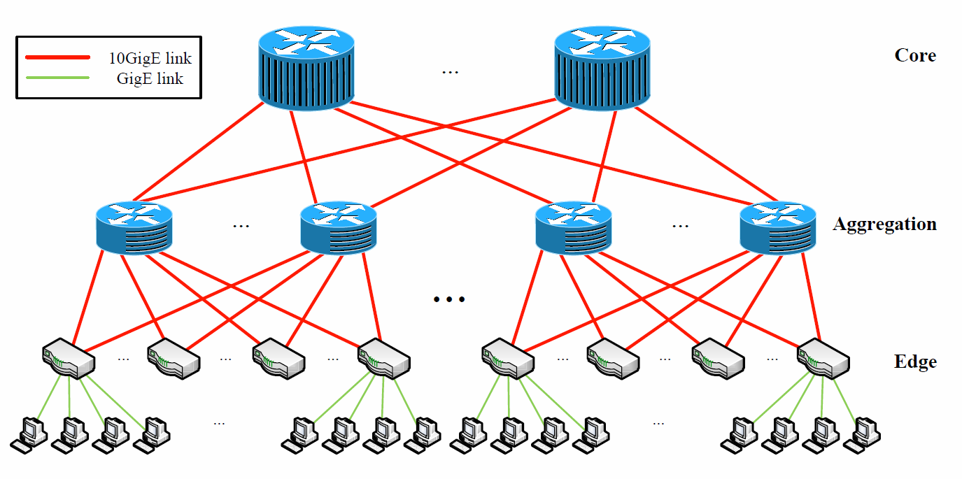
Data Center Networks Do Not Scale
ECMP Limited to 8 or 16 Root Switches
M. Al-Fares, “Multipath Load-Balancing in Large Ethernet Clusters,” UC San Diego, Dept. of Computer Science and Engineering, Research Exam, Mar 2009.

Slide 3
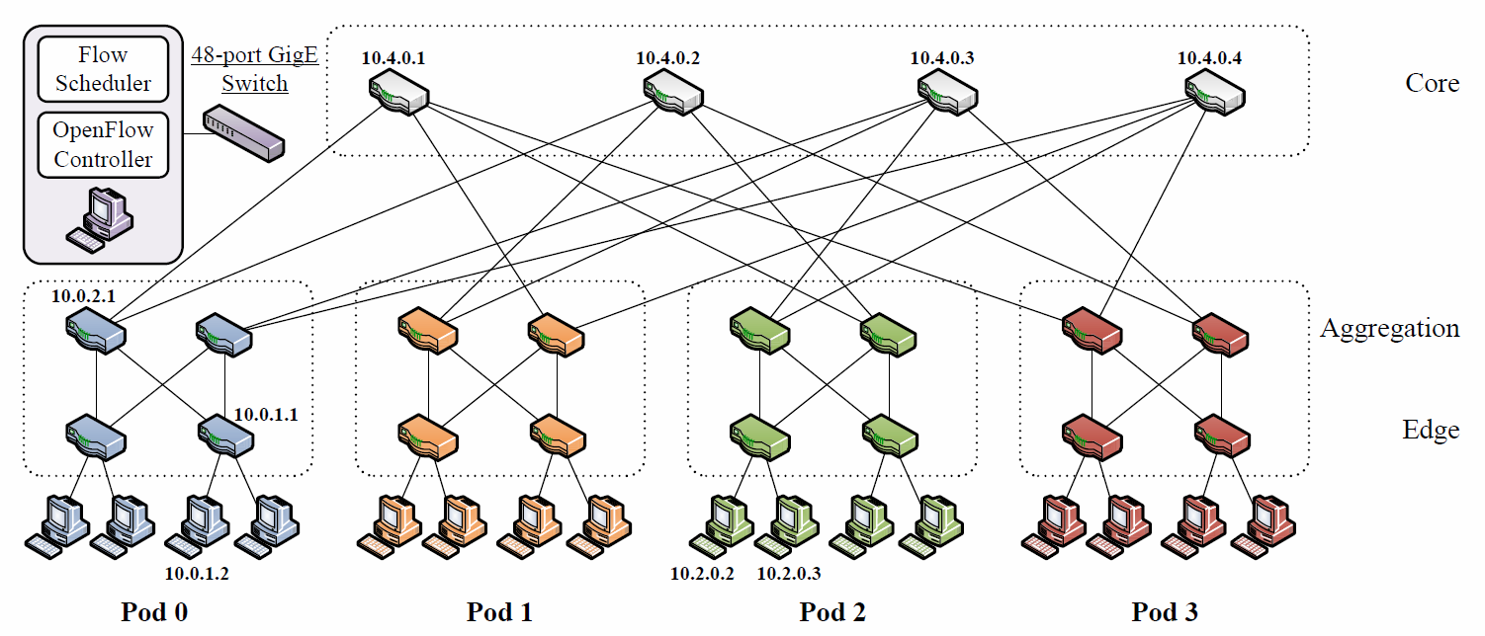
Fat-Tree Networks: Per-Flow vs. Per-Packet Load Balancing
M. Al-Fares, “Multipath Load-Balancing in Large Ethernet Clusters,” UC San Diego, Dept. of Computer Science and Engineering, Research Exam, Mar 2009.

Slide 4
A Guide to all Things Reordered
History of the World (of TCP), Part I
Enter: The Problem
Solutions … and the TCPs who use them
Proposed Experiments
Application Layer
Transport Layer
Network Layer
Link Layer
Physical Layer
You are here

Slide 5
Chapter 1 History of the World (of TCP), Part I
------------------------------------------------------------ Client connecting to 10.0.13.68, TCP port 5001 TCP window size: 8.00 KByte (default) ------------------------------------------------------------ [1924] local (your IP) port 1500 connected with 10.0.13.68 port 5001 [ ID] Interval Transfer Bandwidth [1924] 0.0-10.0 sec 50 Bytes 40 bits/sec

Slide 6
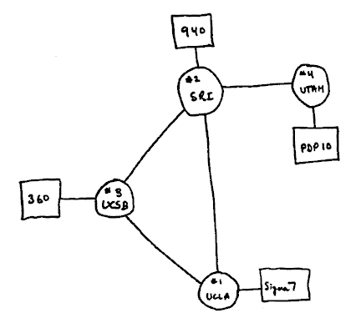
Cerfing the Internet in 1974
TCP has always had:
Segmentation and reassembly
Automatic repeat request (ARQ) for reliability
Sliding window flow control
Three-way handshake
V. Cerf and R. Kahn, “A Protocol for Packet Network Intercommunication,” IEEE Transactions on Communications, Vol. COM-22, No. 5, May 1974.

Slide 7
TCP Postel (1981) Congestion control, what’s that?
Application
Layer
RTO
SND.NXT
rwnd
SND.UNA
100101101100100
Segmenter
Flow Control
8
TCP Send Buffer
9
10
Network
Layer
11
Unacknowledged
Segment Buffer
The flow control module will not transmit more segments than the receiver can accept.
Incoming ACKs will delete entries from the unacknowledged segment buffer.
A timeout will retransmit segments in the unacknowledged segment buffer.
J. Postel, “RFC 793: Transmission Control Protocol,” Sep 1981.

Slide 8
Flow control does not help you
H1
R1
R2
H2
10 Mb/s
56 Kb/s
10 Mb/s
Options for congestion control:
Explicit congestion notification from routers to hosts
ICMP Source Quench
ECN, XCP, RCP, …
Implicit congestion notification from packet loss
TCP

Slide 9
TCP Nagle (1984)
Coined the term congestion collapse
Nagle’s Algorithm for solving the silly window syndrome: 78/79 = 98.7% waste
Experimented with ICMP Source Quench
Payload
L2
L3
L4
L2
J. Nagle, “RFC 896: Congestion Control in IP/TCP Internetworks,” Jan 1984.

Slide 10

1986: The Day the Earth Stood Still
Congestion collapse finally happened
40 b/s of throughput
Most users just gave up and tried again later (self-correcting problem)
V. Jacobson, “Congestion Avoidance and Control,” in Proceedings of the ACM SIGCOMM Conference, 1988.

Slide 11
Jacobson’s TCP (1988)
Conservation of Packets Principle
ACKs used as a clock
Slow Start
Network capacity estimation
Congestion Avoidance
Additive-increase-multiplicative-decrease
Fast Retransmit
Avoids long timeouts
Fast Recovery
Avoids slow start after fast retransmit
V. Jacobson, “Congestion Avoidance and Control,” in Proceedings of the ACM SIGCOMM Conference, 1988.

Slide 12
TCP Tahoe (1988)
Slow Start
ACK: cwnd←cwnd+1
Timeout: ssthresh←cwnd/2; cwnd←1
ssthresh←∞; cwnd←1
Timeout: ssthresh←cwnd/2; cwnd←1
3xDUPACK: ssthresh←cwnd/2; cwnd←1
cwnd ≥ ssthresh
Congestion Avoidance
ACK: cwnd← cwnd+1/cwnd
Note: Units are segments, not bytes.
V. Jacobson, “Congestion Avoidance and Control,” in Proceedings of the ACM SIGCOMM Conference, 1988.
W. Stevens, “RFC 2001: TCP Slow Start, Congestion Avoidance, Fast Retransmit, and Fast Recovery Algorithms,” Jan 1997.
M. Allman, V. Paxson, and W. Stevens, “RFC 2581: TCP Congestion Control,” Apr 1999.

Slide 13
TCP Reno (1990)
Slow Start
ACK: cwnd←cwnd+1
Timeout: ssthresh←cwnd/2; cwnd←1
ssthresh←∞; cwnd←1
Timeout: ssthresh←cwnd/2; cwnd←1
cwnd ≥ ssthresh
Congestion Avoidance
ACK: cwnd← cwnd+1/cwnd
3xDUPACK: ssthresh ← cwnd/2;
cwnd← ssthresh+3
ACK: cwnd ← ssthresh
Fast Recovery
DUPACK: cwnd← cwnd+1
Note: Units are segments, not bytes.
V. Jacobson, “Congestion Avoidance and Control,” in Proceedings of the ACM SIGCOMM Conference, 1988.
W. Stevens, “RFC 2001: TCP Slow Start, Congestion Avoidance, Fast Retransmit, and Fast Recovery Algorithms,” Jan 1997.
M. Allman, V. Paxson, and W. Stevens, “RFC 2581: TCP Congestion Control,” Apr 1999.

Slide 14
Jacobson Designed Congestion Control for this Network:
H1
R1
R2
H2
10 Mb/s
56 Kb/s
10 Mb/s
Assumptions:
Packet corruption is rare (wired links)
Packet reordering is rare (all packets follow same path)
Wireless links violate assumption 1.
Multipath routing violates assumption 2.

Slide 15
Chapter 2 Enter: The Problem

Slide 16
How Common is Packet Reordering?
 | Year | Common? | Discussion
Mogul | 1992 | No | Single server; 4.3% of flows; power law
Paxson | 1997 | Sort of | 35 servers; 20,000 flows; 36% of flows; 2% of data segments (0.6% of ACKs); site dependent; correlated with route fluttering; 4.3% of retransmissions were spurious
Bennett+ | 1999 | Yes | Single router; 90% of “flows”; ICMP ping bursts; correlated with router load
Iannaccone+ | 2001 | No | Single router; 5% of flows; 2% of segments; 40% of retransmissions were spurious
Reordering on the Internet is not common, but also not rare.
Some flows experience lower throughput.
Internet tries hard not to reorder packets; fat-tree would be a worst case.
J. Mogul, “Observing TCP Dynamics in Real Networks,” in Proceedings of SIGCOMM, 1992.
V. Paxson, “End-to-End Internet Path Dynamics,” in IEEE/ACM Transactions on Networking, 7(3): 277-292, Jun 1999.
J. Bennett, C. Partridge, N. Shectman, “Packet Reordering is Not Pathological Network Behavior,” in IEEE/ACM Trans. on Net., 7(6): 789-798, Dec 1999.
G. Iannaccone, S. Jaiswal, C. Diot, “Packet Reordering Inside the Sprint Backbone,” in Sprint ATL, Technical Report TR01-ATL-062917, 2001.

Slide 17
Why do Packets get Reordered?
Mogul: “multiple paths through the Internet”
Paxson: “route flapping”, “router updates”
Bennett+: “internal and external router parallelism”
J. Mogul, “Observing TCP Dynamics in Real Networks,” in Proceedings of SIGCOMM, 1992.
V. Paxson, “End-to-End Internet Path Dynamics,” in IEEE/ACM Transactions on Networking, 7(3): 277-292, Jun 1999.
J. Bennett, C. Partridge, N. Shectman, “Packet Reordering is Not Pathological Network Behavior,” in IEEE/ACM Trans. on Net., 7(6): 789-798, Dec 1999.

Slide 18
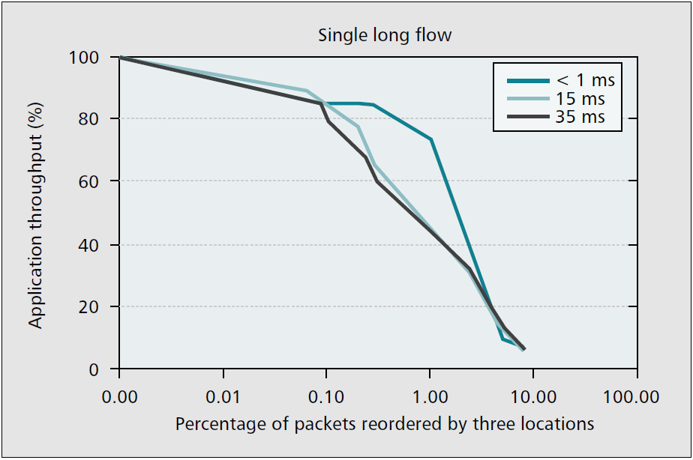
How does TCP Respond to Reordering? *Answer is upside down.
*poorly
M. Laor and L. Gendel, “The Effect of Packet Reordering in a Backbone Link on Application Throughput,” IEEE Network, Sep/Oct 2002.
Notes:
Smaller pipes are more robust to packet reordering since its does not take as long to recover from a non-congestion event.

Slide 19
Fundamental Tradeoff?
Detecting Loss Early vs. Tolerating Packet Reordering
Can you have both?
How long should a sender wait?
Loss implies congestion, what about packet reordering?

Slide 20
Chapter 3 Solutions … and the TCPs who use them

Slide 21
Overview of Solutions
Receive
DUPACK #3 /
Trigger Fast
Retransmit
Receive
DUPACK #1
Receive
DUPACK #2
Enter Fast
Recovery
Receive ACK
time
1
2,3
4
Solve at lower layer: hide DUPACKs from TCP
Dynamically adjust number of DUPACKs required to trigger Fast Retransmit
Retransmit, but delay entering Fast Recovery
Detect when a retransmission was spurious and restore the congestion window
Note: timeline is not to scale

Slide 22
Solution 1: Solve at a Lower Layer
Pros:
Does not require changes to TCP.
Abstracts away the problem of packet reordering.
Cons:
Might cause adverse effects for certain TCP implementations.
Duplicating functionality.
Transport Layer
Transport Layer
Reorder Buffer
Reorder Buffer
Network Layer
Network Layer
Link Layer
Link Layer
Physical Layer
Physical Layer

Slide 23
Solution 2: Dynamically Adjust dupthresh
What is the correct number of DUPACKs to invoke fast retransmit?
Jacobson: 3
Paxson: 3 works pretty well
What criteria should be used to increment and decrement dupthresh?
After a spurious retransmission…
Constant increment
Function of amount of reordering
Exponentially weighted moving average
E. Blanton, M. Allman, “On Making TCP More Robust to Packet Reordering,” ACM SIGCOMM Computer Communication Review, Jan 2002.

Slide 24
Solution 3: Retransmit, but Delay Entering Fast Recovery
How long should a sender wait after receiving 3 DUPACKs before invoking congestion control?
RTO = RTT + 4 * var(RTT)
Answer: 1 RTT?
S. Bhandarkar, et al., “TCP-DCR: A Novel Protocol for Tolerating Wireless Channel Errors,” IEEE Transactions on Mobile Computing, 4(5), Sep/Oct 2005.

Slide 25
Solution 4: Detect and Recover from a Spurious Retransmission
Detecting a spurious retransmission
ACK timing
TCP timestamps
DSACK
Recovering from a spurious retransmission
Restore cwnd and ssthresh
Alternatively, ignore DUPACKs
Measure the instantaneous ACK bandwidth
Time each transmitted segment
E. Blanton, M. Allman, “On Making TCP More Robust to Packet Reordering,” ACM SIGCOMM Computer Communication Review, Jan 2002.

Slide 26
Meet the TCPs
Name | Year | S1 | S2 | S3 | S4 | Extends | Notes
TCP Eifel | 2000 |  |  |  | ✓ | TCP Reno | Timestamps
TCP-LPC | 2002 |  | ✓ | ✓ |  | TCP Reno | Sender+receiver
TCP Westwood | 2002 |  |  |  | ✓ | TCP Reno | Wireless; ACK bandwidth
TCP-BA | 2002 |  | ✓ | ✓ | ✓ | TCP Eifel, TCP SACK | DSACK; inc. dupthresh
RR-TCP | 2003 |  | ✓ |  | ✓ | TCP-BA | Dec. dupthresh
TCP-PR | 2003 |  |  |  | ✓ | TCP Reno | Time each segment
TCP-DCR | 2004 |  |  | ✓ |  | TCP SACK | Wireless; wait 1 RTT
TCP-NCR | 2006 |  | ✓ |  |  | TCP-BA, RR-TCP, TCP-DCR | Entire cwnd of DUPACKs
TCP/NC | 2009 | ✓ |  |  |  | TCP Vegas | Wireless; net. coding
Denotes a particularly interesting contribution.

Slide 27
TCP/NC (Network Coding)
New “Layer 3.5” Coding Layer
Mixes TCP segments that TCP has transmitted
Erasure coding; fountain code
Receiver ACKs every mixed segment
Adds delay to the connection
Eliminates reordering problem
Transforms ordered sequence into unordered set
Completely ignores congestion control
J.K. Sundararajan, D. Shah, M. Médard, M. Mitzenmacher, J. Barros, “Network Coding meets TCP,” in IEEE INFOCOM, Apr 2009.

Slide 28
TCP Eifel (2000)
Restores cwnd and ssthresh after a spurious fast retransmit
Uses TCP timestamps for detection

Slide 29
TCP-NCR (2006)
Restores cwnd and ssthresh after a spurious fast retransmit
Uses DSACK for detection
Dynamically increases dupthresh
Restores dupthresh to 3 after a timeout

Slide 30
RR-TCP (2003)
Restores cwnd and ssthresh after a spurious fast retransmit
Uses DSACK for detection
Dynamically increases dupthresh
Dynamically decreases dupthresh

Slide 31
TCP Westwood (2002)
Sender uses ACKs to estimate bandwidth
“Faster Recovery”
Reduce cwnd and ssthresh in proportion to the estimated bandwidth, not by factor of 2
Simulation shows good performance for multipath
Probably not as good as RR-TCP
S. Mascolo, C. Casetti, M. Gerla, M. Y. Sanadidi, R. Wang, “TCP Westwood: Bandwidth Estimation for Enhanced Transport over Wireless Links,” in Proceedings of MOBICOM, Jul 2001.
M. Gerla, S. S. Lee, G. Pau, “TCP Westwood Simulation Studies in Multiple-Path Cases,” in Proceedings of SPECTS, Jul 2002.

Slide 32
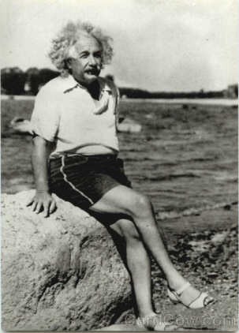
Chapter 4 Proposed Experiments
A theory is something nobody believes, except for the person who made it.
An experiment is something everybody believes, except for the person who made it.

Slide 33
Experiment #1
Conduct a literature search of per-packet load balancing.
Implement per-packet load balancing on our 16-node fat-tree FPGA network.
Least loaded port
Least used port
Random
Which per-packet scheduling algorithm has better load balancing properties?
Which is more fair?
How many resources does each one require?

Slide 34
Experiment #2
Using our testbed, run MapReduce with the 10 different TCP variants included in the Linux kernel.
Which performs the best for each of the per-packet scheduling algorithms?
What are the resource requirements of each TCP variant?
What features account for the relative good or bad performance of a given variant?

Slide 35
Experiment #3
Using one of these variants, implement the 4 different categories of solutions with parameters.
Which combination of solutions and parameters yield the best performance?
Is it possible to implement TCP Awesome, a TCP that performs well in the data center, over wireless networks, and over the Internet?

Slide 36
Experiment #4
[VPS+09] show that reducing RTO_{min} from 200 ms to 200 μs prevents a problem known as incast.
Is it possible that this could also solve the reordering problem?
V. Vasudevan, A. Phanishayee, H. Shah, E. Krevat, D. Anderson, G. Ganger, G. Gibson, “A (In)Cast of Thousands: Scaling Datacenter TCP to Kiloservers and Gigabits,” Carnegie Mellon University, Tech Report CMU-PDL-09-101, Feb 2009.

Slide 37
Experiment #5
[VPS+09] mention that delayed ACKs cause problems in data center networks.
Repeat the experiments above both with and without delayed ACKs.
V. Vasudevan, A. Phanishayee, H. Shah, E. Krevat, D. Anderson, G. Ganger, G. Gibson, “A (In)Cast of Thousands: Scaling Datacenter TCP to Kiloservers and Gigabits,” Carnegie Mellon University, Tech Report CMU-PDL-09-101, Feb 2009.

Slide 38
Conclusion
TCP is ideal for data center networks
Single administrative domain
Hardware is about 16,000 times faster than 1988; it’s time to redo TCP for the data center
Hardware solution may not be necessary
Need to evaluate impact on non-TCP traffic and on Internet traffic

