Slide 1





Hardware Requirements for Optical Circuit Switched Data Center Networks
OFC/NFOEC 2011
Nathan Farrington¹
Yeshaiahu Fainman¹
Hong Liu²
George Papen¹
Amin Vahdat^{1,2}
UCSD¹
Google²

Slide 2
In a Nutshell
Problem: Data center network bandwidth is very expensive (10G: 12.5W/port, $500+/port)
Helios Solution: Use both traditional EPS + 3D MEMS OCS … best of both worlds
New Problem: Network performance is worse
This Talk: Figuring out which hardware components need to be replaced in order to get better performance

Slide 3
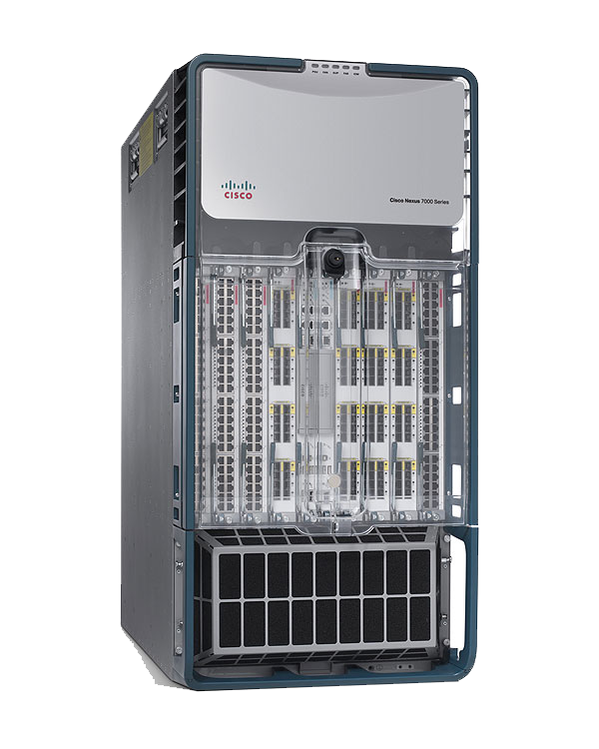
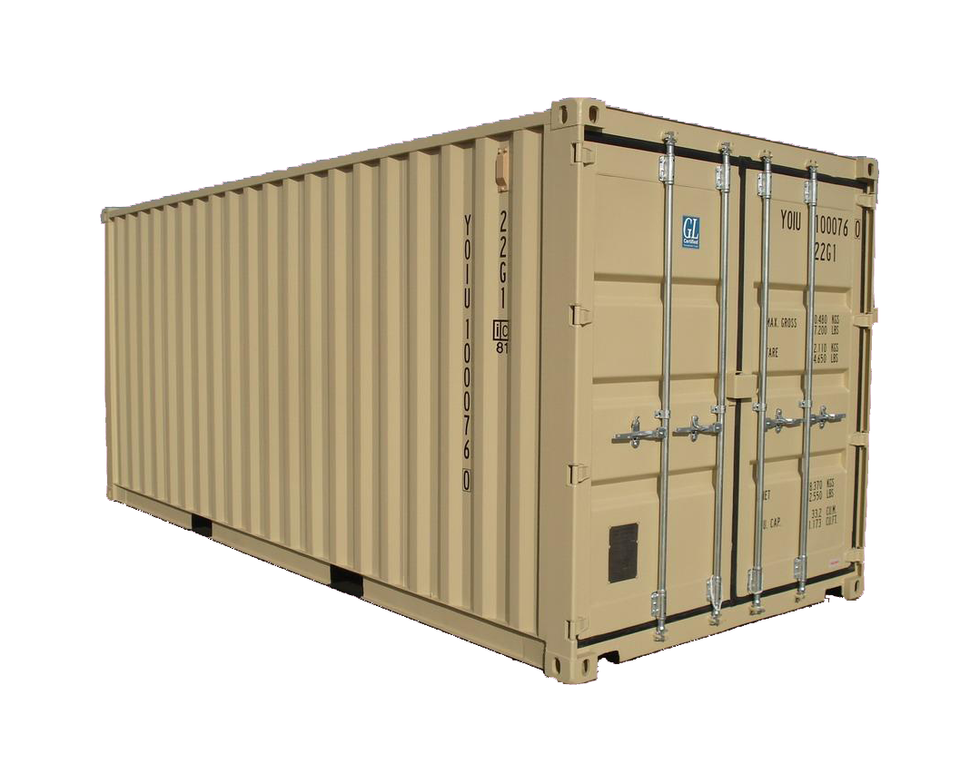
k switches, N-ports each
N pods, k-ports each
Example: N=64 pods * k=1024 hosts/pod = 64K hosts total; 8 wavelengths
Bisection Bandwidth | 10% Electrical (10:1 Oversubscribed) | 100% Electrical | Helios Example 10% Electrical + 90% Optical
Cost | $6.3 M
Power | 96.5 kW
Cables | 6,656
Notes:
Start out by connecting all of the pod switches to a single core packet switch.
Additional core packet switches can be added as needed.
Running example of a 64K-host data center, partitioned into 64 pods of 1,024 hosts each.
Allocating for just the baseline will lead to bottlenecks for communication-intensive applications.
1024 = 104 + 920
Packet Switch Port: $500 (12.5W)
Circuit Switch Port: $500 (0.24W)
Transceiver (w < 8): $200 (1W)
Fiber: $50
920 / 8 = 115
Cost 10% Static: cost(trans) + cost(ports) + cost(fiber) = 104*64*$400 + 104*64*$500 + 104*64*$50 = $6,323,200
Cost 100% Static: cost(trans) + cost(ports) + cost(fiber) = 1024*64*$400 + 1024*64*$500 + 1024*64*$50 = $62,259,200
Cost Helios: cost(trans) + cost(ports) + cost(fiber) = 1024*64*$200 + 104*64*$200 + (104*64+115*64)*$500 + (104*64+115*64)*$50 = $22,147,200
Power 10% Static: 104*64*(12.5W+2W) = 96,512 W
Power 100% Static: 1024*64*(12.5W+2W) = 950,272 W
Power Helios: 1024*64*1W + 104*64*(12.5W+1W) + 115*64*(0.24W) = 157,158 W
Cables 10% Static: 104 * 64 = 6,656
Cables 100% Static: 1024 * 64 = 65,536
Cables Helios: 6,656 + 115 * 64 = 7,360 = 14,016

Slide 4
k switches, N-ports each
N pods, k-ports each
Example: N=64 pods * k=1024 hosts/pod = 64K hosts total; 8 wavelengths
Bisection Bandwidth | 10% Electrical (10:1 Oversubscribed) | 100% Electrical | Helios Example 10% Electrical + 90% Optical
Cost | $6.3 M | $62.3 M
Power | 96.5 kW | 950.3 kW
Cables | 6,656 | 65,536
Notes:
1. 100% bisection bandwidth can be achieved for any traffic pattern, but at significant cost, power, and cabling complexity.

Slide 5
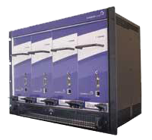
Less than k switches, N-ports each
Fewer Core
Switches
N pods, k-ports each
Example: N=64 pods * k=1024 hosts/pod = 64K hosts total; 8 wavelengths
Bisection Bandwidth | 10% Electrical (10:1 Oversubscribed) | 100% Electrical | Helios Example 10% Electrical + 90% Optical
Cost | $6.3 M | $62.2 M | $22.1 M | 2.8x Less
Power | 96.5 kW | 950.3 kW | 157.2 kW | 6.0x Less
Cables | 6,656 | 65,536 | 14,016 | 4.7x Less
Notes:
1. Optical circuit switches are used for smooth traffic.
2. Electrical packet switches are used for bursty traffic.
3. Aggregating thousands of nodes into pods helps smooth the traffic, and makes optical circuit switching more cost effective.
4. In the best case, the Helios example will have the same performance as the 100% Electrical example.
5. In the worst case, the Helios example will have the same performance as the 10% Electrical example.

Slide 6
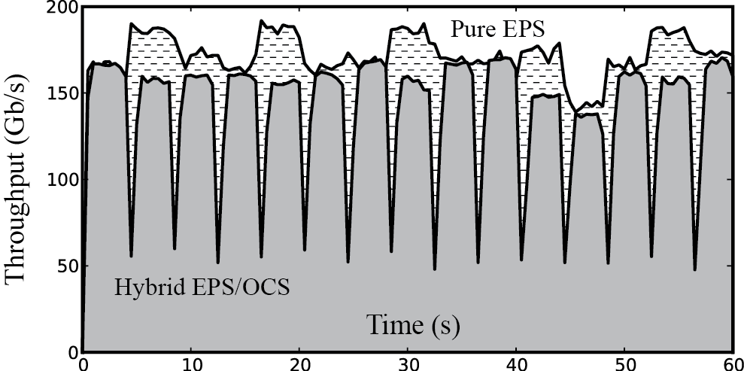
How can we close the gaps?
In this experiment, performance is 20% worse.

Slide 7
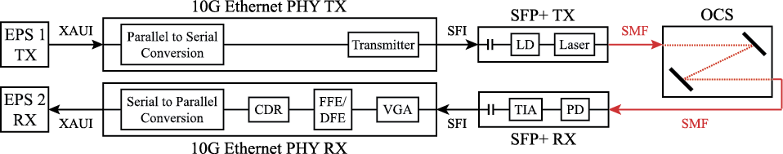
The life of a bit
17ms
15ms
CDR: Clock/Data Recovery
DFE: Decision Feedback Equalizer
EPS: Electronic Packet Switch
FFE: Feed-Forward Equalizer
LD: Laser Driver
OCS: Optical Circuit Switch
PD: Photodetector
PHY: Physical Layer Device
SFI: SFP+ Electrical Interface
SFP+: A 10G Transceiver Form Factor
SMF: Single-mode Fiber
TIA: Transimpedance Amplifier
VGA: Variable Gain Amplifier
XAUI: 10G Ethernet Attachment Unit Interface

Slide 8
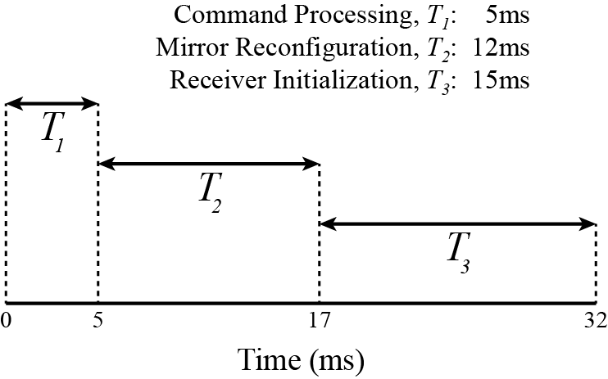

Slide 9
T₁: Command Processing
Embedded Linux microprocessor
TL1 session over TCP (ASCII)
5ms per packet
Old
New!
FPGA
UDP (binary)
10μs per packet

Slide 10
T₂: Mirror Reconfiguration
Glimmerglass 2004 device
Not optimized for this application
12ms average
Old
New!
More power
Smaller mirrors
100μs to 1ms

Slide 11
T₃: Receiver Initialization
NetLogic AEL2005 PHY
Not optimized for LOS
FFE/DFE: 600ms; VGA: 15ms
Old
New!
No EDC (we are using SMF)
Burst-mode TIA from 10G EPONs
200ns to 2μs

Slide 12
200ns – 2μs
7500x – 75,000x
10μs
50x
100μs – 1ms
17x – 170x

Slide 13
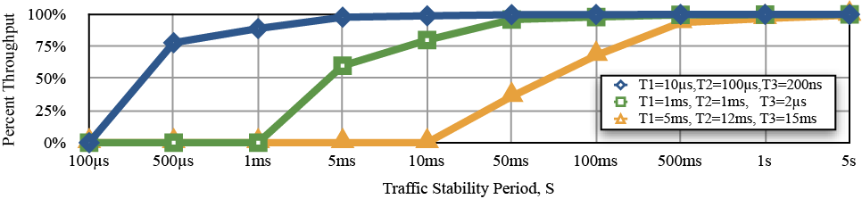
Definition of “better performance”: high throughput for quickly changing network traffic
5MB
50MB
500MB
5GB

Slide 14
Related Work
N. Farrington, G. Porter, S. Radhakrishnan, H. Bazzaz, V. Subramanya, Y. Fainman, G. Papen, A. Vahdat. “Helios: A Hybrid Electrical/Optical Switch Architecture for Modular Data Centers.” In ACM SIGCOMM 2010.
L. Schares, X.J. Zhang, R. Wagle, D. Rajan, P. Selo, S.P. Chang, J. Giles, K. Hildrum, D. Kuchta, J. Wolf, E. Schenfeld. “A reconfigurable interconnect fabric with optical circuit switch and software optimizer for stream computing systems.” In OFC/NFOEC 2009, paper OTuA1.

Slide 15
Contact Information
Mr. Nathan Farrington
PhD Candidate
University of California, San Diego
Department of Computer Science and Engineering
9500 Gilman Drive, M/C 0404
La Jolla, CA 92093-0404
USA
email: farrington@cs.ucsd.edu
Phone: 1-619-316-4302
Website: http://NathanFarrington.com

