Slide 1
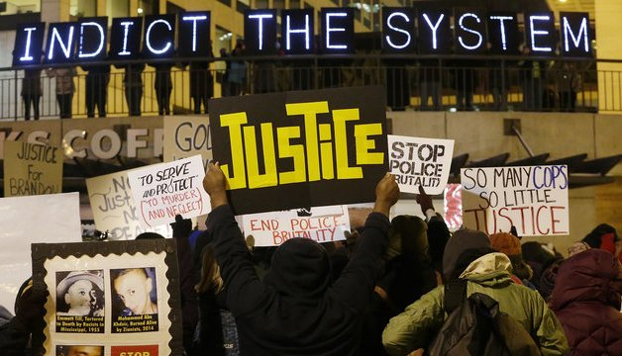
Statistical Analysis of Fatal Police Shootings in the United States

Slide 2
Project Description
Our project aims at finding insights about the fatal police shootings in the United States of America, which is consistently on the rise in the recent years.
Each dataset is categorized by various factors including the race of the deceased, the circumstances of the shooting, whether the person was armed and whether the person was experiencing a mental-health crisis etc.

Slide 3
Sample Data

Slide 4
Visualization
https://public.tableau.com/profile/vivekraj.yuvaraj#!/vizhome/PolicekillingViz/Dashboard1?publish=yes

Slide 5

Which race does most of the victims fall under? Does armament status influence the shootings?

Slide 6
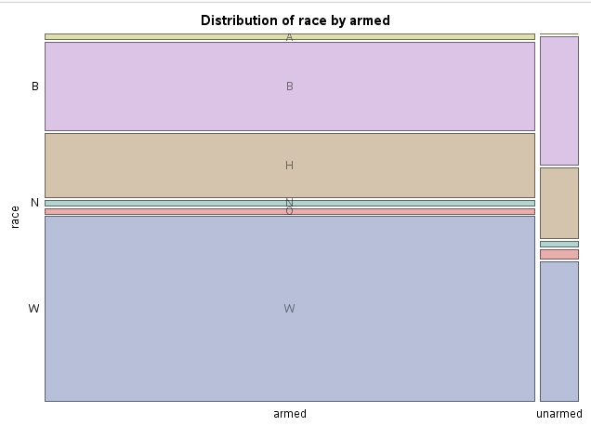
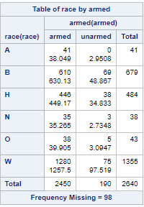
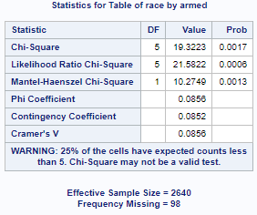
Table Analysis
Variables: Race, Armed

Slide 7
93% of the victims killed were armed and half of them were White Americans.

Slide 8
#2
Are people with mental illness more prone to get killed?
Does age & gender influence mental illness?

Slide 9
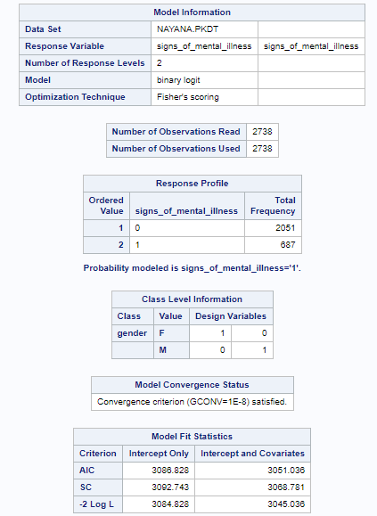
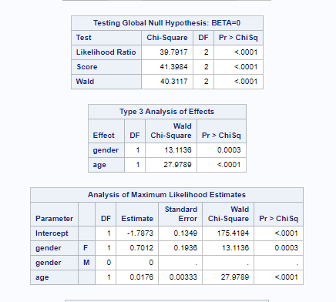
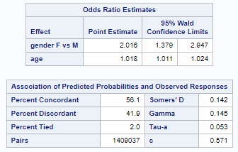
Binary Logistic Regression
Variables: Signs of Mental Illness, Age, Gender

Slide 10
Signs of Mental Illness shown by victims are increasing with respect to their age.
Female victims are observed to have higher rate of mental Illness than Male victims.

Slide 11
Does the Age, mental illness of victims and armed status of the victims have impact on Threat Level?
#3

Slide 12
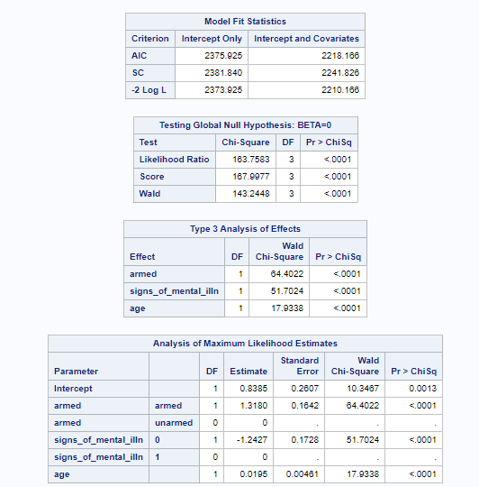
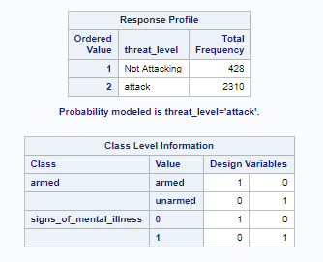
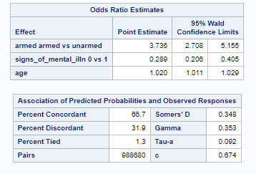
Binary Logistic Regression
Variables: Threat_level, Armed, Signs of Mental Illness, Age,

Slide 13
Threat level increases with victims having Mental Illness in the crime scene.
Threat level is observed to increase with the Victims age.
Threat Level increases if the victims are armed

Slide 14
Does the economic status of an individual affect the fatal rate?
#4

Slide 15
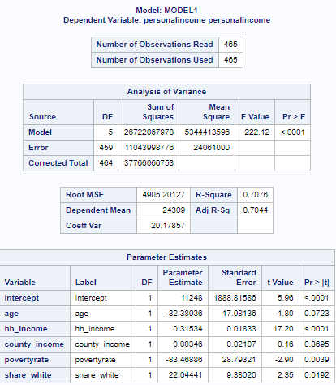
Linear Regression
Variables:
Personal Income,
Age, hh_income, county_income, povertyrate, share_white

Slide 16
Victims with high personal income come from the households with more number of White Americans and belong to rich households.
Victims with lower personal income belong to the poor households having high poverty rate.

Slide 17
Does the relationship between Unemployment and college education moderated by Poverty rate?
#5

Slide 18
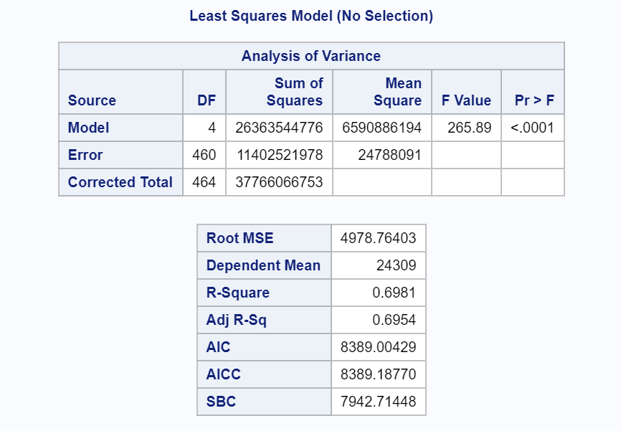
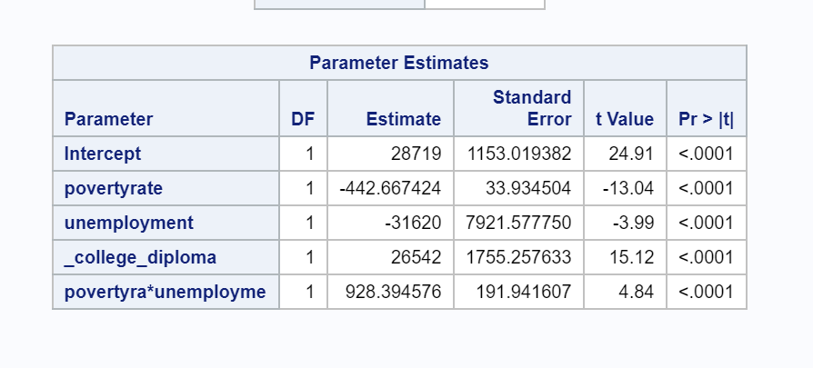
Linear Regression
Variables:
Personal Income
Poverty Rate, Unemployment, College Diploma

Slide 19
Poverty rate, Unemployment and College education factors have impact on personal income of the victims.
The relationship between Unemployment and personal income is observed to be moderated by poverty rate.

Slide 20
Is Unemployment status largely observed in a particular race ? Does the educational background influence the unemployment rate?
#6

Slide 21
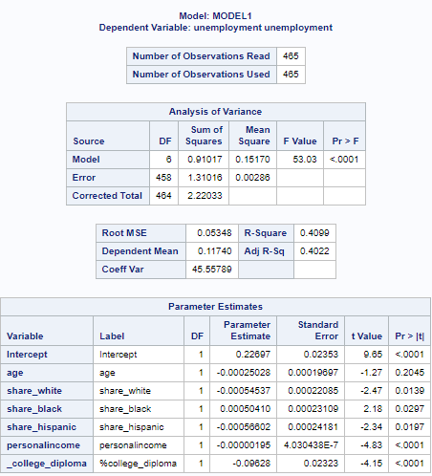
Unemployment affects the economic status of an individual

Slide 22
Victims being unemployed are high, if they belong to households with more number of African American population.
Victims being unemployed are high, if they belong to households with low rate college diploma.

Slide 23
Does the socio-economic status among the two most predominant races have any significance between them?
#7

Slide 24
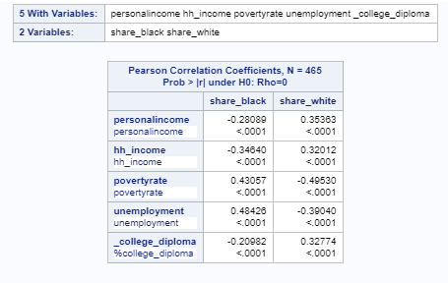
Correlation Analysis If the Share of African Americans and White Americans population in the household suspects belong to, have any correlation with their personal income, household income, poverty rate, unemployment rate and college diploma rate.

Slide 25
Suspects coming from households with more number of African Americans
Have lower personal income
Less educated
Belong to households, with lower household income
Belong to tract with high poverty rate and unemployment rate
Suspects coming from households with more number of White Americans
Have high personal income
Well educated and have college degree.
Belong to households, with higher household income
Belong to tract with low poverty rate and unemployment rate

Slide 26
How the victim population is segregated across the communities based on their ethnicity?
#8

Slide 27
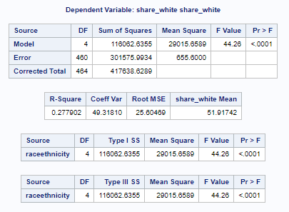
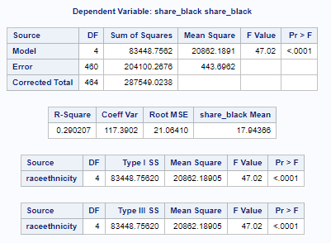
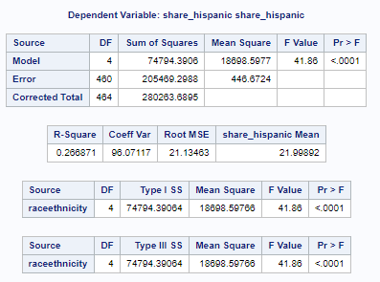
One way Anova Variables: Share_white, share _black, share_hispanic, Race Ethnicity of the victims

Slide 28
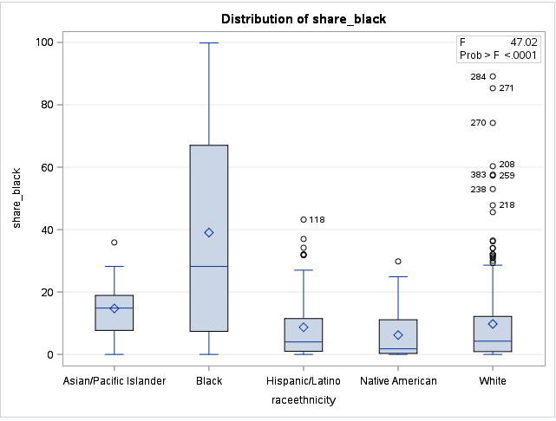
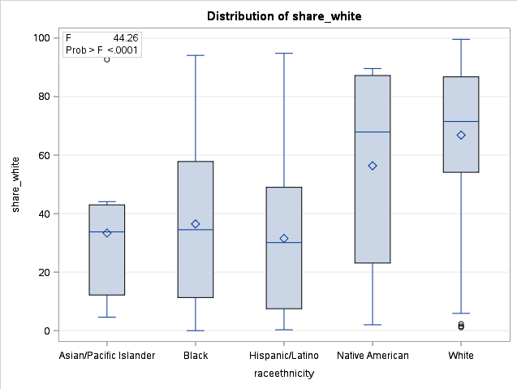
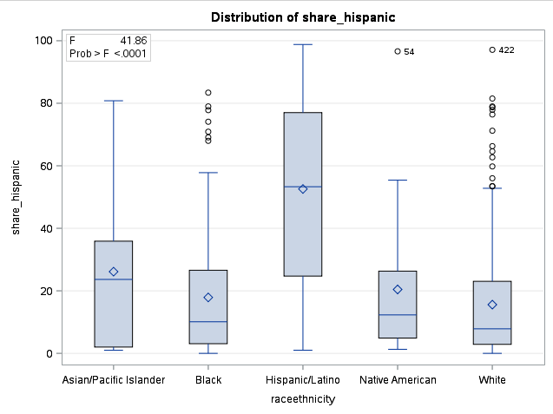

Slide 29
Race of the victims and the household they live, have the same ethnic population.
Share of a particular ethnic population in a household is observed high and is same as the race of the victim.

Slide 30
Does the victim fleeing the scene are armed and considered as a threat?
#9

Slide 31
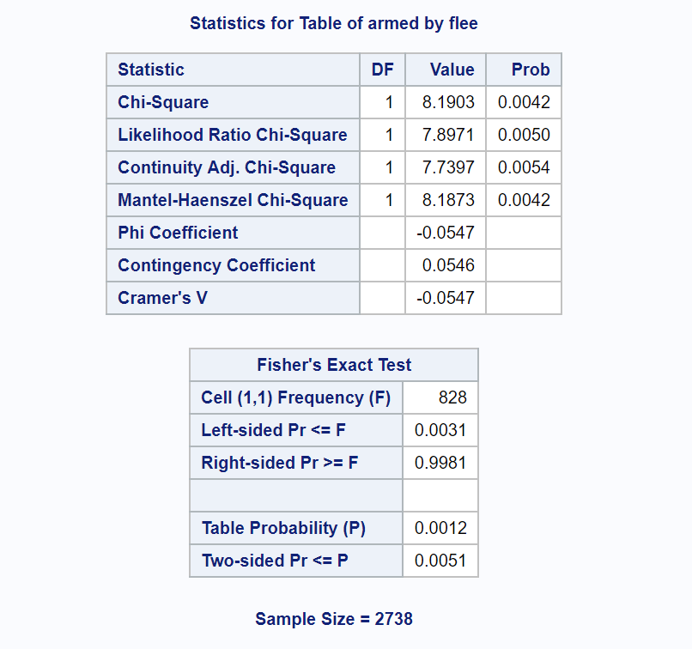
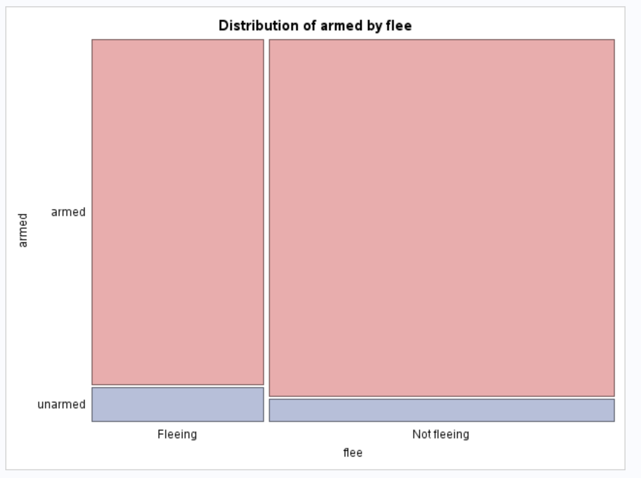
Table Analysis: Armed and Flee

Slide 32
People who are not fleeing from the spot were more likely to be armed.

Slide 33
Does the economic disadvantage in low income counties influence the fatal rates?
#10

Slide 34
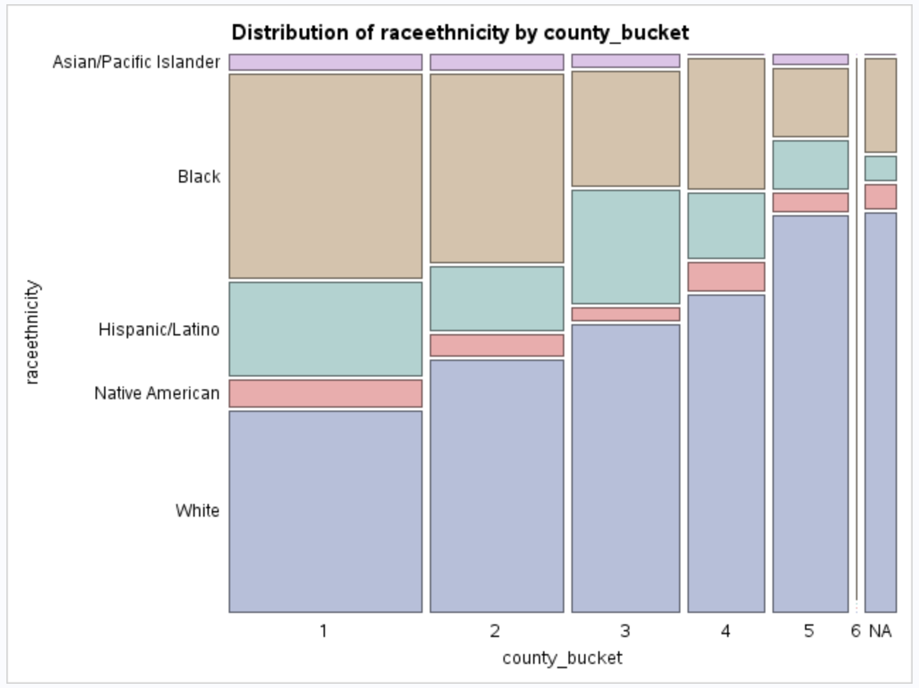
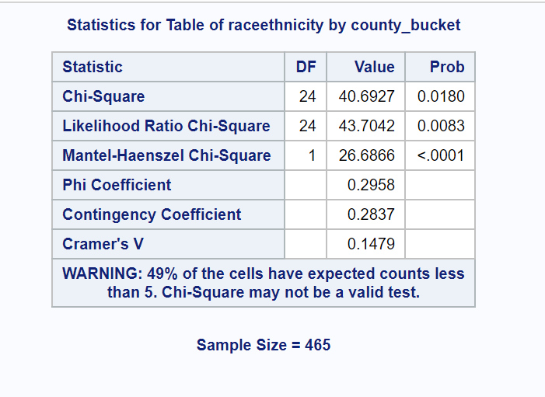
Table Analysis: Race ethnicity vs County Bucket

Slide 35
Among all the races number of African Americans killed fall under the low income county bucket.
Number of white Americans killed are higher than all other races

Slide 36


