Slide 1
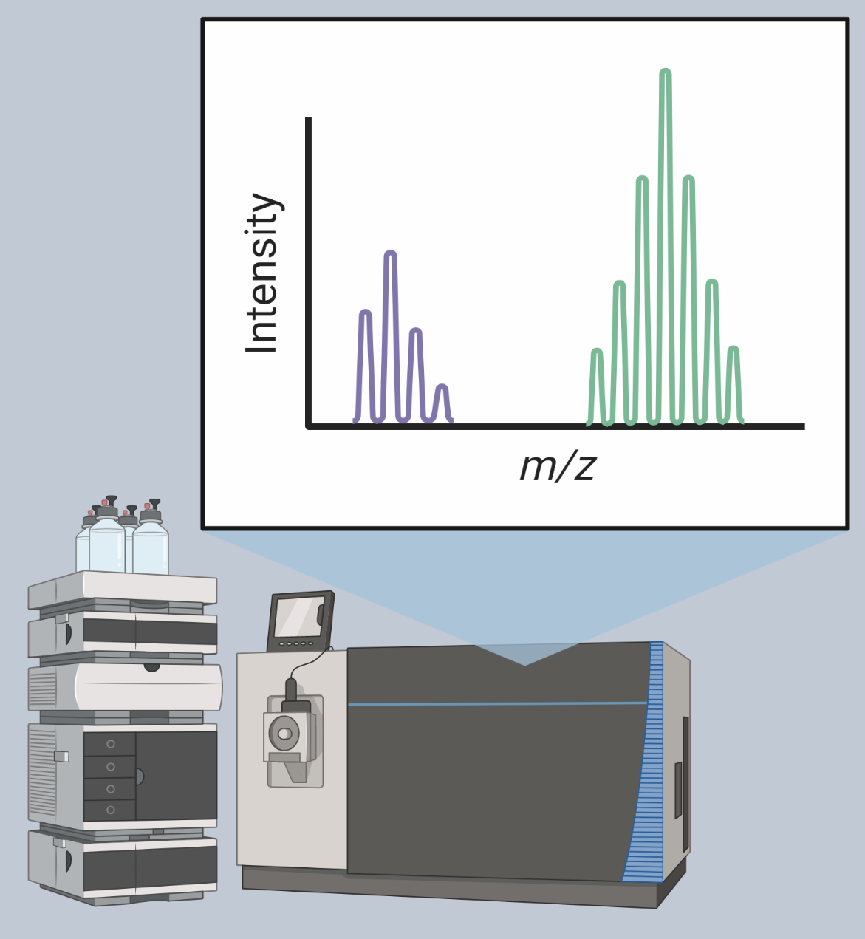
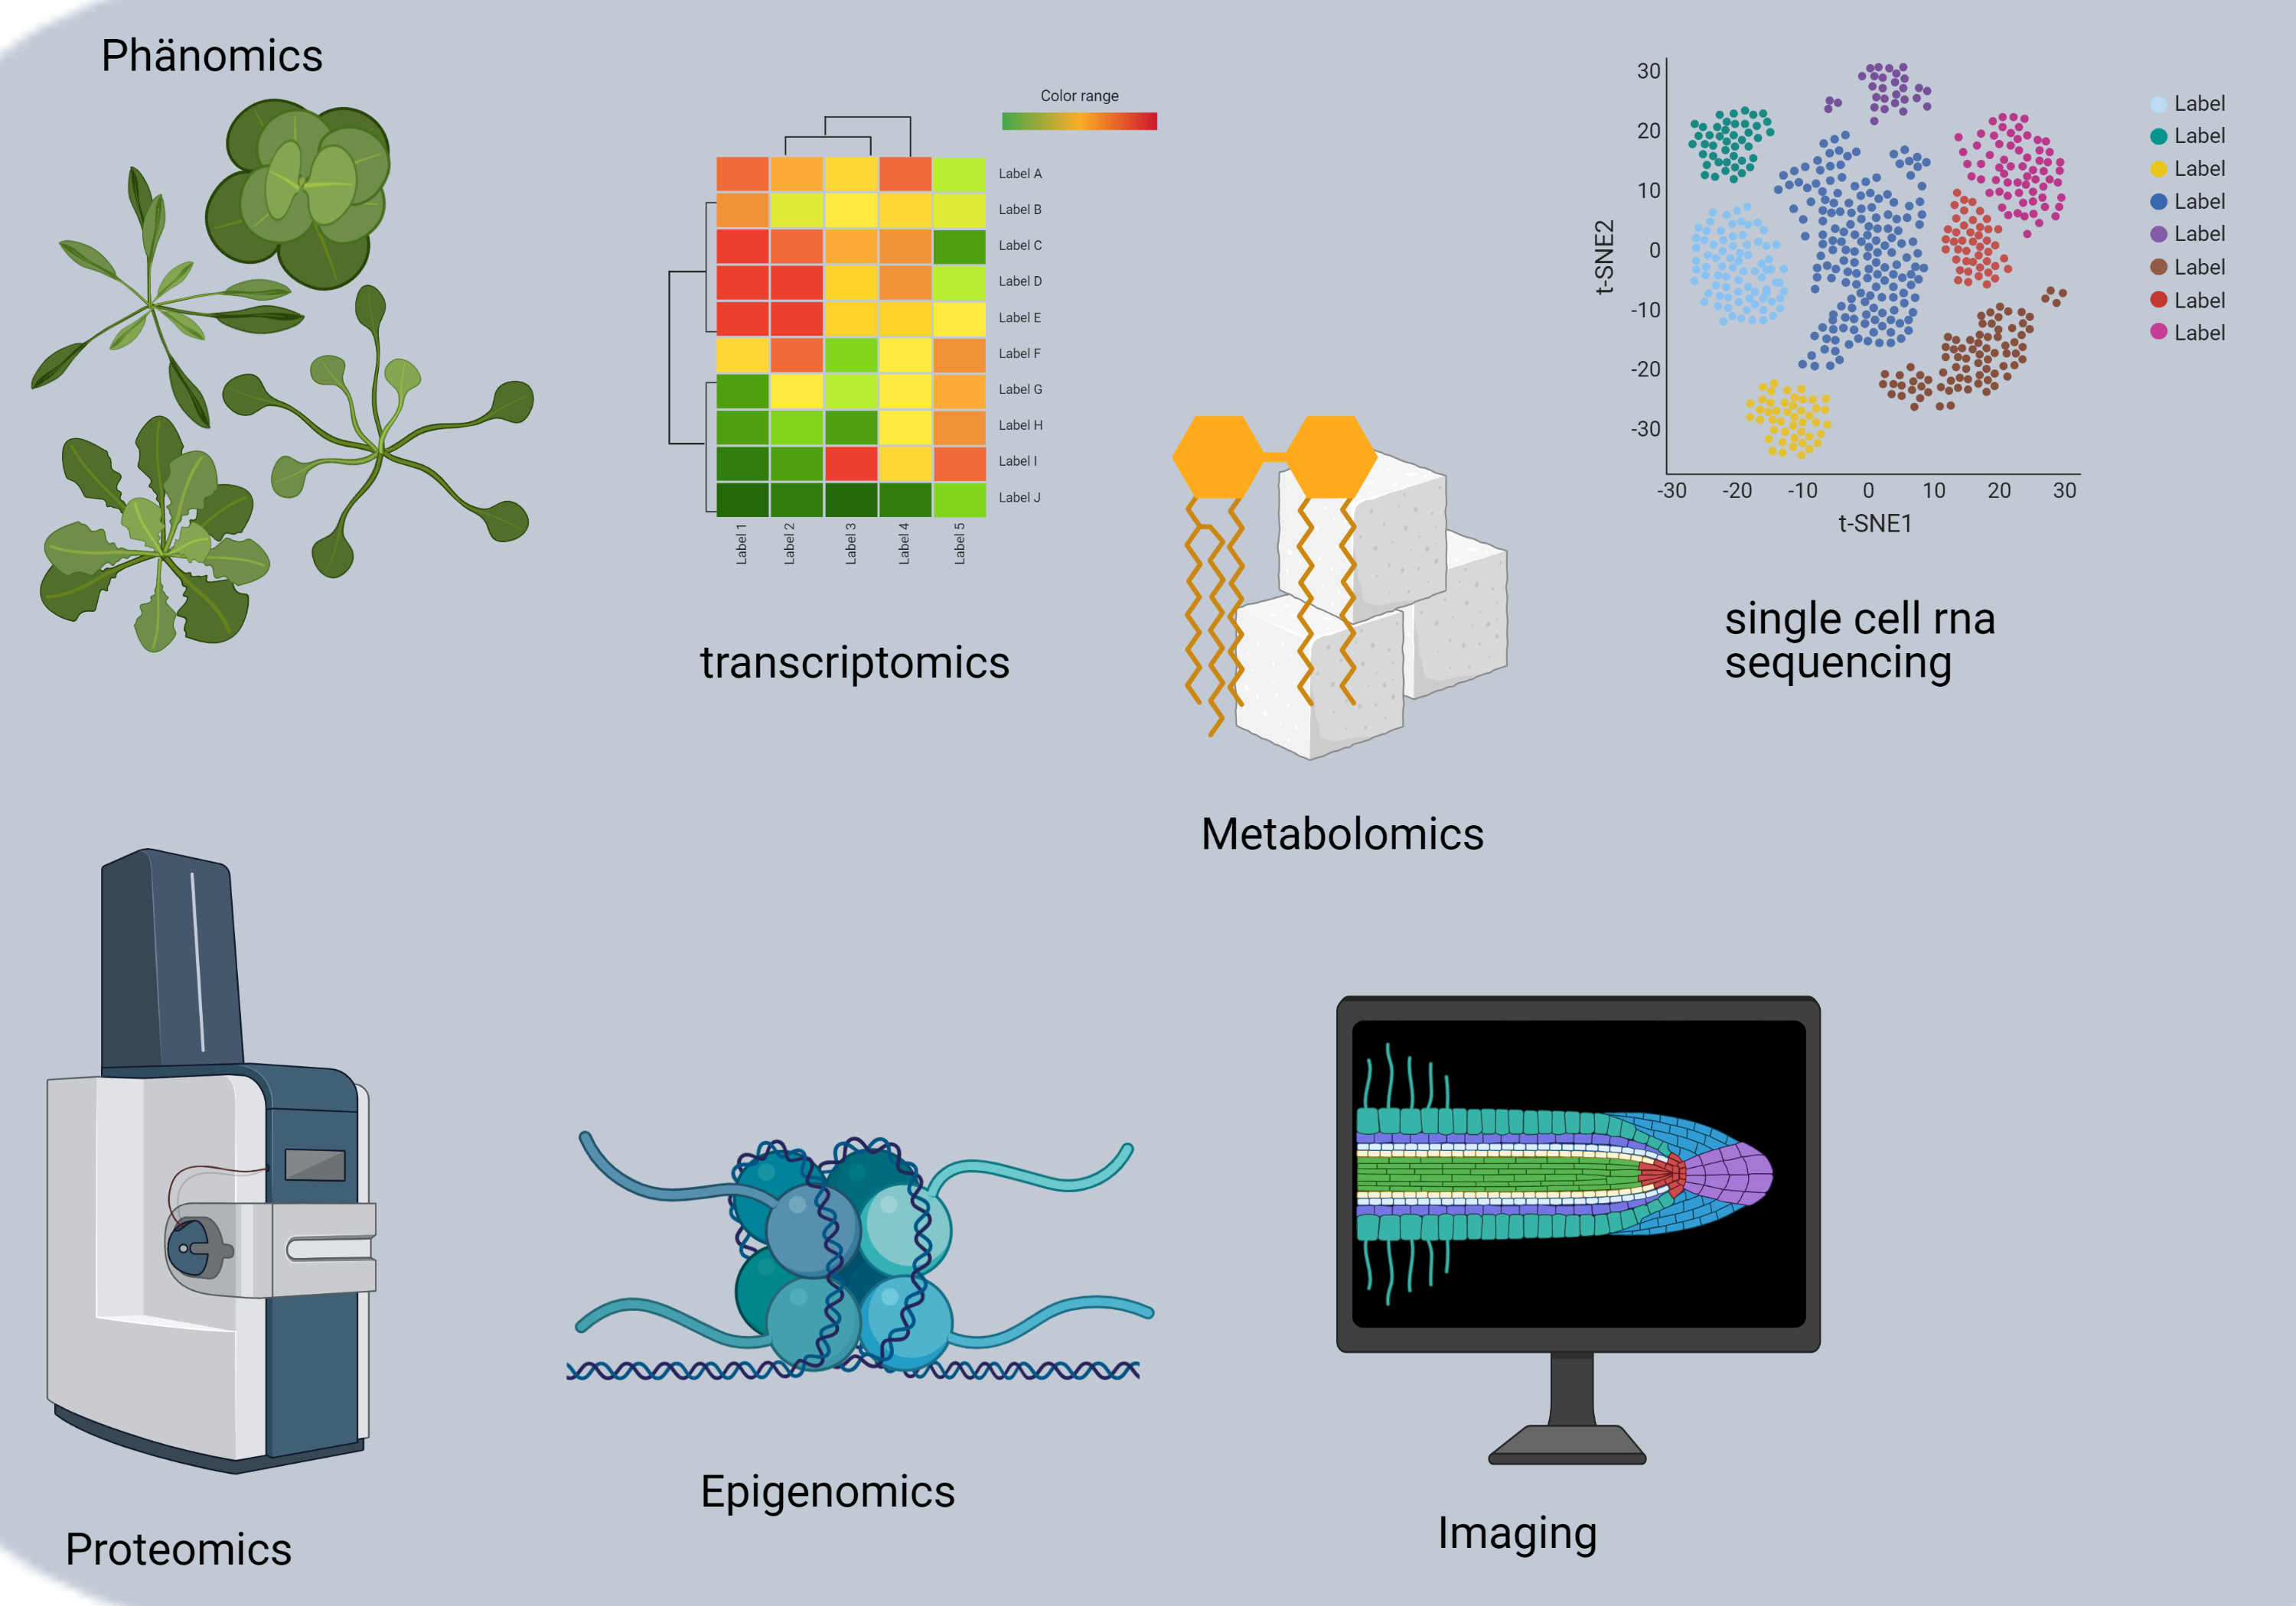
protemoics
transcriptomics
phenomics
imaging
metabolomics
epigenomics

