Slide 1


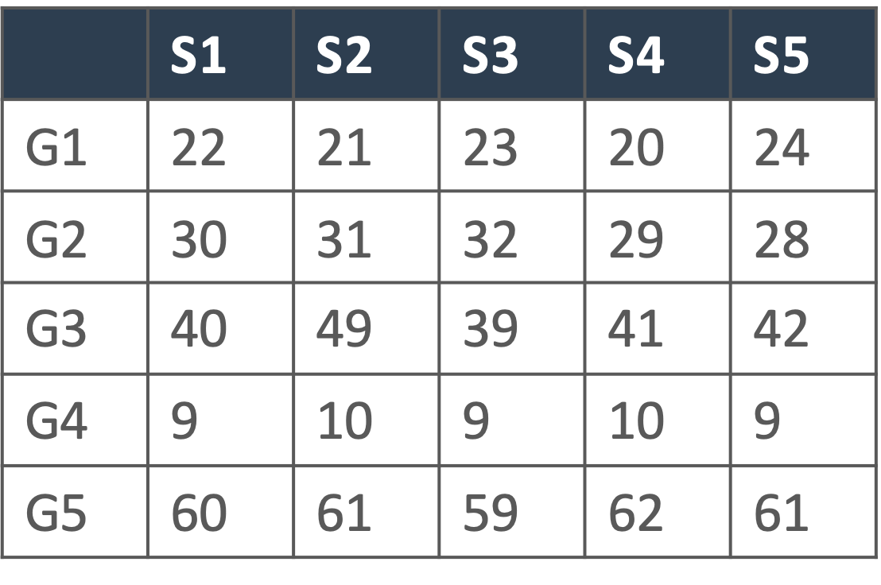





Service provider
DataHUB Collaboration
Metadata
Raw data
Data specialist
Processed data

