Slide 1

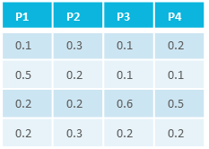


=
characteristics
C₁
C₂
C₃
…
C_{n}
studies
material
samples/data
=
process
P₁
P₂
P₃
…
P_{n}
intensity
m/z
assays
samples
measurement
<study/assay>
=
workflows
result files
<run1>
<workflow1>
result files
runs
<run2>
<workflow2>
=
administrative metadata

