Slide 1

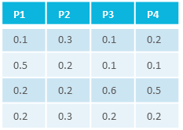
=
characteristics
C₁
C₂
C₃
…
C_{n}
studies
material
samples/data

