Slide 1




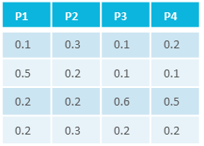





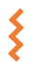



Findable
Acessible
Interoperable
Reusable
Studies
<Study Name>
Resources Resources associated with initial material
characteristics
Material
Alignment Protein abc and def
C₁
C₂
C₃
…
C_{n}
Fasta File Protein abc
Protocols Protocols describing experimental setup
Cultivation scheme At cold
material
samples/data
isa.study.xlsx Characteristics-related Metadata
Assays
<Assay Name>
process
Experiments
Dataset Raw measured data
Sugar measurement
P₁
P₂
P₃
…
P_{n}
intensity
m/z
Protocols Protocols describing each measurement
Sugar extraction in At
samples
measurement
isa.assay.xlsx Process-related Metadata
Workflows
<Workflow Name>
<study/assay>
Script/Code/…
result files
Computation
CWL
<run1>
Runs
<workflow1>
result files
<Run Name>
<run2>
Run Result
<workflow2>
CWL
isa.investigation.xlsx Administrative Metadata
administrative metadata

