Slide 1



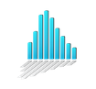





EBI: MetaboLights
ARC
ARC API
converter
repositories

