Slide 1


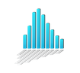



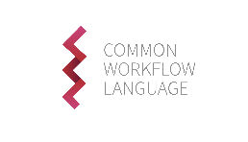





metadata templates
controlled vocabularies
EBI: MetaboLights
standards
repositories
versioning
analyses & workflows
Galaxy

