Slide 1
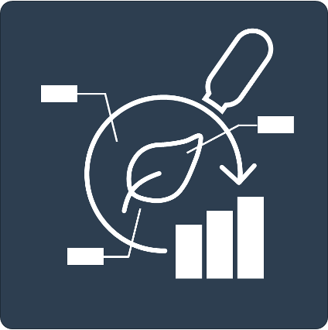





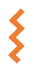


Studies
<Study Name>
Resources
Protocols
isa.study.xlsx
Assays
<Assay Name>
Dataset
Protocols
isa.assay.xlsx
Workflows
<Workflow Name>
Script/Code/…
CWL
Runs
<Run Name>
Run Result
CWL
isa.investigation.xlsx

Slide 2
Studies
<Study Name>
Resources
Protocols
isa.study.xlsx
Assays
Experimental Data
<Assay Name>
Dataset
Protocols
isa.assay.xlsx
Workflows
<Workflow Name>
Script/Code/…
CWL
Runs
<Run Name>
Run Result
CWL
isa.investigation.xlsx

Slide 3
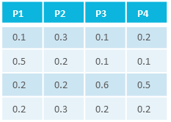
Studies
characteristics
<Study Name>
C₁
C₂
C₃
…
C_{n}
Resources
Protocols
material
samples/data
isa.study.xlsx
Assays
Experimental Data
<Assay Name>
Dataset
Protocols
process
isa.assay.xlsx
Workflows
P₁
P₂
P₃
…
P_{n}
intensity
m/z
<Workflow Name>
samples
measurement
Script/Code/…
CWL
Runs
<Run Name>
Run Result
CWL
isa.investigation.xlsx

Slide 4
Studies
<Study Name>
Resources
Protocols
isa.study.xlsx
Assays
<Assay Name>
Dataset
Protocols
isa.assay.xlsx
Workflows
<Workflow Name>
Script/Code/…
Data analysis
Computation
CWL
Runs
<Run Name>
Run Result
CWL
isa.investigation.xlsx

Slide 5
Studies
<Study Name>
Resources
Protocols
isa.study.xlsx
Assays
<Assay Name>
Dataset
Protocols
isa.assay.xlsx
Workflows
<Workflow Name>
Script/Code/…
<study/assay>
Data analysis
Computation
result files
CWL
Runs
<run1>
<Run Name>
<workflow1>
result files
Run Result
<run2>
CWL
<workflow2>
isa.investigation.xlsx

Slide 6
Studies
<Study Name>
Resources
Protocols
isa.study.xlsx
Assays
Metadata Annotation
<Assay Name>
Dataset
Protocols
isa.assay.xlsx
Workflows
<Workflow Name>
Script/Code/…
CWL
Runs
<Run Name>
Run Result
CWL
isa.investigation.xlsx

Slide 7
Studies
<Study Name>
Resources
Protocols
Experimental Data
isa.study.xlsx
Assays
<Assay Name>
Dataset
Protocols
intensity
isa.assay.xlsx
m/z
…

Slide 8
Studies
characteristics
<Study Name>
C₁
C₂
C₃
…
C_{n}
material
samples/data
Resources
Protocols
isa.study.xlsx
Experimental Data
Assays
<Assay Name>
Metadata Annotation
process
Dataset
intensity
Protocols
P₁
P₂
P₃
…
P_{n}
m/z
isa.assay.xlsx
samples
measurement
Workflows
<Workflow Name>
Script/Code/…
<study/assay>
CWL
Data analysis
Computation
result files
Runs
<run1>
<Run Name>
<workflow1>
Run Result
result files
<run2>
CWL
<workflow2>
isa.investigation.xlsx

