Slide 1


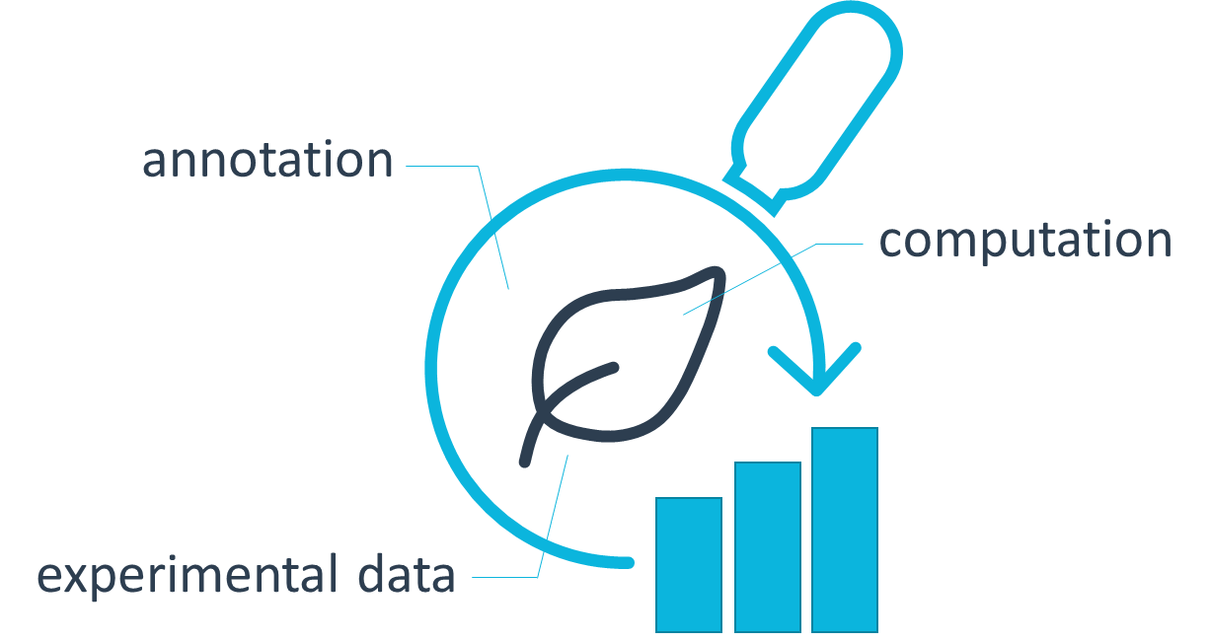



<study1>
resources
…
protocols
studies
=
<assay1>
dataset
…
assays
protocols
workflows
<workflow1>
script / code / …
…
CWL
runs
<run1>
data files
…
CWL
investigation

