Slide 1
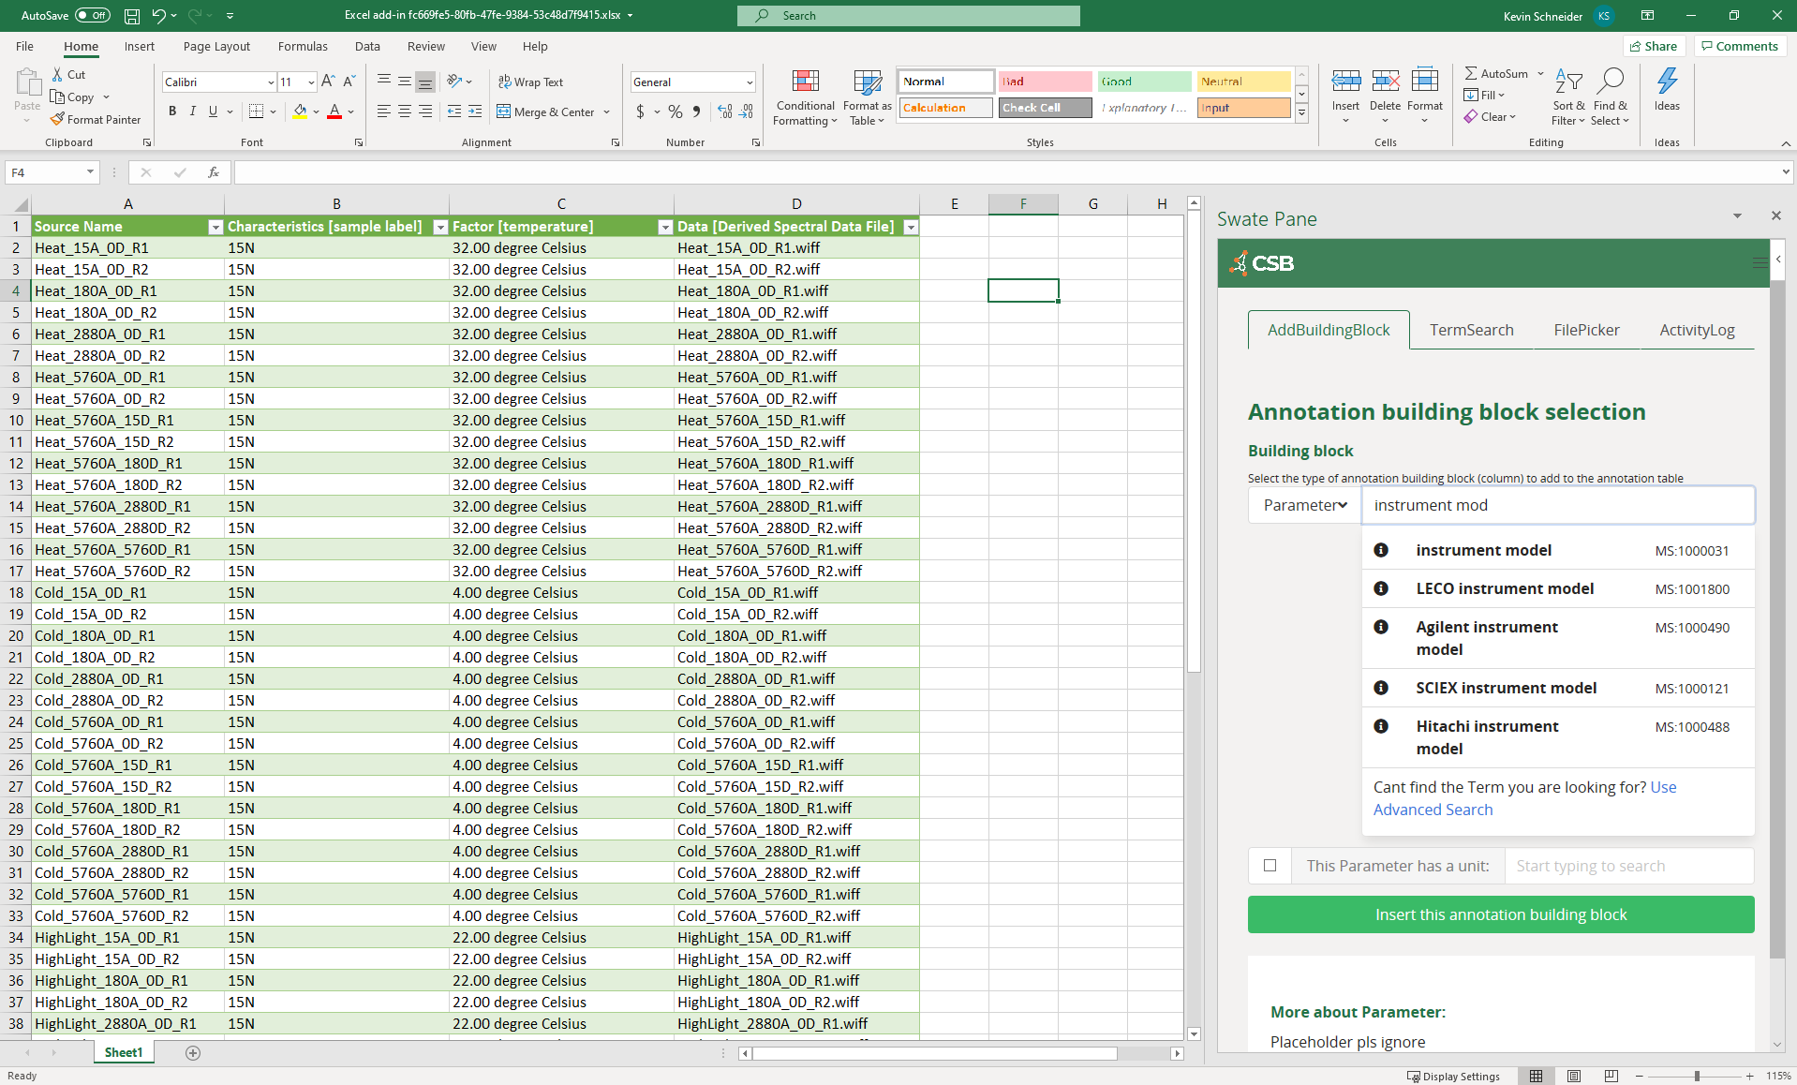

Excel + SWATE add-in

