Slide 1
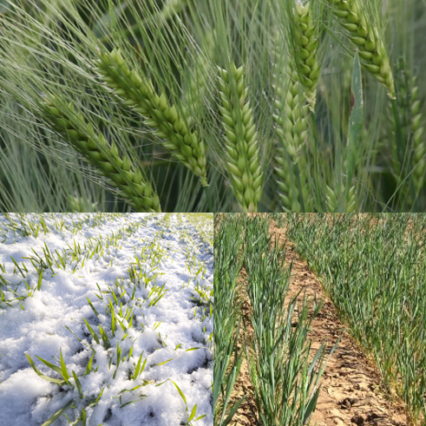

phenome
C
B
metabolome
D
D
P
C
B
proteome
A
B
transcriptome
genome

