Slide 1
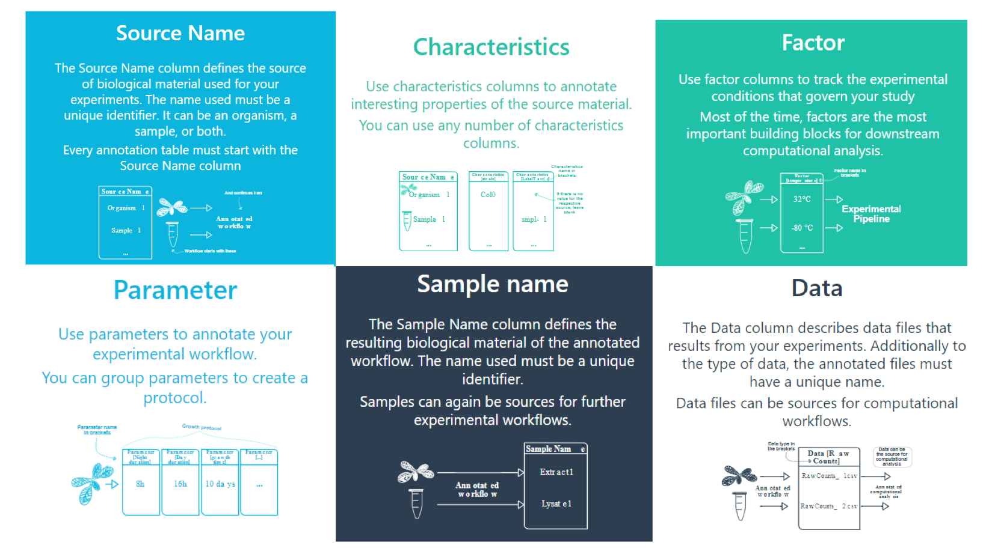
Notes:
Source + Sample Name: starting or intermediate point of your experiment
Characteristics: describe your sample (e.g. the plant sample)
Factors are the major determinant (s) of the experiment (e.g. genotype, heat treatment)
Parameter annotate the experimental workflow (in lab or at computer)
Data: names the files

