Slide 1
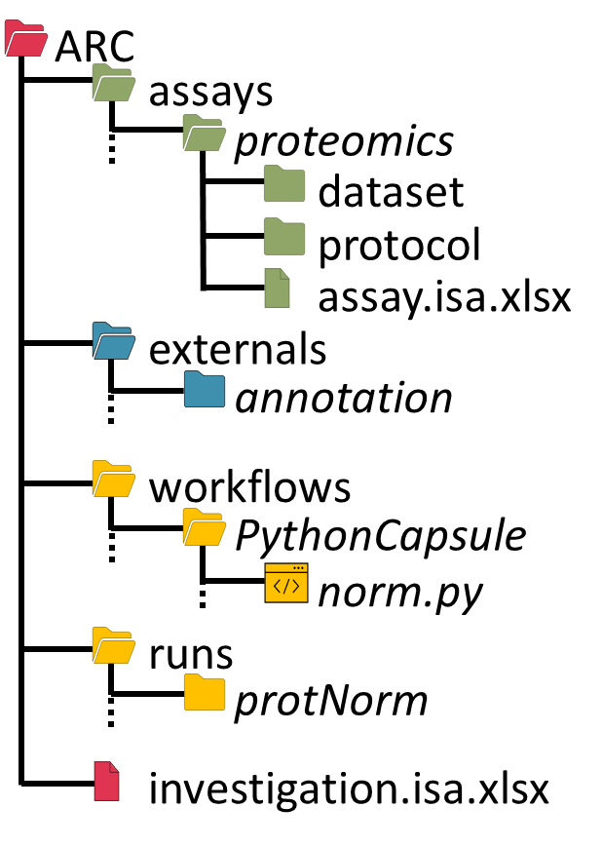


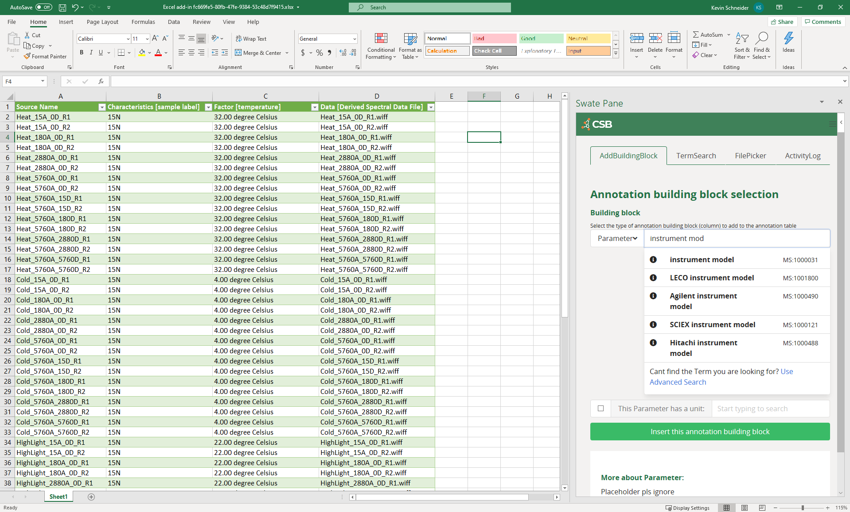


Swobup
Service
Research Data
ARC Commander
Excel + Swate
Metadata templates

