Slide 1

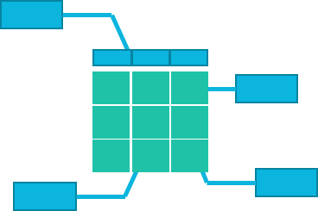
knowledge
data
information

