Slide 1

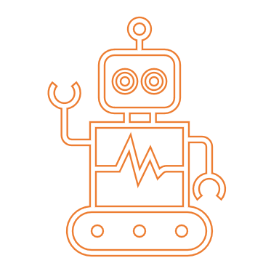
Findable
Accessible
Interoperable
Re-usable
… for humans and machines

