Slide 1

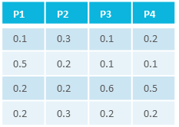



=
characteristics
C₁
C₂
C₃
…
C_{n}
studies
material
samples/data
=
process
P₁
P₂
P₃
…
P_{n}
intensity
m/z
assays
samples
measurement
<study/assay>
=
workflows
result files
<run1>
<workflow1>
result files
runs
<run2>
<workflow2>
=
administrative metadata

Slide 2
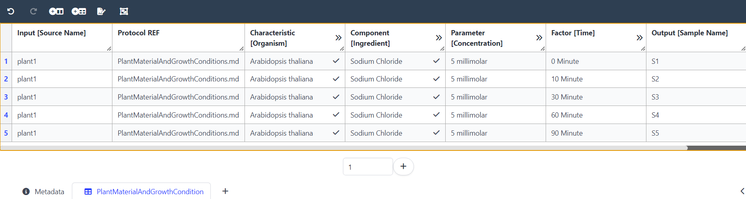
Time series design
S1
S2
S3
Sn
time
plant1
(0 min)
(10 min)
(30 min)
(…)
isa.study.xlsx

Slide 3
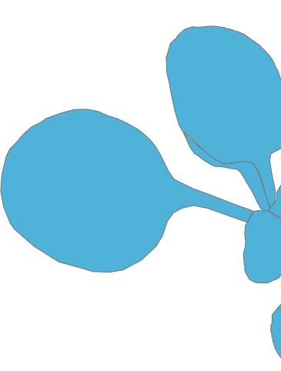

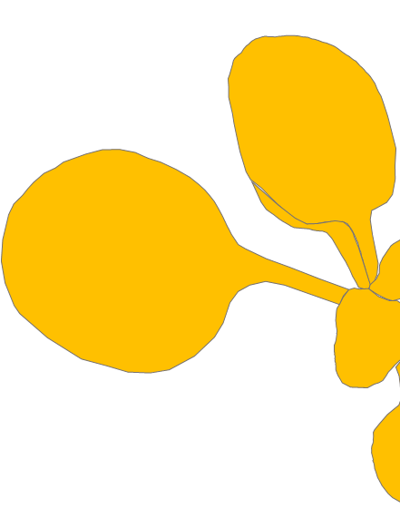

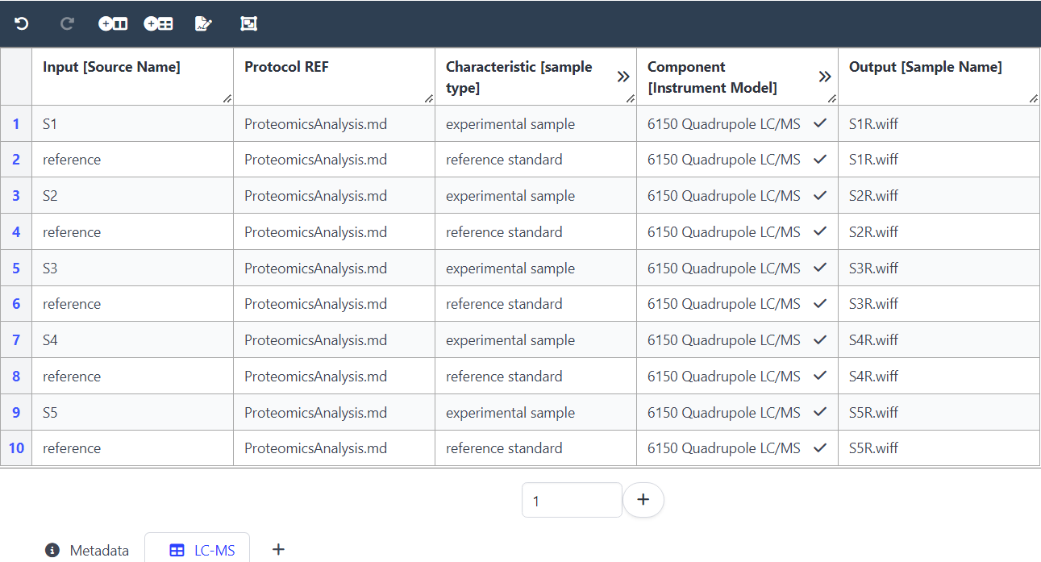
Mixing samples
+
S1
S1
+ reference
+
S2
S2
+ reference
reference
isa.assay.xlsx

Slide 4
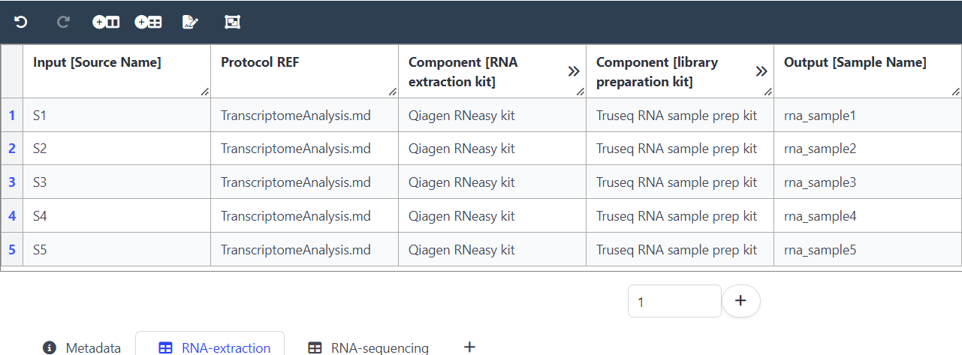
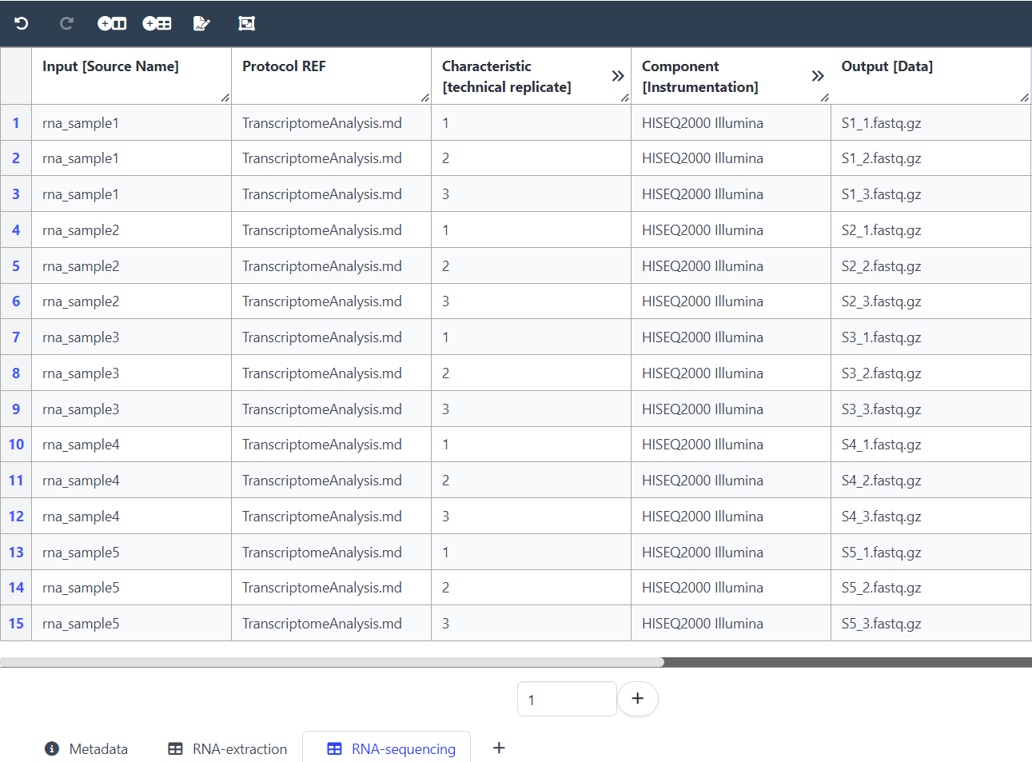
Annotation of replicates
S1_1.fastq.gz
S1_2.fastq.gz
S1_3.fastq.gz
rna_sample1
RNA extraction
analysis
intensity
S1
m/z
rna_sample2
S2_1.fastq.gz
S2_2.fastq.gz
S2_3.fastq.gz
RNA extraction
analysis
intensity
m/z
S2
(…)
S5_1.fastq.gz
S5_2.fastq.gz
S5_3.fastq.gz
rna_sample5
RNA extraction
analysis
intensity
m/z
S5
isa.assay.xlsx

Slide 5
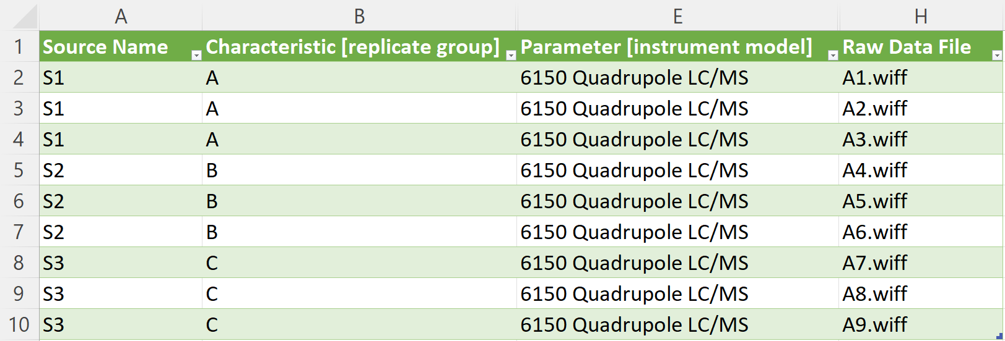
Loading samples on a gel
Ⅰ
Ⅱ
Ⅲ
S1
S3
GelA
S2
60
isa.assay.xlsx

