Slide 1






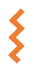


Studies
<Study Name>
Resources
Protocols
isa.study.xlsx
Assays
Metadata Annotations
<Assay Name>
Dataset
Protocols
isa.assay.xlsx
Workflows
<Workflow Name>
Script/Code/…
CWL
Runs
<Run Name>
Run Result
CWL
isa.investigation.xlsx

Slide 2
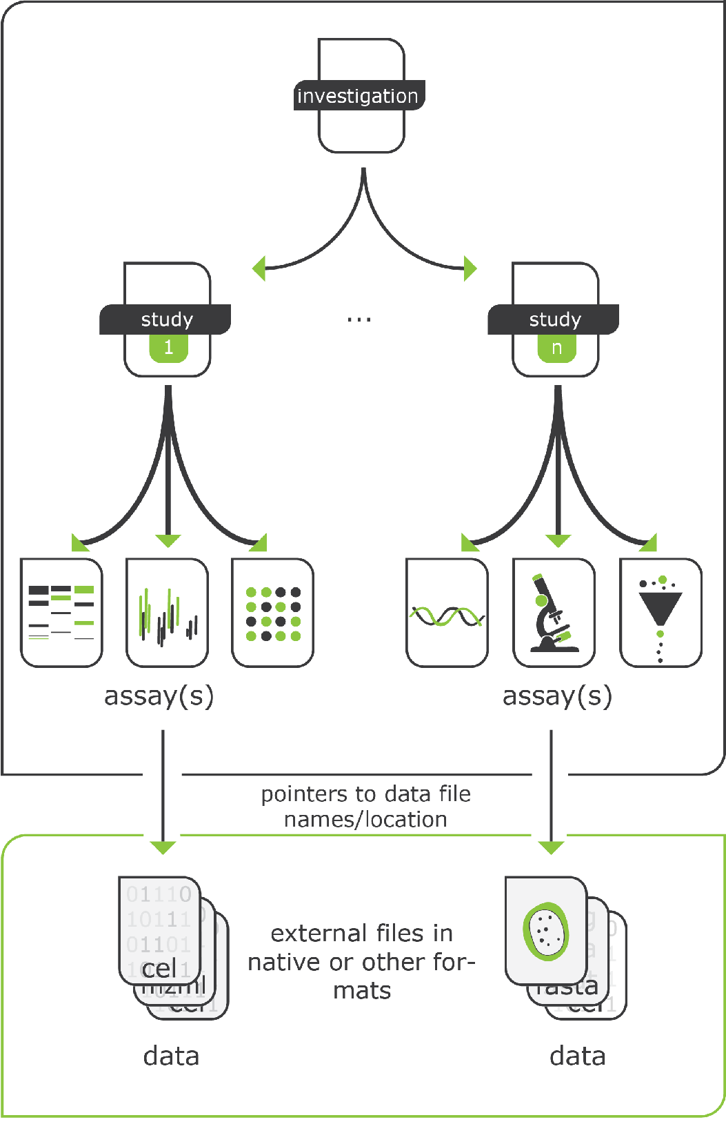
Investigation
Overall goals
Scientific context
Studies
<Study Name>
Resources
Protocols
isa.study.xlsx
Assays
<Assay Name>
Study
Experimental design
Dataset
Protocols
isa.assay.xlsx
Workflows
<Workflow Name>
Script/Code/…
Assay
Leading to (raw) data
CWL
Runs
<Run Name>
Run Result
https://isa-tools.org/format/specification.html
CWL
isa.investigation.xlsx

Slide 3
Source Name
Characteristics [Organism]
Sample Name
Studies
Ath001
Arabidopsis thaliana
Lre001
<Study Name>
Ath002
Arabidopsis thaliana
Lre002
Resources
Ath003
Arabidopsis thaliana
Lre003
Protocols
isa.study.xlsx
…
…
…
Assays
<Assay Name>
Source Name
Parameter [instrument model]
Raw Data File
Lre001
Dataset
Metadata Annotations
6130 Quadrupole LC/MS
Lre001.wiff
Protocols
Lre002
6130 Quadrupole LC/MS
Lre002.wiff
isa.assay.xlsx
Lre003
6130 Quadrupole LC/MS
Lre003.wiff
Workflows
<Workflow Name>
…
…
…
Script/Code/…
CWL
Investigation Title
Runs
Investigation Description
<Run Name>
Investigation Person Last Name
Run Result
Investigation Person First Name
CWL
isa.investigation.xlsx
…
…

Slide 4
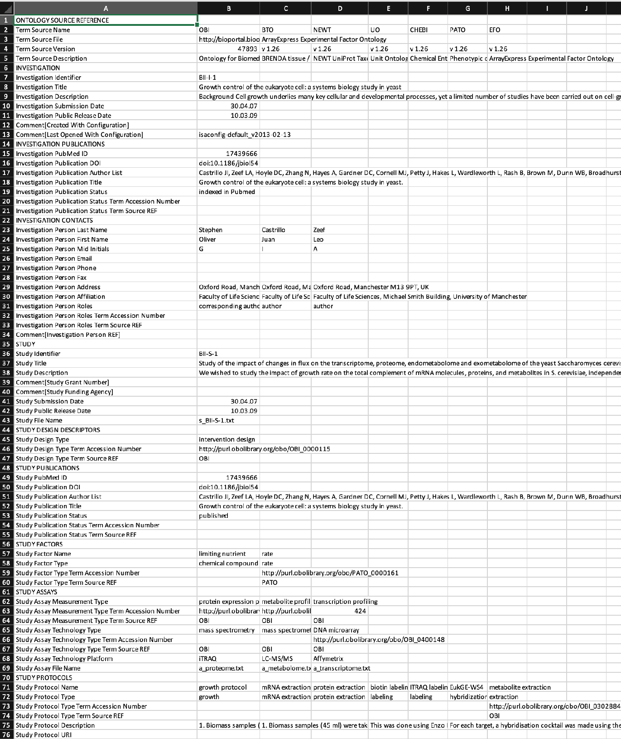
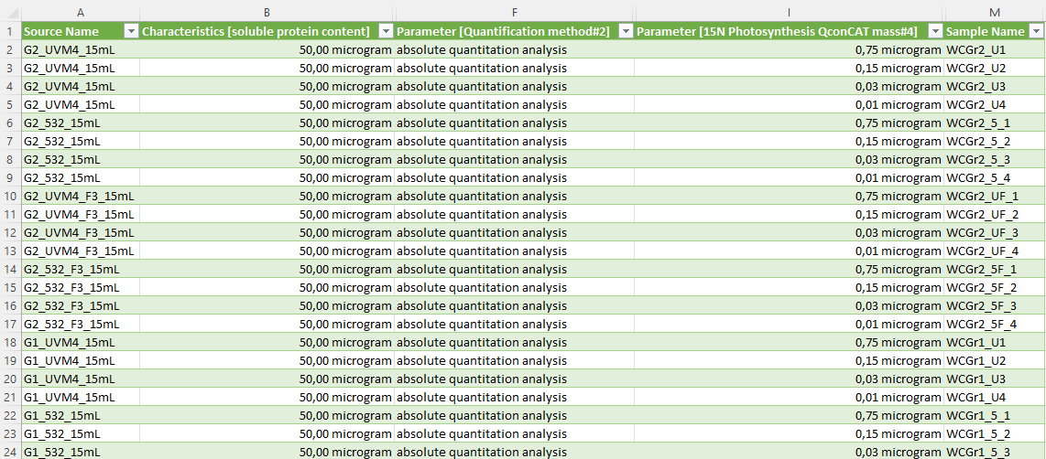
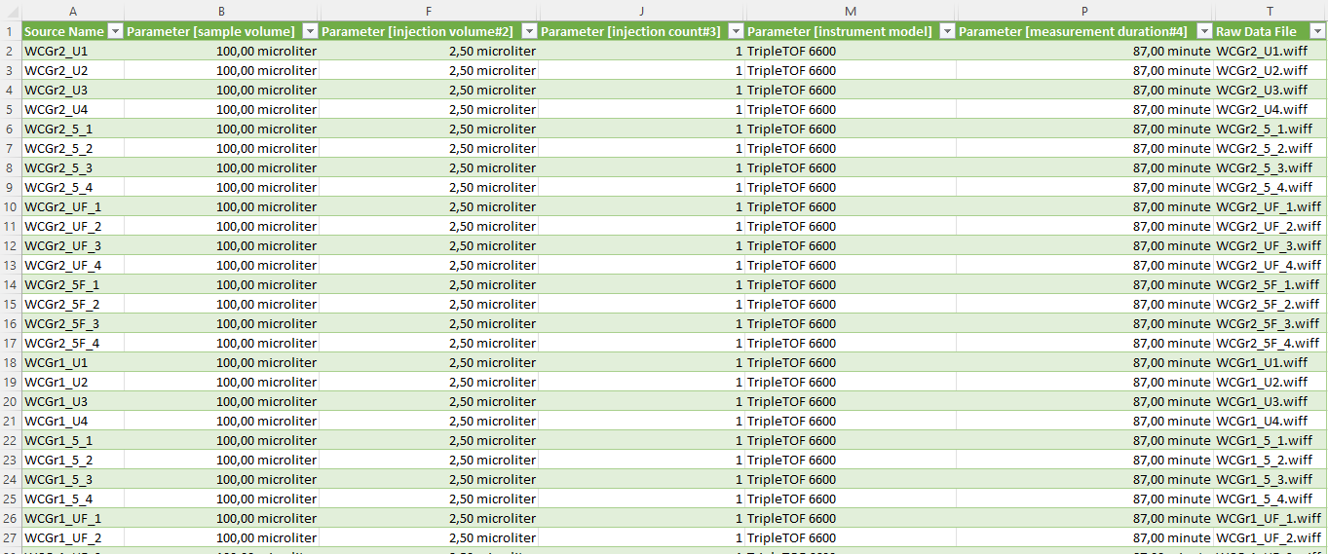
isa.investigation.xlsx
isa.study.xlsx
isa.assay.xlsx

Slide 5
isa.investigation.xlsx
isa.study.xlsx
isa.assay.xlsx
Study file
Assay file

Slide 6
isa.study.xlsx
Samples
isa.assay.xlsx

Slide 7
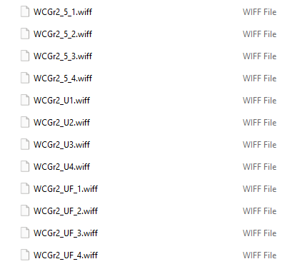
isa.study.xlsx
Studies
<Study Name>
Resources
Protocols
isa.study.xlsx
Assays
<Assay Name>
Dataset
Protocols
isa.assay.xlsx
isa.assay.xlsx
Workflows
<Workflow Name>
Script/Code/…
CWL
Raw data
Runs
<Run Name>
Run Result
CWL
isa.investigation.xlsx

