Slide 1
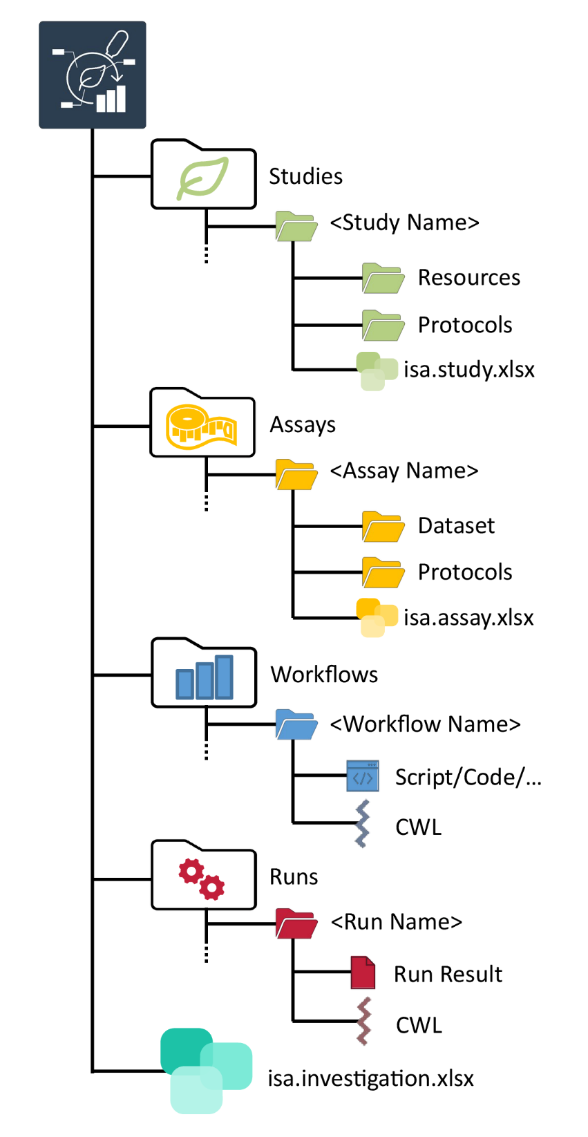
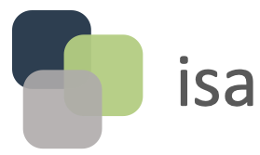
Source Name
Characteristics [Organism]
Sample Name
Ath001
Arabidopsis thaliana
Lre001
Ath002
Arabidopsis thaliana
Lre002
Ath003
Arabidopsis thaliana
Lre003
…
…
…
Source Name
Parameter [instrument model]
Raw Data File Name
Lre001
6130 Quadrupole LC/MS
Lre001.wiff
Metadata Model
Lre002
6130 Quadrupole LC/MS
Lre002.wiff
Lre003
6130 Quadrupole LC/MS
Lre003.wiff
…
…
…
Investigation Title
Investigation Description
Investigation Person Last Name
Investigation Person First Name
…
…

