Slide 1
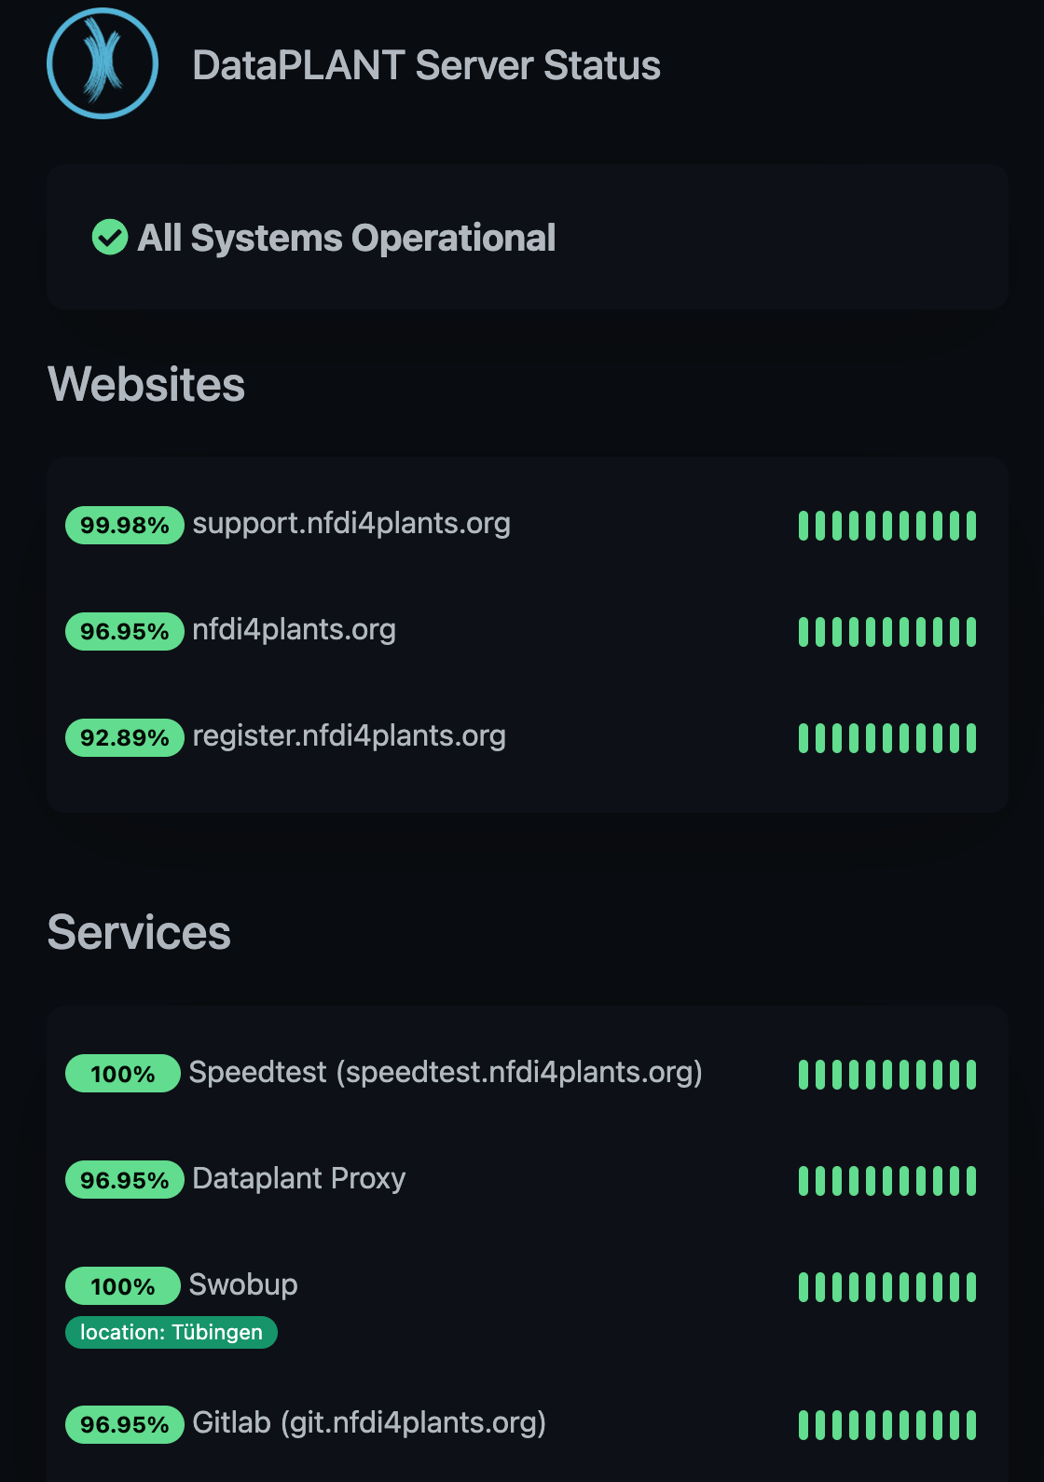
Notes:
Status view for users
https://status.nfdi4plants.org

