Slide 1

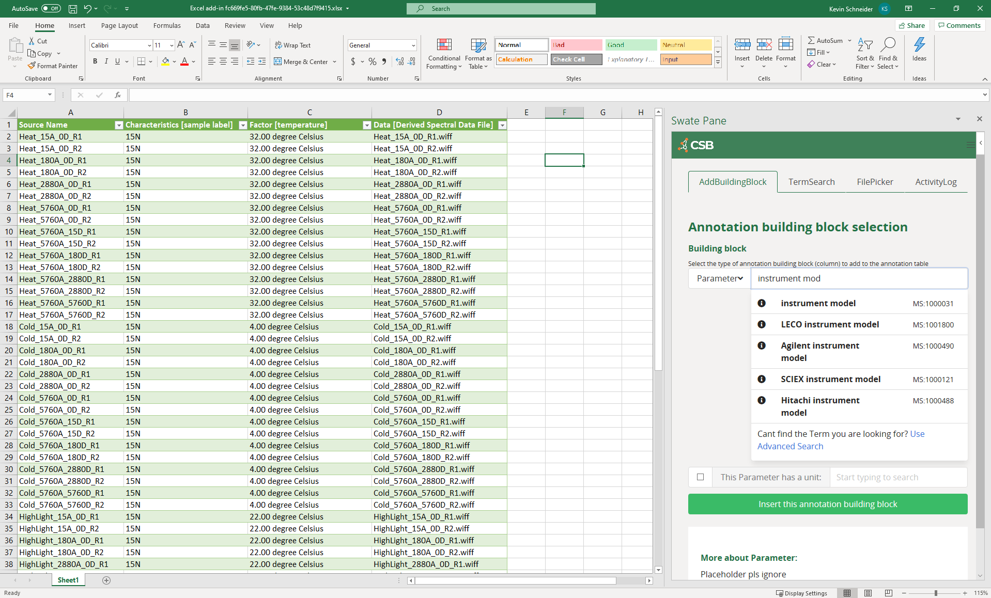



External
ontologies
Nfdi4plants ontology
Excel + Swate
ARC Commander
ARC
Swate Ontology DB
(MySQL/MariaDB)
Swobup
Service
Metadata templates

