Slide 1
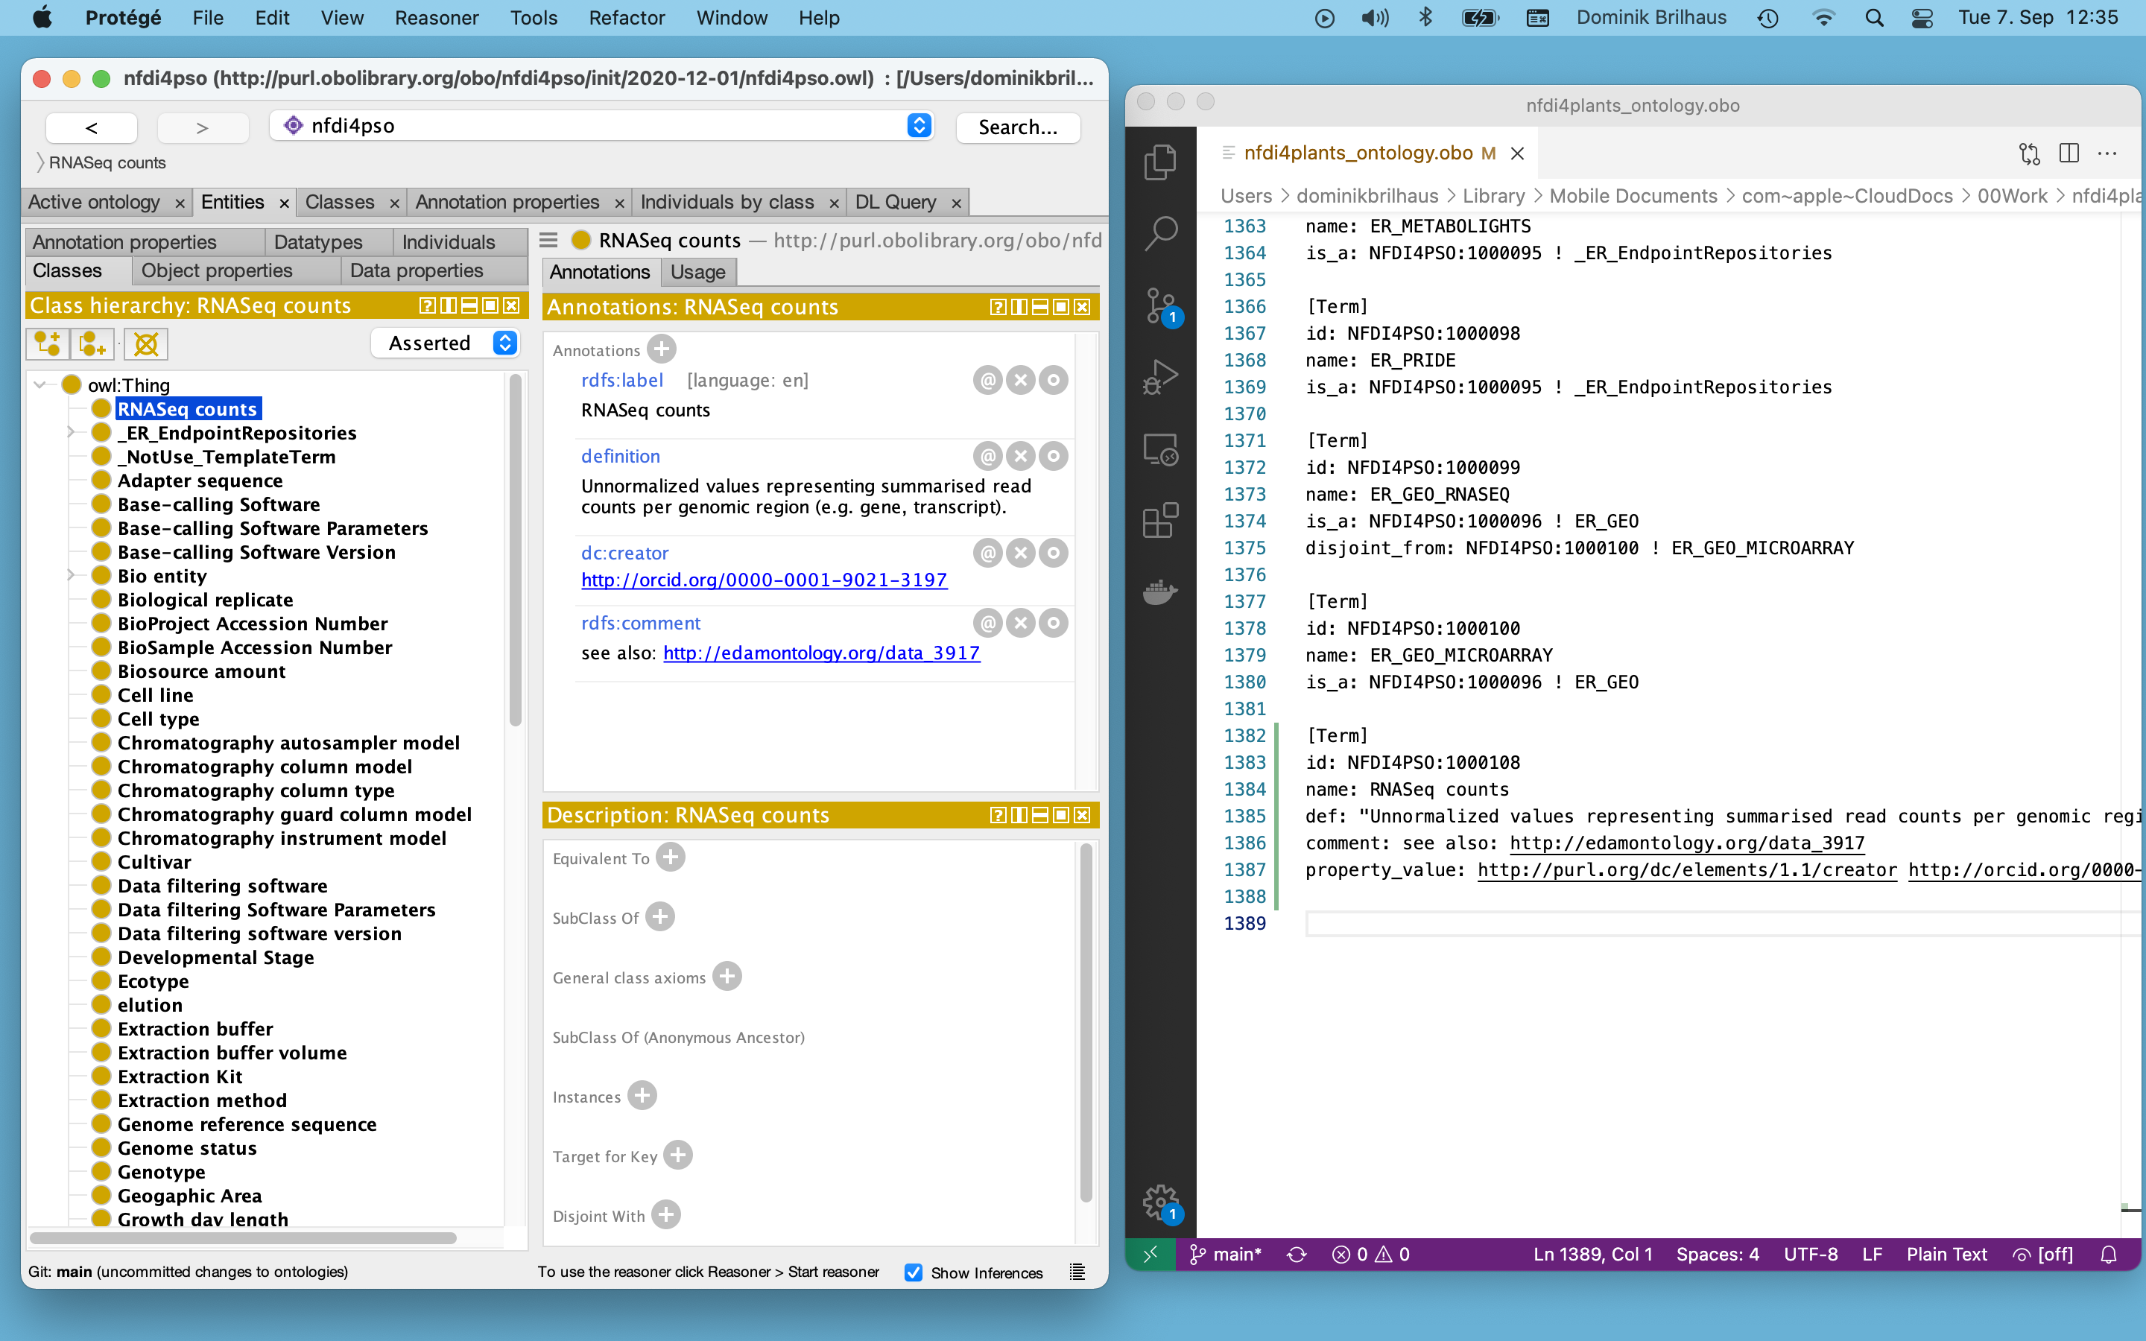
Notes:
Left: Protege Right: Text editor

