Slide 1



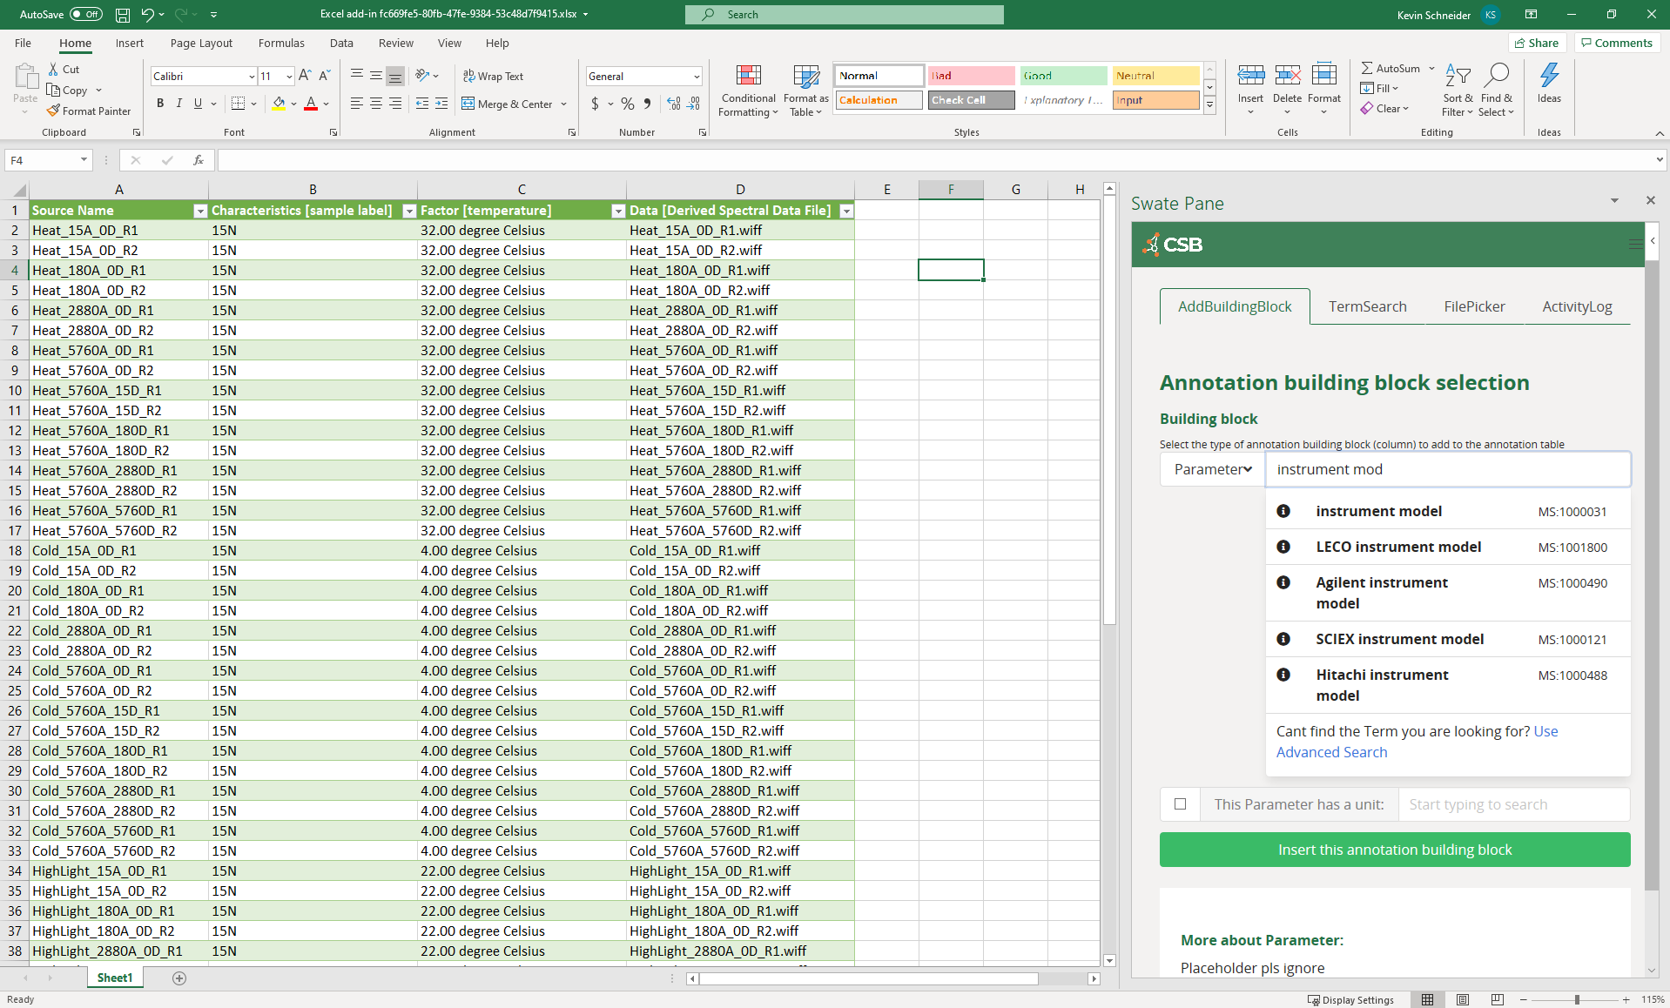


domain experts
External
ontologies
Nfdi4plants ontology
metadata specialists
Excel + Swate
Swate Ontology DB
(MySQL/MariaDB)
Swobup
Service

