Slide 1

Plan

Slide 2

Plan
Collect

Slide 3


Plan
Collect
Process

Slide 4
Plan
Collect
Process
Analyse

Slide 5

Plan
Collect
Process
Preserve
Analyse

Slide 6

Plan
Share
Collect
Process
Preserve
Analyse

Slide 7

Reuse
Plan
Share
Collect
Process
Preserve
Analyse

Slide 8
Reuse
Plan
Share
Collect
Process
Preserve
Analyse

Slide 9
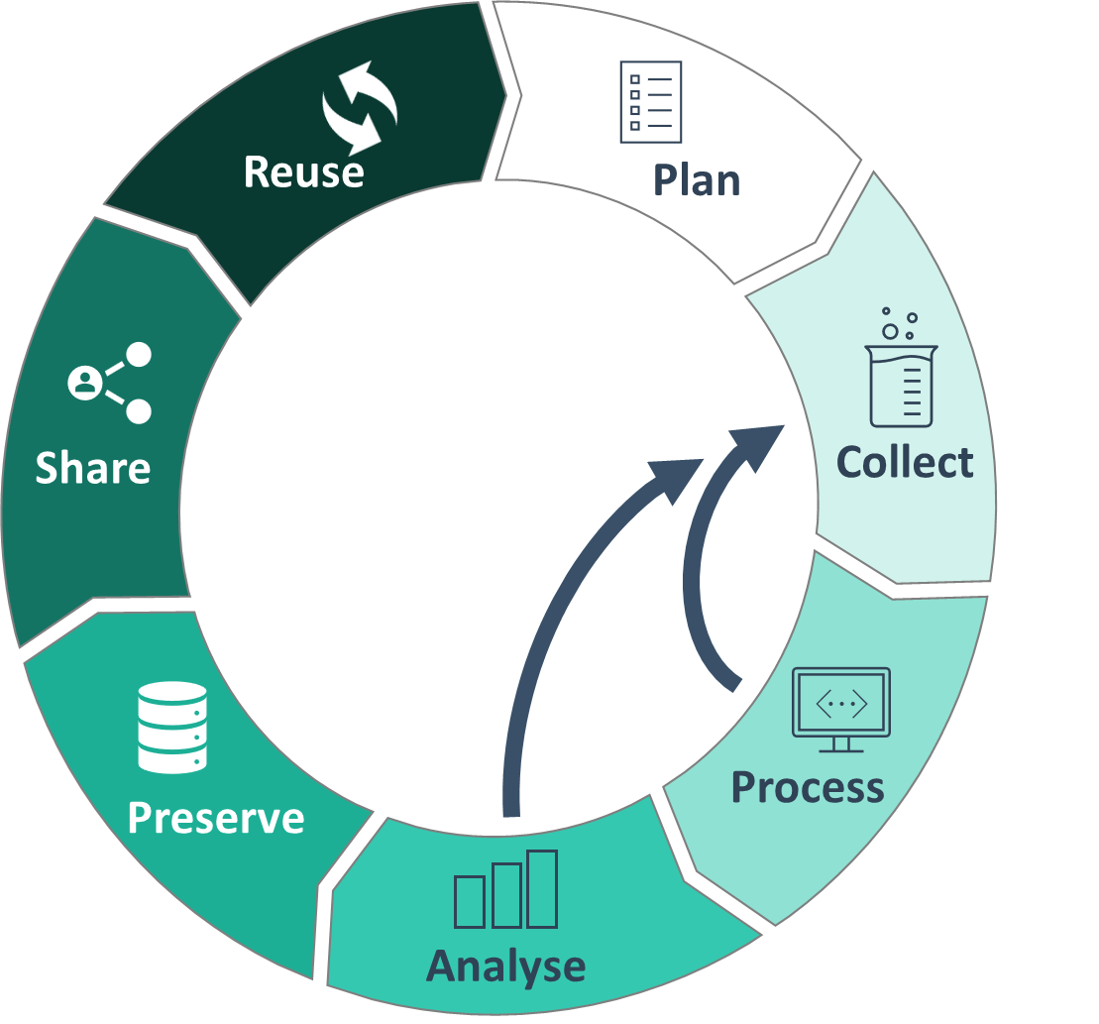
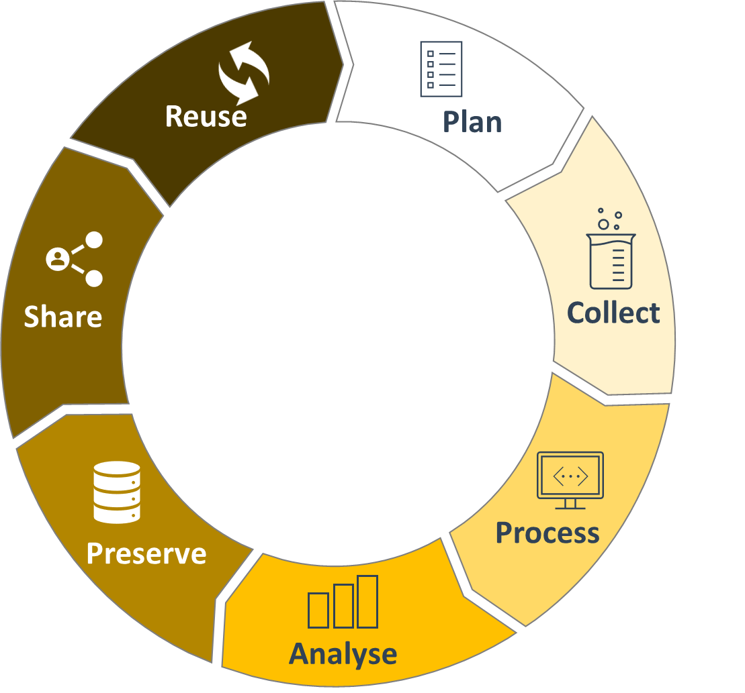
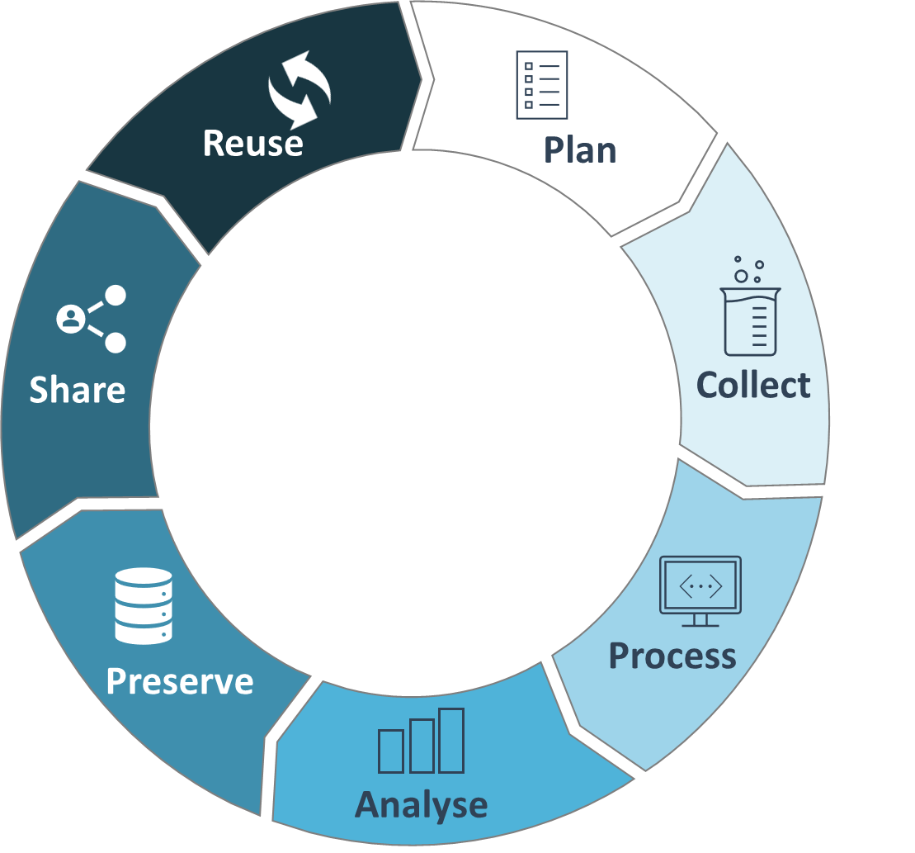

Slide 10



Plan
Collect
Process
Analyse
Preserve
Share
Reuse

Slide 11
Plan
Collect
Process
Analyse
Preserve
Share
Reuse
Plan
Collect
…

Slide 12
Plan
Collect
Process
Analyse
Preserve
Reuse
Plan
Collect
Process
Analyse
Preserve

