Slide 1
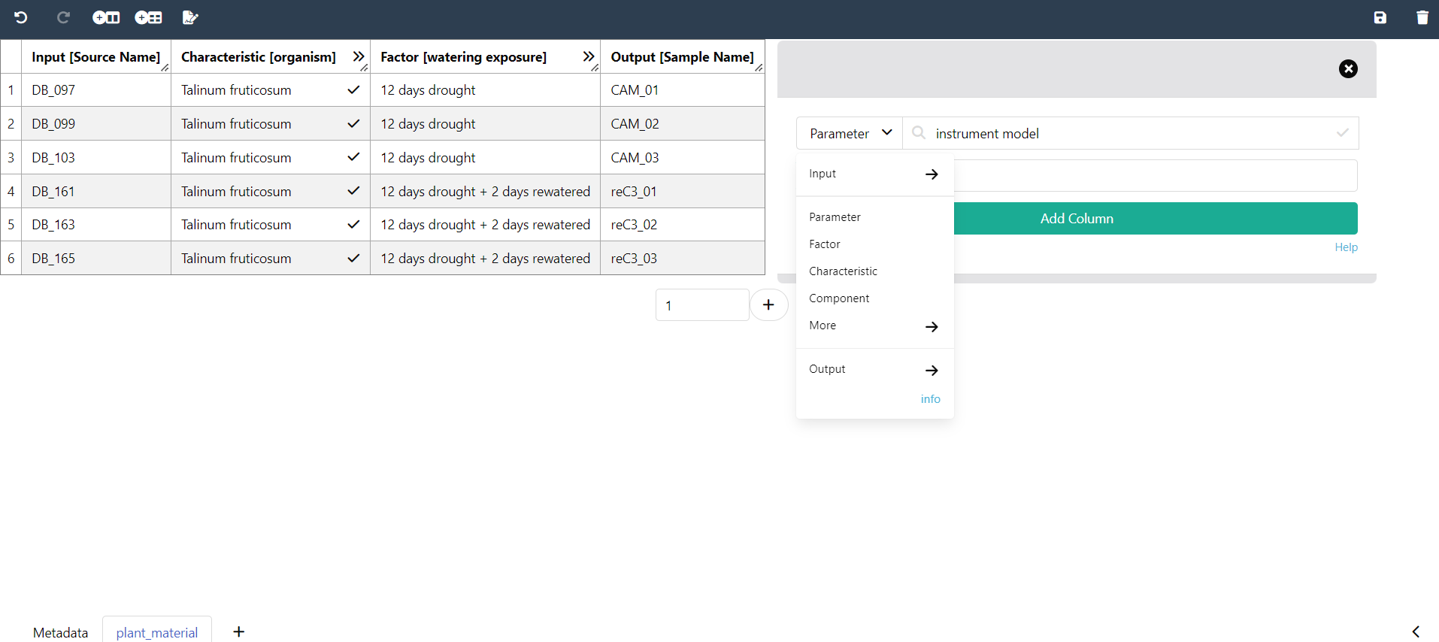
Widgets
New Parameter
Factor
Output
Input
Characteristic
Sidebar

Slide 2
New building blocks

