Slide 1
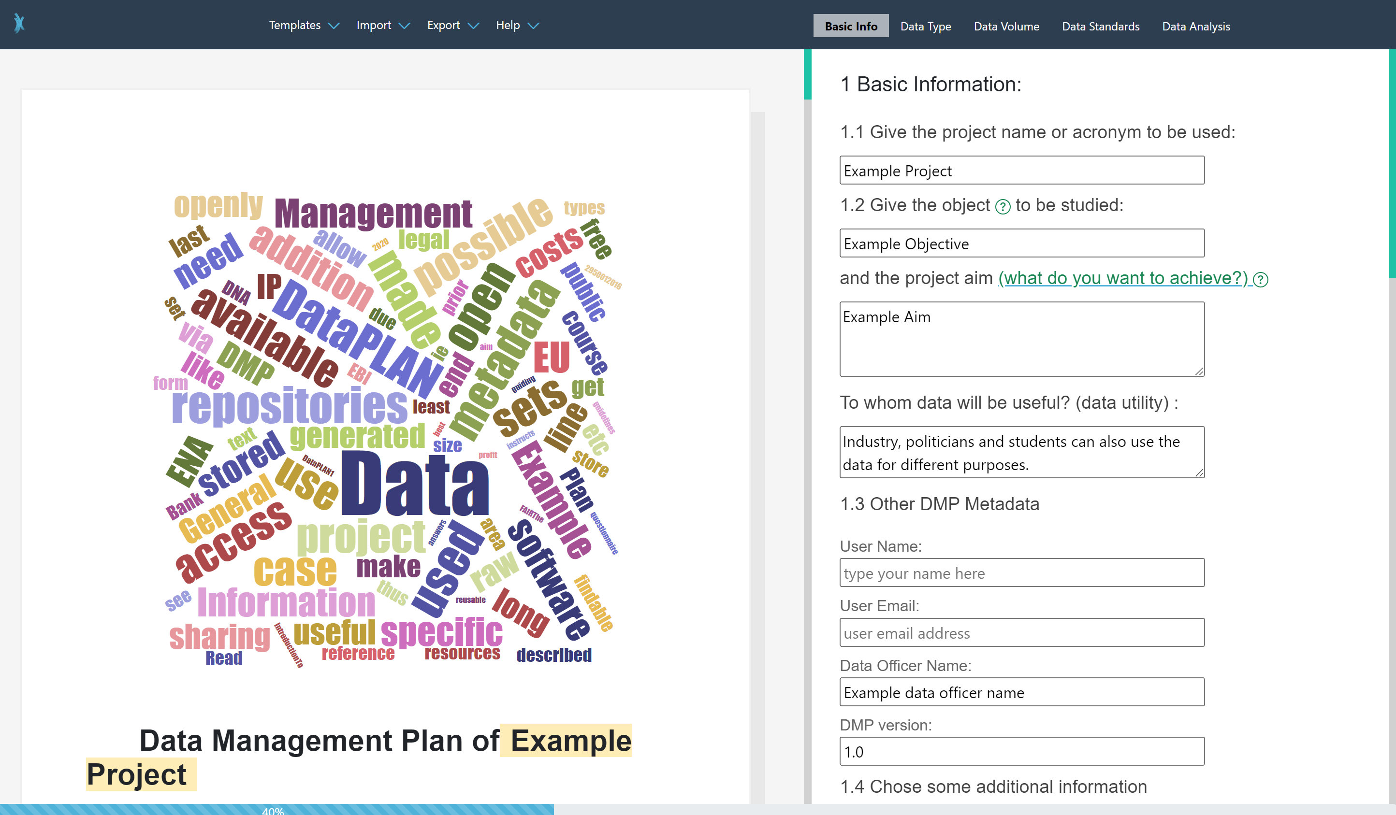
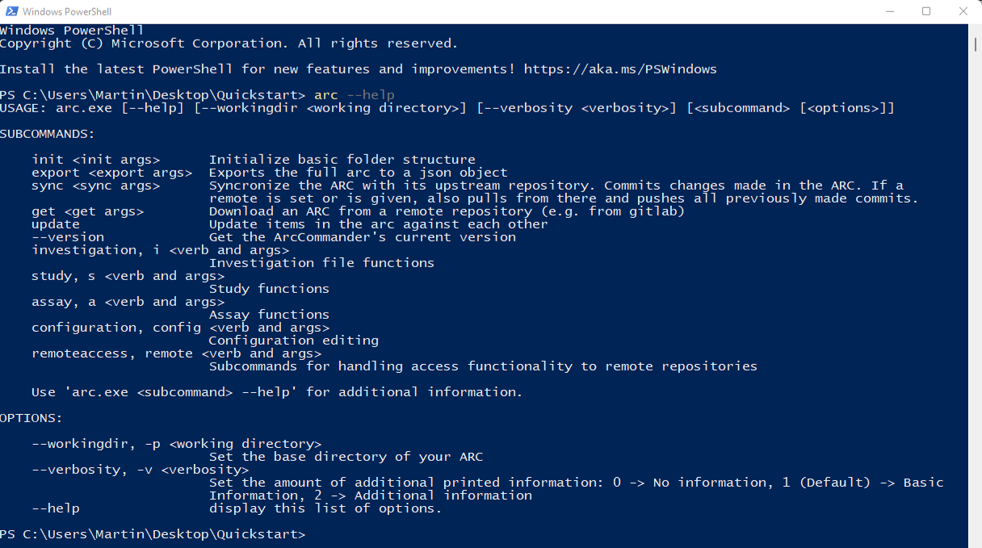
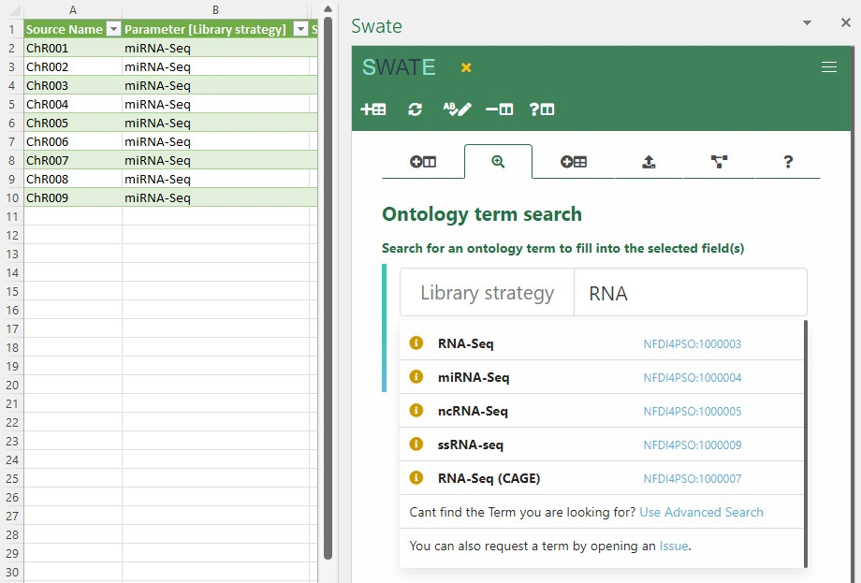
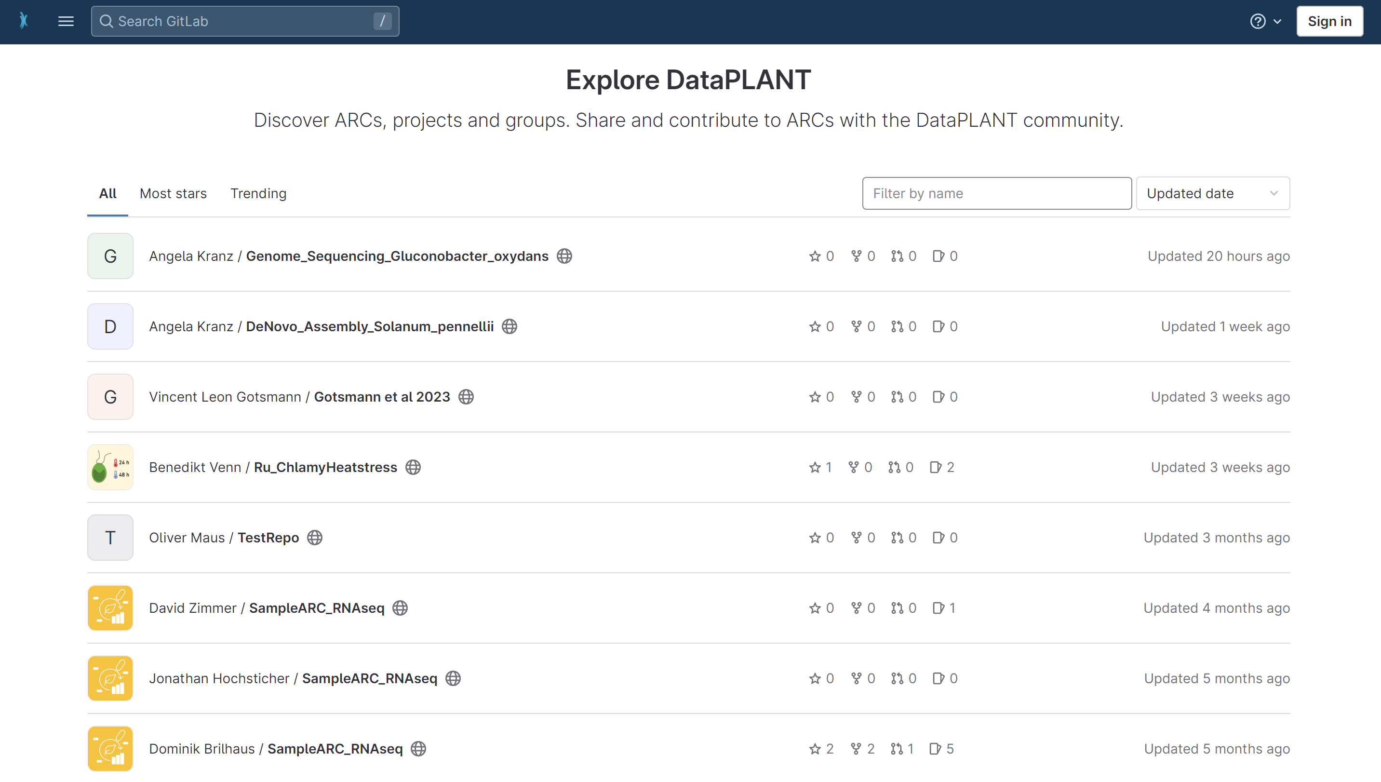
Tools and Services
provide support in being FAIR
Data
Management
Planning
ARC Initialization
ARC Management
Metadata Annotation
Term Finding
Template Finding
Storage
Sharing
Version Control
DataPLAN
ARC Commander
Swate
DataHUB

