Slide 1
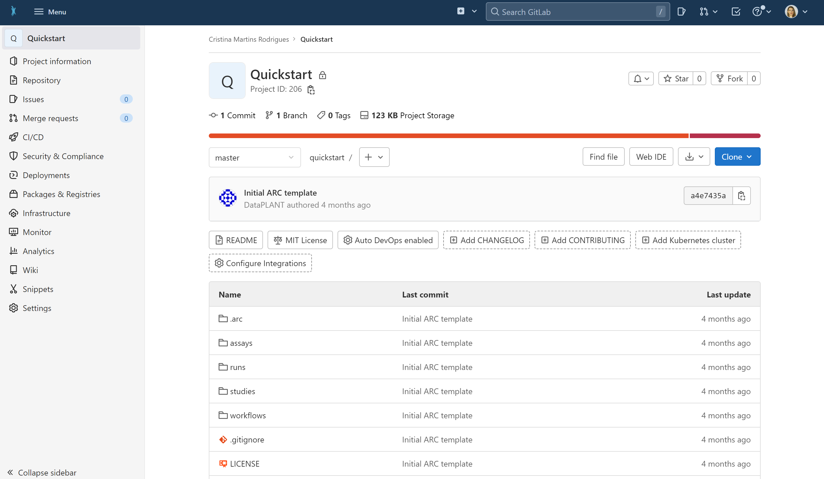

Slide 2
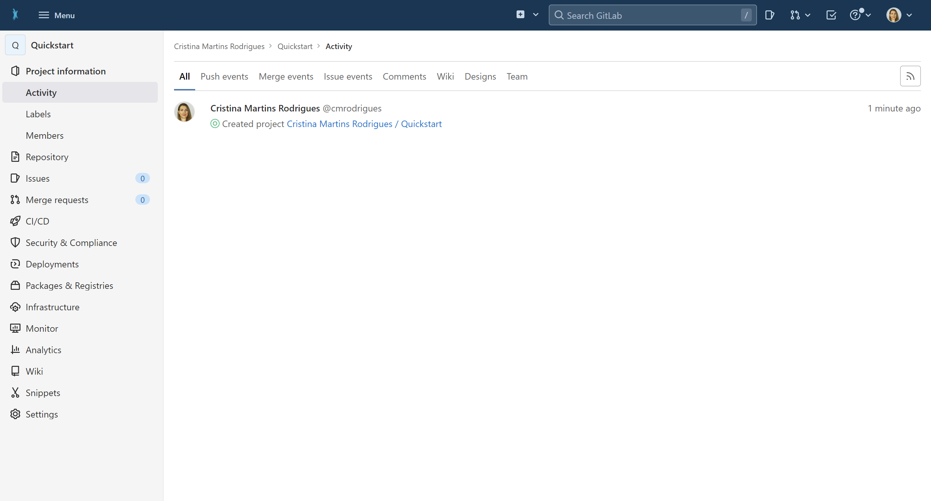
1
User Name
@username
User Name / Quickstart

Slide 3
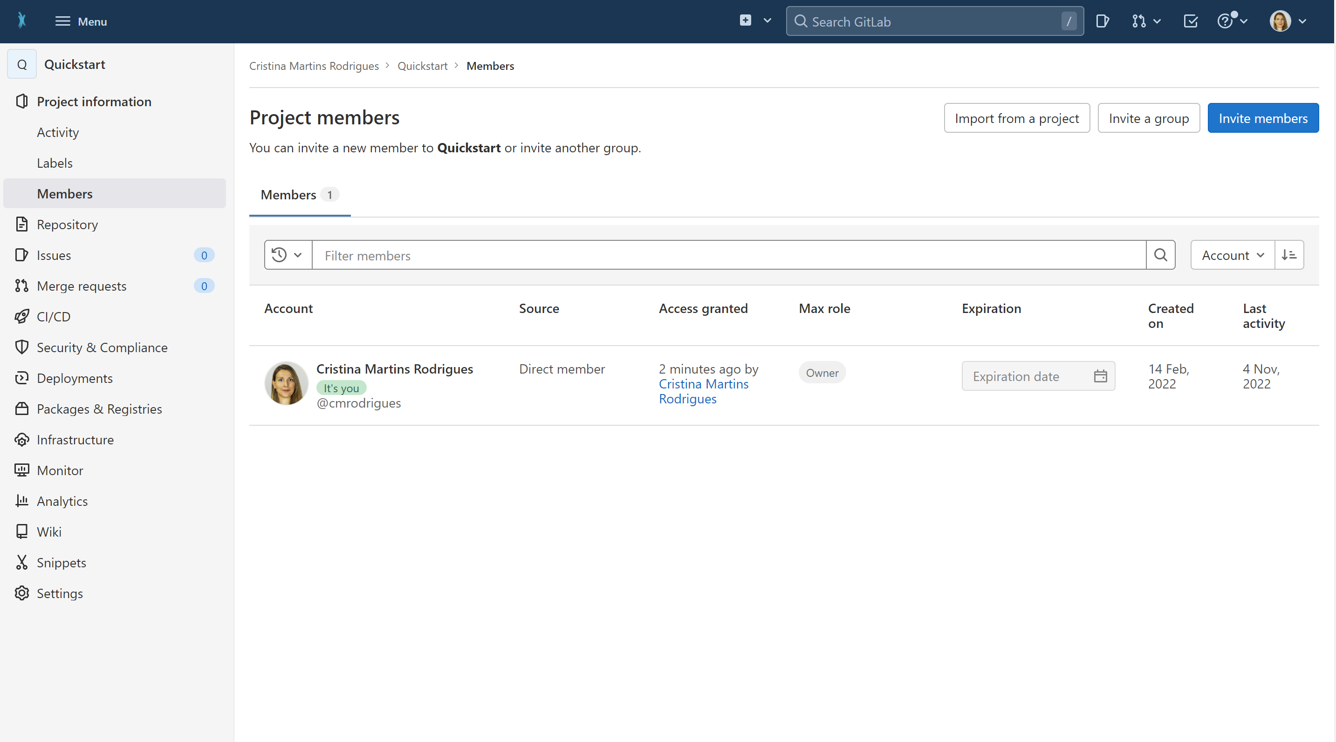
1
2
User Name
User Name
@username

Slide 4
1
3
2
User Name
User Name
@username

Slide 5
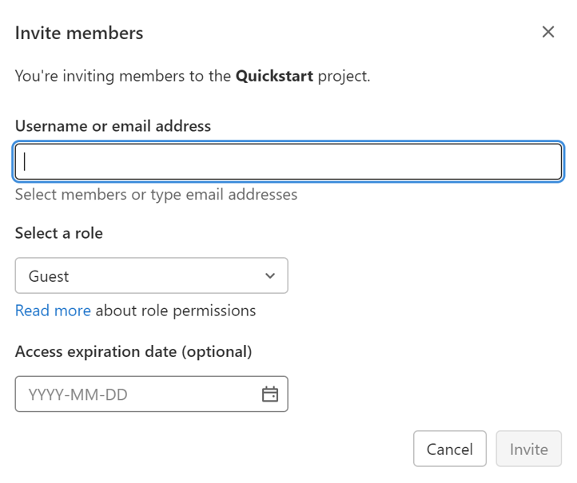
1
3
2
0
4
User Name
User Name
@username

Slide 6
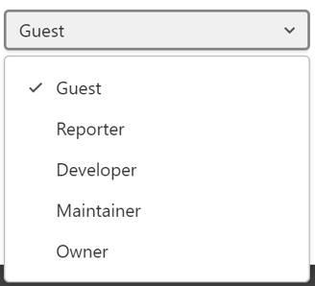
1
3
2
User Name
User Name
@username
5

