Slide 1
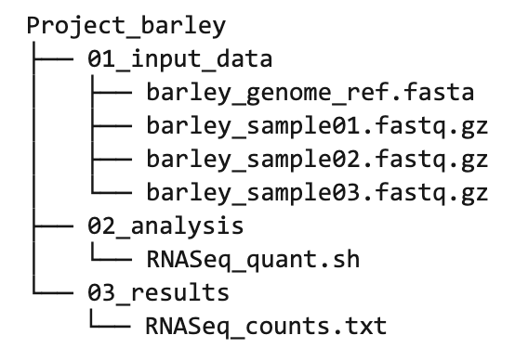

Slide 2
Input(s)

Slide 3
Input(s)
Computation

Slide 4
Input(s)
Computation
Output

Slide 5
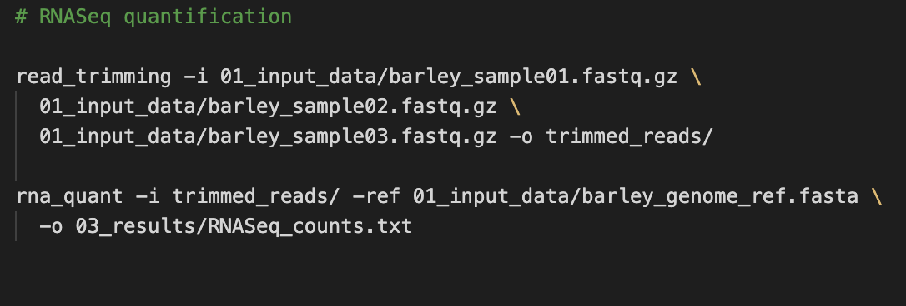
*
Input(s)
Computation
Output
* Disclaimer: this is not a good example for reusable code

Slide 6
Input(s)
Computation
Output
✓

Slide 7


Input(s)
Computation
Output
✓

Slide 8
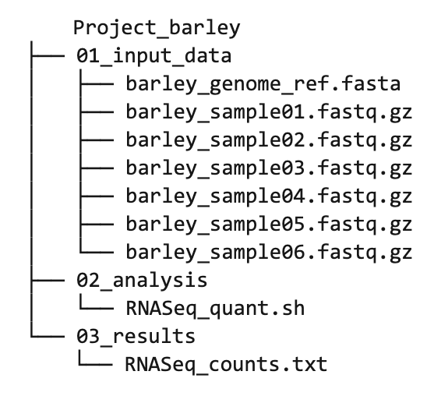

Slide 9
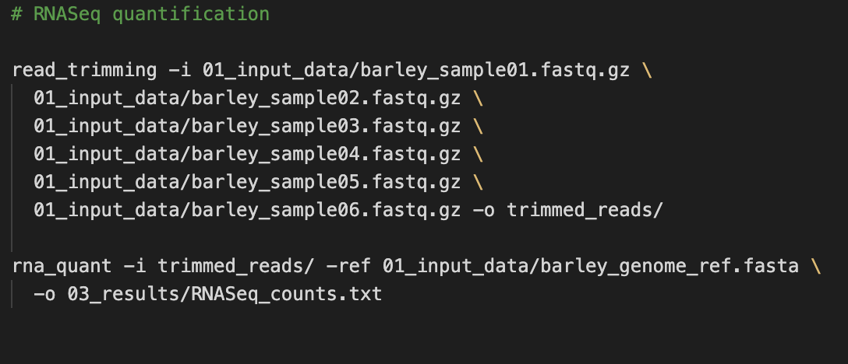

Slide 10
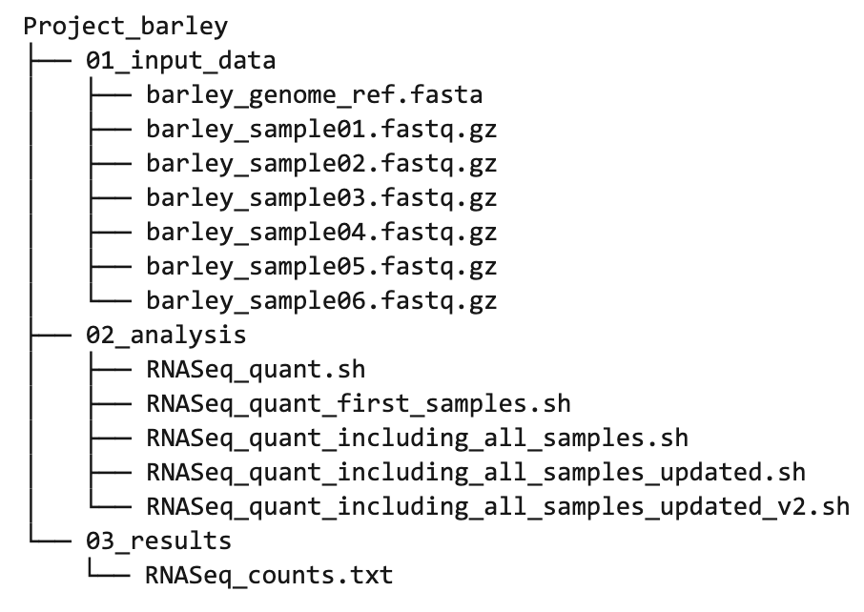

Slide 11
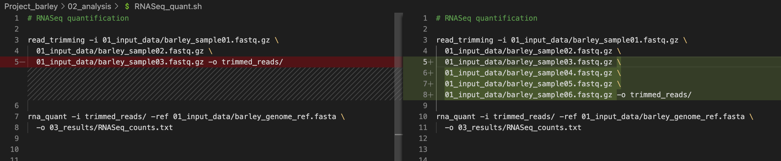
“version 1”
“version 2”

Slide 12
Input(s)
Computation
Output
X

Slide 13


Input(s)
Computation
Output
X
“version xy”

Slide 14
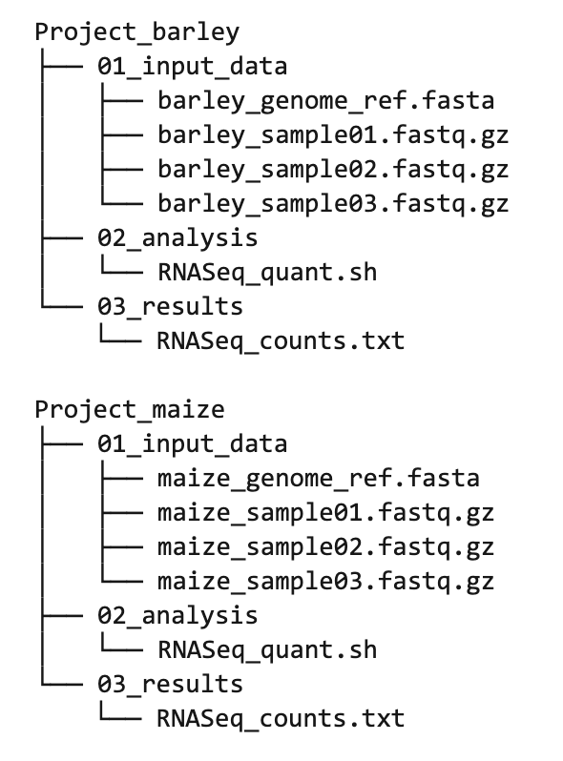

Slide 15
