Slide 1


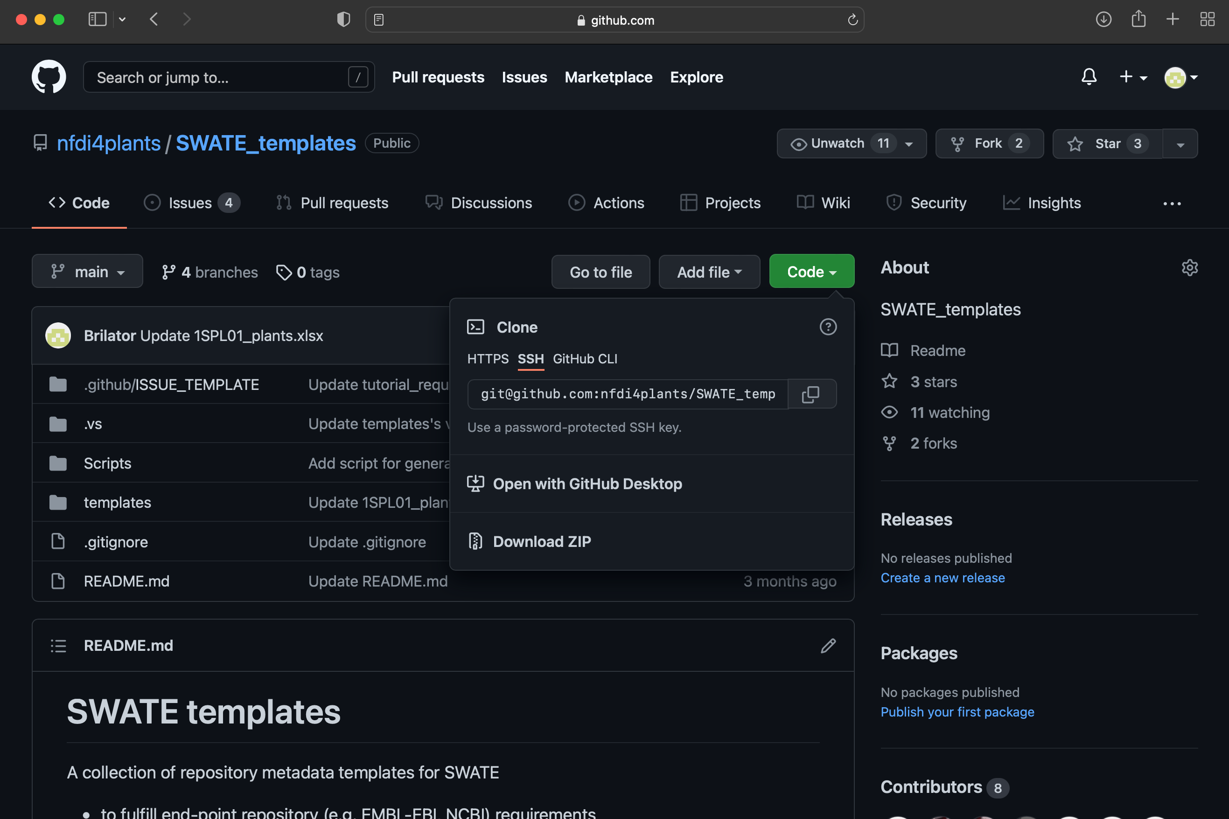
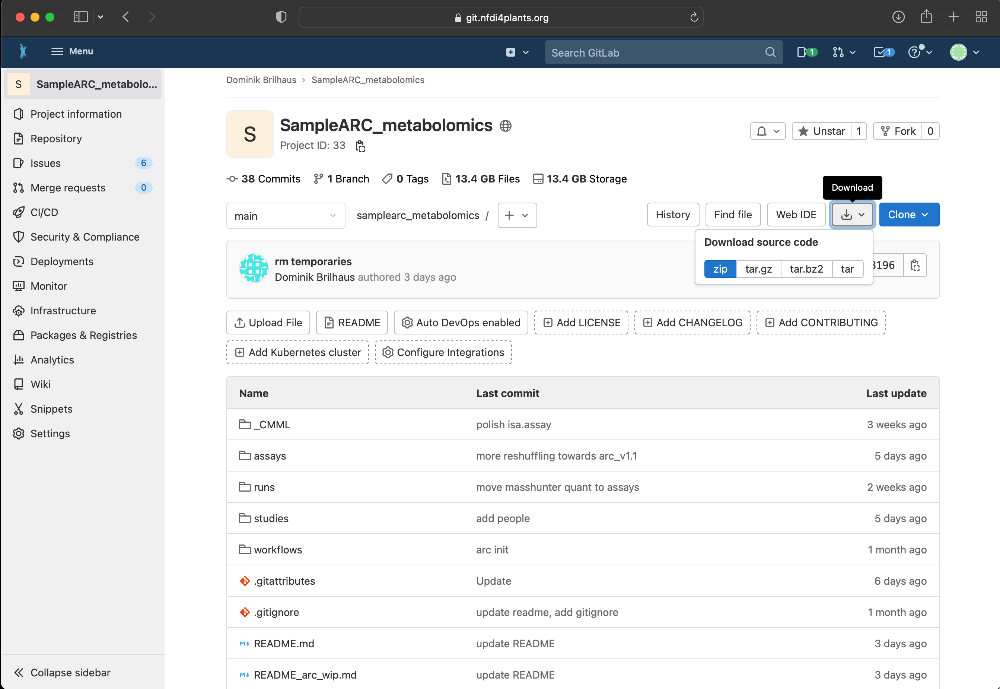
When downloading from a git repository, you receive the files of the current snapshot only.
You do not download the file history (stored in .git).

