Slide 1







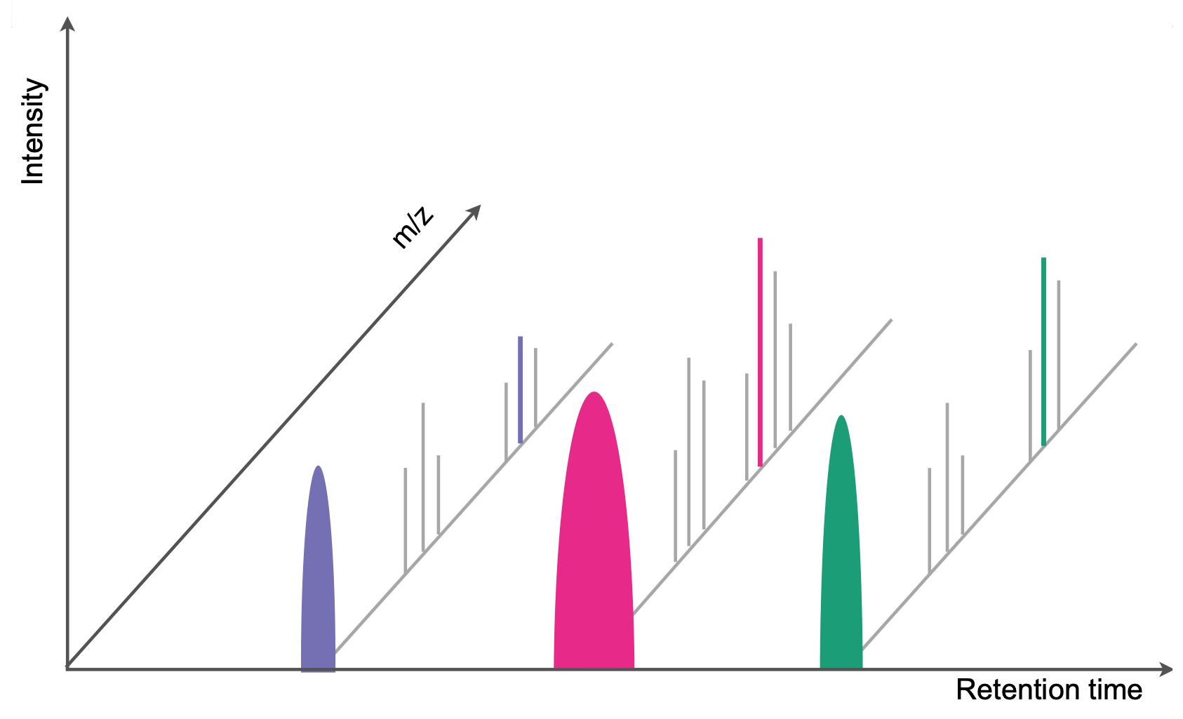
Metadata templates
Domain-specific repositories
CEPLAS aims to assemble a blueprint of the genetic mechanisms that control complex plant traits with sufficient detail to enable predictions of trait performance in different environments. This knowledge is crucial for the design of new crop varieties using predictive trait engineering and will be important for sustainable food security for a growing population faced with climate change.

