Slide 1
Payroll_Dashboard
File created on: 11/5/2019 11:08:36

Slide 2
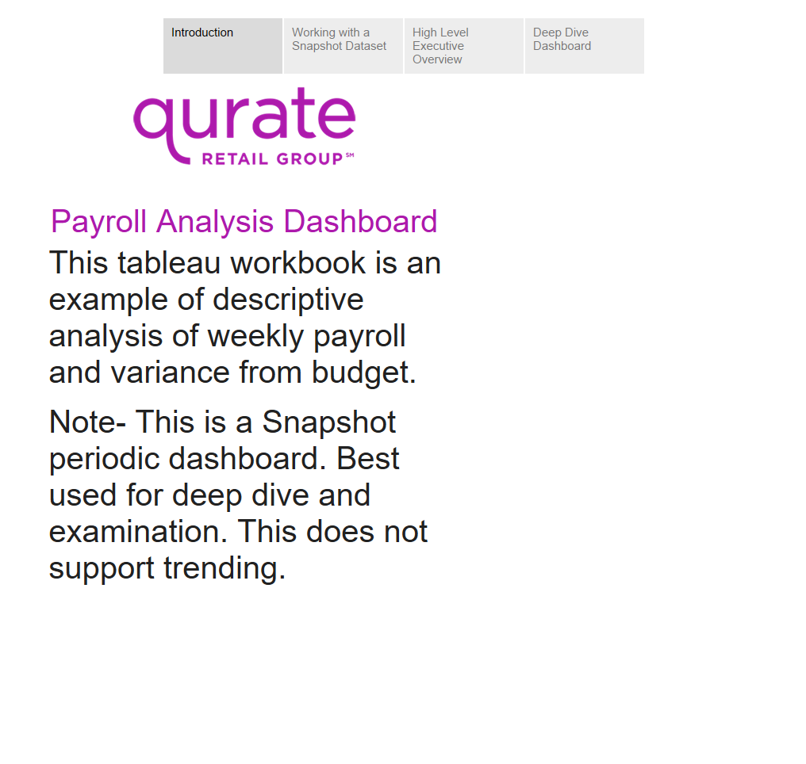

Slide 3
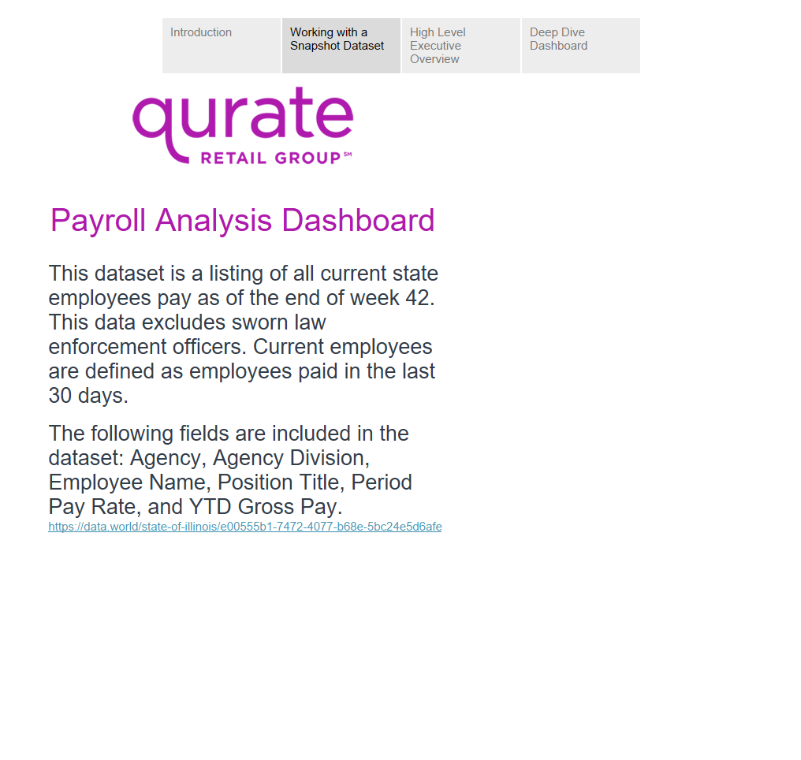

Slide 4
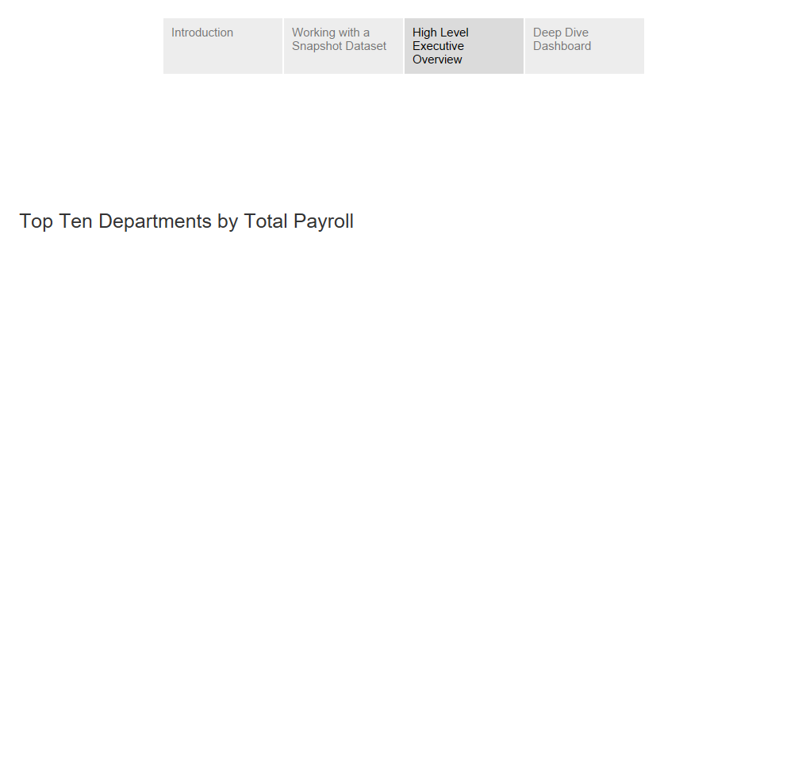

Slide 5
