Slide 1
Building Better BVHs
Nicolas Feltman

Slide 2
Ray tracing: shoot rays into the scene.
Notes:
You have a representation of the scene, which I will assume is just a list of triangles, and we shoot a bunch of rays out into the scene, hopefully at least one per pixel.
Not all rays start at the eye, since rays bounce and spawn other rays, and so on. In many applications, there are many more of these bounces than eye rays.
The goal for each ray is to find the first object in the scene that it hits. The naïve way to intersect a ray with the scene is to intersect with every single triangle in turn and select the closest intersection. That’s linear on the number of triangles, so it’s really slow.
We can probably do better by breaking down the scene in some hierarchical way.

Slide 3
BVHs recursively bound the scene.
BVH = Bounding Volume Hierarchy
Notes:
…and that’s exactly what a BVH is.
In terms of scene geometry, the idea is to grouped the scene into two subscenes around each of which a box is drawn.
These subscenes are also split, and so on, until we arrive at a single triangle. Notice that in some cases, the bounding boxes of subscenes overlap, which is ok.
We can think of the BVH as an unordered tree, which is down on the right.
So then how do we intersect a ray with the triangles carried in a BVH?

Slide 4
BVHs allow quick rejection of parts of the scene.
Box/Triangle Hit
Box/Triangle Miss
Notes:
There’s one key invariant in a BVH. That is that is a ray intersects the bounding box of a BVH node, then it intersects the bounding box of the parent of that node.
The corollary of this is that if a ray does not intersect the bounding box of a node, as we see with the orange node and the right half of the scene,
we know that the ray cannot intersect any of the triangles in that part of the scene, and we don’t have to test there.
Another important concept is that finding an intersection of a ray is only half the story, we also have to show that there are no prior intersections on the ray. This is
exemplified by the red ray, where a good portion of the work is dedicated to proving no intersections in the right part of the scene.
The key takeaway is that the cost of intersection is dependent on both…

Slide 5
Intersection cost depends on both rays and geometry.
GEOMETRY AND
ACCELERATION
STRUCTURE
COST TO
INTERSECT
WORKLOAD OF RAY QUERIES
Notes:
…the BVH and the ray workload. Some BVHs will do better for some workloads than others.
How then do we build BVHs?

Slide 6
BVH-building comes in many flavors.
Top-Down
Bottom-Up
Neither of Those
Notes:
There are three general techniques. There’s top-down, bottom up, and then a fun grab bag of things that aren’t top down or bottom up.
For the most part, state of the art these days is in top-down builds, so how do those work?

Slide 7
Top-Down: Pick some partitions.
Notes:
We start with all of our scene geometry in a big list, and somehow we pick a set of candidate partitions.

Slide 8
Top-Down: try each partition.
Notes:
For each partition, we split the list of primitives into two subsets..

Slide 9
Top-Down: minimize cost.
(Cost of Sub-Tree) ≈
(Size of Box) x (# Triangles)
Notes:
And the we quickly estimate a “cost” of that partition based on the two primitive subsets it induces, and pick the partition with the minimum cost.
Current best practice is to say that the cost of a partition is the sum of the cost of its two subsets, which is estimated as the product of the size of the bounding box of that set and the number of elements in that set.
I’m intentionally vague about what “size of box” means.
So you’ll notice I’ve made a bunch of assumptions here…

Slide 10
The current best practice makes lots of assumptions.
TOP-DOWN
BUILD
AXIS-ALIGNED
SPLITS
LINEAR COST
ESTIMATOR
UNIFORM RAY
DISTRIBUTION
Notes:
That top down is even a good idea.
We’ve only considered axis-aligned splits.
We estimate the cost of the subtree as linear on the number of number of nodes in it.
Last (which is an assumption I haven’t covered yet) is that we assume that rays are distributed proportionately. Lets zoom in on that last assumption.

Slide 11
Why the uniform ray assumption?!
ACCURATE, MAYBE
UNIFORM
ASSUMPTION
EASY TO CALCULATE
(# Rays Intersecting B) ∝ (Surface Area of B)
Notes:
The uniform ray assumption is a good idea for two reasons…
First, it’s accurate, probably. (bounces)
Next, it’s easy to calculate.
But there’s all one big problem here, and this is the intuition for this project.

Slide 12
Since rays are part of the cost function, we should consider them, too.
BUILDING THE BEST BVH
WORKLOAD OF RAY QUERIES
GEOMETRY
Notes:
Both rays and geomtry are part of the cost function, so both should be considered in building the bvh.

Slide 13
Let’s assume we know all the queries ahead of time. What can we do?
TOP-DOWN
BUILD
AXIS-ALIGNED
SPLITS
LINEAR MONOMIAL
COST ESTIMATOR
UNIFORM ACTUAL
RAY DISTRIBUTION
Notes:
Lets assume (unrealistically) we know all of the ray queries that are going to be asked of our bvh. How do we build the best BVH?
I decided to still go with top-down, and simply modify my cost estimator to use real ray data.

Slide 14
Use the measure of ray traffic in the cost estimator to be minimized.
(Cost of Sub-Tree) ≈
(Traffic of Box) x (# Triangles-1)^{α}
(3 Rays)
(4 Rays)
Notes:
In particular, I estimate the cost of a subtree as the traffic of it’s boudning box (which is to say the number of rays that intersect with it), times the number of triangle.
I also added minus 1 and a little alpha coefficient for reasons I’m not going to cover, but they’re a good idea.
So when is this going to make a big difference? Lets consider a contrived example…

Slide 15
Consider a contrived example.
Focus = 0
Focus = 1

Slide 16
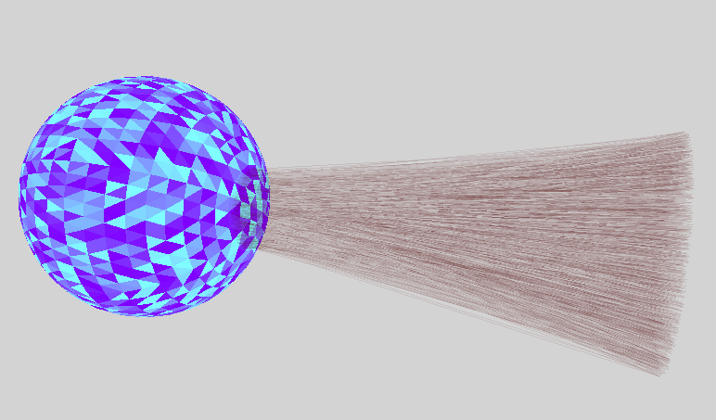
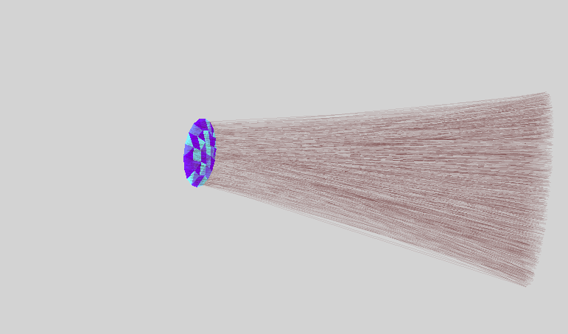
We want the BVH to quick isolate the active portion of the scene.

Slide 17
It works in the contrived case.

Slide 18
And another contrived case.

Slide 19
And a third.

Slide 20
A blended cost function leads to “blended” results.

Slide 21
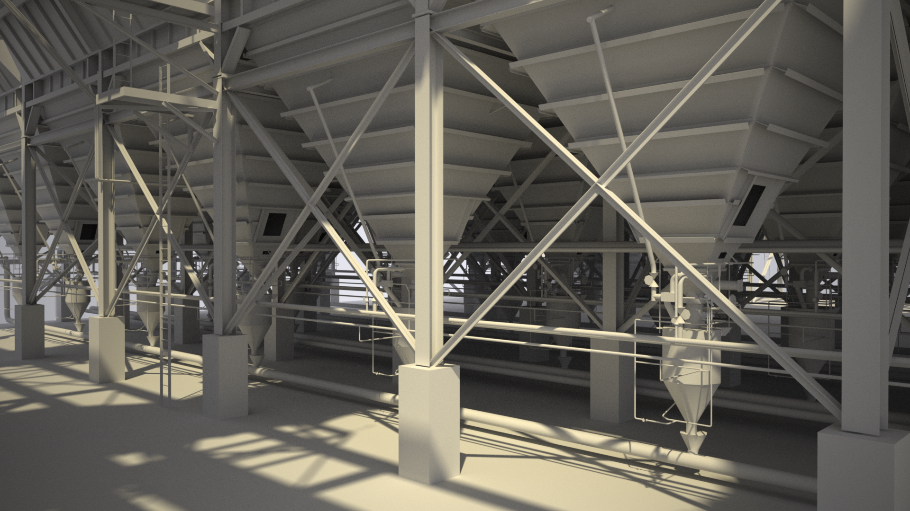
And how about a real scene?
“Powerplant,” courtesy of Intel

Slide 22
Results are modest for real scenes.

Slide 23
Questions?

