Slide 1
Using Ray Distributions to Build Better BVHs
Nicolas Feltman

Slide 2
Overview
Rays and BVHs background
Building BVHs
Results
BONUS I: Novel traversal techniques
BONUS II: The problem with empty space

Slide 3
Rays and BVHs Background

Slide 4
Ray tracing: shoot rays into the scene.
RADIANCE RAY
Notes:
You have a representation of the scene, which I will assume is just a list of triangles, and we shoot a bunch of rays out into the scene, hopefully at least one per pixel.
Not all rays start at the eye, since rays bounce and spawn other rays, and so on. In many applications, there are many more of these bounces than eye rays.
The goal for each ray is to find the first object in the scene that it hits.

Slide 5
Ray tracing: end with a shadow ray.
RADIANCE RAY
SHADOW RAY
Notes:
You have a representation of the scene, which I will assume is just a list of triangles, and we shoot a bunch of rays out into the scene, hopefully at least one per pixel.
Not all rays start at the eye, since rays bounce and spawn other rays, and so on. In many applications, there are many more of these bounces than eye rays.
The goal for each ray is to find the first object in the scene that it hits. The naïve way to intersect a ray with the scene is to intersect with every single triangle in turn and select the closest intersection. That’s linear on the number of triangles, so it’s really slow.
We can probably do better by breaking down the scene in some hierarchical way.

Slide 6
ESTABLISHED IDEA:
Shadow rays are different from radiance rays.

Slide 7
BVHs recursively bound the scene.
BVH = Bounding Volume Hierarchy
Notes:
The naïve way to intersect a ray with the scene is to intersect with every single triangle in turn and select the closest intersection. That’s linear on the number of triangles, so it’s really slow.
We can probably do better by breaking down the scene in some hierarchical way.
…and that’s exactly what a BVH is.
In terms of scene geometry, the idea is to grouped the scene into two subscenes around each of which a box is drawn.
These subscenes are also split, and so on, until we arrive at a single triangle. Notice that in some cases, the bounding boxes of subscenes overlap, which is ok.
We can think of the BVH as an unordered tree, which is down on the right.
So then how do we intersect a ray with the triangles carried in a BVH?

Slide 8
BVHs allow quick rejection of parts of the scene.
Box/Triangle Hit
Box/Triangle Miss
Notes:
There’s one key invariant in a BVH. That is that is a ray intersects the bounding box of a BVH node, then it intersects the bounding box of the parent of that node.
The corollary of this is that if a ray does not intersect the bounding box of a node, as we see with the orange node and the right half of the scene,
we know that the ray cannot intersect any of the triangles in that part of the scene, and we don’t have to test there.
Another important concept is that finding an intersection of a ray is only half the story, we also have to show that there are no prior intersections on the ray. This is
exemplified by the red ray, where a good portion of the work is dedicated to proving no intersections in the right part of the scene.
The key takeaway is that the cost of intersection is dependent on both…

Slide 9
BVHs are extra good for shadow rays
Box/Triangle Hit
Box/Triangle Miss
Notes:
With shadow rays, the traversal might terminate early.
Thus, there is a large difference between a “good” traversal and a “bad traversal”

Slide 10
GOOD RESEARCH IDEA:
Build a better data structure.
Notes:
-It’s often an upfront cost.
-This goal has been on the radar for 25 years or so.
-how far are we from optimal?

Slide 11
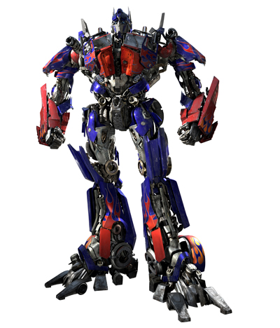
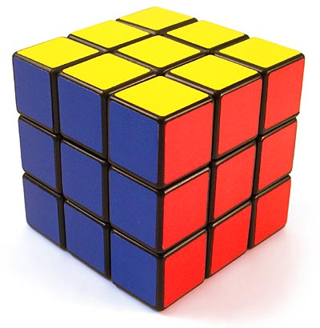
For whom is the scene more costly: Green or Orange?
Complex geometry
Simple geometry
Notes:
You have to search more deeply for optimus prime than for the rubik’s cube

Slide 12
Intersection cost depends on both rays and geometry.
GEOMETRY AND
ACCELERATION
STRUCTURE
COST TO
INTERSECT
WORKLOAD OF RAY QUERIES
Notes:
Raytracing is search
Need to motivate spatial coherence != traversal coherence

Slide 13
KEY NEWISH IDEA:
[Hunt, Mark 08]
[Havran, Bittner 09]
Use information about the rays in the build process.
(Today, we’re using the full set of rays as the prior.)
Notes:
Warren
Then havran
(add citations)

Slide 14
APPLICATION: SHADOW RAYS
Shadow rays yield more room in which to optimize. Let’s ignore radiance rays.

Slide 15
BVH Shadow Ray Traversal
def traverse(n,r)
if(miss(n,r))
return false;
if(isLeaf(n))
return intrsctPrims(n,r);
// n is a branch
ord = [left(n), right(n)] (p_{n}),
[right(n), left(n)] (q_{n}).
return traverse(ord[0],r)
|| traverse(ord[1],r);
p₀
q₀
p₁
q₁
p₃
q₃
p₂
q₂
p₄
q₄
p_{i} + q_{i} = 1
Notes:
Key them in to the novelty of this.
Emphasize this will come back
I am setting up a theoretical framework in which to analyze performance.

Slide 16
Some Definitions.
PASS
HIT
FAUX-HIT
MISS
PIERCE

Slide 17
Some Definitions.
PASS
H(N,r)
F(N,r)
M(N,r)
HIT
FAUX-HIT
MISS
PIERCE

Slide 18
COST METRICS
Know ray distribution.
Don’t know ray distribution.
Shadow ray distribution cost metric.
Surface area cost metric.
Notes:
If we want to have any hope of building a good tree, we need to have some metric of what a good tree is.
In particular, I want to measure how many box intersections I am performing.

Slide 19
Surface Area Cost Metric
We assume uniform distribution of rays.
We assume rays do not stop traversing when they hit an object (meaning p and q go unused).
Note: The probability of piercing a bounding box is proportional to its surface area.

Slide 20
Surface Area Cost Metric
N
C(N,r) = c_{b} + [H(N,r)+F(N,r)][C(A,r)+C(B,r)]
A
B
N
C(N,r) = c_{b} + [H(N,r)+F(N,r)] c_{p}
Notes:
Define my variables!

Slide 21
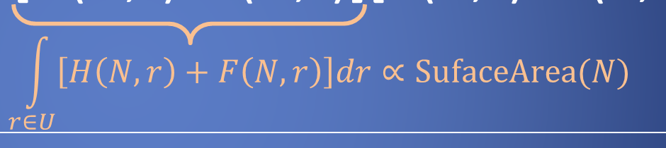
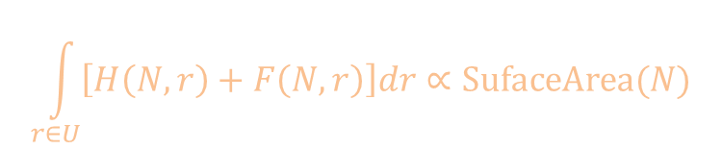
Surface Area Cost Metric
N
C(N,r) = c_{b} + [H(N,r)+F(N,r)][C(A,r)+C(B,r)]
A
B
$$\int_{r∈U}{\left[H\left(N,r\right)+F\left(N,r\right)\right]dr}∝\text{SufaceArea}(N)$$
N
C(N,r) = c_{b} + [H(N,r)+F(N,r)] c_{p}
Notes:
Define my variables!

Slide 22
Shadow Ray Cost Metric
C(N,r) = c_{b} + [H(N,r)+F(N,r)]
[(p_{N}H(B,r)+F(B,r)+M(B,r))C(A,r)
+(q_{N}H(A,r)+F(A,r)+M(A,r))C(B,r)]
N
A
B
N
C(N,r) = c_{b} + [H(N,r)+F(N,r)] c_{p}
Notes:
Define my variables!

Slide 23
Building BVHs

Slide 24
KEY TERRIBLE IDEA:
Try every BVH.

Slide 25
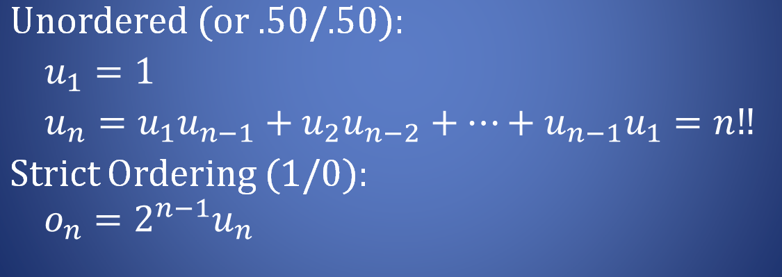

How many BVHs are there?
Unordered (or .50/.50):
$u_{1}=1$
$u_{n}=u_{1}u_{n−1}+u_{2}u_{n−2}+…+u_{n−1}u_{1}=n‼$
Strict Ordering (1/0):
$$o_{n}=2^{n−1}u_{n}$$

Slide 26
BVH-building comes in many flavors.
Top-Down
Bottom-Up
Neither of Those
Notes:
There are three general techniques. There’s top-down, bottom up, and then a fun grab bag of things that aren’t top down or bottom up.
For the most part, state of the art these days is in top-down builds, so how do those work?

Slide 27
Top-Down Methods
def tdBuild(L)
if(|L|==1) return Leaf(L);
P = partitions(L);
bestP = selectPart(P, L);
(p,L₁,L₂) = bestP(L);
return new Branch(p,
tdBuild(L₁),
tdBuild(L₂));
L
L₁
L₂
Notes:
Note that the partition is not inherently a spatial one. We could partition however we like. Also, every possible tree is 1-to-1 with a chain of possible partitions.

Slide 28
Example Partition Set: Linear splits in each dimension
Notes:
We start with all of our scene geometry in a big list, and somehow we pick a set of candidate partitions.

Slide 29
Example Partition Set: Radial splits from a point
Notes:
We start with all of our scene geometry in a big list, and somehow we pick a set of candidate partitions.

Slide 30
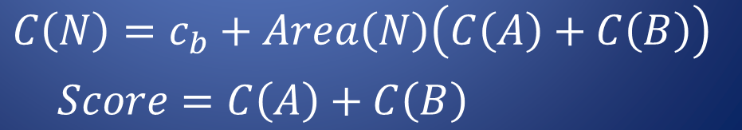


Scoring Partitions: SAM in detail.
B
A
N
$$C\left(N\right)=c_{b}+Area\left(N\right)\left(C\left(A\right)+C\left(B\right)\right)$$
A
B
$$Score=C\left(A\right)+C\left(B\right)$$
Notes:
And the we quickly estimate a “cost” of that partition based on the two primitive subsets it induces, and pick the partition with the minimum cost.
Current best practice is to say that the cost of a partition is the sum of the cost of its two subsets, which is estimated as the product of the size of the bounding box of that set and the number of elements in that set.
I’m intentionally vague about what “size of box” means.
So you’ll notice I’ve made a bunch of assumptions here…

Slide 31
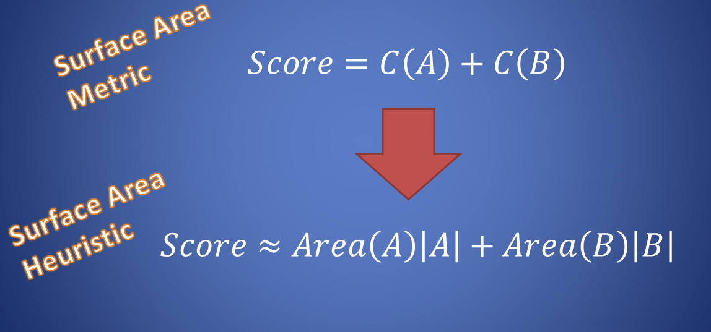


The true cost of a subtree cannot be known. We must estimate score with a heuristic.
Surface Area Metric
$$Score=C\left(A\right)+C\left(B\right)$$
Surface Area Heuristic
$$Score≈Area\left(A\right)\left|A\right|+Area\left(B\right)\left|B\right|$$
$\left|A\right|=$Number of Leaves in A

Slide 32
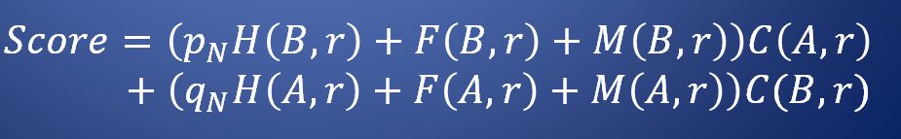

Scoring Partitions: SRDM in detail.
B
A
N
$$Score=\left(p_{N}H\left(B,r\right)+F\left(B,r\right)+M\left(B,r\right)\right)C\left(A,r\right)+\left(q_{N}H\left(A,r\right)+F\left(A,r\right)+M\left(A,r\right)\right)C(B,r)$$
A
B
Notes:
And the we quickly estimate a “cost” of that partition based on the two primitive subsets it induces, and pick the partition with the minimum cost.
Current best practice is to say that the cost of a partition is the sum of the cost of its two subsets, which is estimated as the product of the size of the bounding box of that set and the number of elements in that set.
I’m intentionally vague about what “size of box” means.
So you’ll notice I’ve made a bunch of assumptions here…

Slide 33
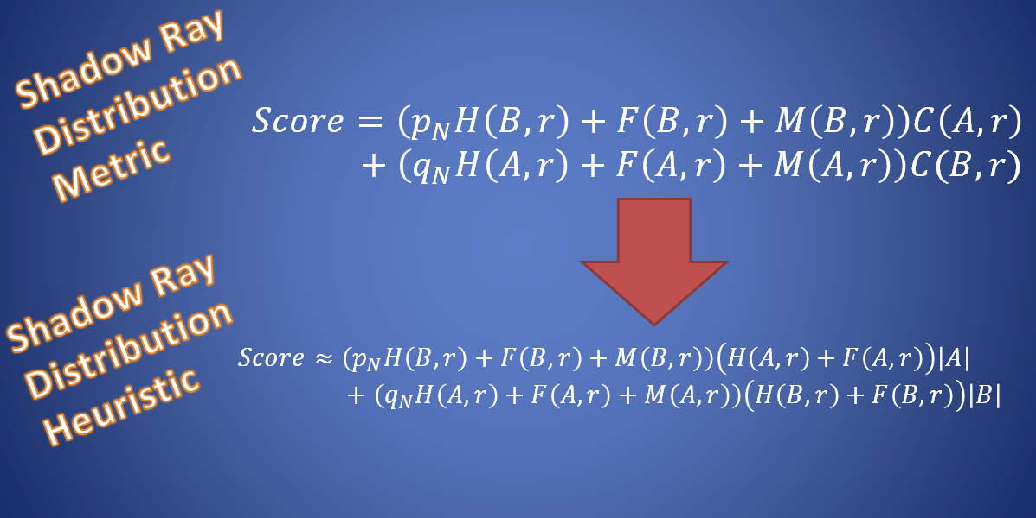

As before, we need to estimate SRDM
Shadow Ray Distribution Metric
$$Score=\left(p_{N}H\left(B,r\right)+F\left(B,r\right)+M\left(B,r\right)\right)C\left(A,r\right)+\left(q_{N}H\left(A,r\right)+F\left(A,r\right)+M\left(A,r\right)\right)C(B,r)$$
Shadow Ray Distribution
Heuristic
$$Score≈\left(p_{N}H\left(B,r\right)+F\left(B,r\right)+M\left(B,r\right)\right)\left(H\left(A,r\right)+F\left(A,r\right)\right)\left|A\right|+\left(q_{N}H\left(A,r\right)+F\left(A,r\right)+M\left(A,r\right)\right)\left(H\left(B,r\right)+F\left(B,r\right)\right)\left|B\right|$$
$\left|A\right|=$Number of Leaves in A

Slide 34
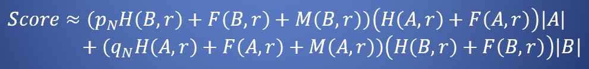

I can evaluate H,F,M because I have evaluated the whole trace ahead of time
For each ray, I have stored the entire set of triangles that it hits.
$$Score≈\left(p_{N}H\left(B,r\right)+F\left(B,r\right)+M\left(B,r\right)\right)\left(H\left(A,r\right)+F\left(A,r\right)\right)\left|A\right|+\left(q_{N}H\left(A,r\right)+F\left(A,r\right)+M\left(A,r\right)\right)\left(H\left(B,r\right)+F\left(B,r\right)\right)\left|B\right|$$

Slide 35
PARTITION GENERATION
Four Major Issues
ALREADY AT OPTIMUM?
LOCAL COVERGENCE IMPLIES GLOBAL CONVERGENCE?
PARTITION SELECTION

Slide 36
Results

Slide 37
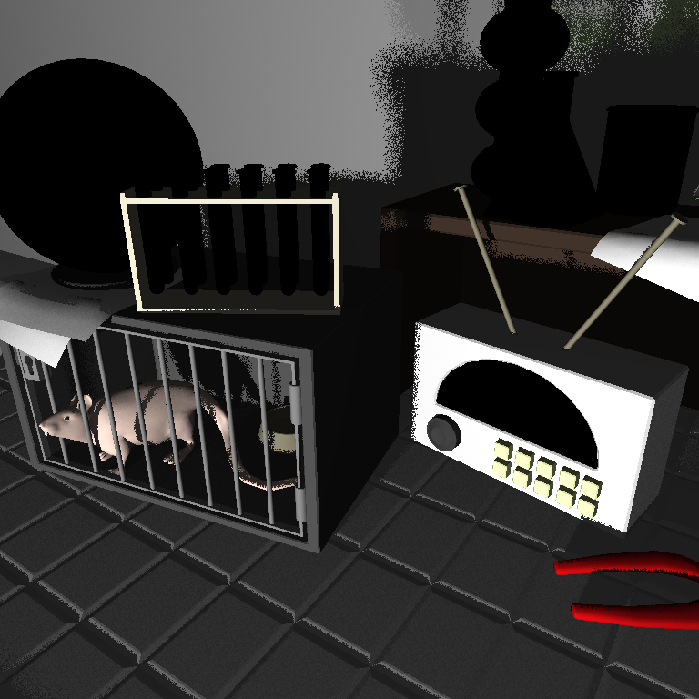
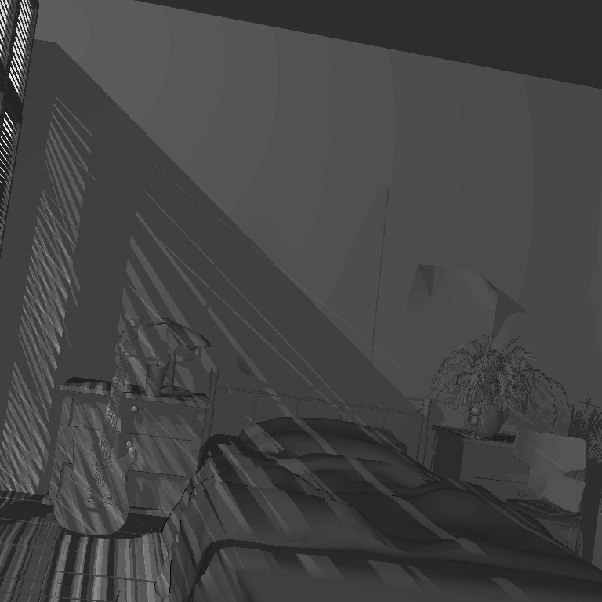
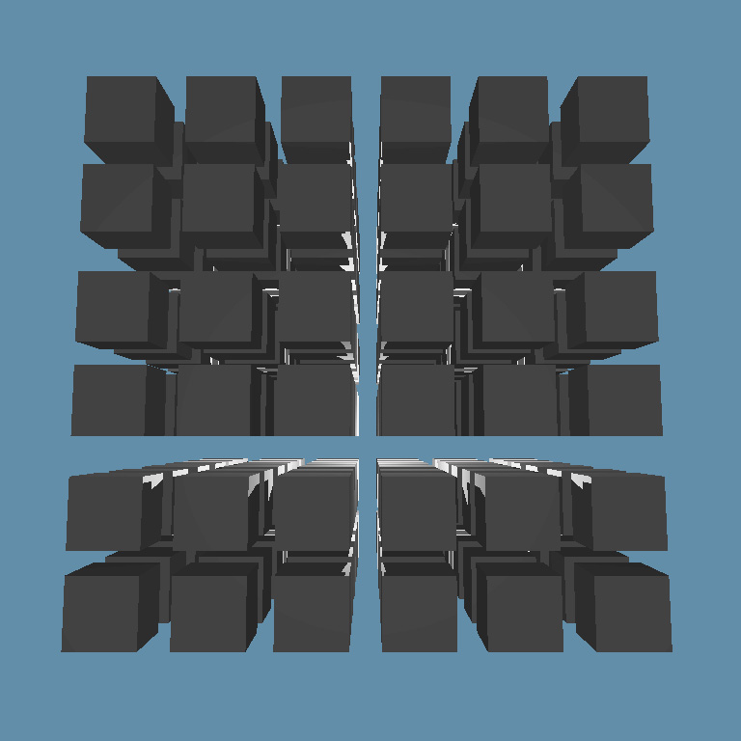
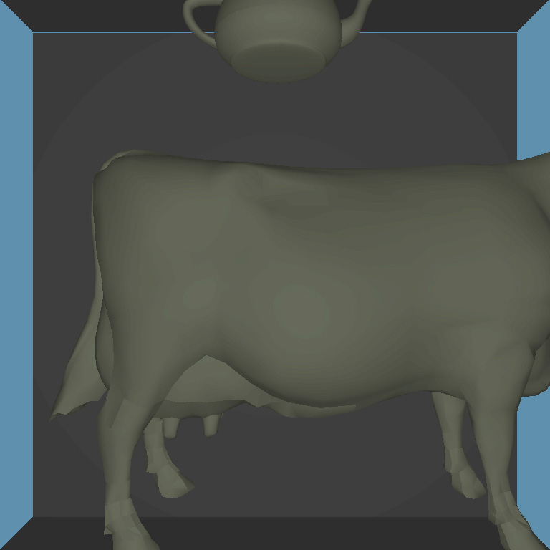
MadSci
Bedroom
Matrix
Dark

Slide 38
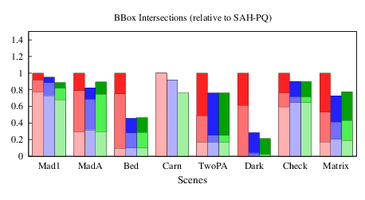
SRDH: fewer bounding box intersection tests.
RED = SAH (AA3 + RAD)
BLUE = SRDH (AA3 + RAD)
GREEN = SRDH (AA3)
Bounding Box Intersections
>2x benefit on Bedroom and Dark
Little benefit ⬄ Few Shadows
Notes:
-measuring boudning box intersection tests: lower is better
-8 scenes
-for each scene 3 groups of bars (red, green, blue)
-for now, compare red to green

Slide 39
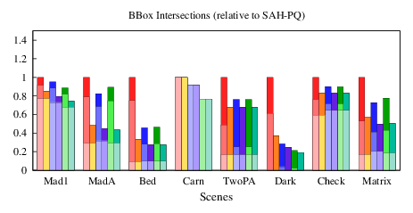
Oracle traverser: ~2x fewer tests.
RED = SAH (AA3 + RAD)
BLUE = SRDH (AA3 + RAD)
GREEN = SRDH (AA3)
Bounding Box Intersections
Notes:
In this graph, I’ve split each vertical column into two.
The left is the standard expected bounding box, but the right is expected number of bounding box intersection tests using a special traverser which always takes the correct path to a triangle hit if there is one.
We call this the oracle traverser.

Slide 40
PARTITION GENERATION
Four Major Issues
ALREADY AT OPTIMUM?
LOCAL COVERGENCE IMPLIES GLOBAL CONVERGENCE?
PARTITION SELECTION

Slide 41
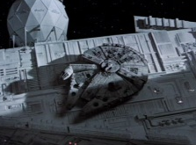
PARTITION GENERATION

Slide 42
Questions?

Slide 43
Novel Traversal Techniques

Slide 44
What if I’m reeeeeeaaally sure that I’m going to pierce node N?
N
A
B

Slide 45
Empty Space

Slide 46
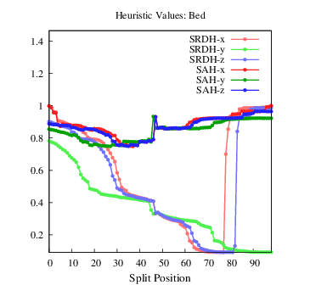
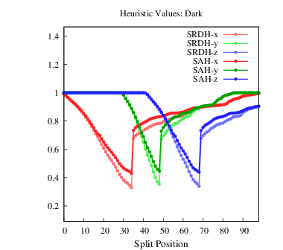
Appendix: Split Plots

