Slide 1
LAC GROWTH SHORTFALL:
Productivity and Inequality
Eduardo Fernández-Arias
UNDP Regional Human Development Report
Buenos Aires. March 20, 2020

Slide 2
Outline
1. LAC economic performance
2. Comparative approach to assess LAC performance
3. Productivity growth and inequality

Slide 3
ARGENTINA, BOLIVIA, BRAZIL, BARBADOS, CHILE, COLOMBIA, COSTA RICA, DOM REPUBLIC, ECUADOR, GUATEMALA, JAMAICA, MEXICO, PERU, T & T, URUGUAY, VENEZUELA
1962-68, 1969-75, 1976-82, 1983-89
1990-96, 1997-2003, 2004-10, 2011-17
LAC ECONOMIC PERFORMANCE

Slide 4
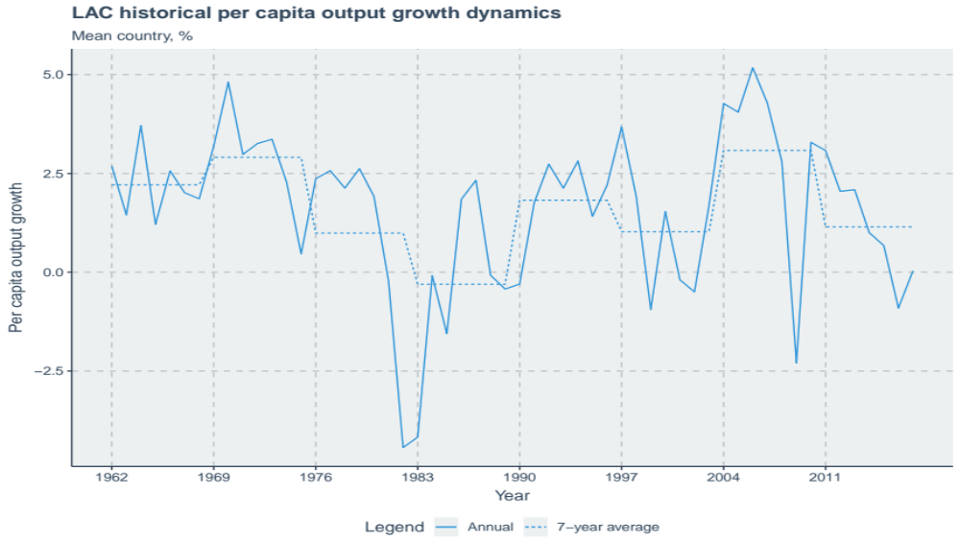
Unstable per capita output growth pivots around the debt crisis
Fig 1

Slide 5
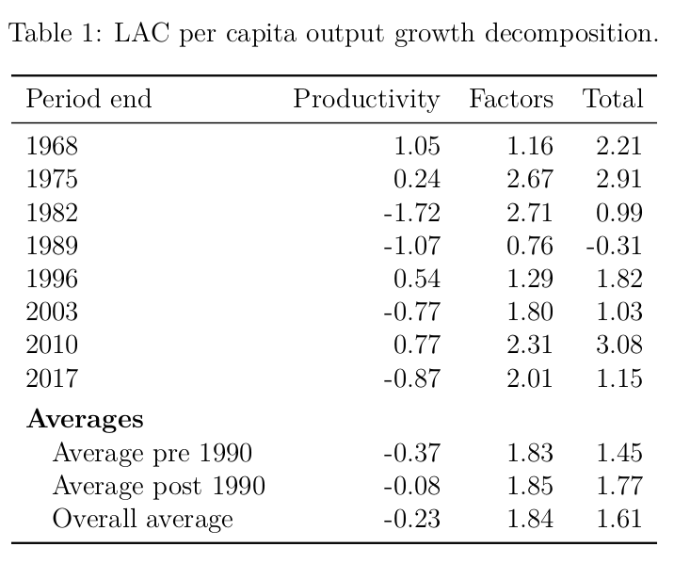
Productivity growth (PWT) tracked GDP growth swings (corr 0.84)...
table 1

Slide 6
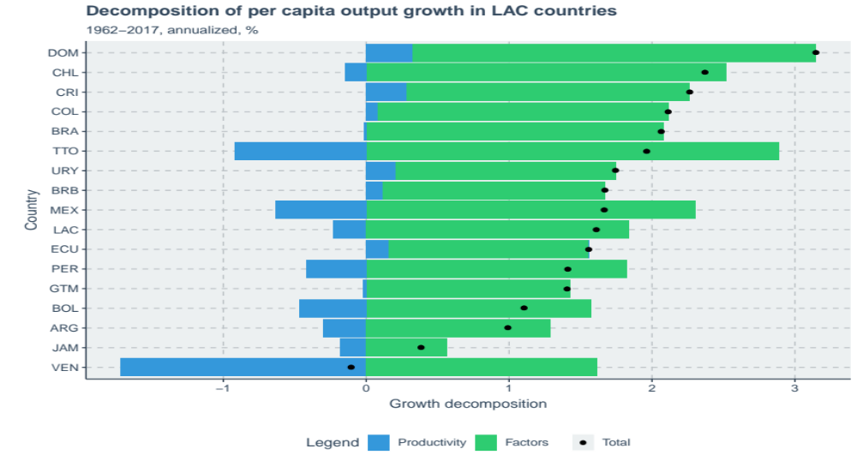
...but did not contribute much to sustain per capita output growth...

Slide 7
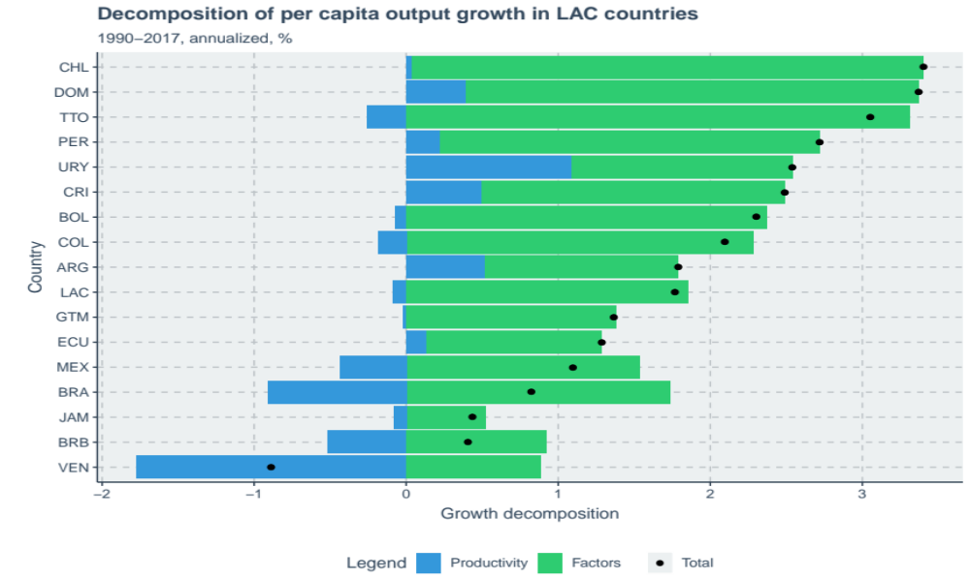
...not even after 1990 (but Uruguay)

Slide 8
Comparative development analysis comparative growth accounting adjusting for stage of development lac comparative growth in panel regressions
A COMPARATIVE APPROACH
TO ASSESS LAC PERFORMANCE

Slide 9
Comparative development: low LAC GDP pc wrt USA due to low productivity (Daude and FA 2010)
Productivity gap of about 50% increasing while gap in the stock of factors decreasing
If productivity gap closed, output gap would largely disappear over time
Productivity spillover of LAC investment is low (FA and Rodriguez Apolinar 2014)

Slide 10
Comparative growth accounting
(v. Non-LAC (the norm), EAT, Africa, USA) controls for global shocks
Almost 1% growth shortfall below the norm. Why?
Because productivity growth is subpar (wrt to all benchmarks, even post-1990).
Factor accumulation is in line (strong post-1990)
Conclusion: factor accumulation is healthy and productivity growth is faulty
Post-1990 better but only halfway: qualitative findings remain

Slide 11
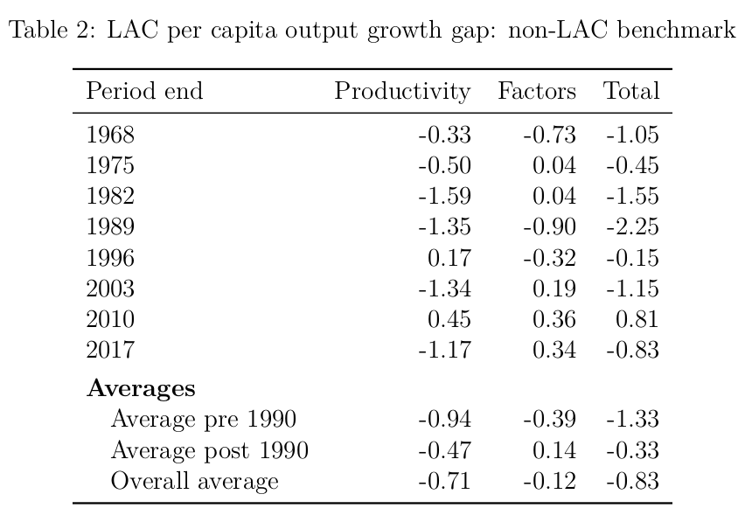
Productivity growth is subpar...

Slide 12
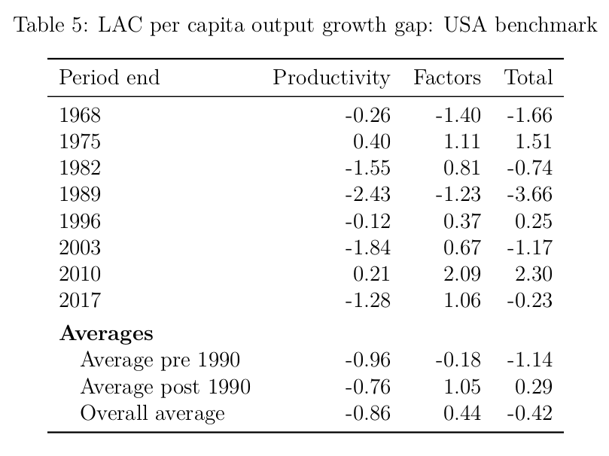
...and not catching up with frontier

Slide 13
Panel regressions of per capita output growth decompositions show:
Global shocks are large, often statistically significant (post 1990 better performance in LAC is larger than it seems)
Statistically significant unconditional divergence of productivity (backwardness is bad for productivity growth)
Adjusting comparisons for stage of development confirms conclusions

Slide 14
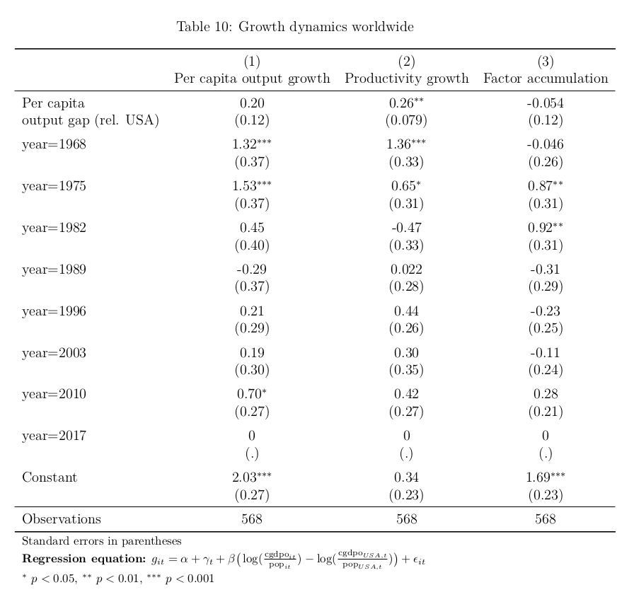
Controlling growth for global shocks and stage of development

Slide 15
LAC dummies in growth regressions measure anomalies statistically
Overall, with high levels of confidence, LAC per capita output growth was subpar because of subpar productivity growth
Post-1990, productivity growth improved but continued to be subpar (with 90% confidence) and drive subpar total growth.

Slide 16
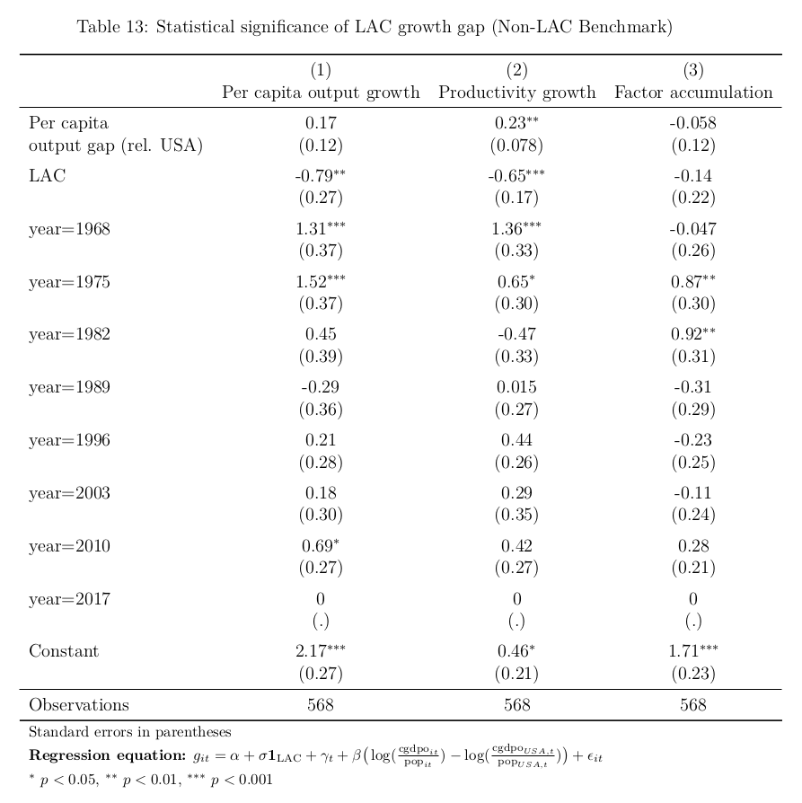
LAC productivity and total growth significantly below the norm...

Slide 17
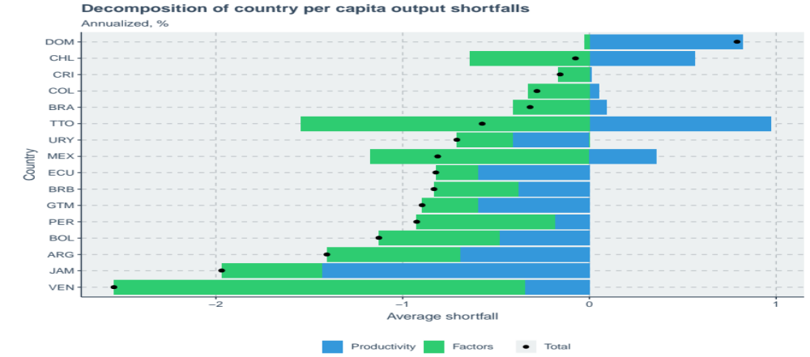
...with subpar productivity growth in every country!

Slide 18
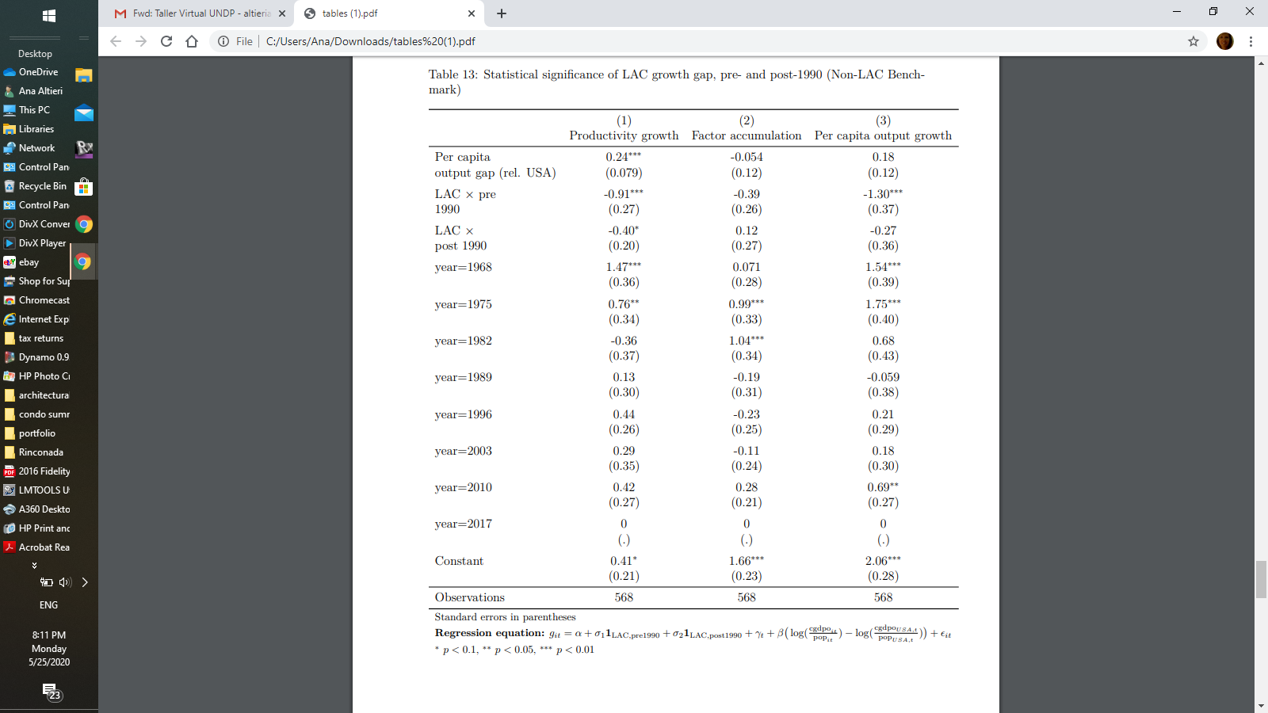
LAC improved after 1990 but productivity growth is still lagging

Slide 19
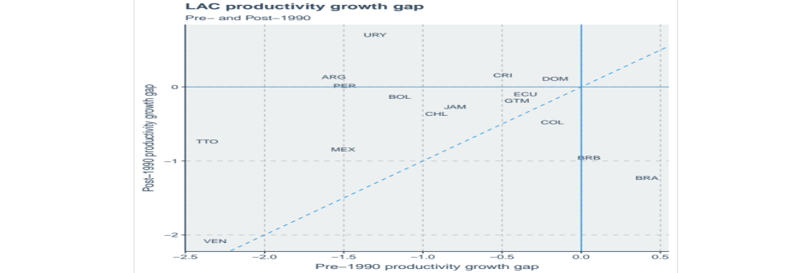
Little progress in productivity growth (only Uruguay is catching up)

Slide 20
To what extent can the growth gaps be explained by inequality?
We re-run growth regressions controlling for inequality
PRODUCTIVITY GROWTH
AND INEQUALITY

Slide 21
TENTATIVE
(TO BE COMPLETED)
Standardized World Income Inequality Database (SWIID), Market and Disposable Income Ginis
Smaller sample size, mostly post 1980. Findings roughly similar, so it is a good laboratory to gauge effects of controlling for inequality on growth gaps (to re-estimate gaps purged from inequality in the spirit of diff in diff)

Slide 22
Controlling for Inequality
(Disposable Income Gini)
LAC productivity growth gap is reduced by 0.40 points, eliminating the post-1990 gap
However no effect on overall growth gap because opposite effect on factor accumulation
Preliminary conclusion: LAC inequality explains its productivity shortfall, but hides a potential accumulation shortfall.

Slide 23
Controlling for both Ginis
Disposable income is Market Income plus Distribution, potentially different implications
Findings: Market inequality is bad for both sources of growth, but lowering inequality through redistribution is only good for productivity, not for factor accumulation

Slide 24
Tentative conclusions
High inequality is the smoking gun of LAC productivity growth gap, especially post 1990 (both unequal market and low redistribution)
But high inequality hides higher underlying growth gaps in factor accumulation and overall because of the substantial help it gets from low redistribution.

