Slide 1
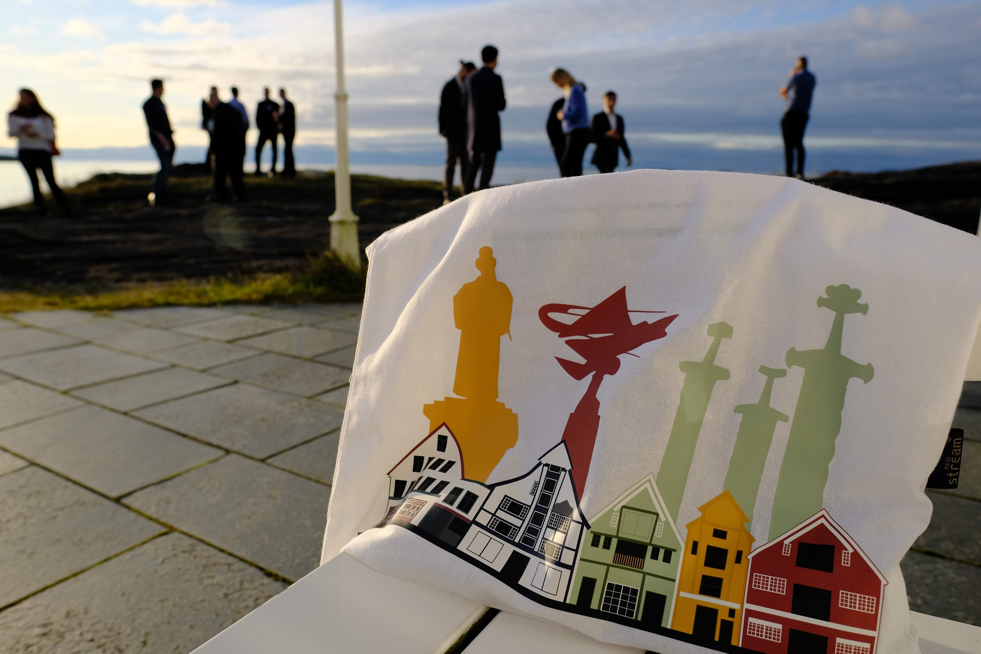
SAVE THE DATES
3rd Geosteering workshop
by NORCE and NFES
November 11-13, 2024
Stavanger, Norway

