Slide 1
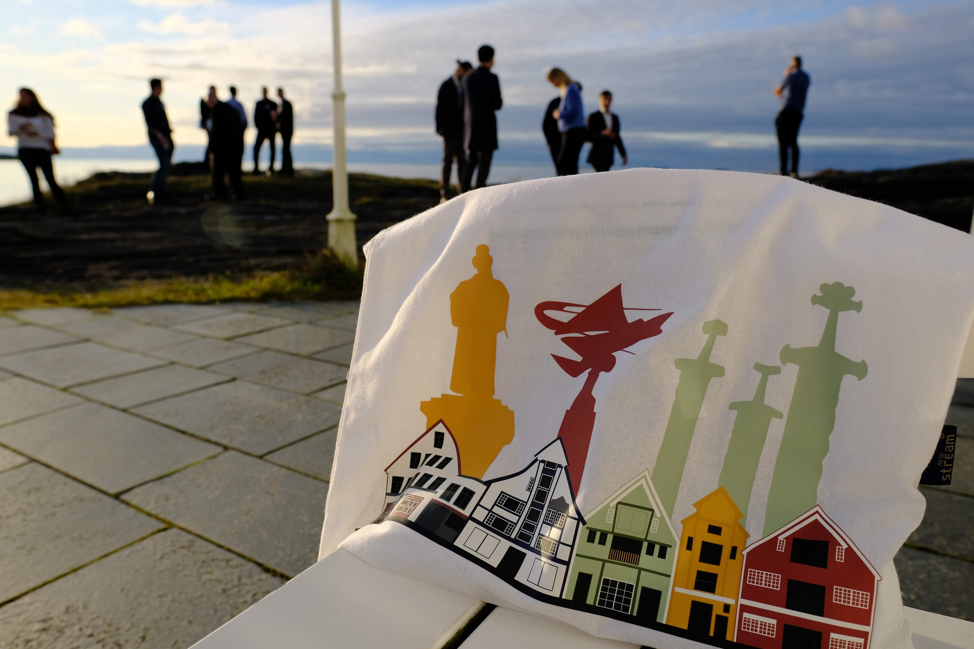
SAVE THE DATES
November 11-13, 2024
3rd Geosteering workshop
by NORCE and NFES
Stavanger, Norway

