Slide 1

CS212: Object-Oriented Programming
Introduction
Ayesha Kanwal
Ayesha.kanwal@seecs.edu.pk
Slides Courtesy (Dr. Nazia Perwais)

Slide 2
Recap
Last week we learnt:
What are classes and objects
How to declare a class
How to create an object
How to declare methods in a class
How to call a method using object
Instance variables vs local variables vs Static variables
How to use a constructor/ parameterized constructor
Date class methods
Random class methods

Slide 3
Objectives
Access Modifiers
Accessor & Mutator Methods
Scope of declarations - Shadowing
How to refer to the current object’s members using the this reference?
3

Slide 4
Access Modifiers/ Visibility Modifiers
There’s a special relationship between classes that are compiled in the same directory, such classes are considered to be in the same package—known as the default package.
Default (No Modifier)
  If no access modifier is specified, the members are accessible only within the same package (package-private access).
public
  The class, data, or method is visible to any class in any package.
private
  The data or methods can be accessed only by the declaring class.
Protected
  The class members are accessible within the same package and by subclasses (even in different packages) through inheritance.

Slide 5
The private modifier restricts access to within a class, the default modifier restricts access to within a package, and the public modifier enables unrestricted access.

Slide 6
NOTE
An object cannot access its private members directly in other class (b). However, if the object is declared in its own class, as shown in (a), it can access its private members directly.
public class Foo {
private boolean x;
public static void main(String[] args) {
Foo f = new F ();
System.out.println(f.x);
System.out.println(f.convert(true));
}
private int convert(boolean b) {
return x ? 1 : -1;
}
}
(a) This is OK because object f is used inside the F class
public class Test {
public static void main(String[] args) {
Foo f = new Foo();
System.out.println(f.x);
System.out.println(f.convert(f.x));
}
}
(b) This is wrong because x and convert() are private in Foo.
(a)
(b)

Slide 7
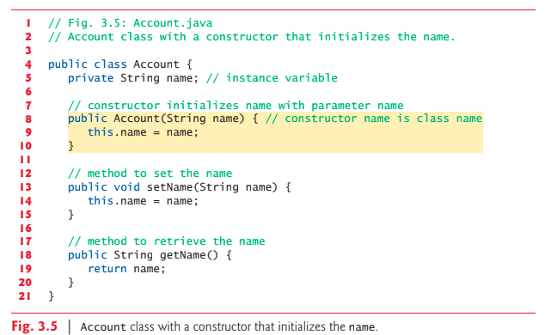
Accessor/Mutator Methods
The get and set methods are used to read and modify private properties. (accessor and mutator methods)

Slide 8
Why Data Fields Should Be private?
A class object can peek at the private data any time with the public get method and that can modify the private data at will through the public set method.
But set methods can be programmed to validate their arguments and reject any attempts to set the data to bad values, such as a negative body temperature, a day in March out of the range 1 through 31, a product code not in the company’s product catalog, etc.

Slide 9
Example of Data Field Encapsulation
The radius of this circle (default: 1.0).
The number of circle objects created.
Constructs a default circle object.
Constructs a circle object with the specified radius.
Returns the radius of this circle.
Sets a new radius for this circle.
Returns the number of circle objects created.
Returns the area of this circle.

Slide 10
Scope of Declarations - Shadowing
Shadowing
  A field is shadowed (or hidden) if a local variable or parameter has the same name as the field
    This lasts until the local variable or parameter goes out of scope
10

Slide 11
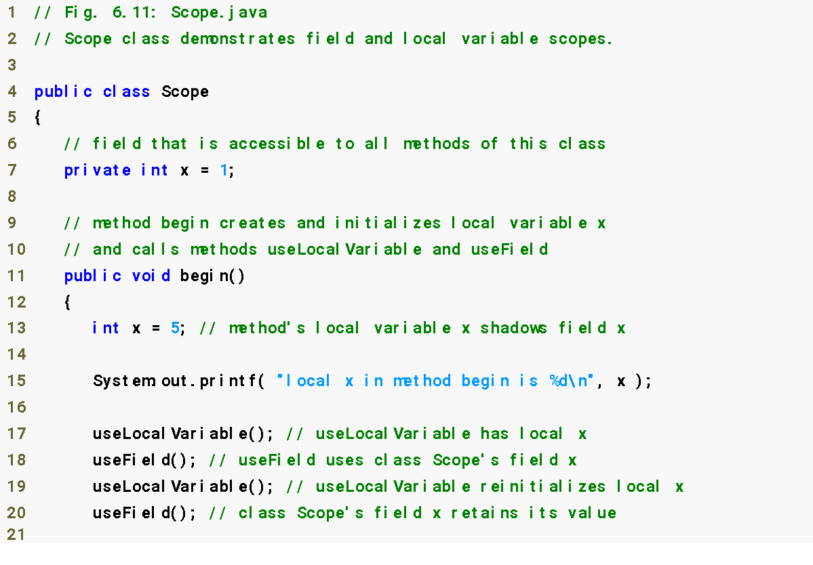
Shadows field x
Display value of local variable x
11

Slide 12
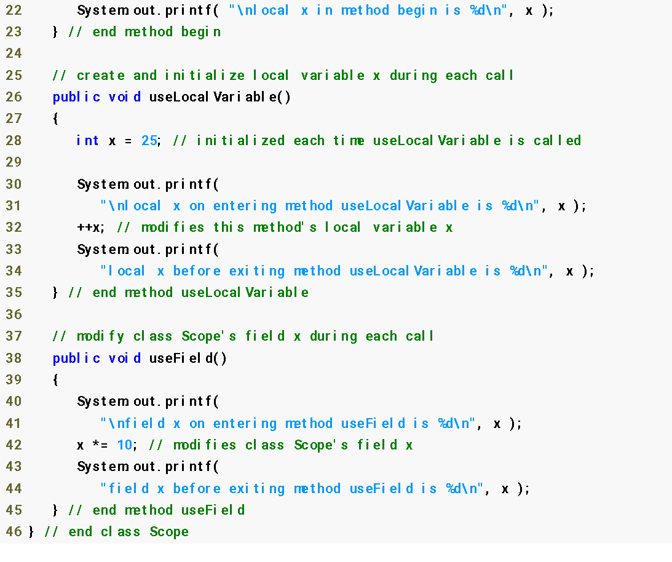
Shadows field x
Display value of local variable x
Display value of field x
12

Slide 13
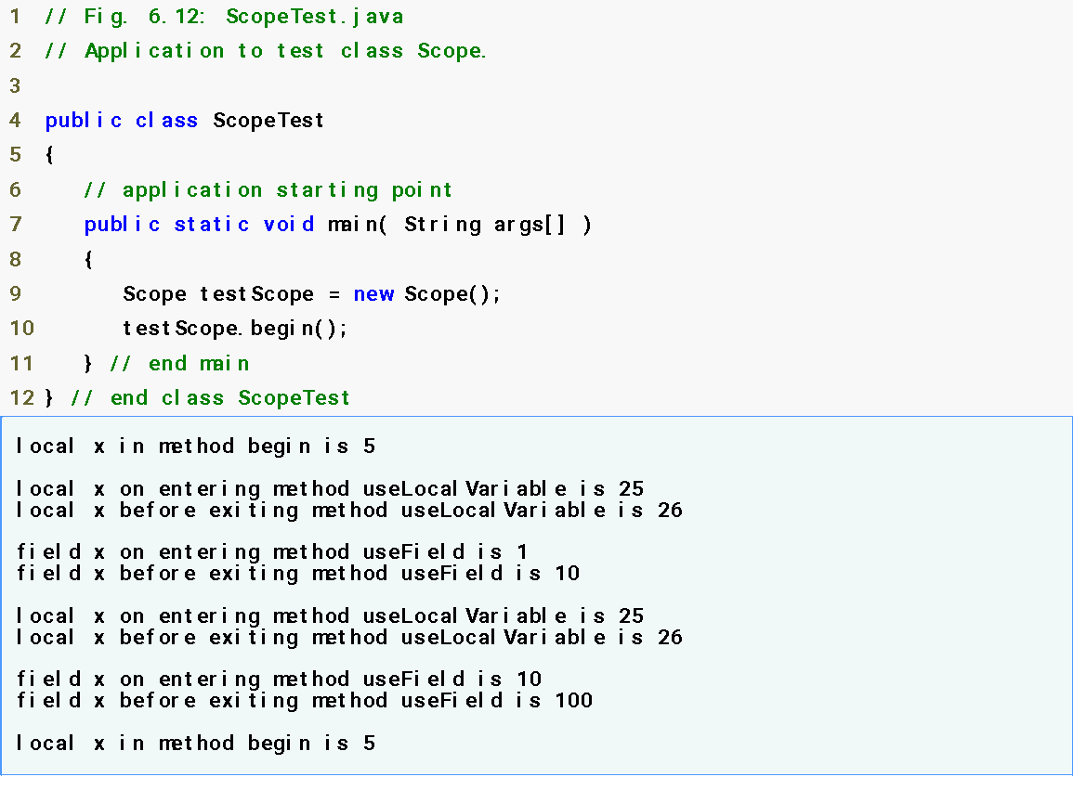
13

Slide 14
Referring to the Current Object’s Members with the this Reference
Any object can access a reference to itself with keyword this
Non-static methods implicitly use this when referring to the object’s instance variables and other methods
Can be used to access instance variables when they are shadowed by local variables or method parameters
A .java file can contain more than one class
  But only one class in each .java file can be public
14

Slide 15
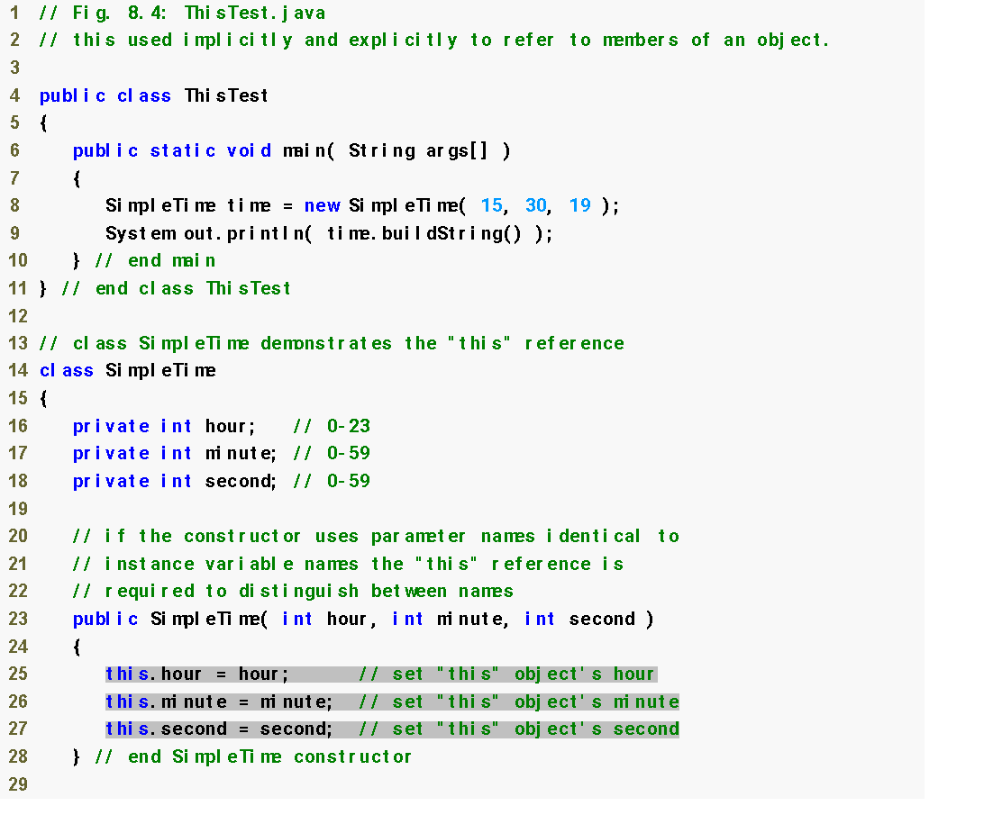
Create new SimpleTime object
Declare instance variables
Method parameters shadow instance variables
15
Using this to access the object’s instance variables
Notes:
// Fig. 8.4: ThisTest.java
// this used implicitly and explicitly to refer to members of an object.
public class Main {
public static void main(String args[]) {
SimpleTime time = new SimpleTime(15, 30, 19);
System.out.println(time.buildString());
}
}
// class SimpleTime demonstrates the "this" reference
class SimpleTime {
private int hour; // 0-23
private int minute; // 0-59
private int second; // 0-59
// if the constructor uses parameter names identical to
// instance variable names the "this" reference is
// required to distinguish between names
public SimpleTime(int hour, int minute, int second) {
this.hour = hour; // set "this" object's hour
this.minute = minute; // set "this" object's minute
this.second = second; // set "this" object's second
}
// use explicit and implicit "this" to call toUniversalString
public String buildString() {
return String.format("%24s: %s\n%24s: %s",
"this.toUniversalString()", this.toUniversalString(), "toUniversalString()", toUniversalString());
}
// convert to String in universal-time format (HH:MM:SS)
public String toUniversalString() {
// "this" is not required here to access instance variables,
// because method does not have local variables with same
// names as instance variables
return String.format("%02d:%02d:%02d",
this.hour, this.minute, this.second);
}
}

Slide 16
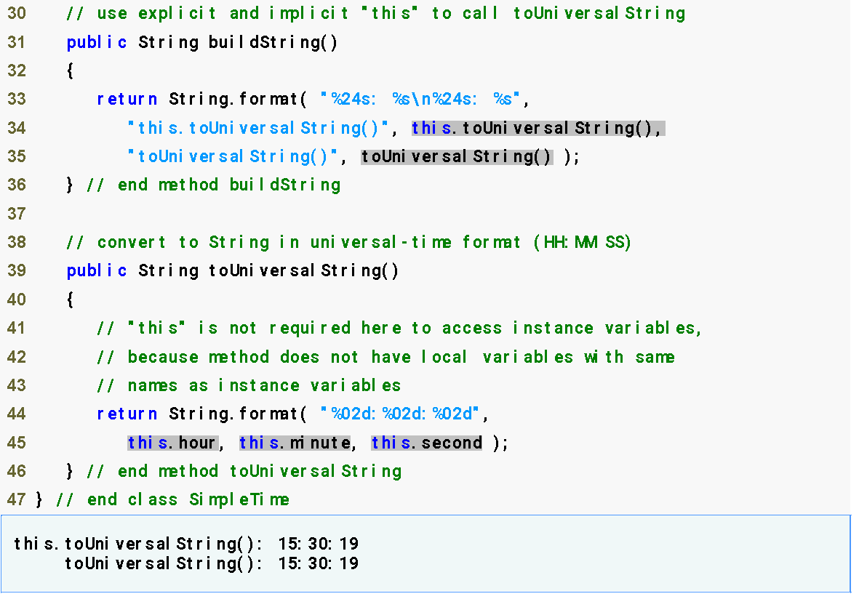
Using this explicitly and implicitly to call toUniversalString
Use of this not necessary here
16

Slide 17
Common Programming Errors
It is often a logic error when a method contains a parameter or local variable that has the same name as a field of the class. In this case, use reference this if you wish to access the field of the class—otherwise, the method parameter or local variable will be referenced.
Avoid method parameter names or local variable names that conflict with field names. This helps prevent subtle, hard-to-locate bugs.
17

Slide 18
Performance Tip
Java conserves storage by maintaining only one copy of each method per class—this method is invoked by every object of the class. Each object, on the other hand, has its own copy of the class’s instance variables (i.e., non-static fields). Each method of the class implicitly uses this to determine the specific object of the class to manipulate.
18

Slide 19
Output?
public static void main(String[] args) {
Student s1 = new Student();
Student s2 = new Student();
s1.get_UG_student();
s2.get_PG_student();
s1.get_UG_student();
s2.get_PG_student();
}
}
class Student {
private static int SID = 0;
public void get_UG_student() {
SID++;
System.out.println("UG SID: " + SID);
}
public void get_PG_student() {
SID++;
System.out.println("PG SID: " + SID);
}
UG SID: 1
PG SID: 2
UG SID: 3
PG SID: 4

Slide 20
Output?
public static void main(String[] args) {
Student s1 = new Student();
Student s2 = new Student();
s1.get_UG_student();
s2.get_PG_student();
s1.get_UG_student();
s2.get_PG_student();
}
}
class Student {
private static int SID = 0;
public int setSID() {
return ++SID;
}
public void get_UG_student() {
int studentID = setSID();
System.out.println("UG SID: " + studentID);
}
public void get_PG_student() {
int studentID = setSID();
System.out.println("PG SID: " + studentID);
}
UG SID: 1
PG SID: 2
UG SID: 3
PG SID: 4

Slide 21
Questions/Answers &
Discussion
21

