Slide 1

CS212: Object-Oriented Programming
Introduction
Ayesha Kanwal
Ayesha.kanwal@seecs.edu.pk
Slides Courtesy (Dr Nazia Perwaiz)

Slide 2
Objectives
In this week you will learn:
What are classes, objects, methods and instance variables.
How to declare a class and use it to create an object.
How to declare methods in a class to implement the class's behaviors.
How to declare instance variables in a class to implement the class's attributes.
How to call an object's method to make that method perform its task.
The differences between instance variables of a class and local variables of a method.
How to use a constructor to ensure that an object's data is initialized when the object is created.
The differences between primitive and reference types.

Slide 3
OO Programming Concepts
Object-oriented programming (OOP) involves programming using objects.
An object represents an entity in the real world that can be distinctly identified.
For example, a student, a desk, a circle, a button, and even a loan can all be viewed as objects.
An object has a unique identity, state, and behaviors.
The state of an object consists of a set of data fields (also known as properties) with their current values.
The behavior of an object is defined by a set of methods.

Slide 4
Objects
An object has both a state and behavior.
  state defines the object, and
  behavior defines what the object does.

Slide 5
A class template
Three objects of the Circle class

Slide 6
Classes
Classes are constructs that define objects of the same type.
A Java class uses variables to define data fields and methods to define behaviors.
Additionally, a class provides a special type of methods, known as constructors, which are invoked to construct objects from the class.

Slide 7
Classes
class Circle {
/** The radius of this circle */
double radius = 1.0;
/** Construct a circle object */
Circle() {
}
/** Construct a circle object */
Circle(double newRadius) {
radius = newRadius;
}
/** Return the area of this circle */
double getArea() {
return radius * radius * 3.14159;
}
}
Data field
Constructors
Method

Slide 8
UML Class Diagram
UML notation for objects

Slide 9
Constructors
Constructors are a special kind of methods that are invoked to construct objects.
Constructors must have the same name as the class itself.
Constructors do not have a return type—not even void.
Java requires a constructor for every class.
Circle() {
}
Circle(double newRadius) {
radius = newRadius;
}

Slide 10
Creating Objects Using Constructors
Constructors are invoked using the new operator when an object is created.
Constructors play the role of initializing objects.
new ClassName();
Example
new Circle();
new Circle(5.0);

Slide 11
Default Constructor
A constructor with no parameters is referred to as a no-arg constructor.
Java will provide a default no-argument constructor if none is provided.

Slide 12
Declaring Object Reference Variables
To reference an object, assign the object to a reference variable.
To declare a reference variable, use the syntax:
ClassName objectRefVar;
Example:
Circle myCircle;

Slide 13
Declaring/Creating Objects in a Single Step
Syntax:
ClassName objectRefVar = new ClassName();
Example:
Circle myCircle = new Circle();
Create an object
Assign object reference
stack has addresses that refer to a memory space in heap as objects may take up an unset amount of space
Notes:
class Circle {
/** The radius of this circle */
double radius = 1.0;
/** Construct a circle object */
Circle() {
}
/** Construct a circle object */
Circle(double newRadius) {
radius = newRadius;
}
/** Return the area of this circle */
double getArea() {
return radius * radius * 3.14159;
}
}
class Main {
public static void main(String[] args) {
Circle c1 = new Circle();
Circle c2 = new Circle(5.0);
System.out.println("radius of c1 object: " + c1.radius);
System.out.println("radius of c2 object: " + c2.radius);
// System.out.println();
// System.out.println("Area of c1 object: " + c1.getArea());
// System.out.println("Area of c2 object: " + c2.getArea());
}
}

Slide 14
Trace Code
animation
Declare myCircle
Circle myCircle = new Circle(5.0);
Circle yourCircle = new Circle();
yourCircle.radius = 100;
myCircle
no value

Slide 15
Trace Code, cont.
animation
Circle myCircle = new Circle(5.0);
Circle yourCircle = new Circle();
yourCircle.radius = 100;
myCircle
no value
Create a circle

Slide 16
Trace Code, cont.
animation
Circle myCircle = new Circle(5.0);
Circle yourCircle = new Circle();
yourCircle.radius = 100;
myCircle
reference value
Assign object reference to myCircle

Slide 17
Trace Code, cont.
animation
Circle myCircle = new Circle(5.0);
Circle yourCircle = new Circle();
yourCircle.radius = 100;
myCircle
reference value
yourCircle
no value
Declare yourCircle

Slide 18
Trace Code, cont.
animation
Circle myCircle = new Circle(5.0);
Circle yourCircle = new Circle();
yourCircle.radius = 100;
myCircle
reference value
yourCircle
no value
Create a new Circle object

Slide 19
Trace Code, cont.
animation
Circle myCircle = new Circle(5.0);
Circle yourCircle = new Circle();
yourCircle.radius = 100;
myCircle
reference value
yourCircle
reference value
Assign object reference to yourCircle

Slide 20
Trace Code, cont.
animation
Circle myCircle = new Circle(5.0);
Circle yourCircle = new Circle();
yourCircle.radius = 100;
myCircle
reference value
yourCircle
reference value
Change radius in yourCircle

Slide 21
Accessing Object's Members
Referencing the object's data:
objectRefVar.data
Example
myCircle.radius
Invoking the object's method:
objectRefVar.methodName(arguments)
Example
myCircle.getArea()

Slide 22
Trace Code
Circle myCircle = new Circle(5.0);
Circle yourCircle = new Circle();
yourCircle.radius = 100;

Slide 23
NOTE
Normally, objects are created with new operator.
One exception is a string literal that is contained in quotes, such as "hello".
String literals are references to String objects that are implicitly created by Java.

Slide 24
public class Main {
public static void main(String[] args) {
// String literal (implicit object creation)
String a = "hello";
// Using new (explicit object creation)
String b = new String("hello");
System.out.println(a);
System.out.println(b);
}
}

Slide 25
Note
Try this in the compiler
Math.methodName(arguments)
Example
Math.pow(3, 2.5)
to invoke a method in the Math class.
Q. Can you invoke getArea() using Circle.getArea()?
A. The answer is no. All the methods used in Math are static methods, which are defined using the static keyword.
However, getArea() is non-static. It must be invoked from an object using
objectRefVar.methodName(arguments)
Example
myCircle.getArea()

Slide 26
Exponent Operations
System.out.println(Math.pow(2, 3));
// Displays 8.0
System.out.println(Math.pow(4, 0.5));
// Displays 2.0
System.out.println(Math.pow(2.5, 2));
// Displays 6.25
System.out.println(Math.pow(2.5, -2));
// Displays 0.16

Slide 27
Reference Data Fields
The data fields can be of reference types.
For example, the following Student class contains a data field name of the String type.
public class Student {
String name; // name has default value null
int age; // age has default value 0
boolean isScienceMajor; // isScienceMajor has default value false
char gender; // c has default value '\u0000'
}

Slide 28
The null Value
If a data field of a reference type does not reference any object, the data field holds a special literal value, null.
String name; // name has default value null

Slide 29
Default Value for a Data Field
The default value of a data field is
  null for a reference type
  0 for a numeric type
  false for a boolean type
  '\u0000' for a char type
However, Java assigns no default value to a local variable inside a method.
public class Test {
public static void main(String[] args) {
Student student = new Student();
System.out.println("name? " + student.name);
System.out.println("age? " + student.age );
System.out.println("isScienceMajor? " + student.isScienceMajor);
System.out.println("gender? " + student.gender);
}
}
Notes:
class Student {
String name; // name has default value null
int age; // age has default value 0
boolean isScienceMajor; // isScienceMajor has default value false
char gender; // c has default value '\u0000'
}
public class Main {
public static void main(String[] args) {
Student student = new Student();
System.out.println("name?\t\t\t " + student.name);
System.out.println("age?\t\t\t " + student.age );
System.out.println("isScienceMajor?\t " + student.isScienceMajor);
System.out.println("gender?\t\t\t " + student.gender);
}
}

Slide 30
Example
Java assigns no default value to a local variable inside a method.
public class Test {
public static void main(String[] args) {
int x; // x has no default value
String y; // y has no default value
System.out.println("x is " + x);
System.out.println("y is " + y);
}
}
Compilation error: variables not initialized
Notes:
public class Main {
public static void main(String[] args) {
int x; // x has no default value
String y; // y has no default value
System.out.println("x is " + x);
System.out.println("y is " + y);
}
}

Slide 31
Differences between Variables of Primitive Data Types and Object Types
Primitive type
int i = 1;
Object type Circle c = new Circle();
c is a reference created using new Circle()

Slide 32
Copying Variables of Primitive Data Types and Object Types
Primitive type assignment i = j
Object type assignment c1 = c2

Slide 33
Copying Variables of Object Types: Output?
class Circle {
int radius;
Circle(int radius) {
this.radius = radius;
}
}
public class Main {
public static void main(String[] args) {
Circle c1 = new Circle(5);
Circle c2 = new Circle(5);
System.out.println(c1 == c2);
System.out.println(c1.equals(c2));
c1 = c2; // c2 also copies address of c1 so both point to same object now so c1== c2 will work.
System.out.println(c1 == c2); }
}
false false true

Slide 34
String Class Overrides equal Method: Output?
class Circle {
int radius;
Circle(int radius) {
this.radius = radius;
}
}
public class Main {
public static void main(String[] args) {
String s1 = new String(“Ahmad”);
String s2 = new String(“Ahmad”);
System.out.println(s1 == s2);
System.out.println(s1.equals(s2));
s1 = s2;
System.out.println(s1 == s2); }
} // ALL pirnt true
string pool and method area

Slide 35
Garbage Collection
After the assignment statement
c1 = c2
c1 points to the same object referenced by c2.
The object previously referenced by c1 is no longer referenced.
This object is known as garbage.
Garbage is automatically collected by JVM.

Slide 36
Garbage Collection, cont.
If you know that an object is no longer needed, you can explicitly assign null to a reference variable for the object.
The JVM will automatically collect the space if the object is not referenced by any variable.

Slide 37
Note
Each class declaration that begins with keyword public must be stored in a file that has the same name as the class and ends with the .java filename extension.
Declaring more than one public class in the same file is a compilation error.

Slide 38
The Date Class
Java provides a system-independent encapsulation of date and time in the java.util.Date class.
Used to create an instance for the current date and time.
Use toString method implicitly to return the date and time as a string.
Notes:
import java.util.Date;
public class Main {
public static void main(String[] args) {
Date currentDate = new Date(); // Creates an instance with the current date & time
System.out.println(currentDate); // Prints the date as a string
System.out.println(currentDate.toString());
}
}

Slide 39
The Date Class, Cont.
Constructs a Date object for the current time.
Constructs a Date object for a given time in milliseconds elapsed since January 1, 1970, GMT.
Returns a string representing the date and time.
Returns the number of milliseconds since January 1, 1970, GMT.
Sets a new elapse time in the object.
Notes:
import java.util.Date;
public class Main {
public static void main(String[] args) {
long milliseconds = 100000000000L;
Date date = new Date(milliseconds); // Creating Date object
System.out.println("Date for given milliseconds: " + date);
System.out.println("Date for given milliseconds: " + date.toString());
}
}

Slide 40
The Date Class Example
Example
java.util.Date date = new java.util.Date();
System.out.println(date.toString()); // same
System.out.println(date); // same
displays a string like Mon Feb 27 11:15:30 PKT 2017

Slide 41
The Random Class
You have used Math.random() to obtain a random double value between 0.0 and 1.0 (excluding 1.0).
A more useful random number generator is provided in the java.util.Random class.
We have seen both of them earlier!

Slide 42
The Random Class
Constructs a Random object with the current time as its seed.
Constructs a Random object with a specified seed.
Returns a random int value.
Returns a random int value between 0 and n (exclusive).
Returns a random long value.
Returns a random double value between 0.0 and 1.0 (exclusive).
Returns a random float value between 0.0F and 1.0F (exclusive).
Returns a random boolean value.
Notes:
import java.util.Random;
public class Main {
public static void main(String[] args) {
Random random1 = new Random(100); // Random object with seed 100
Random random2 = new Random(100); // Another Random object with the same seed
// Generate some random numbers
System.out.println(random1.nextInt(100)); // Output: 28
System.out.println(random1.nextInt(100)); // Output: 97
System.out.println(random2.nextInt(100)); // Output: 28 (Same as random1)
System.out.println(random2.nextInt(100)); // Output: 97 (Same as random1)
}
}

Slide 43
The Random Class Example
If two Random objects have the same seed, they will generate identical sequences of numbers.
For example, the following code creates two Random objects with the same seed 3.
Random random1 = new Random(3);
System.out.print("From random1: ");
for (int i = 0; i < 10; i++)
System.out.print(random1.nextInt(1000) + " ");
Random random2 = new Random(3);
System.out.print("\nFrom random2: ");
for (int i = 0; i < 10; i++)
System.out.print(random2.nextInt(1000) + " ");
From random1: 734 660 210 581 128 202 549 564 459 961
From random2: 734 660 210 581 128 202 549 564 459 961

Slide 44
Instance Variables and Methods
Instance variables belong to a specific instance.
Instance methods are invoked by an instance of the class.

Slide 45
Instance variables belong to a specific instance.
class Student {
String name; // instance variable
int age; // instance variable
}
public class Test {
public static void main(String[] args) {
Student s1 = new Student();
Student s2 = new Student();
s1.name = "Ali";
s2.name = "Sara";
System.out.println(s1.name); // Ali
System.out.println(s2.name); // Sara
}
}

Slide 46
Instance methods are invoked by an instance of the class.
class Student {
String name;
// instance method
void displayName() {
System.out.println("Student name is: " + name);
}
}
public class Test {
public static void main(String[] args) {
Student s1 = new Student();
s1.name = "Ali";
Student s2 = new Student();
s2.name = "Sara";
s1.displayName(); // invoked by s1
s2.displayName(); // invoked by s2
}
}

Slide 47
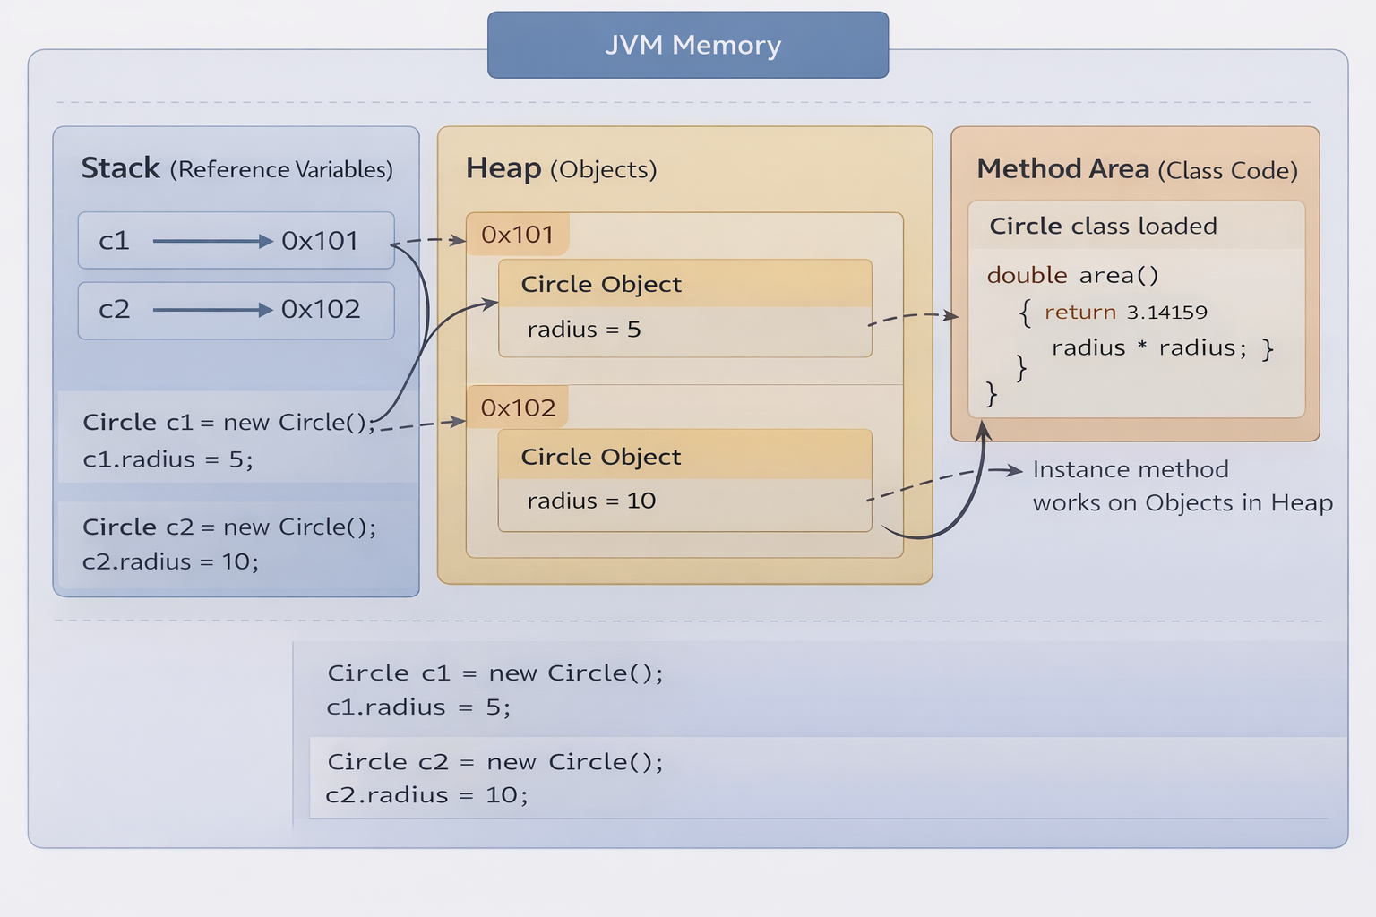

Slide 48
Static Variables, Constants, and Methods
Static variables are shared by all the instances of the class.
Static methods are not tied to a specific object.
Static constants are final variables shared by all the instances of the class.
To declare static variables, constants, and methods, use the static modifier.

Slide 49
Static Variables, Constants, and Methods, cont.
numberOfObjects is static variable of class.
Static variables/ methods are underlined in class diagram.
After two Circle objects were created, numberOfObjects is 2.

Slide 50
Questions/Answers &
Discussion

