Slide 1
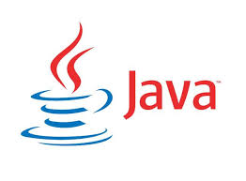
CS212: Object-Oriented Programming
Introduction
Ayesha Kanwal
Ayesha.kanwal@seecs.edu.pk
Slides Courtesy (Dr Nazia Perwaiz, SEECS)

Slide 2
OBJECTIVES
Understand object-oriented programming basics
Introduce Object-oriented analysis-and-design (OOAD) process
Learn a typical Java program development environment
Write simple Java applications

Slide 3
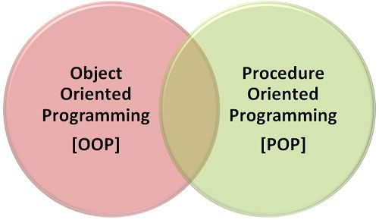
Programming Paradigms

Slide 4
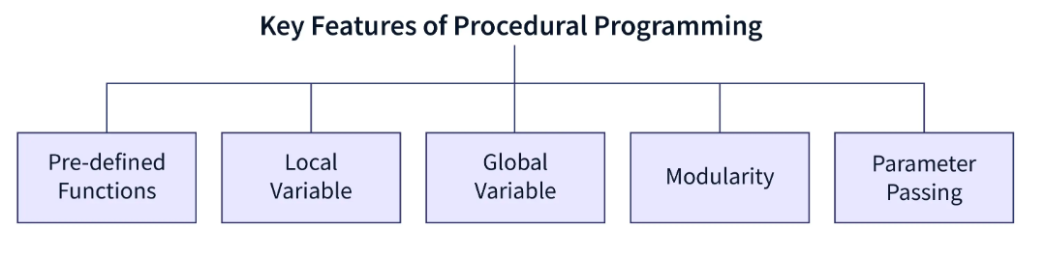
Programming Paradigms

Slide 5
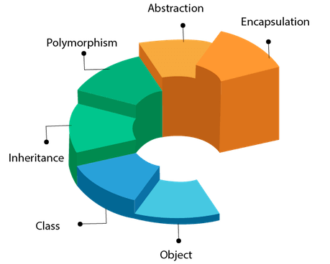
Core Concepts of OOP

Slide 6
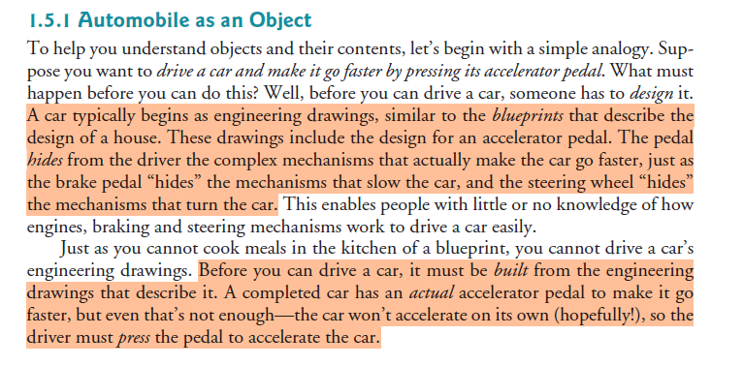
Class/ Object
Book reading task: Section 1.5.1 to 1.5.8

Slide 7
object-oriented analysis-and-design (OOAD) process
A detailed analysis process for determining your project’s requirements (i.e., defining what the system is supposed to do)
Developing a design that satisfies them (i.e., specifying how the system should do it).
Standard Tool?

Slide 8
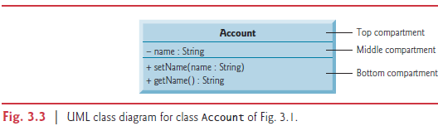
object-oriented analysis-and-design (OOAD) process
The UML (Unified Modeling Language)
  The most widely used graphical scheme for modeling object oriented systems.

Slide 9
Java Class Libraries
Classes
  Include methods that perform tasks
    Return information after task completion
  Used to build Java programs
Java provides class libraries
  Known as Java APIs (Application Programming Interfaces)
Use a building-block approach to create programs. Avoid reinventing the wheel—use existing pieces wherever possible. Called software reuse, this practice is central to object-oriented programming.

Slide 10
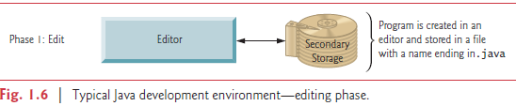
Typical Java Development Environment
Java programs normally undergo five phases
1. Edit
    Programmer writes program/ source code (and stores program on disk)
ook reading task: Section 1.9

Slide 11
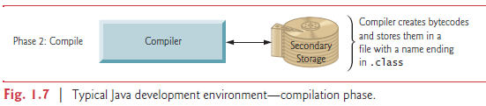
Typical Java Development Environment
Java programs normally undergo five phases
2. Compile
    Compiler creates bytecodes from source code
ook reading task: Section 1.9

Slide 12
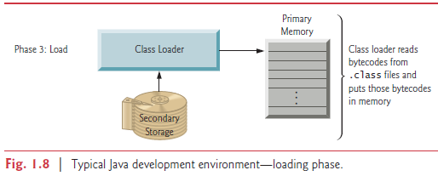
Typical Java Development Environment
Java programs normally undergo five phases
3. Load
    the JVM places the program in memory to execute it
ook reading task: Section 1.9

Slide 13
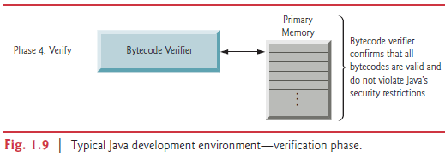
Typical Java Development Environment
Java programs normally undergo five phases
4. Verify
    Bytecode Verifier confirms bytecodes do not violate security restrictions
Book reading task: Section 1.9

Slide 14
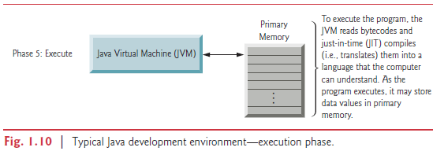
Typical Java Development Environment
Java programs normally undergo five phases
5. Execute
    JVM translates bytecodes into machine language
Book reading task: Section 1.9

Slide 15

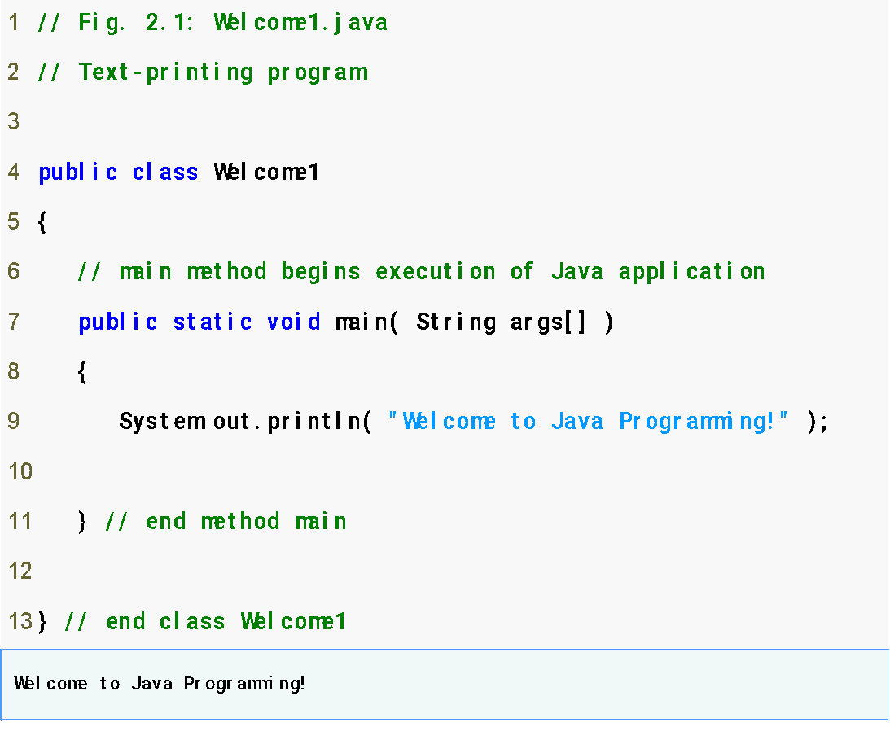
First Program in Java
Key Components:
Comments
Line Numbers!
  For reference only
Keywords
White Space
  Readability
File Name
  *.java
  Same as public class name
main method
print statement
Book reading:Section 2.1 - 2.5

Slide 16
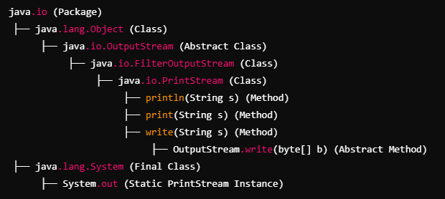
First Program in Java – Important Points

Slide 17
First Program in Java – Important Points
Every Java program has at least one user-defined class
Keyword: words reserved for use by Java
  class keyword followed by class name
Naming classes: capitalize every word (camel case)
  SampleClassName
Java identifiers
  Series of characters consisting of letters, digits, underscores ( _ ) and dollar signs ( $ )
  Does not begin with a digit, has no spaces
  Examples: Welcome1, $value, _value, button7
    7button is invalid
  Java is case sensitive (capitalization matters)
    a1 and A1 are different
Book reading:Section 2.1 - 2.5

Slide 18
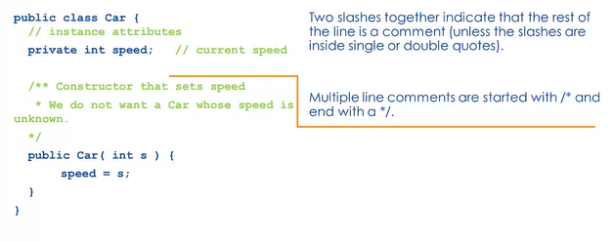
First Program in Java – Important Points
Now we have three different kinds of comments:
One is a double slash, that's the example here. It's a single line comment, // instance variables or // current speed.
Multiple line comments start with a slash asterisk and eventually end with an asterisk slash.
That is a special form of multiline comment called javadoc comments, delimited by /** and */. These provide the documentation for that source code. (run this command: javadoc Car.java)
Book reading:Section 2.1 - 2.5

Slide 19
Good Programming Practice
By convention, always begin a class name’s identifier with a capital letter and start each subsequent word in the identifier with a capital letter.
Java programmers know that such identifiers normally represent Java classes, so naming your classes in this manner makes your programs more readable.
Book reading:Section 2.1 - 2.5

Slide 20
Common Programming Errors
Java is case sensitive. Not using the proper uppercase and lowercase letters for an identifier normally causes a compilation error. Java is case sensitive. Not using the proper uppercase and lowercase letters for an identifier normally causes a compilation error.
It is an error for a public class to have a file name that is not identical to the class name (plus the .java extension) in terms of both spelling and capitalization.
It is a syntax error if braces do not occur in matching pairs.
Book reading:Section 2.1 - 2.5

Slide 21
Common Error Prevention Tips
When learning how to program, sometimes it is helpful to “break” a working program so you can familiarize yourself with the compiler's syntax-error messages.
  These messages do not always state the exact problem in the code. When you encounter such syntax-error messages in the future, you will have an idea of what caused the error.
When the compiler reports a syntax error, the error may not be on the line number indicated by the error message. First, check the line for which the error was reported. If that line does not contain syntax errors, check several preceding lines.
Book reading:Section 2.1 - 2.5

Slide 22
Compiling & Executing a Java Program
Open a command prompt window, go to directory where program is stored
Type javac Welcome1.java
If no syntax errors, Welcome1.class is created
  Has bytecodes that represent application
  Bytecodes passed to JVM
Type java Welcome1
  Launches JVM
  JVM loads .class file for class Welcome1
  .class extension omitted from command
  JVM calls method main
Book reading:Section 2.1 - 2.5

Slide 23
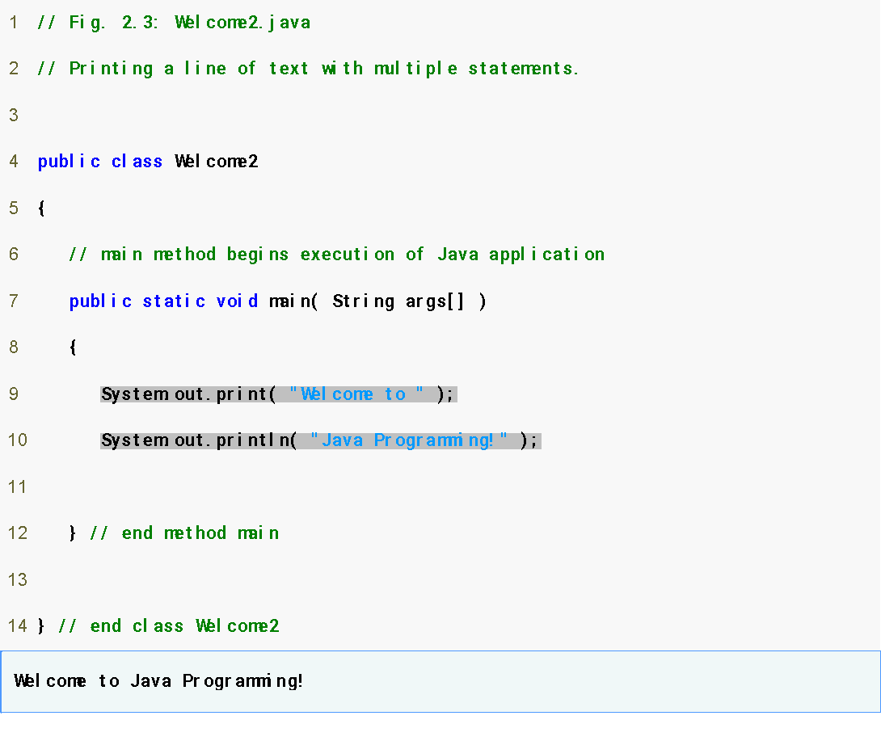
Modifying the Java Program
Welcome2.java
1. Comments
2. Blank line
3. Begin class Welcome2
3.1 Method main
4. Method System.out.print
4.1 Method System.out.println
5. end main, Welcome2
Program Output
System.out.print keeps the cursor on the same line, so System.out.println continues on the same line.

Slide 24
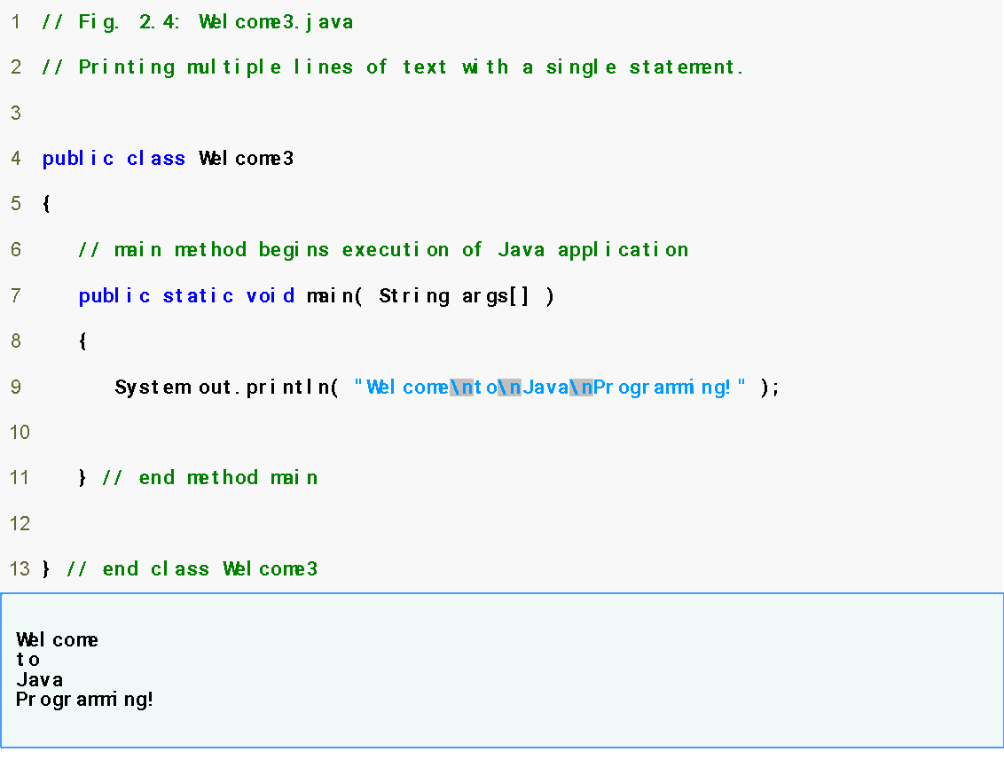
A Slightly Different Version
Welcome3.java
1. main
2. System.out.println (uses \n for new line)
Program Output
Notice how a new line is output for each \n escape sequence.
Book reading:Section 2.1 - 2.5

Slide 25
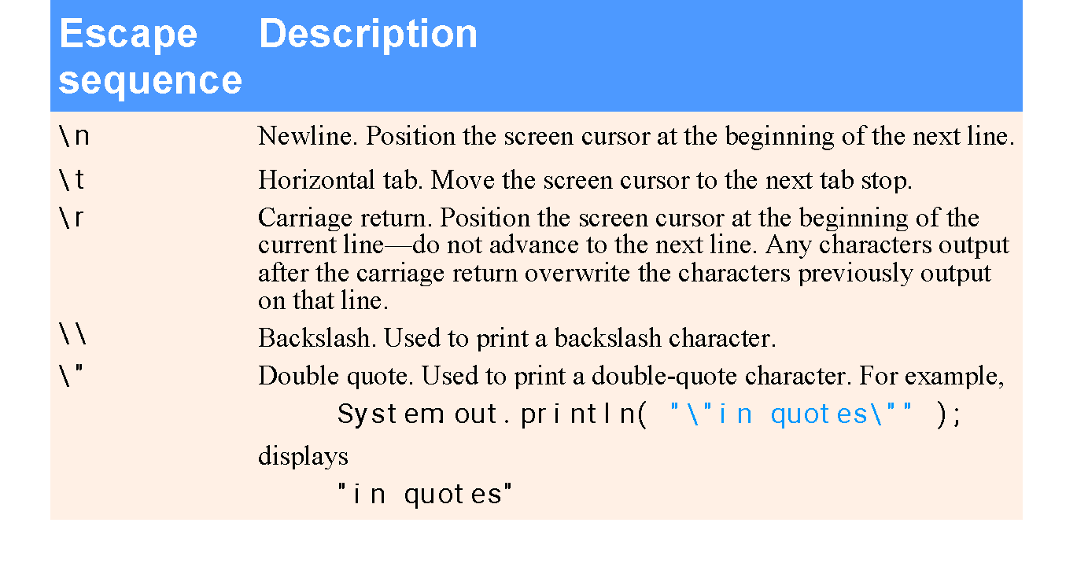
Some Common Escape Sequences
Book reading:Section 2.1 - 2.5

Slide 26
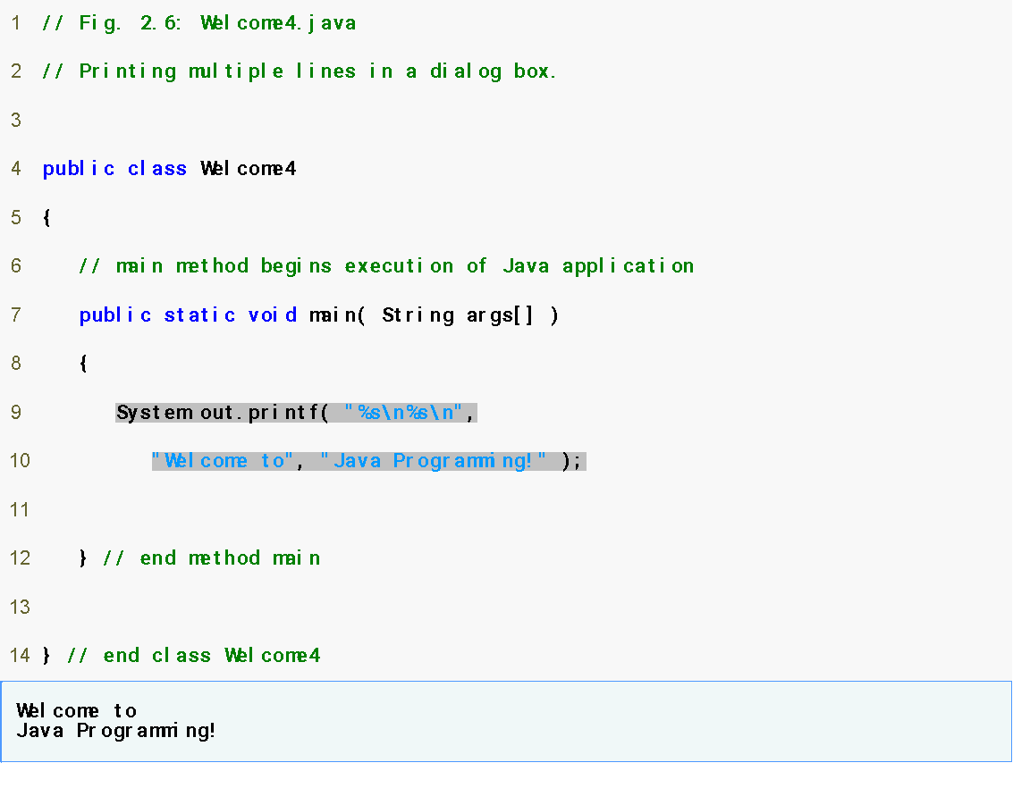
Displaying Text with printf
Welcome4.java
main
printf
Program output
System.out.printf displays formatted data.
Book reading:Section 2.1 - 2.5

Slide 27
Another Java Application: Adding Integers
Use Scanner to read two integers from user
Some other methods to get input from user are:
http://stackoverflow.com/questions/5287538/how-can-i-get-the-user-input-in-java
Use printf to display sum of the two values
Use packages
  By default, package java.lang is imported in every Java program; thus, java.lang is the only package in the Java API that does not require an import declaration.
Book reading:Section 2.1 - 2.5

Slide 28
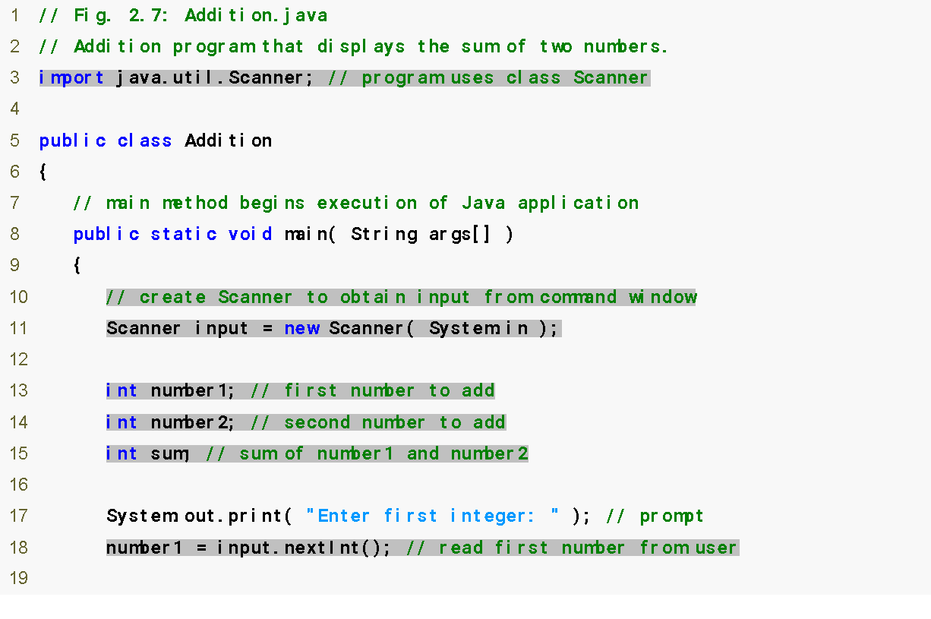
Another Java Application: Adding Integers
import declaration imports class Scanner from package java.util.
Declare and initialize variable input, which is a Scanner.
Declare variables number1, number2 and sum.
Read an integer from the user and assign it to number1.

Slide 29
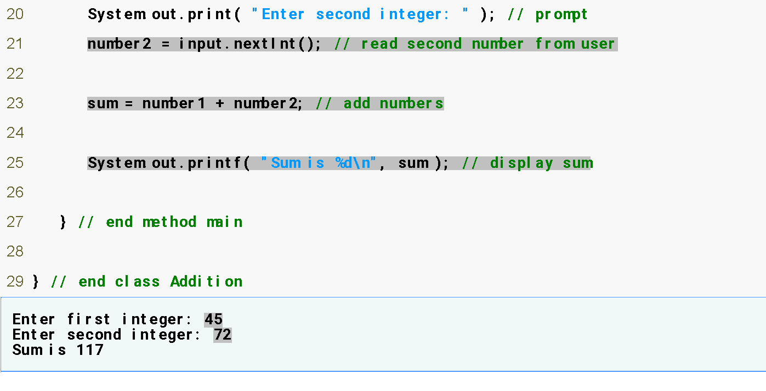
Another Java Application: Adding Integers
Read an integer from the user and assign it to number2.
Calculate the sum of the variables number1 and number2, assign result to sum.
Display the sum using formatted output.
Two integers entered by the user.

Slide 30
Import Declarations
import declarations are used by compiler to identify and locate classes used in Java programs
All import declarations must appear before the first class declaration in the file. Placing an import declaration inside a class declaration’s body or after a class declaration is a syntax error.
Forgetting to include an import declaration for a class used in your program typically results in a compilation error containing a message such as “cannot resolve symbol.”
  When this occurs, check that you provided the proper import declarations and that the names in the import declarations are spelled correctly, including proper use of uppercase and lowercase letters.
Try this: https://www.carbonfootprint.com/calculator.aspx

Slide 31
Good Programming Practice – Tips
Declare each variable on a separate line. This format allows a descriptive comment to be easily inserted next to each declaration.
Choosing meaningful variable names helps a program to be self-documenting (i.e., one can understand the program simply by reading it rather than by reading manuals or viewing an excessive number of comments).
By convention, variable-name identifiers begin with a lowercase letter, and every word in the name after the first word begins with a capital letter. This convention is usually referred as camel case.

Slide 32
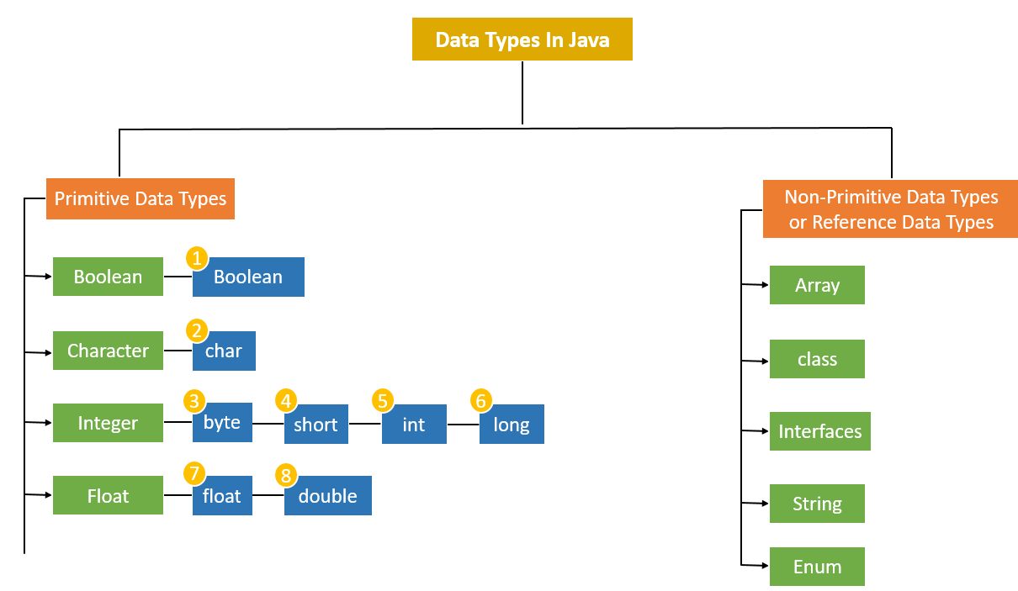
Java Datatypes

Slide 33

Memory Concepts
Variables
  Every variable has a name, a type, a size and a value
    Name corresponds to location in memory
  When new value is placed into a variable, replaces (and destroys) previous value
  Reading variables from memory does not change them

Slide 34
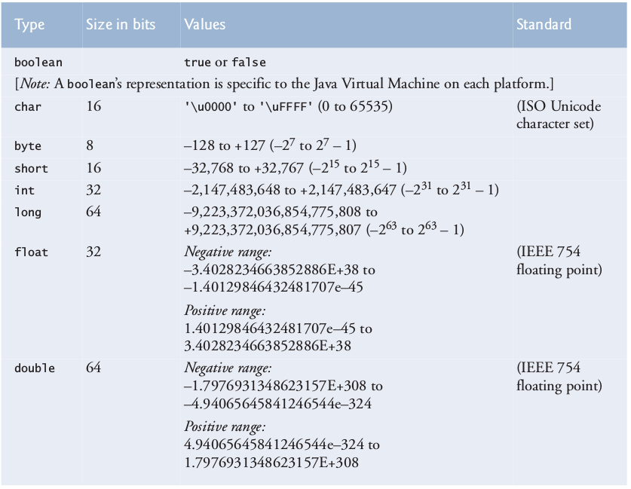
Primitive Data Types in Java

Slide 35
Arithmetic Operations
Arithmetic calculations used in most programs
  Usage
    * for multiplication
    / for division
    % for remainder
    +, -
  Integer division truncates remainder (no rounding off)
    7 / 5 evaluates to 1
  Remainder operator % returns the remainder
    7 % 5 evaluates to 2

Slide 36
Operator Precedence
Some arithmetic operators act before others (i.e., multiplication before addition)
  Use parenthesis when needed
Example: Find the average of three variables a, b and c
  Do not use: a + b + c / 3
  Use: ( a + b + c ) / 3
Question: How the following expression will be evaluated?
Y = 2 * 5 * 5 + 3 * 5 + 7;

Slide 37
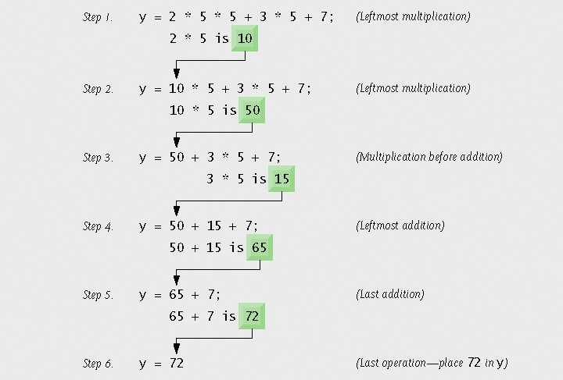
Operator Precedence

Slide 38
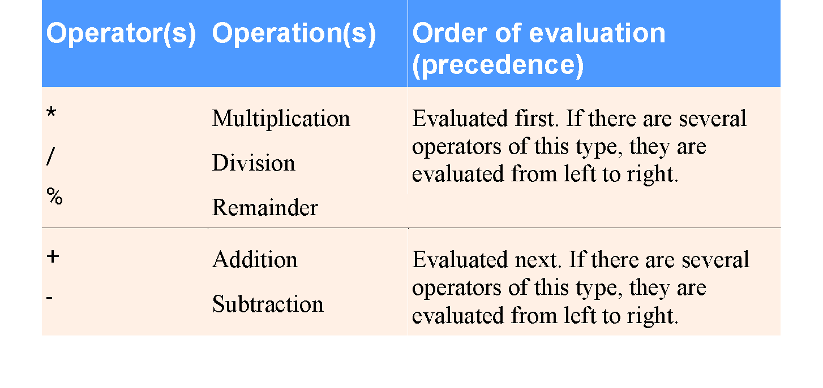
Operator Precedence
Tip: Using parentheses for complex arithmetic expressions, even when the parentheses are not necessary, can make the arithmetic expressions easier to read.

Slide 39
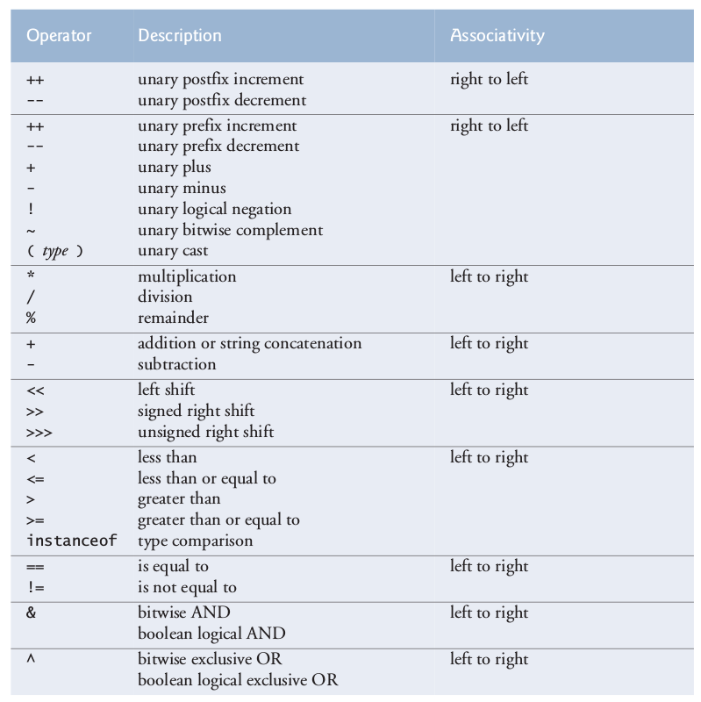
Operator Precedence

Slide 40
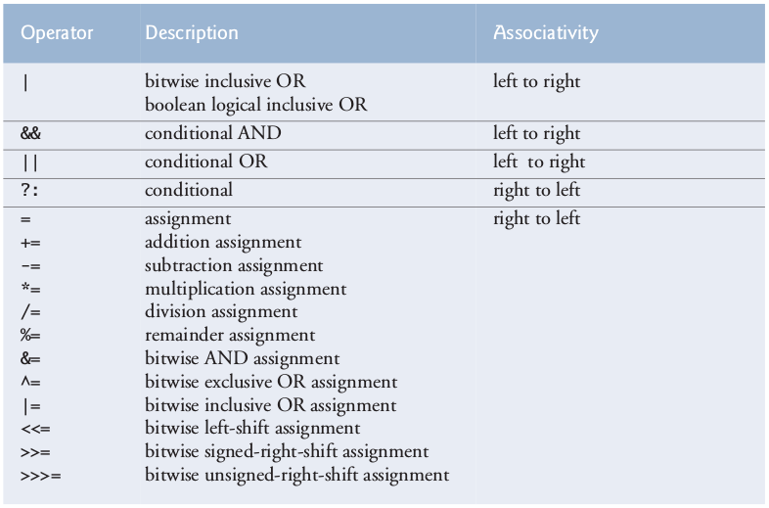
Operator Precedence

Slide 41
Questions/Answers &
Discussion

