Slide 1

CS212: Object-Oriented Programming
Introduction
Ayesha Kanwal
Ayesha.kanwal@seecs.edu.pk
Slides Courtesy (Dr Nazia Perwaiz)

Slide 2
RECAP
Control Structures in Java
  Sequence structure
  Selection structure
  Repetition structure
  Break/ Continue
Increment/ decrement operators
Logical operators

Slide 3
OBJECTIVES
Arrays in Java
  Creating arrays
  Using arrays

Slide 4
Class Activity (Predict Output)
public class Test {
public static void main(String[] args) {
int x = 5;
int y = ++x + x++ + --x + x--;
System.out.println("x = " + x);
System.out.println("y = " + y);
}
}
Expression | Value Used | New Value
Options:
A) x = 5, y = 23
B) x = 6, y = 22
C) x = 5, y = 24
D) x = 4, y = 21

Slide 5
Class Activity (Predict Output)
public class BooleanTest {
public static void main(String[] args) {
boolean a = false;
boolean b = false;
boolean c = (a = true) || (b = true);
System.out.println("a = " + a);
System.out.println("b = " + b);
System.out.println("c = " + c);
}
}
a | b | c
Options:
A) a = false, b = true, c = true
B) a = true, b = true, c = true
C) a = true, b = false, c = true
D) a = true, b = true, c = false

Slide 6
Class Activity (Predict Output)
x | y | total
public class Test {
public static void main(String[] args) {
int x = -2;
int total = 0;
while (x <= 5) {
int y = x + 2;
x++;
total += y;
System.out.printf("Y is: %d and total is %d\n", y, total);
}
}
}

Slide 7
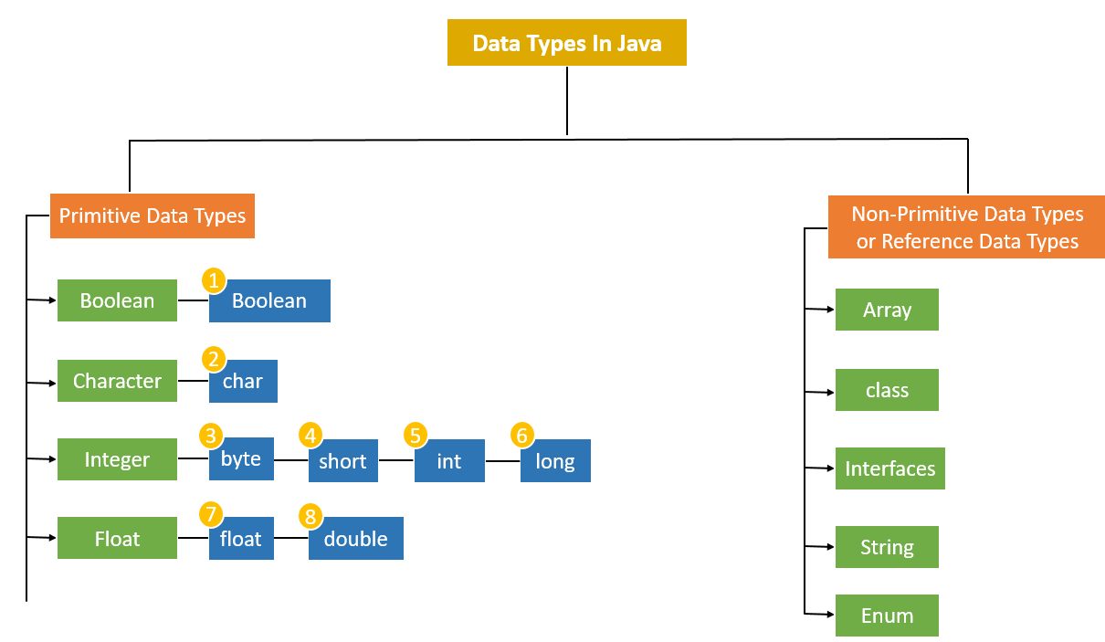
Java Datatypes

Slide 8
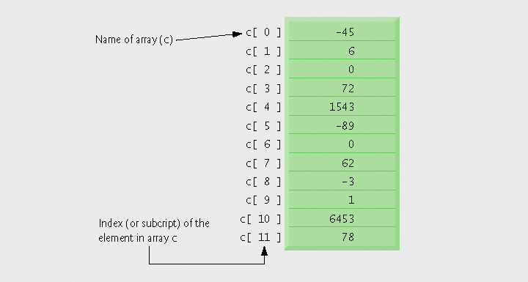
Introduction - Arrays
It’s a Data structure
A Group of variables having the same data type
Remain same size once created.
  Fixed-length entries

Slide 9
Arrays Index
Index
  Also called subscript
  Position number in square brackets
  Must be positive integer or integer expression
  First element has index zero
  a = 5;
  b = 6;
  c[a + b] += 2; // Adds 2 to c[ 11 ]

Slide 10
Declaring and Creating Arrays (in Java)
Declaring and Creating arrays
  Arrays are objects that occupy memory
  Created dynamically with keyword new
    int c[] = new int[ 12 ];
      Equivalent to
      int c[]; or int[] c // declare array variable
      c = new int[ 12 ]; // create array
  We can create arrays of objects too
      String b[] = new String[ 100 ];
      String[] b = new String[ 100 ], x = new String[ 27 ];

Slide 11
Important Notes
Declaring multiple array variables in a single declaration can lead to subtle errors.
Consider the declaration int[] a, b, c;. If a, b and c should be declared as array variables, then this declaration is correct—placing square brackets directly following the type indicates that all the identifiers in the declaration are array variables.
However, if only a is intended to be an array variable, and b and c are intended to be individual int variables, then this declaration is incorrect—the declaration int a[], b, c; would achieve the desired result.

Slide 12
Important Notes
In an array declaration, specifying the number of elements in the square brackets of the declaration (e.g., int c[12];) is a syntax error.
Can we declare and initialize an array without using the new keyword?
yes
int[ ] c = {1, 2, 3, 4, 5};

Slide 13
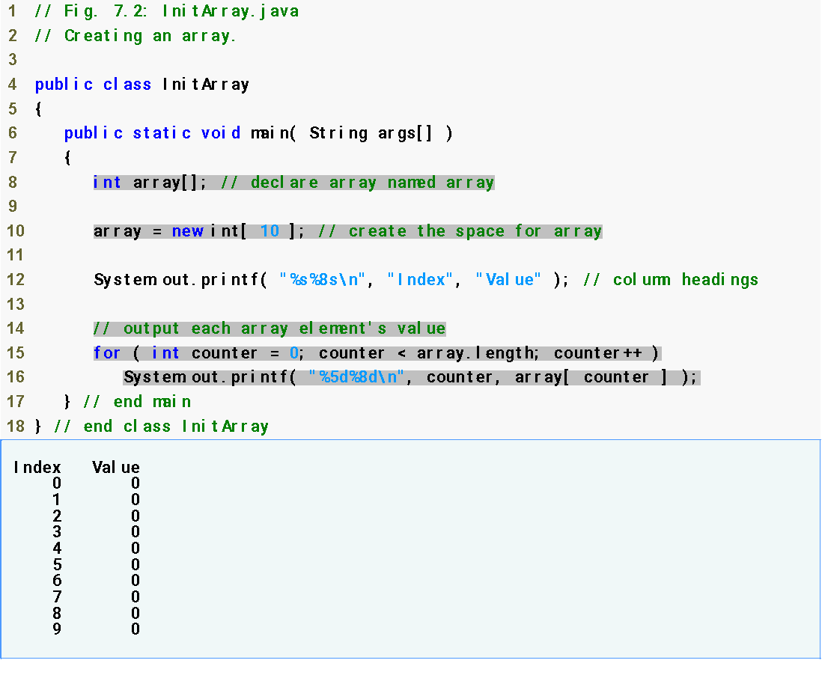
Declare array as an array of ints
Create 10 ints for array; each int is initialized to 0 by default
array.length returns length of array
Each int is initialized to 0 by default
array[counter] returns int associated with index in array

Slide 14
Examples Using Arrays (Cont.)
Using an array initializer
  Use initializer list
    Items enclosed in braces ({})
    Items in list separated by commas
    int n[] = { 10, 20, 30, 40, 50 };
      Creates a five-element array
      Index values of 0, 1, 2, 3, 4
  Do not need keyword new

Slide 15
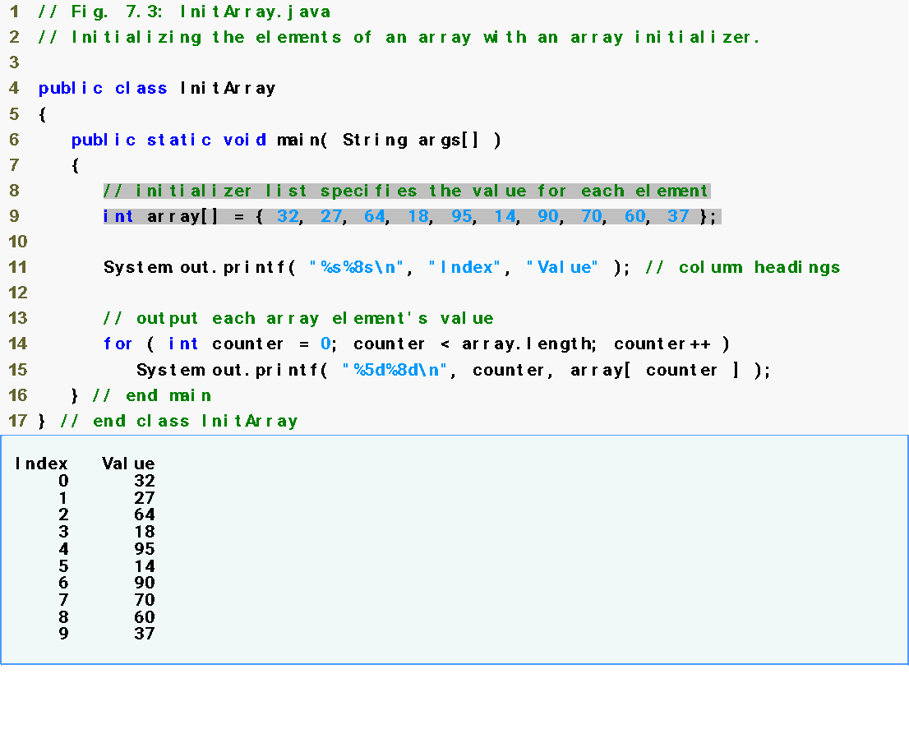
Declare array as an array of ints
Compiler uses initializer list to allocate array
15

Slide 16
Important Notes
Constant variables also are called named constants or read-only variables.
Declared with the keyword Final
Such variables often make programs more readable than programs that use literal values (e.g., 10)—a named constant such as ARRAY_LENGTH clearly indicates its purpose, whereas a literal value could have different meanings based on the context in which it is used.
Assigning a value to a constant after the variable has been initialized is a compilation error.
Attempting to use a constant before it is initialized is a compilation error.

Slide 17
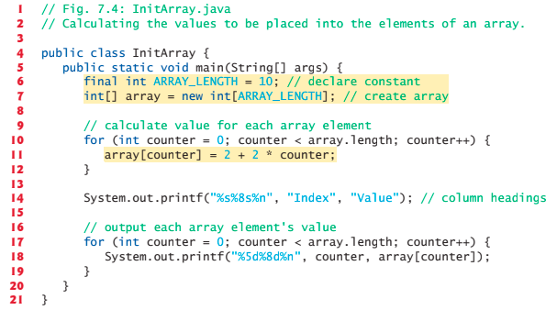
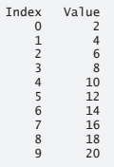
Calculate the values to store in array

Slide 18
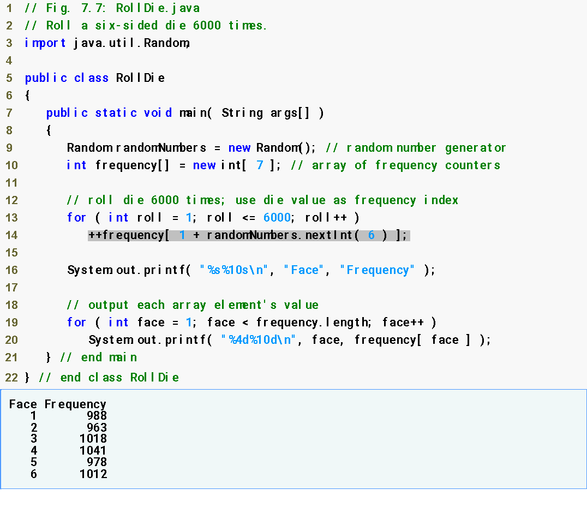
Examples Using Arrays (Cont.)
Declare frequency as array of 7 ints
Generate 6000 random integers in range 1-6
Increment frequency values at index associated with random number
Notes:
Book Page 281 (same example using switch statement)

Slide 19
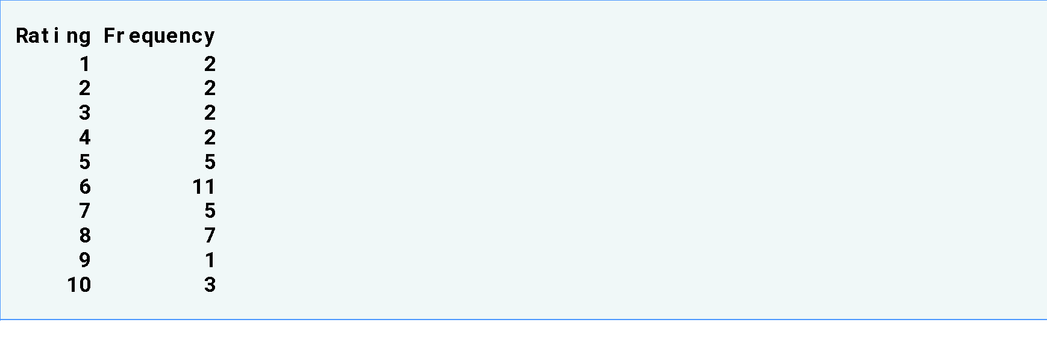
Examples Using Arrays (Cont.)
Using arrays to analyze survey results
  40 students rate the quality of food
    1-10 Rating scale: 1 mean awful, 10 means excellent
  Place 40 responses in array of integers
  Summarize results

Slide 20
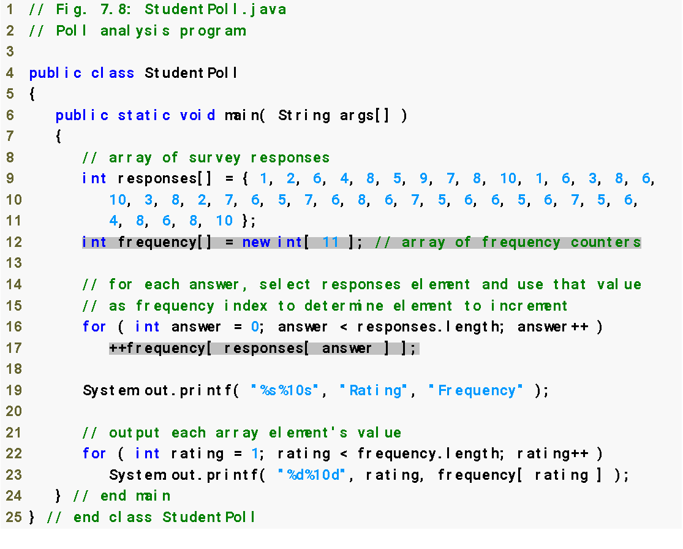
Declare responses as array to store 40 responses
Declare frequency as array of 11 int and ignore the first element
For each response, increment frequency values at index associated with that response
20

Slide 21
Error-Prevention Tips
When writing code to loop through an array, ensure that the array index is always greater than or equal to 0 and less than the length of the array. The loop-continuation condition should prevent the accessing of elements outside this range.
An exception indicates that an error has occurred in a program. A programmer often can write code to recover from an exception and continue program execution, rather than abnormally terminating the program. When a program attempts to access an element outside the array bounds, an ArrayIndexOutOfBoundsException occurs.

Slide 22
Enhanced For Loop Statement
Enhanced for statement
  Allows iterates through elements of an array or a collection without using a counter
    Avoiding the possibility of “stepping outside” the array
  Syntax
    for (parameter : arrayName)
      statement
  where parameter has a type and an identifier.
  type of the parameter must be consistent with the type of the elements in the array

Slide 23
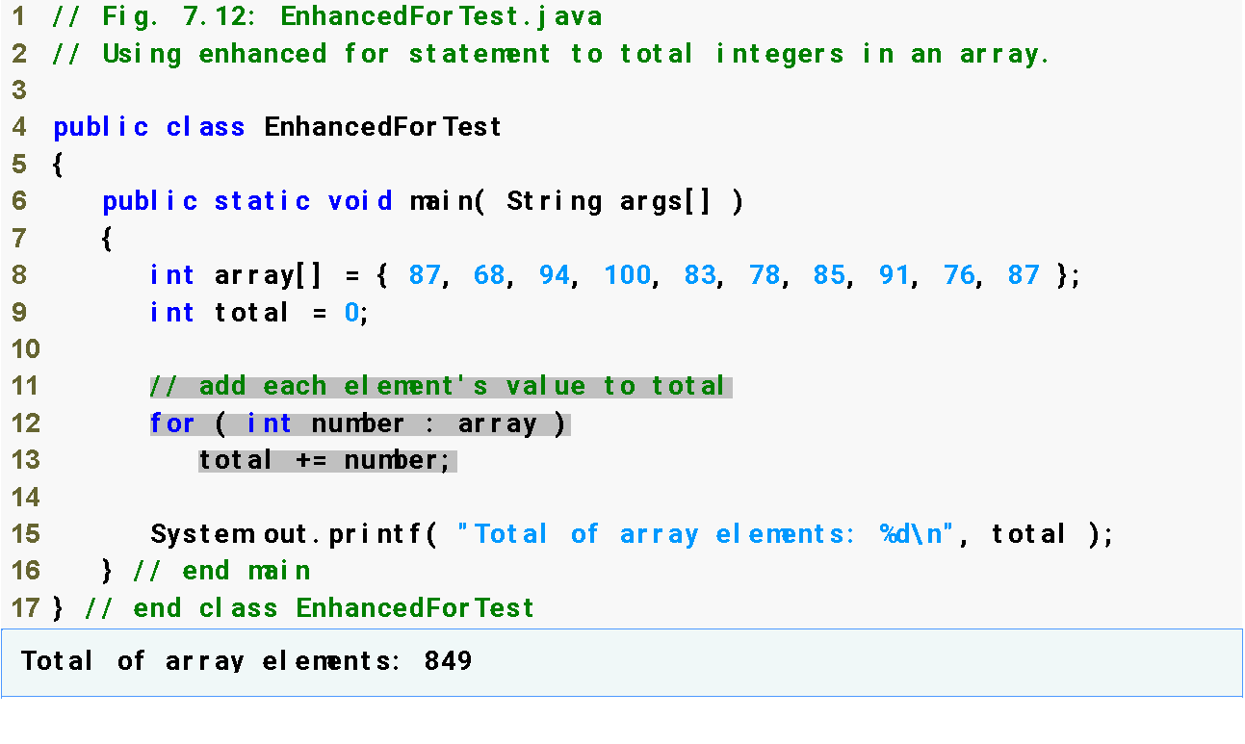
Enhanced For Loop Statement
For each iteration, assign the next element of array to int variable number, then add it to total
23

Slide 24
Enhanced For Loop Statement
Lines 12-13 are equivalent to
for (int number : array)
total += number;
  for (int counter = 0; counter < array.length; counter++)
  total += array[ counter ];
Usage Limitations
  Can access array elements
  Cannot modify array elements
  Cannot access the counter indicating the index
SAME

Slide 25
Passing Arrays to Methods
To pass array argument to a method
  Specify array name without brackets
    Array hourlyTemperatures is declared as
    int hourlyTemperatures[] = new int[ 24 ];
    The method call
    modifyArray( hourlyTemperatures );
    Passes array hourlyTemperatures to method modifyArray

Slide 26
Passing Arrays to Methods
While calling a method with passing array as parameter, you cannot use the array type and square brackets.
✔ Valid Call: printArray(numbers);
❌ Invalid Call: printArray(int[] numbers);
// (Array type and square brackets are not allowed in method call)

Slide 27
Defining Methods with Array Parameters
You cannot skip the array type and square brackets when defining a method.
Valid ways to declare an array parameter:
✅ public static void printArray(int[] arr) (Preferred syntax)
✅ public static void printArray(int arr[]) (Less common/ valid)
Invalid syntax:
❌ public static void printArray(arr) (Missing type & brackets → Compilation Error!)

Slide 28
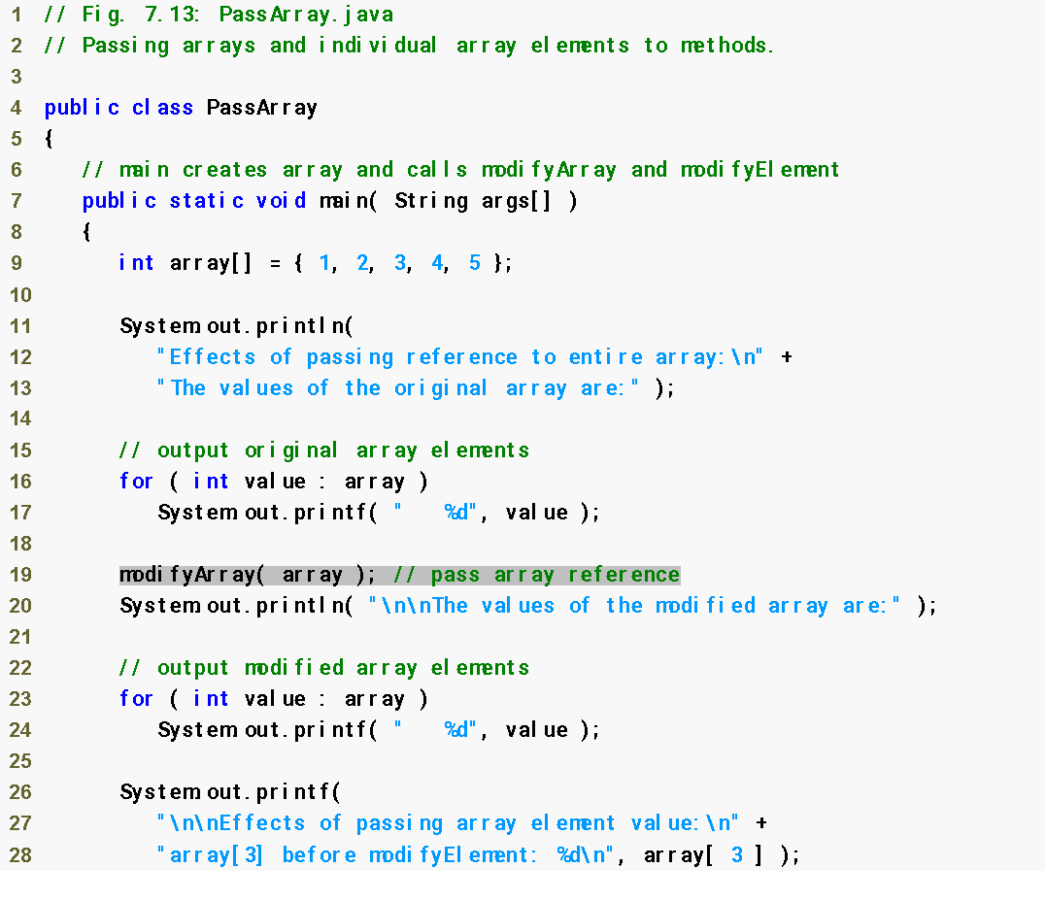
Declare 5-int array with initializer list
Pass entire array to method modifyArray
28

Slide 29
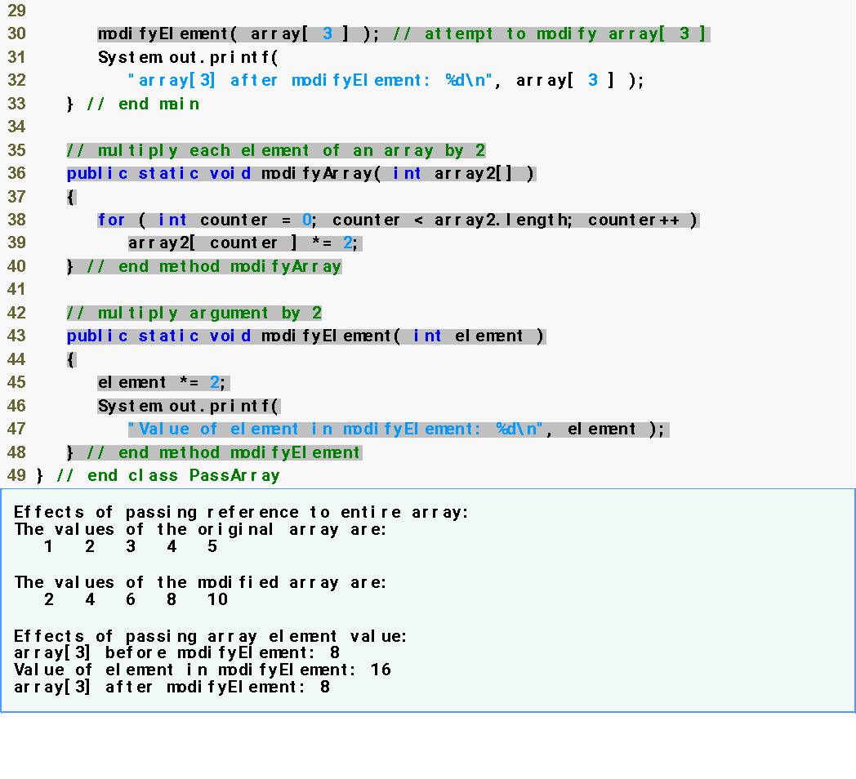
Pass array element array[3] to method modifyElement
Method modifyArray manipulates the array directly
Method modifyElement manipulates a primitive’s copy
29

Slide 30
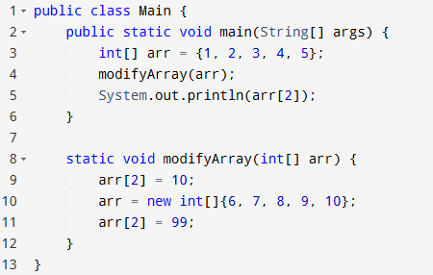
Test Yourself
Output?
3
10
99
Error

Slide 31
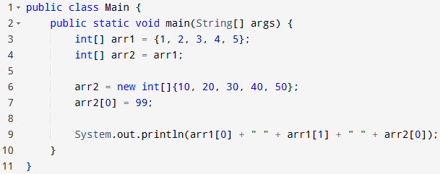
Test Yourself
A) 99 2 99
B) 1 2 99
C) 1 2 1
D) 1 2 99 10

Slide 32
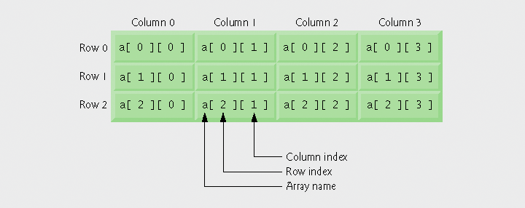
Multidimensional Arrays
Tables with rows and columns
  Two-dimensional array
  m-by-n array

Slide 33
Multidimensional Arrays
Arrays of one-dimensional array
  Declaring two-dimensional array b[2][2]
    int b[][] = { { 1, 2 }, { 3, 4 } };
      1 and 2 initialize b[0][0] and b[0][1]
      3 and 4 initialize b[1][0] and b[1][1]
    int b[][] = { { 1, 2 }, { 3, 4, 5 } };
      row 0 contains elements 1 and 2
      row 1 contains elements 3, 4 and 5
  Lengths of rows in array are not required to be the same!

Slide 34
Multidimensional Arrays
Creating two-dimensional arrays with array-creation expressions
  Can be created dynamically
    3-by-4 array
    int b[][];
    b = new int[ 3 ][ 4 ];
    Rows can have different number of columns
    int b[][];
    b = new int[ 2 ][ ]; // create 2 rows
    b[ 0 ] = new int[ 5 ]; // create 5 cols for row 0
    b[ 1 ] = new int[ 3 ]; // create 3 cols for row 1

Slide 35
Multidimensional Arrays
Creating two-dimensional arrays
✅ int[][] b = new int[2][]; → Valid
❌ int[][] b = new int[][]; → Invalid (compiler error)
✅ int[][] b = new int[3][4]; → Valid
✅ int[][] b = { {1,2}, {3,4,5} }; → Valid

Slide 36
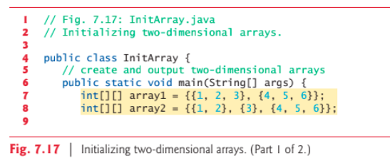
Multidimensional Arrays

Slide 37
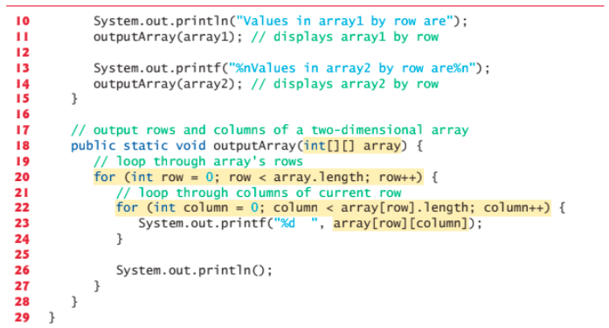
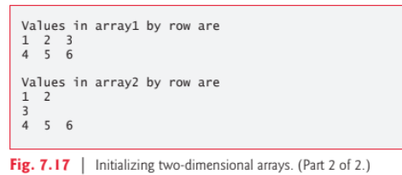
Multidimensional Arrays

Slide 38

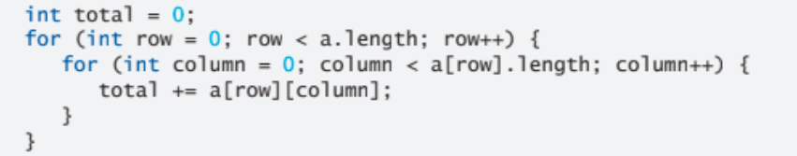
Multidimensional Arrays
Output?
Output?

Slide 39
Questions/Answers &
Discussion

